Slide 1
Hadoop
Introduction and Overview
RDBMS vs Hadoop
HDFS
YARN

Slide 2
Data… Too Much Data
Every Day
NYSE generates 1.5 billion shares and trade data.
Google processes 24 petabytes of data.
Every Minute
X users tweet nearly 300,000 times.
Instagram users post nearly 220,00 new photos.
Every Second
Banking applications process more than 10000 credit card transactions.
YouTube users upload 72 hours of new video content.
Google receives over 4 million search queries.

Slide 3
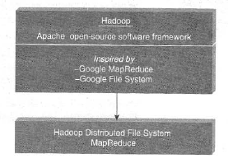
Introduction to Hadoop
Designed for storing and processing large datasets, and different kinds of data, across clusters of computers.
It has the capability to handle massive volumes and variety of data in a fairly quick manner.
Optimised to handle structured, semi-structured, and unstructured data!

Slide 4
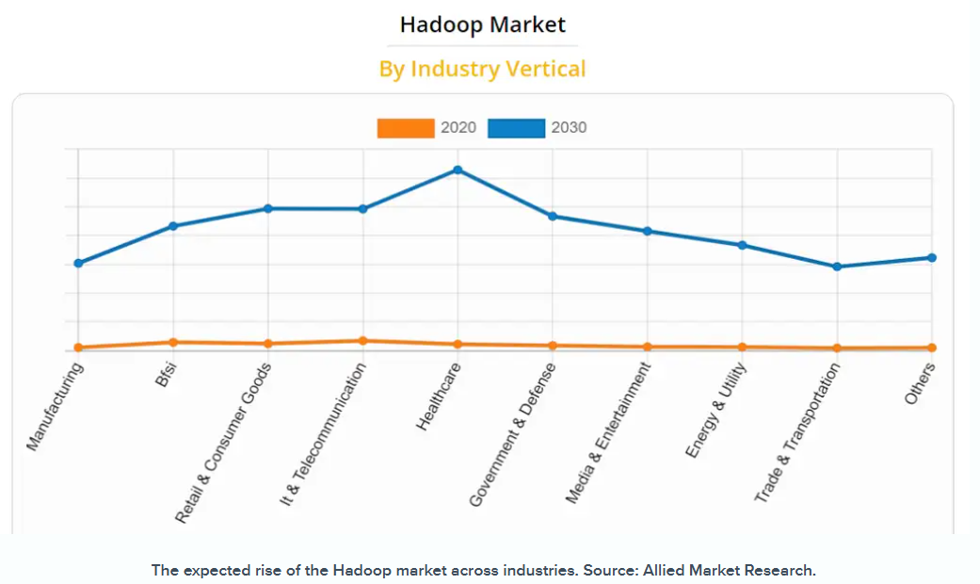

Slide 5
Features of Hadoop
Shared nothing architecture
Data replication across multiple computers
High throughput rather than low latency
NOT good when work can’t be parallelised, or for processing small files!
Complements OLTP and OLAP

Slide 6
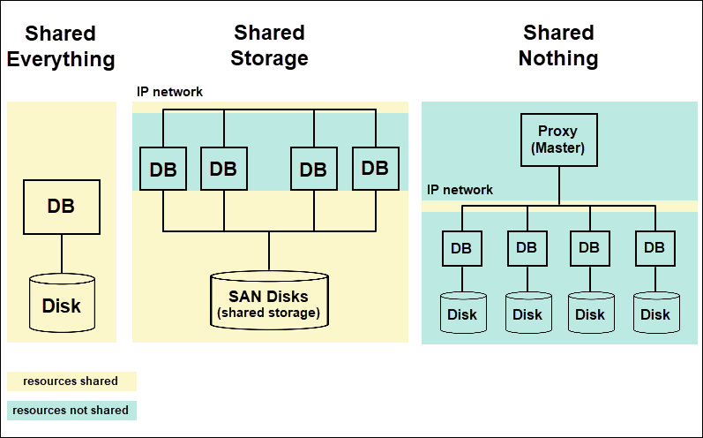

Slide 7
Main Advantages of Hadoop
Stores data in its native format
Scalable
Cost-effective
Fault tolerance
Flexibility
Code-to-data paradigm

Slide 8
 | Hadoop | RDBMS
System | Node-based Flat Structure | Relational Database Management System
Data Variety | Structured, semi-structured, unstructured data | Structured data
Data Storage | TB or PB | GB
Type of Processing | Analytics, Big Data processing | OLTP
Choice | Big Data processing, which doesn’t need consistent relationships between data | When data needs consistent relationship
Hardware Requirements | A node in a Hadoop cluster requires just a processor, a network card, and a few hard drives | Expensive hardware, high-end processors
Cost | $4000 per TB of storage | $10000 to $14000 per TB of storage
Scalability | Horizontal | Vertical

Slide 9
Components of Hadoop
Storage
Hadoop Distributed File System
Resource Management
Yet Another Resource Negotiator
Processing
MapReduce

Slide 10
Hadoop Distributed File System - HDFS
Default data block size: 64M or 128M
Default replication factor: 3
Master-Slave architecture
Sits on top of native file system
Breaks large files into smaller pieces - blocks

Slide 11
NameNode
Racks
Collection of DataNodes
Uses rackID to identify DataNodes in a rack
File System Namespace
Manages collection of files in the cluster
Manages read, write, create, and delete operations
EditLog
Transaction log that records every transaction happening to file system
NameNode reads FsImage, EditLog from disk
Maps blocks to files and file properties – this info is stored in FsImage
Applies all transactions in EditLog to FsImage
Truncates the now old EditLog

Slide 12
DataNode
Data Pipeline
Block is replicated to multiple DataNodes
Heartbeart
Periodically sends message to NameNode
Ensures connectivity between NameNode and DataNode
Replication
Assume no heartbeat is received
NameNode replicates the DataNode within the cluster
No need to wait till entire block is copied to a DataNode

Slide 13
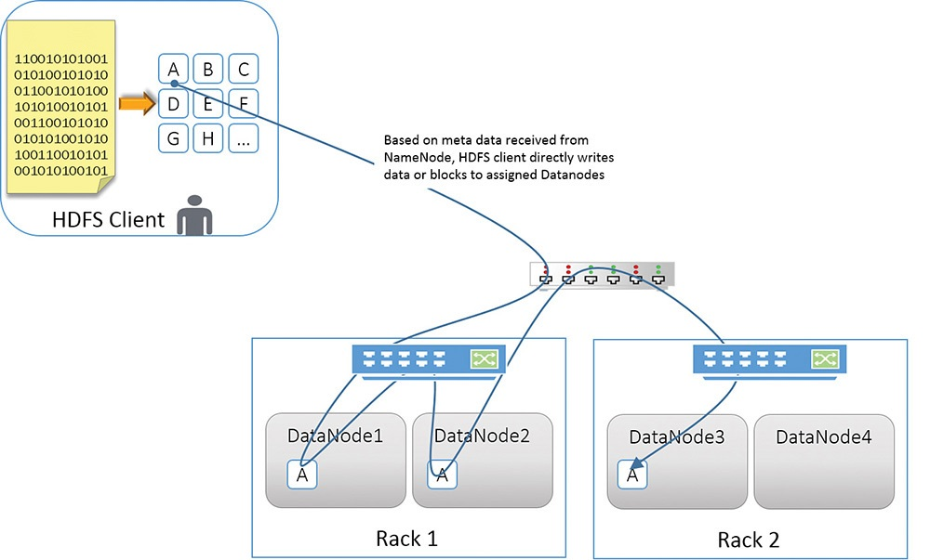

Slide 14
Default Data Replication Strategy
First Replica | Placed on the same node as the client
Second Replica | Placed on a node that is present on a different rack
Third Replica | Place on the same rack as the second replica, but on a different node

Slide 15
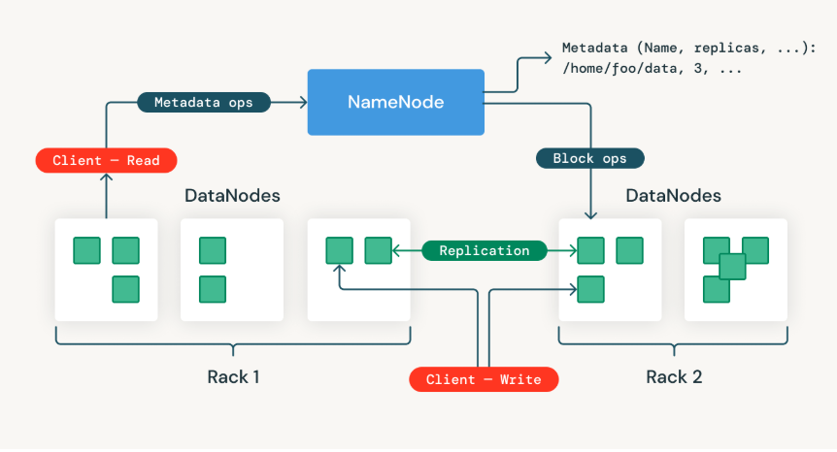

Slide 16
Yet Another Resource Negotiator
YARN
Allocates system resources to various applications running in a cluster
Schedules tasks to be executed on different cluster nodes – supports multiple scheduling methods
Sits between HDFS and the processing engines.
FIFO, Fair Scheduler, Capacity Scheduler

Slide 17
Components of YARN
Global Resource Manager
Distributes resources amongst various applications
Node Manager
Each node has its own resource manager
Application Master
Application-specific entity
Scheduler: any scheduler can be plugged; allocation of resources ONLY, doesn’t monitor
ApplicationManager: accepts job submissions, negotiates resources
Monitors resource usage such as memory, CPU, disk, network
Reports resource usage to global ResourceManager
Negotiates required resources for execution
Works with NodeManager for executing and monitoring component tasks
Container
Basic unit of allocation
Fine-grained resource allocation across multiple resource types
container_0: 2 GB, 1 CPU, container_1: 1 GB, 6 CPU

Slide 18
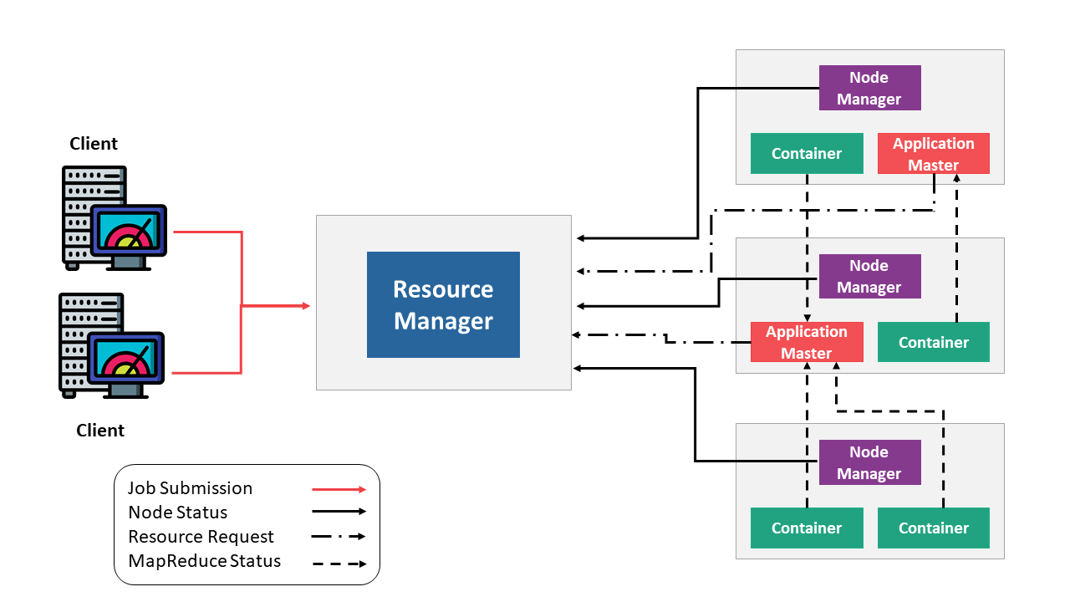

Slide 19
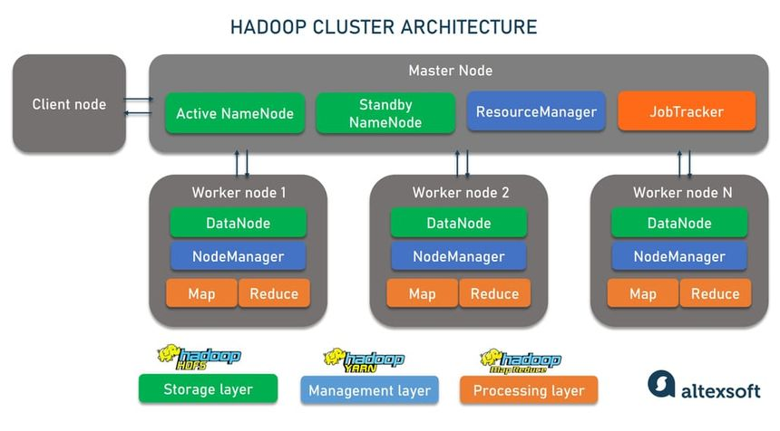

Slide 20
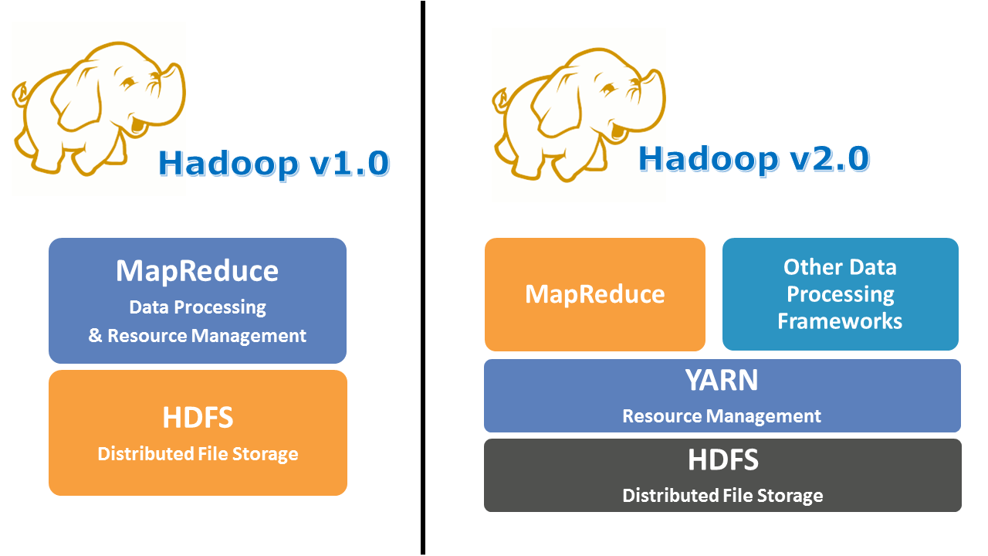

Slide 21
References
Shared Nothing Architecture - phoenixNAP
Hadoop Cluster Architecture – altextsoft
HDFS – Databricks
HDFS – IBM
Big Data Processing – Medium
Data Pipeline - Stack Overflow
YARN - TechTarget

Slide 22
Thank You!
Yuvaraj K
2022506079
B.Tech Information Technology

