Slide 1
Hypermedia Concepts
K Mohamed Jamal Basha – 2022506001
Kabilesh Selvakumar E – 2022506078
Yuvaraj K - 2022506079

Slide 2
Hypertext
Text that is displayed on an electronic medium.
Contains links to other text in the same document.
Or to external files or other documents.
Defines navigational pathways over the internet.

Slide 3
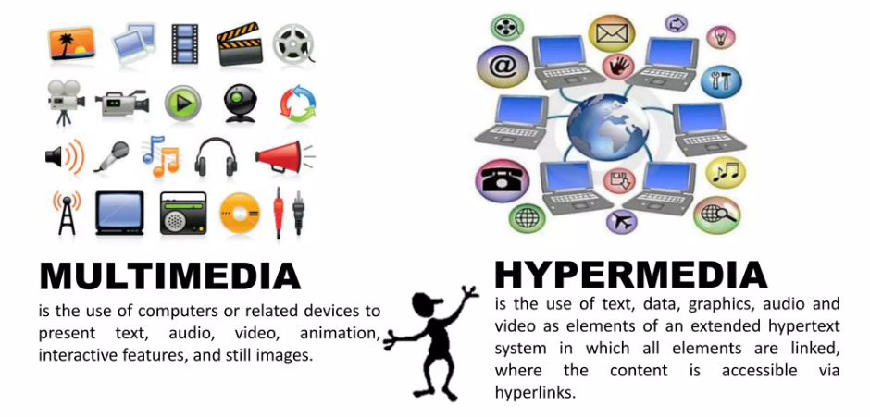
Hypermedia – The Logical Evolution
Extension of Hypertext
Use non-textual media to create hyperlinks
Audio, video, image, animation, graphics
Also called as interactive multimedia

Slide 4
Markup
Everything in a document that is not content.
Markup indicators are called tags.
Procedural Markup
Unique to a specific software package.
Eg: <Ctrl>+B for making text bold in MS Word.
Descriptive Markup
Recognisable by different application softwares.
Eg: a tag used for making text bold in HTML.
Interpreted by different browsers, and they produce the actual change in their own way.
Markup language: syntax or system which uses markup rules to define document format and structure.
Eg: HTML and XML

Slide 5
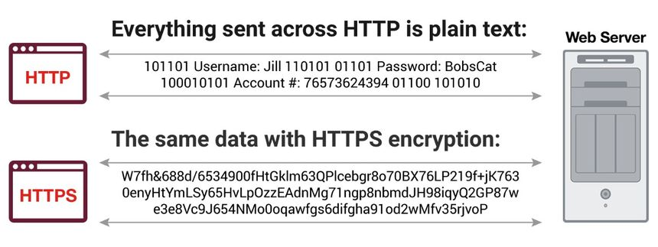
Hypertext Transfer Protocol
Set of rules for data communication in a hypermedia information system.
Functions in a request-response manner.
Stateless: server doesn’t retain information about a specific client.
HTTP connections can be made secure by using Secure Sockets Layer (SSL) → HTTPS

Slide 6
HTTP Status Codes
1xx Information Exchange | 100 | Continue | The server has received the request headers and the client should proceed to send the request body.
 | 101 | Switching Protocols | The requester has asked the server to switch protocols and the server has agreed to do so.
2xx Success | 200 | OK | Standard response for successful HTTP requests.
 | 201 | Created | The request has been fulfilled, resulting in the creation of a new resource.
 | 202 | Accepted | The request has been accepted for processing.
 | 204 | No Content | The server processed the request, but is not returning any content.
3xx Redirection | 304 | Not Modified | Indicates that the resource has not been modified. In such a case, there is no need to retransmit the resource since the client still has a previously-downloaded copy.
 | 305 | Use Proxy | The requested resource is available only through a proxy.
 | 307 | Temporary Redirect | In this case, the request should be repeated with another URI; however, future requests should still use the original URI.
 | 308 | Permanent Redirect | This and all future requests should be directed to the given URI.

Slide 7
HTTP Status Codes
4xx Client Errors | 400 | Bad Request | The server cannot or will not process the request due to an apparent client error.
 | 401 | Unauthorised | Authentication is required but has failed or has not yet been provided.
 | 403 | Forbidden | The request contained valid data and was understood by the server, but the server is refusing action.
 | 404 | Not Found | The requested resource could not be found.
 | 408 | Request Timeout | The server timed out waiting for the request.
 | 414 | URI Too Long | The URI provided was too long for the server to process.
5xx Server Errors | 500 | Internal Server Error | A generic error message, given when an unexpected condition was encountered and no more specific message is suitable.
 | 502 | Bad Gateway | The server was acting as a gateway or proxy and received an invalid response from the upstream server.
 | 503 | Service Unavailable | The server can’t handle the request. Generally, this is a temporary state.
 | 504 | Gateway Timeout | The server was acting as a gateway or proxy and did not receive a timely response from the upstream server.

Slide 8
Document Type Definition
Set of rules which validate a markup language.
Main building blocks:
Elements: represented by tags in HTML; use them to describe different parts of a data.
Attributes: provide additional information about tags, located inside opening tag of an element; use them to include metadata
Entities: set of characters having special meaning (eg: nbsp)
PCDATA: parsed character data → text found between start and end tags, but without any entities.
CDATA: character data → not parsed by parser, represents text inside tags
<!ELEMENT element-name (element-content)>
<!ATTLIST element-name attribute-name attribute-type default-value>
<!ELEMENT html (head, body)>
<!ELEMENT p (#PCDATA | p | ul | dl | table | h1|h2|h3)*>

Slide 9
Document Type Definition
<students>
<student>
<id>...</id>
<name>...</name>
<department>...</department>
<grades>
<subject>
<name>...</name>
<score>...</score>
</subject>
</grades>
</student>
</students>
<!ELEMENT students (student+)>
<!ELEMENT student (id, name, department, grades)>
<!ELEMENT id (#PCDATA)>
<!ELEMENT name (#PCDATA)>
<!ELEMENT grades (subject+)>
<!ELEMENT subject (name, score)>
For an entry <score format=“.4f”/>, the corresponding DTD declaration can be <!ATTLIST score format CDATA “.10f”>

Slide 10
Standard Generalised Markup Language
Prescribes a standard format for embedding descriptive markup within a document. Also specifies a standard method for describing the structure of a document.
Three Parts:
Structure: DTD describes structure
Content: The actual information
Style: Two standards-based style sheets
FOSI: Formatting Output Specification Instance
DSSSL: Document Style Semantics and Specification Language
<!ELEMENT - - students (student+)>
<!ELEMENT - - student (id, name, department, grades)>
<!ELEMENT - O id (#PCDATA)>
<!ELEMENT - O grades (subject+)>
<!ELEMENT - O subject (name, score)>

Slide 11
Dynamic HTML
Combining HTML, CSS, and JS to create animated web sites.
HTML | Predominant markup scripting language for WWW; based on SGML
CSS | Allows for sophisticated sizing, positioning, and other appearance related manipulations of web page contents
JS | Cross-platform, object-based scripting language for client (user interactions) and server (database) applications

Slide 12
Extensible Markup Language
HTML | focuses on how the content on a page is displayed to the user
XML | concerned with how to structure and store data, such that it can subsequently be searched for and transported
Just information wrapped in tags.
XML does not have standard tags. Rather, it enables the user to create customised tags to suit the document being stored.
XML Schema – an alternative to DTD for XML.

Slide 13
Extensible HTML
XHTML – a family of markup languages generally regarded as extensions of HTML.
Based on XML.
Why?: Provided a way for developers to migrate to the XML world while maintaining compatibility with the older HTML platform.
But, XHTML working group officially expired in 2007 after it was decided that HTML 5 was more suitable as the next-gen HTML.
XHTML 5.0 – latest version, developed as part of HTML 5 specifications instead of a separate standard.

Slide 14
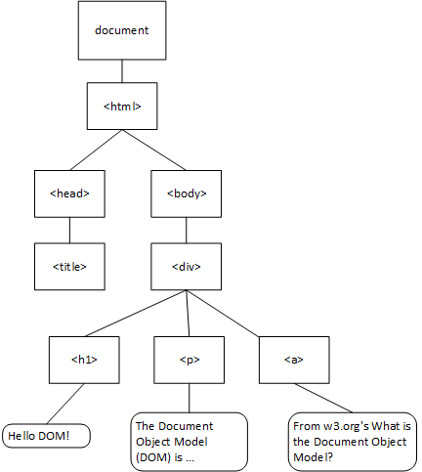
Document Object Model
Underlying platform to enable manipulation of web objects in a language independent manner.
Used by languages like JS to change content of a page dynamically.
3 different DOM models – DOM by W3C, IE specific DOM, Netscape DOM.

Slide 15
Document Object Model - HTML
HTML Document
<html> <head> <title>My Website</title> </head> <body> <h1>Welcome to DOM</h1> <p>This is my website.</p> </body> </html>
Corresponding DOM Tree
- Document (root) - html - head - title - "My Website" - body - h1 - "Welcome" - p - "This is my website."

Slide 16
Document Object Model – XML
XML Document Snippet
<student> <id>2022506001</id> <name>K Mohamed Jamal Basha </name> <department>IT</department> <grades> <subject> <name>MMT</name> <score>100</score> </subject> </grades> </student>
Corresponding DOM Tree
- … - student - id - "2022506001" - name - "K Mohamed Jamal Basha“ - department - "IT" - grades - subject - name - "MMT" - score - 100

Slide 17
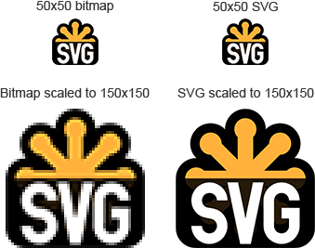
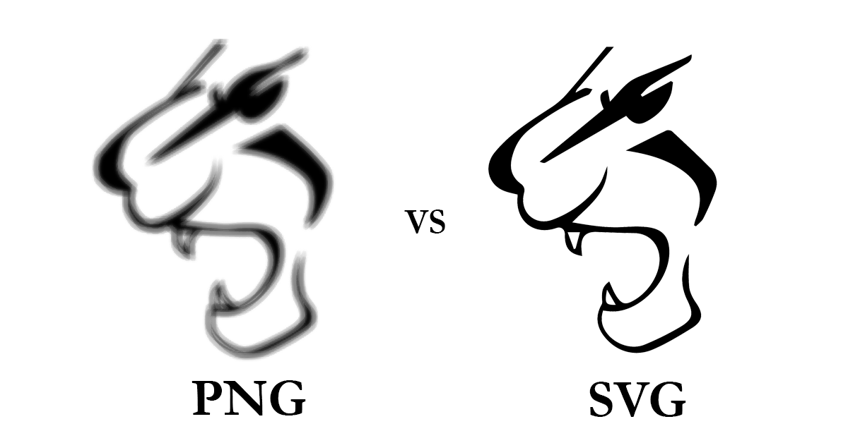
Scalable Vector Graphics
Set of XML-based specifications for describing 2D vector graphics.
Being vector formats, they don’t suffer from pixelation due to zooming.
Being XML, they can be edited using a text editor, can be indexed.
Perfect for simple graphics and illustrations.
Not the best choice for more complex images, which contain a large number of small elements - SVG files can grow significantly in size in such cases.

Slide 18
Scalable Vector Graphics
<?xml version="1.0" encoding="UTF-8" standalone="no"?> <!DOCTYPE svg PUBLIC "-//W3C//DTD SVG 1.1//EN" "http://www.w3.org/Graphics/SVG/1.1/DTD/svg11.dtd"> <svg width="391" height="391" viewBox="-70.5 -70.5 391 391" xmlns="http://www.w3.org/2000/svg" xmlns:xlink="http://www.w3.org/1999/xlink"> <rect fill="#fff" stroke="#000" x="-70" y="-70" width="390" height="390"/> <g opacity="0.8"> <rect x="25" y="25" width="200" height="200" fill="lime" stroke-width="4" stroke="pink" /> <circle cx="125" cy="125" r="75" fill="orange" /> <polyline points="50,150 50,200 200,200 200,100" stroke="red" stroke-width="4" fill="none" /> <line x1="50" y1="50" x2="200" y2="200" stroke="blue" stroke-width="4" /> </g> </svg>

Slide 19
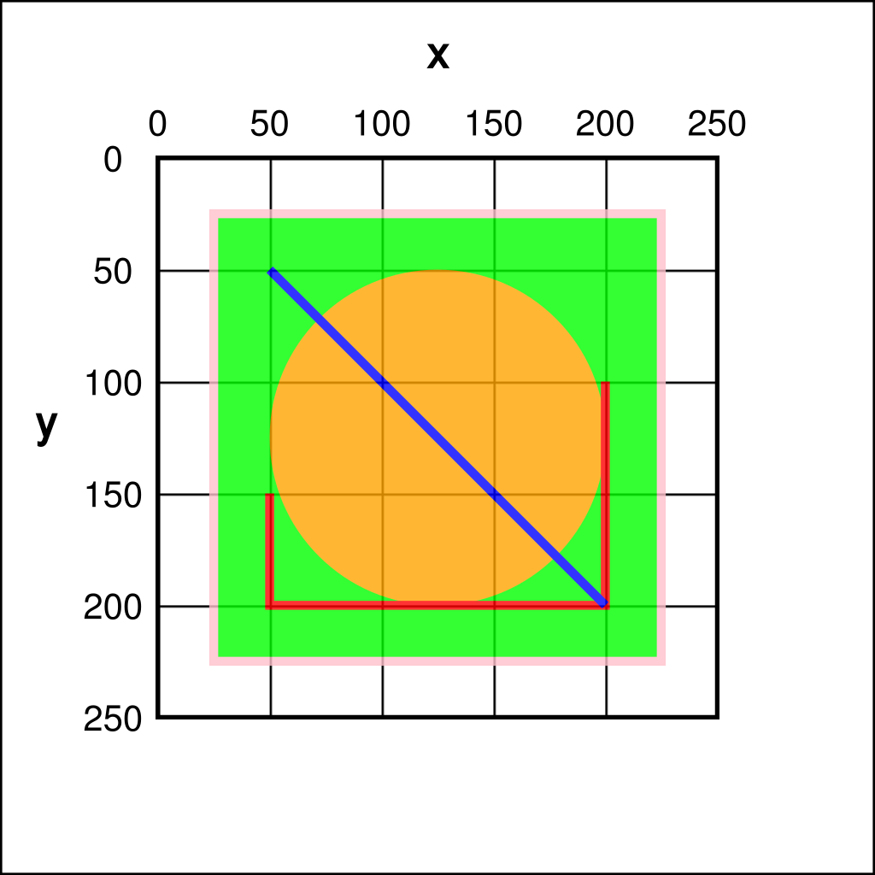
Scalable Vector Graphics

Slide 20
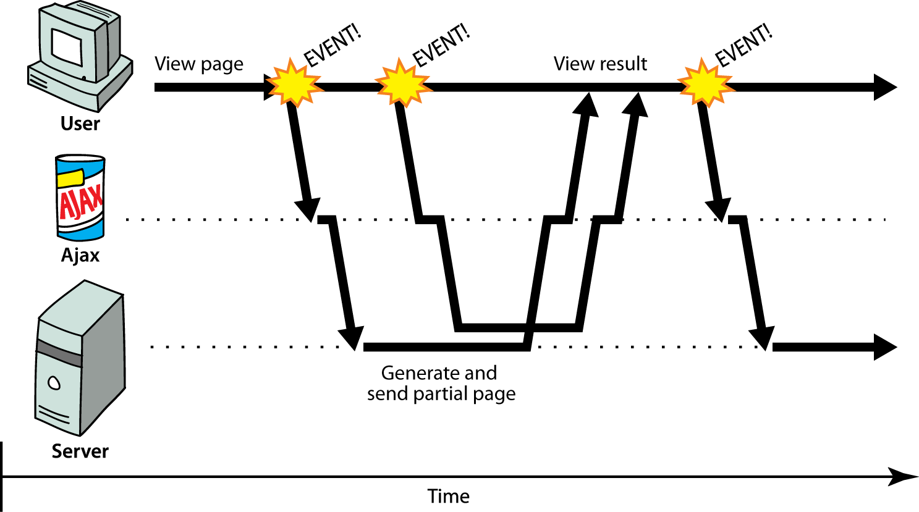
Asynchronous JavaScript and XML
AJAX – Set of techniques used on client side to retrieve data from the server asynchronously in the background.
This means the rest of the page content is undisturbed and can still be interacted with.

Slide 21
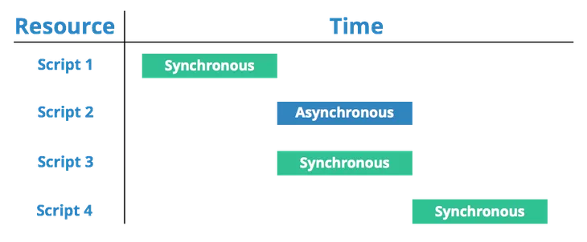
Asynchronous JavaScript and XML
There are 3 synchronous scripts being loaded one after another. However, there is also an asynchronous script which can be loaded at the same time as the synchronous script, which makes for a much more efficient loading process.

Slide 22
Multipurpose Internet Mail Extension
MIME – identifier for file formats on the Internet.
Originally, for use with email sent through SMTP, but later expanded to other protocols like HTTP and RTP.
In HTTP, servers insert a MIME header field at the beginning of any Web transmission. Clients use the content type or media type header to select an appropriate viewer application for the type of data indicated.

Slide 23
Multipurpose Internet Mail Extension
MIME Header contains
Version
Media Type: composed of two parts, a type and a sub-type.
Media Disposition
Inline: automatically displayed when the message is displayed
Attachment: requires some user action, like download
Encoding: mentions the encoding schemes used for the media.
Text | Image | Audio | Application | Video
text/plain | image/gif | audio/mpeg | application/javascript | video/mpeg
text/html | image/jpeg | audio/mp4 | application/pdf | video/mp4
text/css | image/png | audio/ogg | application/zip | video/ogg
text/xml | image/tiff | audio/wave | application/powerpoint | video/quicktime

Slide 24
Synchronised Multimedia Integration Language
XML-based W3C recommendation for describing multimedia presentations.
Defines markup elements for timing, layout, animations, and transitions.
Core of SMIL: Synchronizing zones with multimedia content.
Divides the different media components into separate files and streams and then displays them together as if they were a single multimedia stream.
Eg: Delivering captions/audio in a synchronized manner with video.

Slide 25
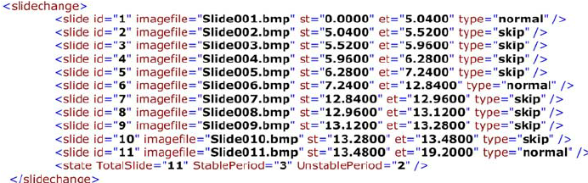
Synchronised Multimedia Integration Language
A snippet of an SMIL file defining a slide change sequence.
Defines slide ID, the image file name for the slide, start time, end time, and type of slide.

Slide 26
Multimedia Messaging Service
Technique for sending messages containing multimedia content to and from mobile devices.
MMS messages can contain text (formatted with different fonts, colours, and styles), images, audio, video, and animations.
MMS is a natural evolution of SMS, but MMS is still limited.
Rich Communication Services (RCS): a newer standard which
provides end-to-end encryption,
enables sharing of high-resolution photos and videos,
Provides typing indicators
receive read receipts.

Slide 27
SMS vs MMS vs RCS
Feature | SMS | MMS | RCS
Character Limit | 160 characters | 1600 characters | No
File Size Limit | No file support | 5 MB | 100 MB
Format | Text | Text and Multimedia | Text and Multimedia
Sent Via | Cellular | Cellular | Wi-Fi or Cellular
Security | No encryption | No E2EE | End-to-End Encrypted
Read Receipts | No | No | Yes
Typing Indicators | No | No | Yes
Group Chat Limit | No support | 10 people | 100 people
Internet Required | No | No | Yes
Reactions/Emojis | Limited (text-based) | Limited | Yes
Voice Messages | No | No | Yes
Video Calls | No | No | Yes
Backup Support | No | No | Cloud Backup

Slide 28
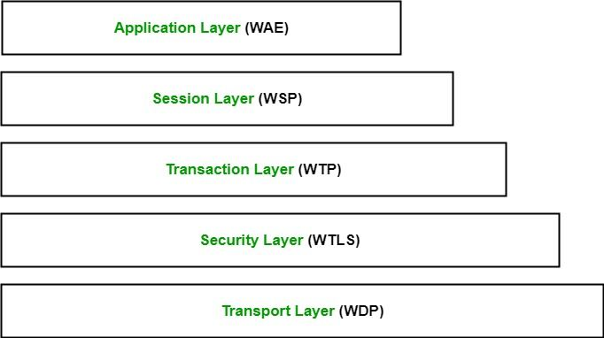
Wireless Application Protocol
Open standard protocol suite to display Internet content on mobile devices. Has become obsolete, due to advancements in modern mobile browsers.
Enables delivery of web-based content.
Responsible for maintaining a session between the wireless device and the server.
Provides a reliable transport mechanism for transmitting data between the wireless device and the server.
Provides public-key encryption based security, similar to SSL.
Helps in transport of data in an unreliable way, similar to UDP.

Slide 29
Thank You
Go Back

