Slide 1
Power BI Capstone Project
Amazon E-Commerce Sales Analysis — Ghana Region
113,000 orders • 2015 – 2020 • 26 locations
Prepared by: [Your Name] | Submission date: [Date]

Slide 2
THE PROBLEM
Problem statement: stakeholders can't see what drives revenue, returns and ratings
Amazon's Ghana business relies on manual reports to track revenue, customer behaviour and operational health.
Questions to answer: Where does revenue come from? Which products and categories perform best? Why are 27% of orders returned? What drives customer ratings?
Goal: turn 113,000 raw order records into a self-serve, 3-tab Power BI report (Main, Product, Individual Product).
113,000
2015–2020
GHS 107.2M
26
Orders analysed
Date range
Total revenue
Locations
2

Slide 3
DATA OVERVIEW (DATABASE SCHEMA)
Data overview: two related tables, 113,000 orders
Orders (fact table) — 17 fields
Customers (dimension) — 3 fields
OrderID (PK), CustomerID (FK)
OrderDate, Delivery Date, Delivery Duration (Days)*
Location, Zone, Delivery Type
Product Category, SubCategory, Product
Unit Price, Order Quantity, Shipping Fee, Sale Price
Status, Reason, Rating
* calculated column added in Power Query
CustomerID (PK)
Customer Age
Customer Gender
1 : Many
on CustomerID
Data preparation
Power Query: fixed data types, trimmed and standardised text, removed 8 rows with missing price/quantity, imputed 1 missing category, kept blank Reason for delivered orders. Model: Calendar date table plus one-to-many Customers → Orders. Analysis: DAX measures and SQL (window functions).
3

Slide 4
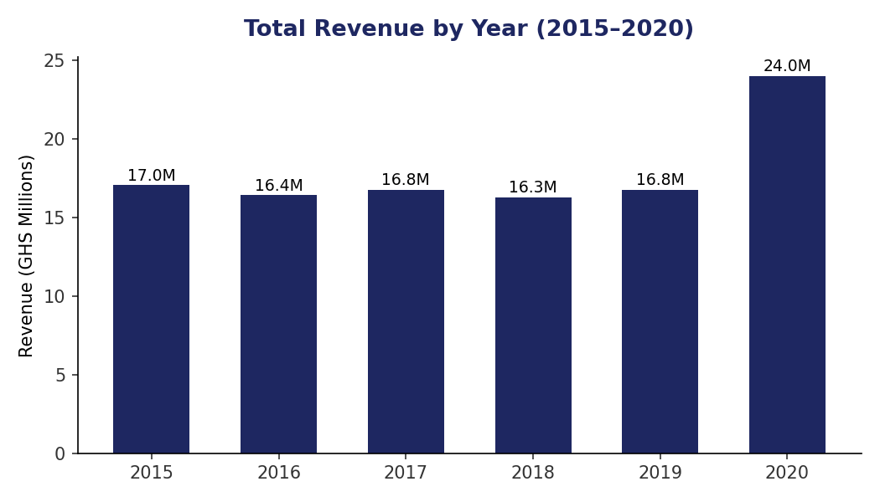
ANALYSIS
Revenue was flat for five years, then jumped 43% in 2020
KEY INSIGHTS
Total revenue: GHS 107.2M across 6 years.
2015–2019 held steady at roughly GHS 16–17M a year.
2020 reached GHS 24.0M, up 43% on 2019.
4

Slide 5
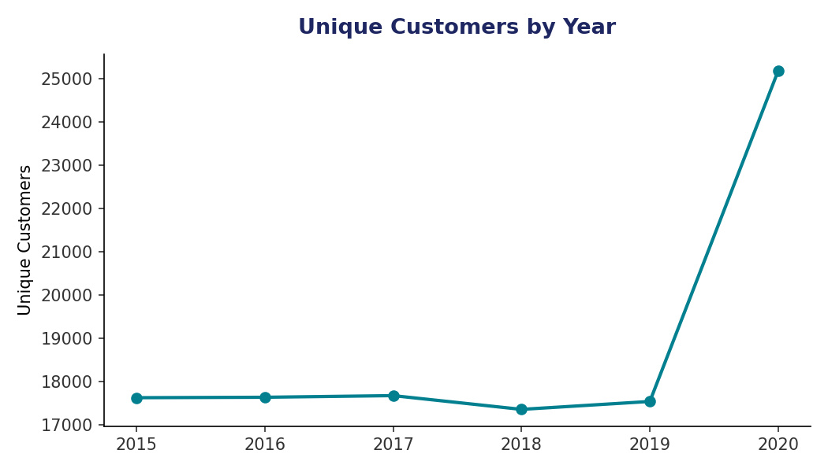
ANALYSIS
The 2020 jump came from customers, not spend per customer
KEY INSIGHTS
About 17.5K unique customers a year from 2015 to 2019.
2020 rose to 25,179, up 43.6%.
The customer surge lifted every category; none declined year on year.
5

Slide 6
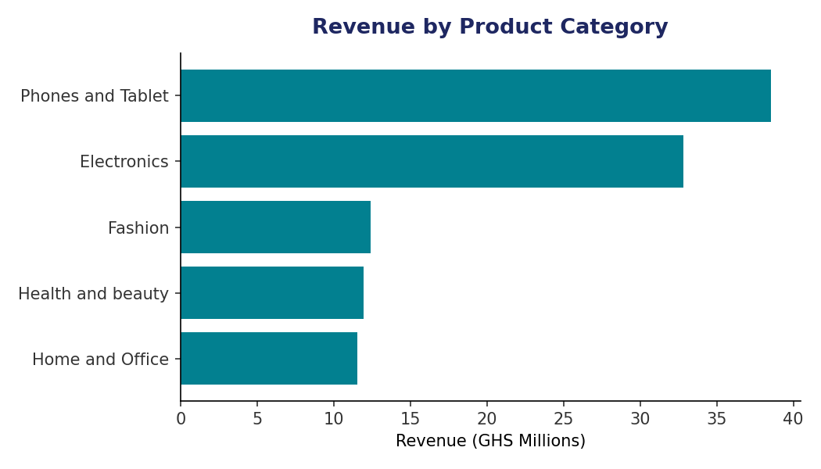
ANALYSIS
Phones and Tablet earns the most revenue despite fewer orders
KEY INSIGHTS
Phones and Tablet leads at GHS 38.5M.
Fashion and Health and beauty have the most orders but lower revenue.
High unit price per order explains the gap.
6

Slide 7
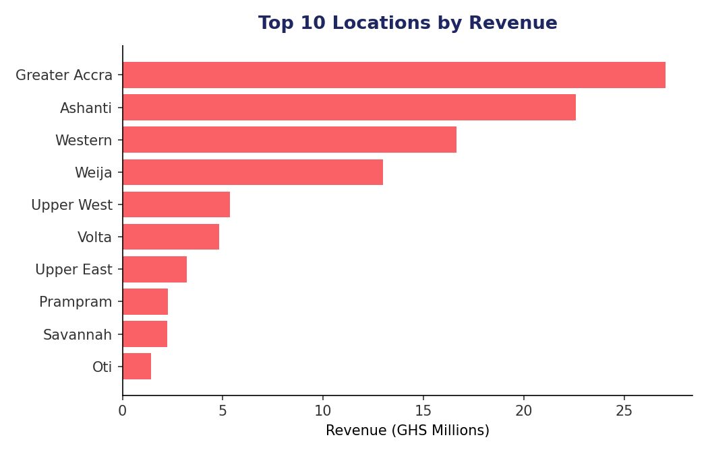
ANALYSIS
Three regions generate over 60% of revenue
KEY INSIGHTS
Greater Accra: GHS 27.1M (25.2%).
Ashanti: GHS 22.6M (21.1%); Western: GHS 16.6M (15.5%).
Marketing and fulfilment spend should follow this concentration.
7

Slide 8
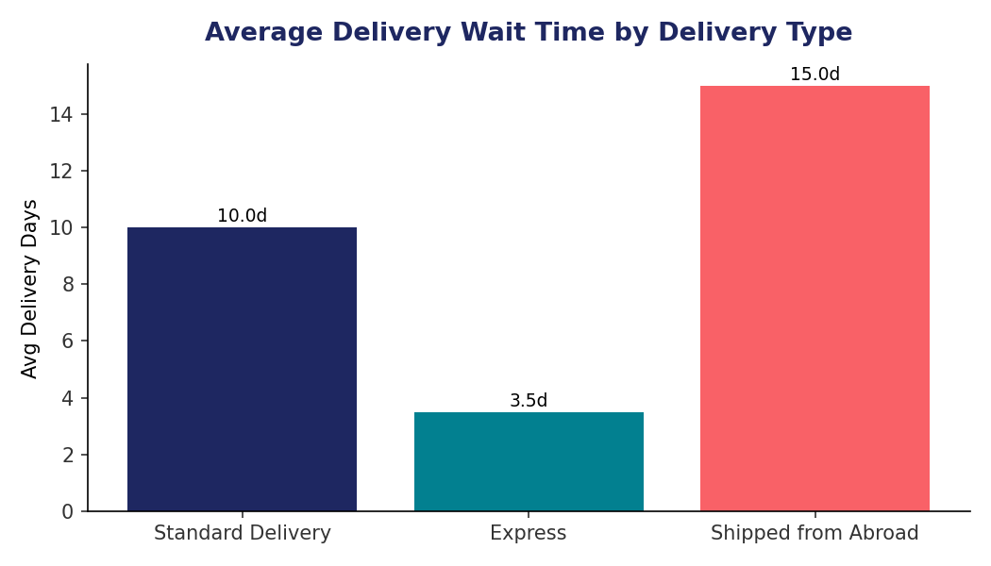
ANALYSIS
Delivery time depends on delivery type, not product
KEY INSIGHTS
Average delivery is 9.41 days overall.
Express takes 3.5 days; Shipped from Abroad takes 15.0 days.
Category makes almost no difference (9.39–9.45 days).
8

Slide 9
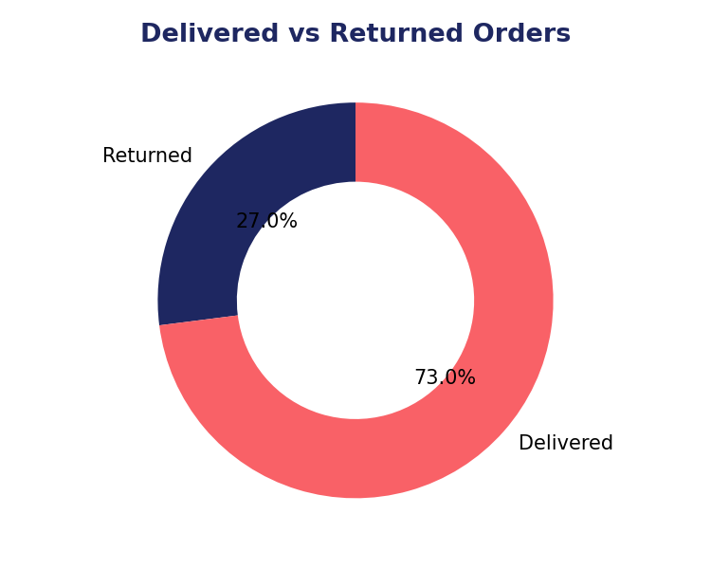
ANALYSIS
27% of orders are returned, high for e-commerce
KEY INSIGHTS
30,526 of 113,000 orders were returned.
73% were delivered.
The next slide looks at why.
9

Slide 10
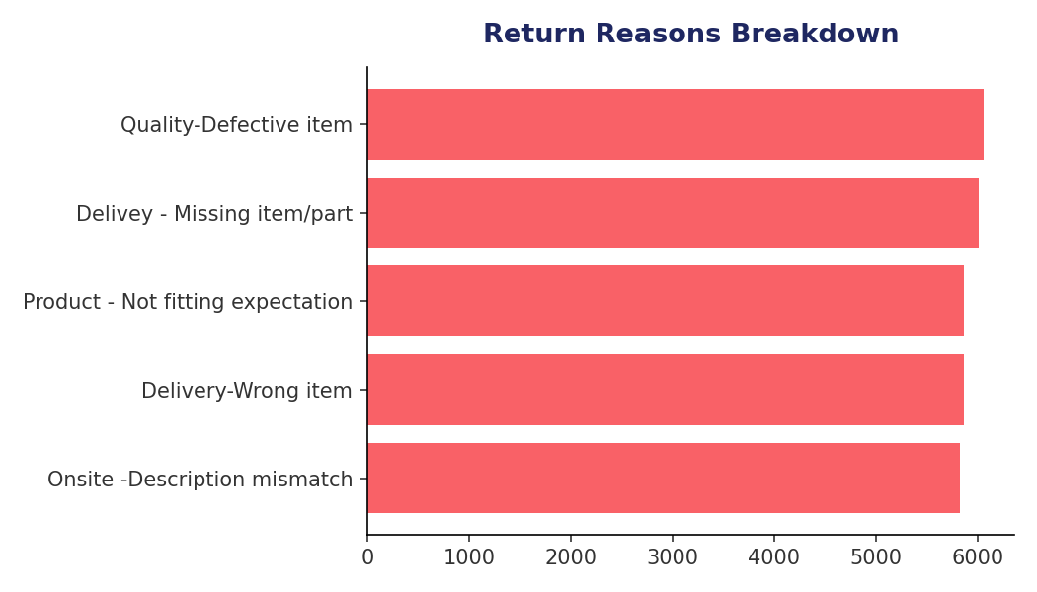
ANALYSIS
About 40% of returns are fulfilment errors
KEY INSIGHTS
Five reasons are almost evenly split (~19–20% each).
Missing or wrong item (~40%) is a warehouse QC issue.
Defective item (6,065) and description mismatch (5,827) point to supplier QC and product-page accuracy.
10

Slide 11
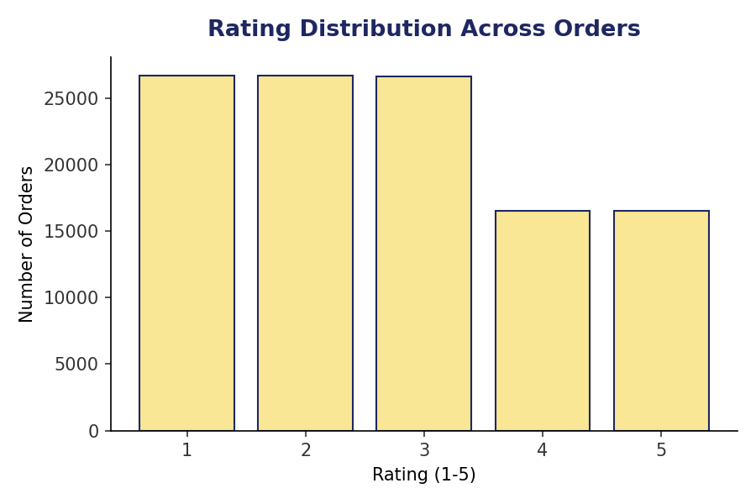
ANALYSIS
Ratings do not drive sales, and logistics does not explain low ratings
KEY INSIGHTS
Average sale price varies under 2% across rating bands (GHS 940–959).
Wait time (9.42 days), shipping fee and unit price are the same for 1–2★ and 4–5★ orders.
Quality and description accuracy matter more than speed or cost.
11

Slide 12
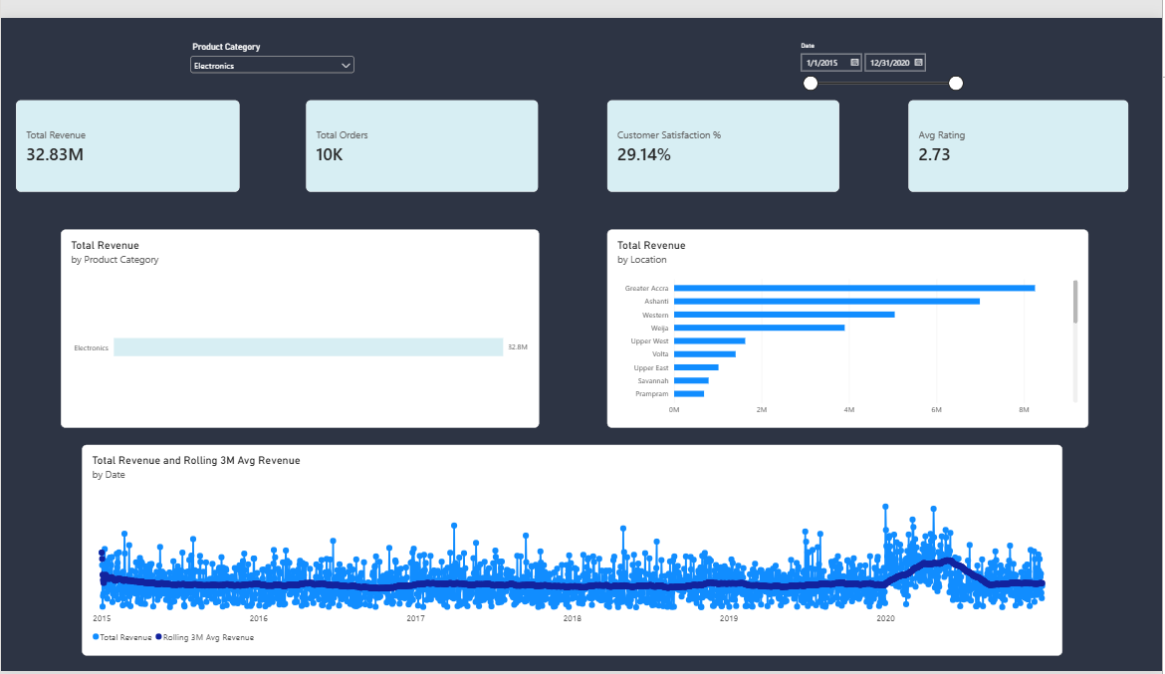
DASHBOARD SCREENSHOT
Dashboard: Main Tab
Paste screenshot of Main Tab here
Total revenue, orders, rating and satisfaction across categories. Slicers: Category, Date.
14

Slide 13
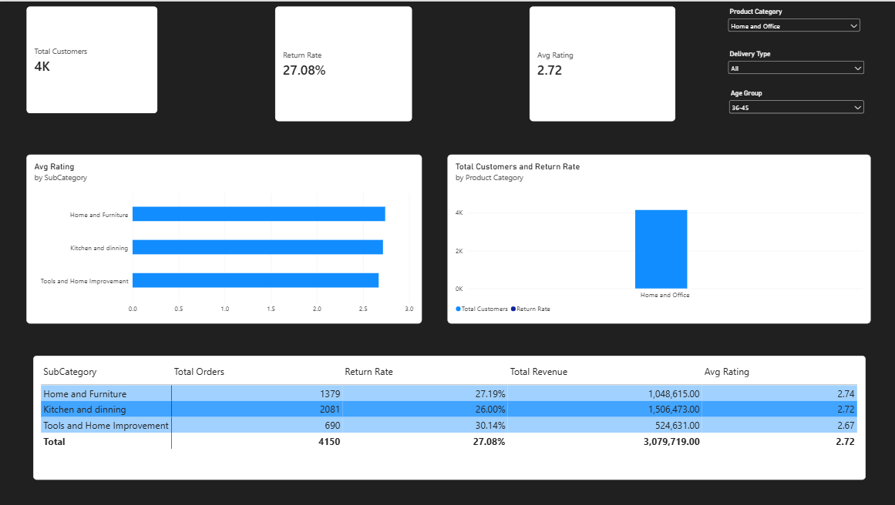
DASHBOARD SCREENSHOT
Dashboard: Product Tab
Paste screenshot of Product Tab here
Category-wise performance, customers and returns, products needing improvement. Slicers: Gender, Delivery Type, Category, Age Group.
15

Slide 14
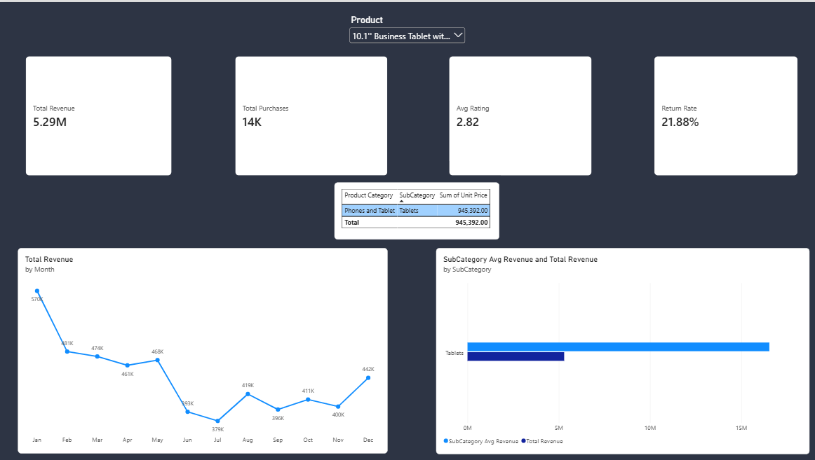
DASHBOARD SCREENSHOT
Dashboard: Individual Product Tab
Paste screenshot of Individual Product Tab here
Deep dive on one product: purchases, category, average rating, revenue. Slicer: Product.
16

Slide 15
CONCLUSION
Conclusion
2020 drove disproportionate growth in customers and revenue — worth investigating what changed operationally.
The 27% return rate is a fulfilment and quality problem, not a delivery-speed problem.
Revenue is concentrated in 3 regions and a handful of high-ticket products.
The Power BI report turns all of this into a live, filterable tool for stakeholders.
12

Slide 16
RECOMMENDATIONS
Recommendations
Fix fulfilment QC
Target low-revenue months
~40% of returns are missing or wrong items. Tighten warehouse pick-and-pack to cut the 27% return rate.
September, June and November are weakest. Run a "Back to Business" promo in September and a Black Friday push in November.
Market high-price items
Launch a 3-tier loyalty plan
Canon DSLRs and the Fire HD Kids Tablet under-sell. Invest in visibility (video, reviews), not discounts.
21,023 customers spend 30%+ above average. Reward them with a Gold tier to protect and grow this base.
13

