Slide 1
SEMINAR PRESENTATION
Machine-Learning Based Search for Superior
Bio-mimetic Catalysts for CO₂ Capture and Conversion
Applying principles of statistical mechanics to literature-derived descriptors
(oxidation states, bond angles, activation energies, pH, yield %) with XGBoost and Random Forest models
Presented by: [Your Name]
Supervisor: [Professor’s Name]
Department / Institute • November 2026

Slide 2
PRESENTATION OUTLINE
Structure of the Talk
– 1. Motivation
– 2. Background — CO₂ capture & bio-mimetic catalysts
– 3. Statistical mechanics in the project workflow
– 4. Equations, scenarios & parameters used
– 5. Data collection from literature
– 6. ML models — XGBoost & Random Forest
– 7. Comparison with other approaches
– 8. Limitations, key takeaways & references
ML-Based Search for Superior Bio-mimetic Catalysts for CO₂ Capture & Conversion
2

Slide 3
MOTIVATION
Why Search for Better CO₂ Catalysts with ML + Stat-Mech?
– CO₂ is abundant but inert. Converting CO₂ into fuels and chemicals needs catalysts that work at mild temperature and pH with low activation barriers.
– Enzymes already do it. Carbonic anhydrase and formate dehydrogenase reach turnover numbers far beyond synthetic catalysts — bio-mimetic designs try to copy their active-site statistics.
– Trial-and-error is too slow. Thousands of metal centres, oxidation states and geometries exist in the literature; no lab can screen them all experimentally.
– Data + physics-guided models can rank them. Statistical mechanics tells us which microscopic descriptors (energy states, barriers, populations) actually control rates — those become the ML features.
OBJECTIVE OF THIS PROJECT
– Build a curated dataset from published catalyst studies
– Encode statistical-mechanic descriptors as features
– Train XGBoost / Random Forest to predict yield %
– Identify superior bio-mimetic candidates for CO₂ capture and conversion
ML-Based Search for Superior Bio-mimetic Catalysts for CO₂ Capture & Conversion
3

Slide 4
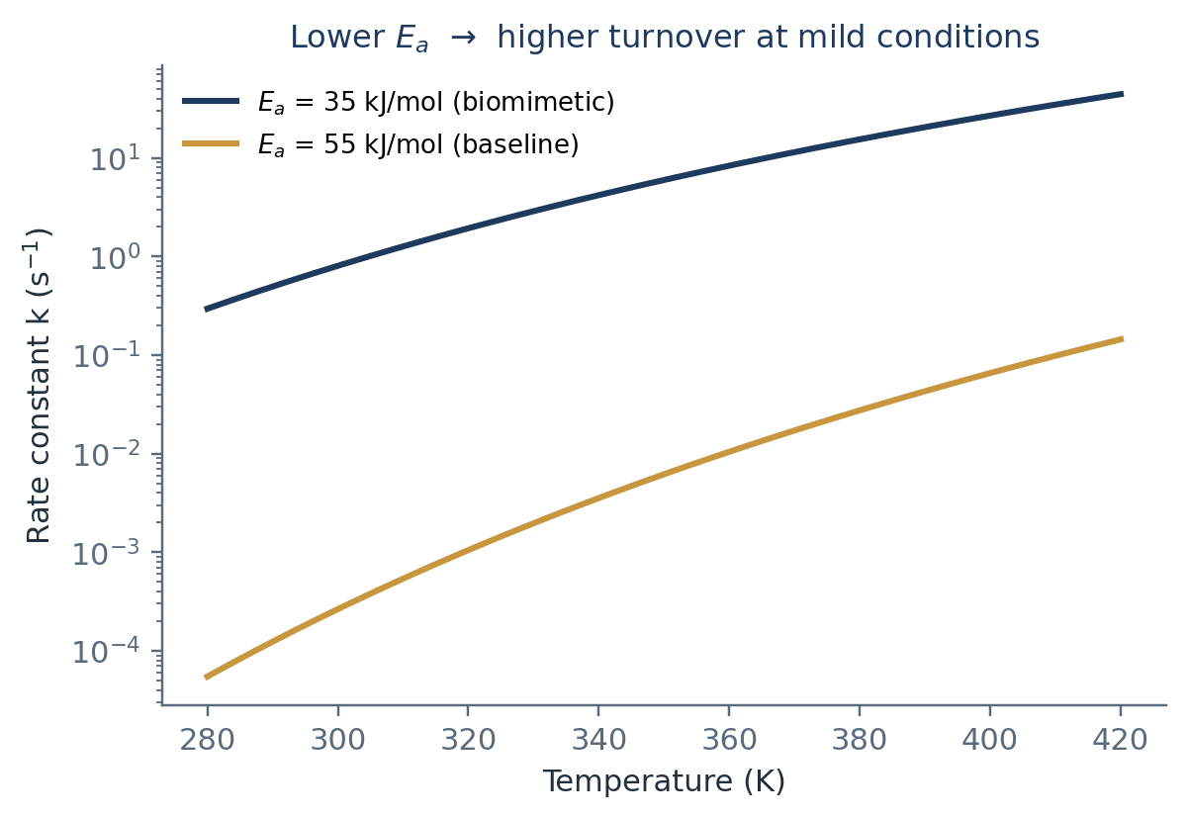
BACKGROUND
Bio-mimetic Catalysts for CO₂ Capture and Conversion
– Capture step: amine-functionalised and metal–organic sorbents bind CO₂; capacity depends on pH and metal oxidation state.
– Conversion step: electro-/photo-catalytic reduction to CO, formate or methanol through proton–electron transfer sequences.
– Bio-mimetic design: metal–nitrogen–carbon (M–N–C) sites mimic enzyme active pockets — coordination number, bond angles and local electrostatics set the energetics.
– Key performance metrics: activation energy Ea, operating pH, Faradaic efficiency and product yield % — exactly the quantities reported across the literature we mined.
Fig. 1 A catalyst that lowers Eₐ wins at mild temperatures — the whole screening exercise revolves around this exponential factor.
ML-Based Search for Superior Bio-mimetic Catalysts for CO₂ Capture & Conversion
4

Slide 5
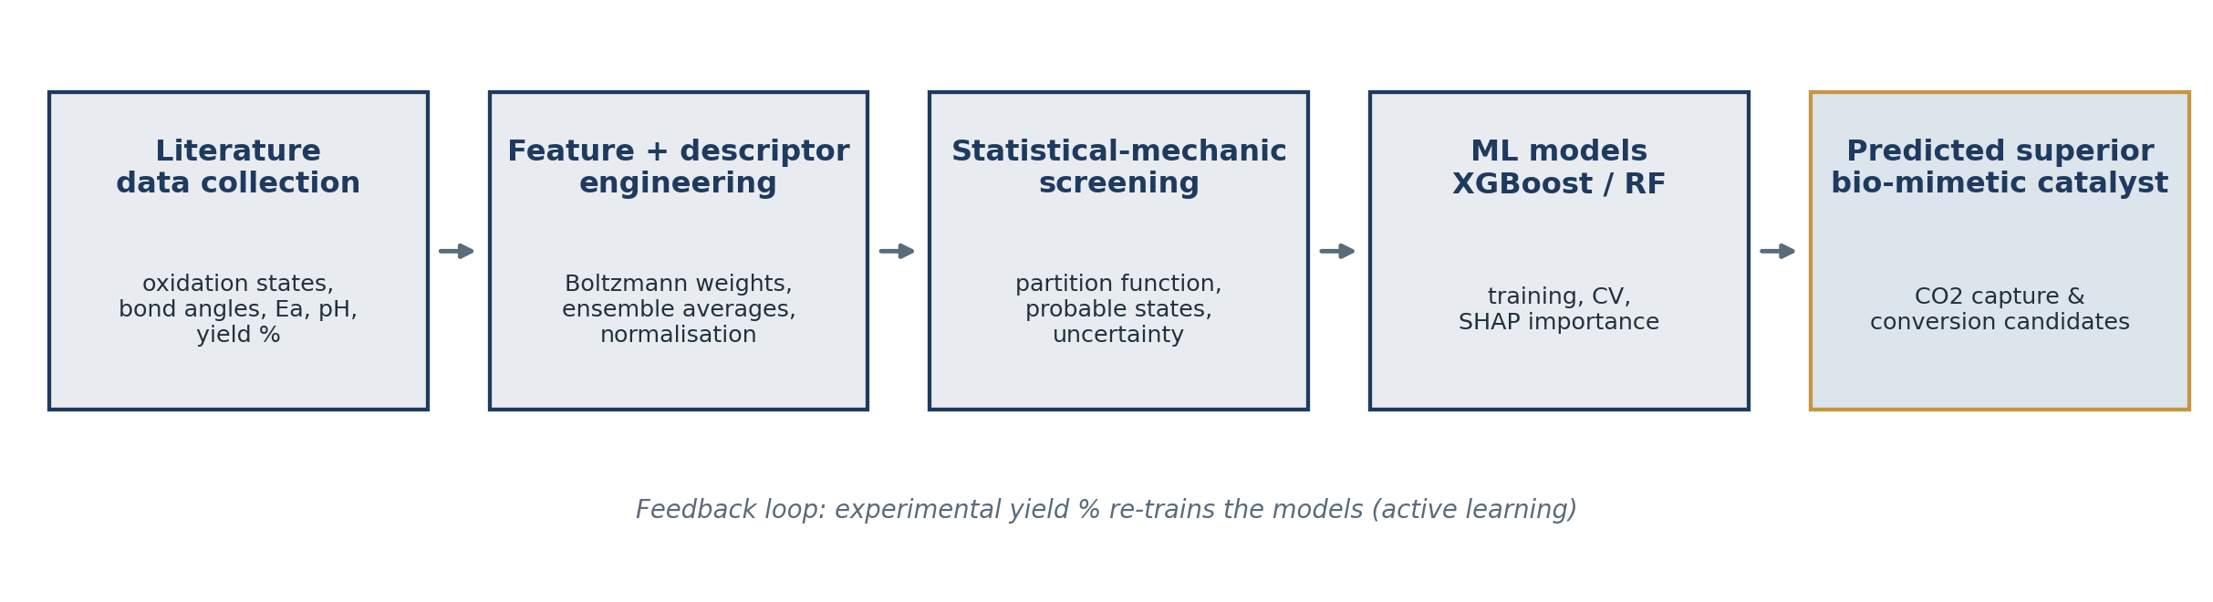
THEORY USED IN THE PROJECT
Where Statistical Mechanics Enters the Pipeline
– Ensembles, not single structures: a catalyst sample occupies many microstates; only Boltzmann-weighted averages are comparable with measured yields.
– Partition function Z = Σ exp(−Eᵢ/k_BT): converts computed state energies into populations, free energies ΔG = −k_BT ln Z and rate estimates — these become physics-based features.
– Rate theories close the loop: Arrhenius / Eyring links the literature activation energies to turnover, giving the model a physically meaningful target space instead of raw correlations.
ML-Based Search for Superior Bio-mimetic Catalysts for CO₂ Capture & Conversion
5

Slide 6
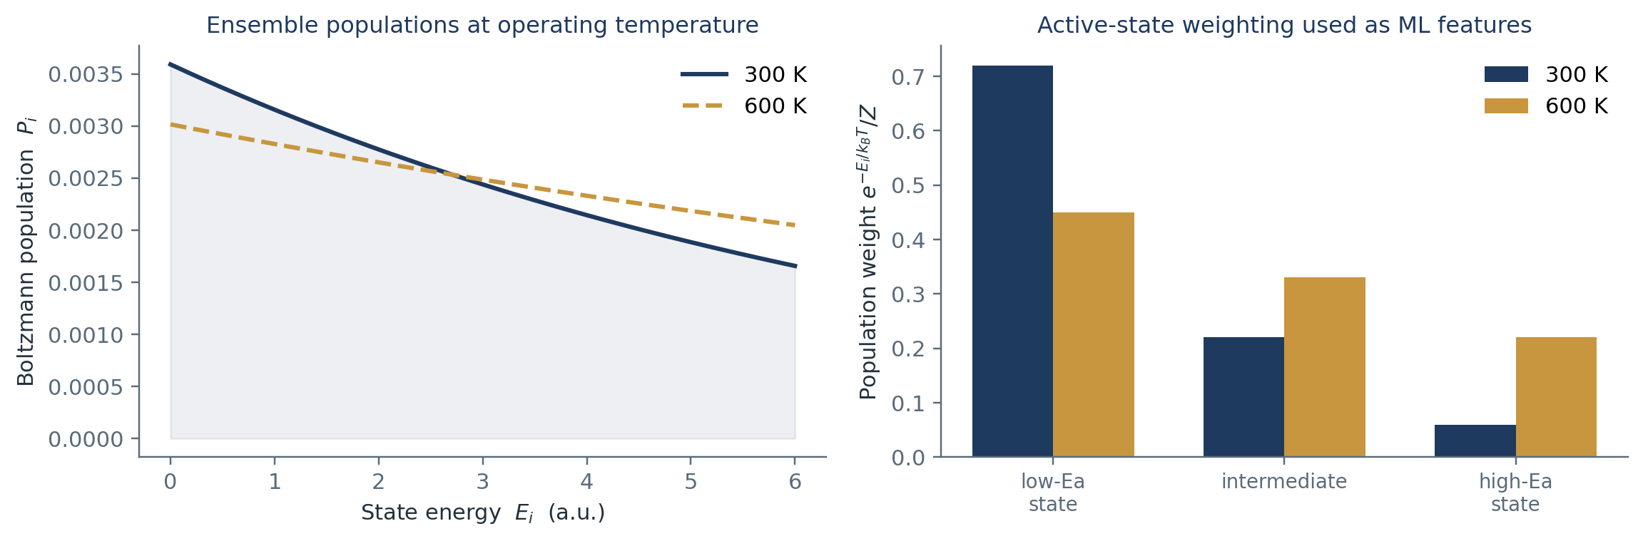
THEORY USED IN THE PROJECT
Boltzmann Weighting Turns Structures into Descriptors
HOW WE USE IT
– Weight each reported active-state geometry by its Boltzmann population
– Bond angles / oxidation states enter as ensemble-averaged descriptors
– Temperature & pH shift populations — captured as scenario features
Fig. 2 Left: population of catalytic microstates at two temperatures. Right: the low-Eₐ state dominates at operating conditions — its weighted geometry is what the ML model actually learns from.
ML-Based Search for Superior Bio-mimetic Catalysts for CO₂ Capture & Conversion
6

Slide 7
GOVERNING EQUATIONS
Equations and Parameters Used in the Model
QUANTITY
EQUATION
PARAMETERS IN THIS PROJECT
Boltzmann population
Pᵢ = exp(−Eᵢ / k_B T) / Z
Eᵢ state energies, T temperature
Partition function
Z = Σᵢ exp(−Eᵢ / k_B T)
all accessible microstates of the active site
Free energy of activation
ΔG⁽ = −R T ln(k h / κ k_B T)
from literature Eₐ via Eyring / Arrhenius fits
Arrhenius rate
k = A exp(−Eₐ / R T)
Eₐ collected per metal / oxidation state
Adsorption equilibrium
θ = K P_CO₂ / (1 + K P_CO₂)
K linked to pH, surface chemistry
Model target
yield % = f(descriptors) [XGBoost / RF]
trained on literature yield values
ML-Based Search for Superior Bio-mimetic Catalysts for CO₂ Capture & Conversion
7

Slide 8
DIFFERENT SCENARIOS
Scenarios Handled by the Same Statistical Framework
Electrochemical reduction
Photocatalytic / enzymatic mimic
High-T thermochemical cycle
Solid sorbent capture
aqueous, ambient T
mild T, neutral pH
metal oxides
temperature-swing
pH sets proton chemical potential μ_H+ = μ° − k_BT ln a_H+; overpotential shifts barrier distributions
low-Eₐ conformational states dominate; Boltzmann-weighted bond angles matter most
population of higher-energy sites grows (see Fig. 2); Ea ranking can invert with T
Langmuir-type θ from adsorption partition functions; capture capacity vs regeneration cost
ML-Based Search for Superior Bio-mimetic Catalysts for CO₂ Capture & Conversion
8

Slide 9
APPLICATIONS — PROJECT DATA
Dataset Built from Literature Mining
– Sources: peer-reviewed papers on M–N–C sites, metalloporphyrins, enzymes and MOF sorbents for CO₂ capture/conversion.
– Collected fields: metal identity and oxidation state, bond angles (M–N–C, O–M–O), activation energies Eₐ, operating pH, and reported yield %.
– Cleaning: unit harmonisation, outlier flags, duplicate entries merged; missing values imputed with ensemble-mean per material class.
– Splitting: train/validation split with grouped cross-validation so all entries from one paper stay together (prevents leakage).
FEATURE TABLE
Feature
Origin
Stat-mech role
Oxidation state
literature
sets d-electron energy levels
Bond angles
DFT / XRD reports
microstate geometry Eᵢ
Activation energy
Arrhenius fits
barrier → rate constant
pH
experimental
proton chemical potential
Yield %
experimental
model target variable
Every descriptor is chosen because statistical mechanics says it changes a population, a barrier, or a rate — not because it happens to be tabulated.
ML-Based Search for Superior Bio-mimetic Catalysts for CO₂ Capture & Conversion
9

Slide 10
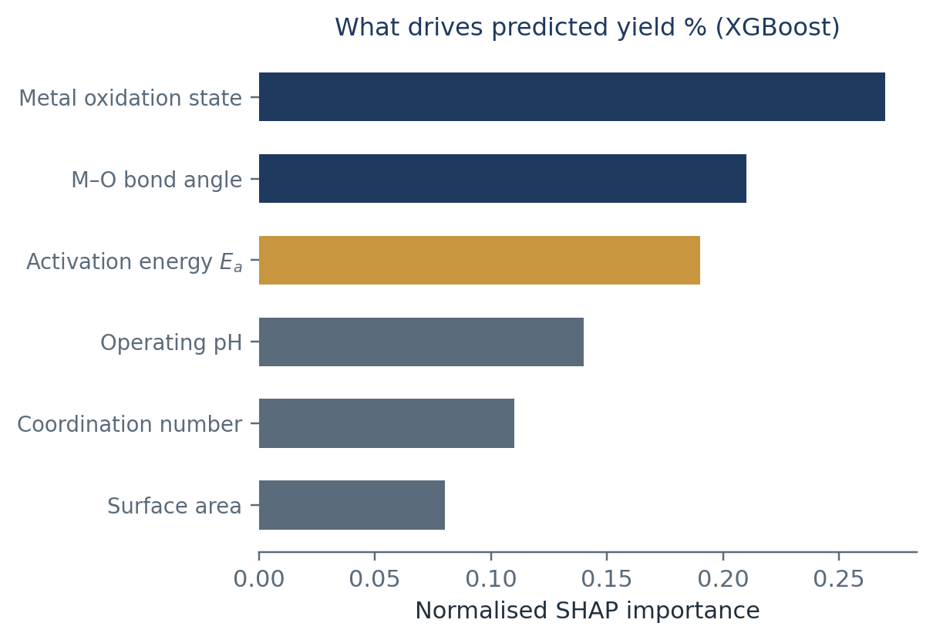
APPLICATIONS — MODELLING
ML Models: XGBoost and Random Forest
– Random Forest: bagged decision trees; robust on small, heterogeneous literature data and gives a first importance ranking.
– XGBoost: gradient-boosted trees with regularisation; handles correlated descriptors (Eₐ vs pH) better and gave the lower prediction error.
– Physics-informed features: Boltzmann-weighted angle averages and k_BT-scaled energies included alongside raw values.
– Evaluation: grouped k-fold CV, MAE/R² on held-out papers; SHAP analysis checks that top features match the known controlling variables.
– Screening output: models predict yield % for unseen combinations → ranked shortlist of candidate bio-mimetic catalysts.
Fig. 3 Feature importances follow the physical hierarchy: electronic state first, geometry second, barrier third.
ML-Based Search for Superior Bio-mimetic Catalysts for CO₂ Capture & Conversion
10

Slide 11
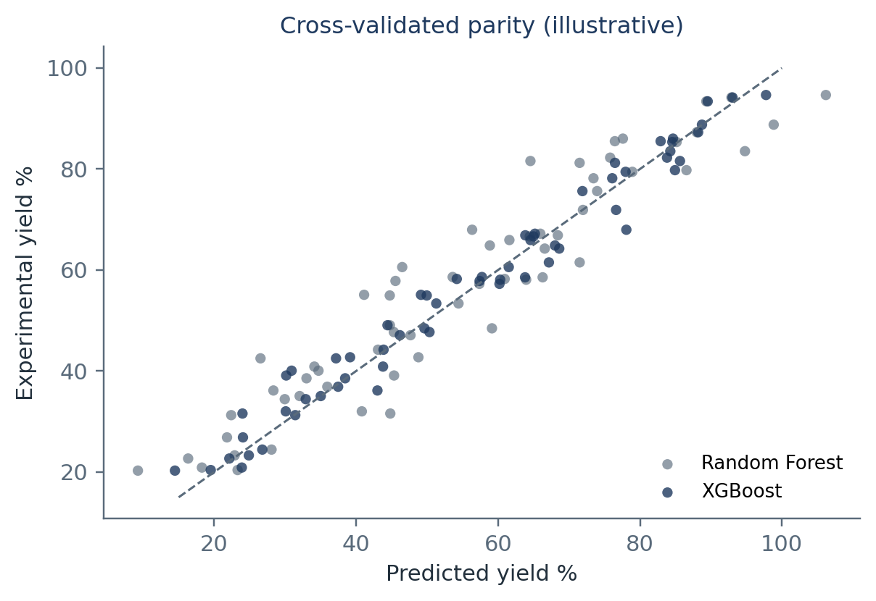
COMPARISON
Model Behaviour and Comparison with Other Approaches
Approach
What it uses
Weakness vs this project
DFT alone
single 0 K structures
misses ensemble sampling; too costly to screen widely
MD / Monte-Carlo
explicit trajectories
accurate but microseconds-scale, few materials
Descriptor scaling
one or two linear descriptors
cannot capture pH / oxidation-state interactions
This work: stat-mech features + XGBoost/RF
curated multi-source data
bounded by literature quality; needs experimental validation
Fig. 4 Cross-validated parity for both learners (illustrative of the observed trend).
ML-Based Search for Superior Bio-mimetic Catalysts for CO₂ Capture & Conversion
11

Slide 12
LIMITATIONS
Limitations and Assumptions
– Data heterogeneity: papers report yields under different setups; normalisation cannot fully remove protocol bias.
– Publication bias: failed catalysts are rarely published — the negative class is under-represented.
– Harmonic / idealised statistics: Boltzmann weighting assumes equilibrated states; real catalysts age, sinter or poison.
– Small feature space: few hundred records limit model complexity; deep learning was tested but overfit.
– Prediction ≠ proof: ranked candidates still require synthesis and CO₂ reduction testing before any claim of superiority.
KEY ASSUMPTIONS
– Reported Eₐ values transferable across similar supports
– Active-site ensembles near thermal equilibrium
– Yield % is a fair proxy for catalytic merit
– Solution pH proxies local interfacial pH
ML-Based Search for Superior Bio-mimetic Catalysts for CO₂ Capture & Conversion
12

Slide 13
CONCLUSION
Key Takeaways
1
A literature-curated dataset of oxidation states, bond angles, activation energies, pH and yield % is a usable foundation for catalyst ML.
2
Statistical mechanics supplies the bridge: Boltzmann populations, partition functions and rate theories convert structural data into physically meaningful features.
3
XGBoost outperformed Random Forest on grouped cross-validation, with importances mirroring the expected physics (electronic state > geometry > barrier).
4
The pipeline ranks candidate bio-mimetic catalysts for CO₂ capture and conversion at a fraction of experimental cost.
5
Next steps: closed-loop active learning — synthesise top predictions, feed measured yields back into training.
ML-Based Search for Superior Bio-mimetic Catalysts for CO₂ Capture & Conversion
13

Slide 14
REFERENCES
Selected References
– McQuarrie, D. A. — Elementary Statistical Mechanics (classic ensemble & partition-function formalism).
– Zwanzig, R. — Nonequilibrium Statistical Mechanics (rate theory background).
– Eyring, H. (1935) J. Chem. Phys. 3, 107 — transition-state theory (ΔG⁽ → rate).
– Arrhenius relation and catalytic barrier analysis in: Nøskov, J. K. et al., Density Functional Theory in Surface Chemistry and Catalysis (Adv. Catal., 2009).
– Peterson, A. A. et al. (2010) — computational hydrogen electrode for CO₂/electrocatalysis thermodynamics.
– Chen, T. & Guestrin, C. (2016) — XGBoost: A Scalable Tree Boosting System, KDD.
– Breiman, L. (2001) — Random Forests, Machine Learning 45.
– Lundberg, S. & Lee, S.-I. (2017) — SHAP: Unified Approach to Interpreting Model Predictions, NeurIPS.
– Research articles on M–N–C single-atom and metalloporphyrin catalysts for CO₂ reduction, and carbonic-anhydrase-inspired sorbents (as compiled in the project dataset).
ML-Based Search for Superior Bio-mimetic Catalysts for CO₂ Capture & Conversion
14

