Slide 1
SEMINAR PRESENTATION
Principles of Statistical Mechanics in
Modelling Biocatalysts
From molecular ensembles to catalytic rates — connecting equilibrium and
non-equilibrium statistical mechanics with enzyme kinetics and simulation.
Presented by: [Your Name]
Supervisor: [Professor’s Name]
Department / Institute • November 2026

Slide 2
PRESENTATION OUTLINE
Structure of the Talk
– 1. Motivation
– 2. Background
– 3. Core concepts of the theory
– 4. Governing equations & key parameters
– 5. Model scenarios
– 6. Applications to biocatalysis
– 7. Comparison with other subject areas
– 8. Limitations
– 9. Key takeaways & references
Principles of Statistical Mechanics in Modelling Biocatalysts
2

Slide 3
MOTIVATION
Why Statistical Mechanics for Biocatalysis?
– Enzymes are not static machines. A biocatalyst samples many conformations; its function is an ensemble property, not a single-structure property.
– Rates emerge from molecular statistics. Catalytic turnover k_cat is set by free-energy differences and barrier crossings — quantities defined by Boltzmann statistics.
– Bulk kinetics hides fluctuations. Michaelis–Menten kinetics averages over ~10^17 molecules; single-enzyme experiments show memory and dynamic disorder that only stochastic theory captures.
– Design needs predictive thermodynamics. Protein engineering and artificial enzymes require linking sequence → ensemble → ΔG⁽ⁱ → rate, which is exactly the domain of statistical mechanics.
THE GAP WE ADDRESS
– Deterministic ODEs ignore thermal noise
– Static structures ignore conformational ensembles
– Fixed barriers ignore protein dynamics & tunnelling
– Continuum treatments lose solvent entropy effects
Principles of Statistical Mechanics in Modelling Biocatalysts
3

Slide 4
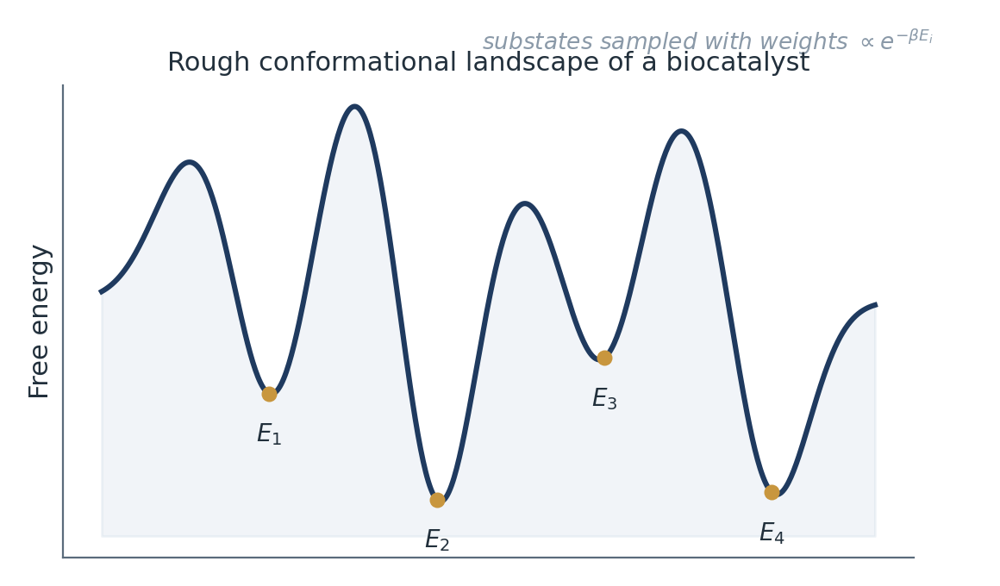
BACKGROUND
Biocatalysts as Statistical Systems
– Biocatalysts: enzymes, ribozymes, engineered proteins and nanozymes that accelerate reactions under mild conditions.
– Hierarchy of scales: Å (bond making/breaking) → nm (domain motions) → µs–ms (conformational gating) → s (turnover).
– Energy landscape picture: the protein has a rough, many-minima free-energy surface; catalysis is a rare transition between basins.
– Thermodynamic anchors: binding affinity K_d, ΔG of ES/EP complexes, transition-state stabilisation — all ensemble averages.
Fig. 1 — A biocatalyst populates substates E_i with Boltzmann weights; inter-basin hopping gates the catalytic step.
Principles of Statistical Mechanics in Modelling Biocatalysts
4

Slide 5
CORE CONCEPTS
Statistical-Mechanical Toolkit Used in the Models
Ensembles (micro / canonical / grand)
Fixes what is conserved; enzyme in solution → canonical ensemble at fixed T, V, μ of bath species.
Partition function Z and free energy
All observables derive from Z; F = −k_BT ln Z connects microscopic states to measurable affinities.
Boltzmann weighting
P(E_i) ∝ exp(−βE_i) determines population of catalytically competent vs. inactive conformers.
Fluctuation–dissipation & equipartition
Thermal noise drives barrier crossings; relates friction (γ) to diffusion (D = k_BT/γ) in Kramers theory.
Entropy–enthalpy compensation
Binding and catalysis trade-off; conformational entropy loss offsets enthalpic gains on substrate capture.
Principles of Statistical Mechanics in Modelling Biocatalysts
5

Slide 6
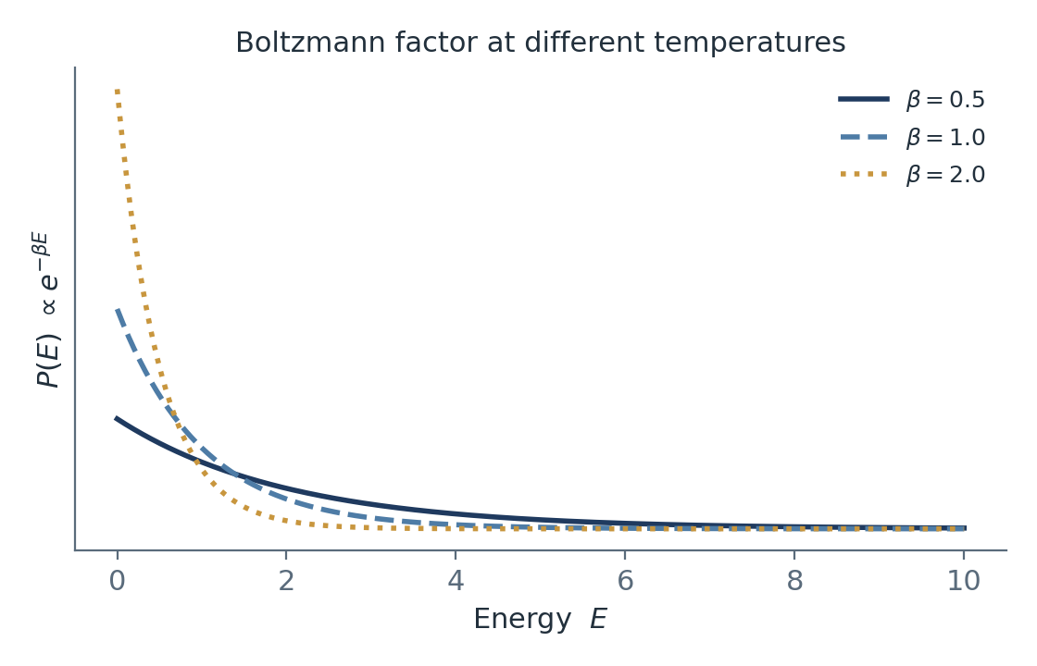
THEORY USED TO MODEL THE SYSTEM (I)
Equilibrium Statistics: Ensembles & Partition Functions
– Canonical distribution governs the enzyme + solvent bath at temperature T; β = 1/k_BT.
– Binding equilibria follow from ratio of partition functions of complex vs. separated partners — e.g. quasi-chemical treatment of ligand binding.
– Constrained / reaction-coordinate Z isolates the chemistry step: integrate out all degrees of freedom except the progress coordinate ξ.
– Free-energy profiles G(ξ) = −k_BT ln P(ξ) + const — histograms from MD become potentials of mean force directly comparable to experiment.
Fig. 2 — Higher temperature (smaller β) broadens state populations; catalysis depends on the tail that reaches the transition state.
Principles of Statistical Mechanics in Modelling Biocatalysts
6

Slide 7
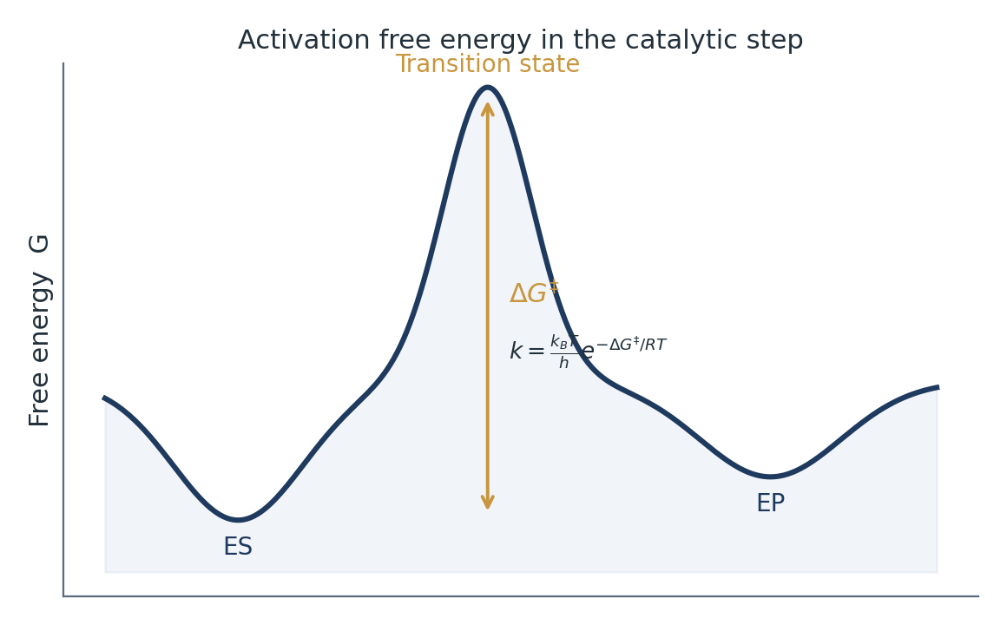
THEORY USED TO MODEL THE SYSTEM (II)
Non-Equilibrium Statistics: Rate Theories
– Eyring / Transition-State Theory: assumes quasi-equilibrium between ES and the transition state; every crossing leads to product.
– Kramers’ extension: in viscous (solvent-loaded) environments the barrier is recrossed; the rate acquires a transmission coefficient κ < 1 set by friction γ.
– Dynamic prefactor idea: protein motion along the reaction coordinate acts like an additional medium — enzymes interpolate between energy-diffusion and spatial-diffusion limits.
– Master equations: discrete kinetic networks (E ↔ ES ↔ EP ↔ E) written as a Markov chain give full distributions, not just mean rates.
Fig. 3 — Catalytic step as barrier crossing on a free-energy profile; TST counts crossings, Kramers corrects them.
Principles of Statistical Mechanics in Modelling Biocatalysts
7

Slide 8
GOVERNING EQUATIONS
Key Relations and Their Parameters
Boltzmann population
P_i = exp(−βE_i) / Z , Z = Σ_i exp(−βE_i)
β = 1/k_BT sets resolution of states; Z encodes every thermodynamic observable.
Eyring TST rate
k = κ · (k_BT/h) · exp(−ΔG⁽ⁱ/RT)
ΔG⁽ⁱ: activation free energy; κ: transmission coefficient (=1 in ideal TST).
Kramers (high friction)
k ≈ (ω_0ω_TS / 2πγ) · exp(−ΔG⁽ⁱ/k_BT)
γ: friction from solvent/protein; ω: curvatures of well and barrier — rate falls when motion slows.
Michaelis–Menten (ensemble limit)
v = V_max[S] / (K_m + [S])
Emerges as the mean-field average of the master equation when fluctuations are neglected.
Principles of Statistical Mechanics in Modelling Biocatalysts
8

Slide 9
MODEL SCENARIOS
Same Framework, Different Physical Regimes
Dilute solution, fast equilibration
Crowded cellular milieu
Single-enzyme observation
Immobilised / surface enzymes
– Standard TST + MM kinetics valid
– Rate controlled by ΔG⁽ⁱ alone
– Ensemble average ≈ single molecule
– Anomalous diffusion, γ effectively rises
– Substrate search becomes fractal-time
– Fractional master equations needed
– Kinetic memory / dynamic disorder
– Non-exponential waiting times
– Single-molecule kinetics ≠ MM prediction
– 2-D diffusion + local pH gradients
– Ensemble heterogeneity in site energies
– Grand-canonical treatment of protons
Each scenario changes which statistical-mechanical ingredient dominates — the barrier, the friction, or the ensemble spread itself.
Principles of Statistical Mechanics in Modelling Biocatalysts
9

Slide 10
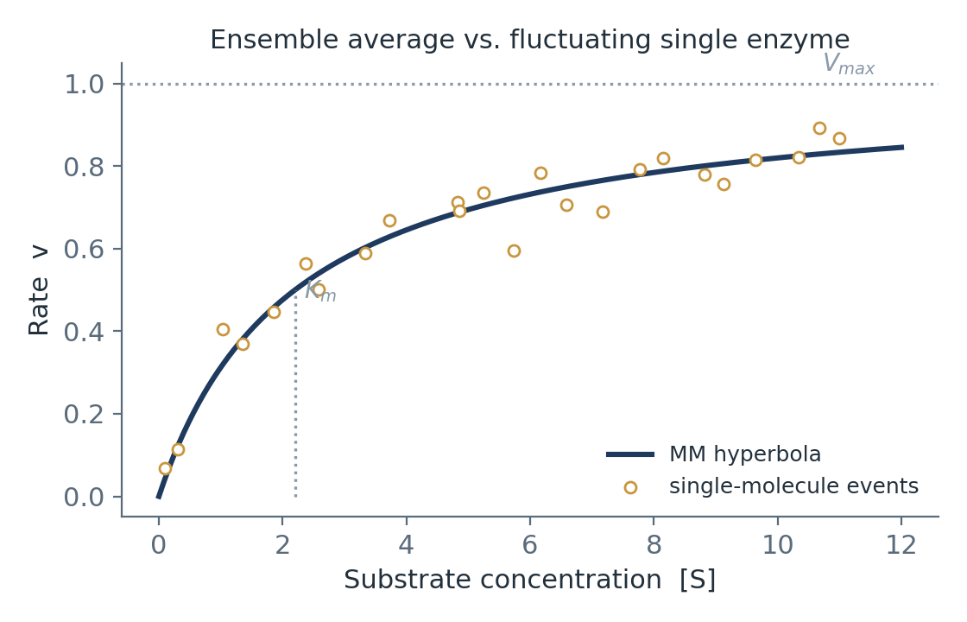
APPLICATIONS
Where the Theory Is Actually Used
– Enzyme engineering: ΔΔG⁽ⁱ decomposition guides mutations; free-energy perturbation (FEP) predicts mutant activities before synthesis.
– Drug design: binding free energies (MM-PBSA, TI) rank inhibitors against the same ensemble machinery.
– Artificial enzymes & nanozymes: landscape design principles borrowed from natural catalysts set selectivity targets.
– Biocatalysis in industry: immobilised-lipase and cellulase process models use Kramers-type temperature dependence for reactor scale-up.
– Simulations powering this: MD + enhanced sampling (metadynamics, replica exchange) numerically evaluate the partition functions behind every number above.
Fig. 4 — The smooth MM hyperbola is the ensemble mean; single-molecule events fluctuate around it — captured only by stochastic models.
Principles of Statistical Mechanics in Modelling Biocatalysts
10

Slide 11
COMPARISONS
With Adjacent Subject Areas
Aspect | Biocatalysis (this talk) | Heterogeneous catalysis | Soft-matter / polymer kinetics
Energy source | Protein fold landscape + solvent | Surface electronic structure | Chain entropy + confinement
Rate theory | Kramers / TST with dynamic κ | Arrhenius + microkinetic ODEs | Rouse/Zimm + reptation models
Ensemble role | Conformational substates gate rate | Site distribution on facets | Relaxation-time spectrum
Key parameter | ΔG⁽ⁱ, γ (friction) | Adsorption energies | Entanglement time τ_e
Shared mathematics, different physics: all three fields cross barriers on landscapes — but the origin of the barrier and of the friction differs.
Principles of Statistical Mechanics in Modelling Biocatalysts
11

Slide 12
LIMITATIONS
Where the Current Models Break Down
– Timescale gap: chemically relevant events (ms–s) exceed routine MD by orders of magnitude; sampling of the true ensemble is incomplete.
– Force-field error: ΔG⁽ⁱ from simulations carries 1–2 kcal/mol uncertainty — enough to shift predicted rates 10–100×.
– TST assumptions fail locally: tunnelling (H-transfer), recrossing and quantum nuclear effects violate the classical barrier-crossing picture.
– Coarse-graining loses detail: Markov state models assume memoryless hops; kinetic memory contradicts this.
COMMONLY MADE ASSUMPTIONS
– Quasi-equilibrium along the reaction coordinate
– Linear response near equilibrium (fluctuation–dissipation)
– Separation of fast solvent / slow protein timescales
– Harmonic wells around each basin
– Dilute-solution ideal behaviour of substrates
Principles of Statistical Mechanics in Modelling Biocatalysts
12

Slide 13
KEY TAKEAWAYS
Five Points to Remember
1
A biocatalyst is a statistical object: its rate is an ensemble property, governed by Boltzmann weights over conformational substates.
2
The partition function is the bridge: everything measurable — affinity, specificity, k_cat — derives from ratios of state sums.
3
Barrier crossing is the core event: Eyring TST gives the skeleton, Kramers friction and dynamic κ give the flesh.
4
Classical kinetics is the averaged limit: Michaelis–Menten emerges only when fluctuations and memory are negligible.
5
The framework transfers: the same landscape logic spans drug design, industrial biocatalysis and abiotic catalysis — within stated limitations.
Principles of Statistical Mechanics in Modelling Biocatalysts
13

Slide 14
REFERENCES
Selected Sources
– McQuarrie, J. D. (2000). Statistical Mechanics. University Science Books.
– Hill, T. L. (1987). Free Energy Transduction and Biochemical Cycle Kinetics. Dover Publications.
– Zwanzig, R. (2001). Nonequilibrium Statistical Mechanics. Oxford University Press.
– Kramers, H. A. (1940). Brownian motion in a field of force and the diffusion model of chemical reactions. Physica, 7(4), 284–304.
– Eigen, M. (1996). Neurobiology and the central role of non-equilibrium thermodynamics. In: Foundations of Sensory Science.
– Min, W., Xie, X. S. (2004). Single-molecule enzyme kinetics and fluctuating enzymes. J. Phys. Chem. B, 108, 15742–15750.
– Warshel, A. et al. (2006). Empirical valence-bond methods as a general approach to enzymatic catalysis. Acc. Chem. Res., 39, 182–191.
– English, B. P. et al. (2006). Ever-fluctuating single enzyme molecules. Proc. Natl. Acad. Sci., 103, 13093–13098.
Thank you — questions and discussion are welcome.
Principles of Statistical Mechanics in Modelling Biocatalysts
14

