Slide 1

Large Language Models & Generative AI
An educational journey into the technology reshaping how we communicate, create, and compute.

Slide 2

What is a Large Language Model?
Trained on Massive Data
AI systems trained on enormous text datasets to predict and generate human language with remarkable fluency.
Powers Modern AI Tools
Drives ChatGPT, Claude, Gemini, and other conversational AI tools used by millions daily.
Transformer Architecture
Uses the transformer architecture to understand context and relationships between words across long passages.

Slide 3
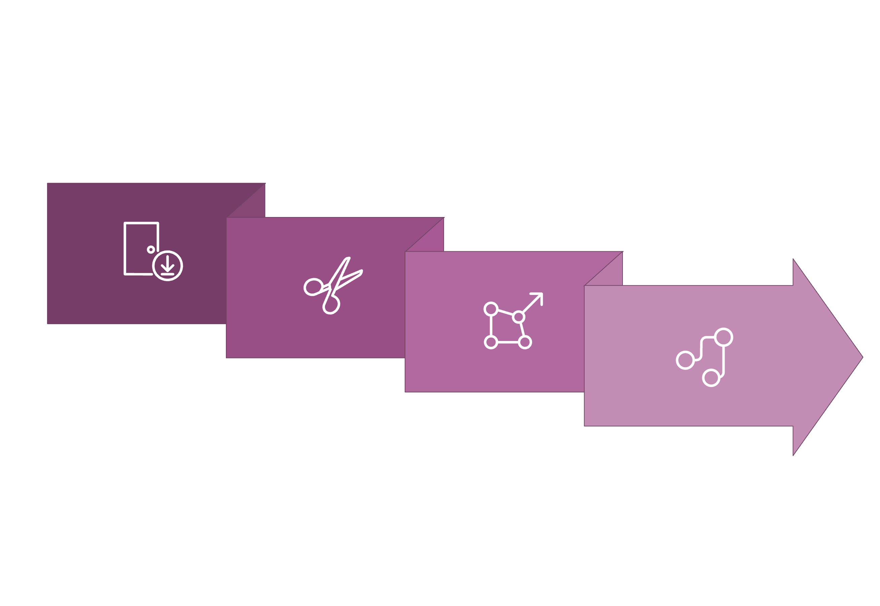
How LLMs Work: The Pipeline
Tokenization
Transformers
Input
Embeddings
Tokenization
Embeddings
Attention
Text is broken into small pieces (tokens) the model understands — words, subwords, or characters.
Tokens become numerical vectors that capture semantic meaning and relationships.
The model learns which words matter most for understanding context and generating accurate output.

Slide 4


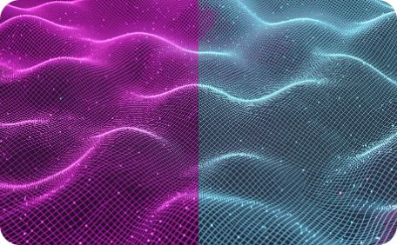

Real-World Generative AI Applications
Content Creation
Customer Service
Software Development
Data Analysis
Writing, copywriting, code generation, and marketing materials at scale.
Chatbots, automated responses, and intelligent knowledge assistants.
Summarizing documents and extracting insights from unstructured data.
Code completion, debugging assistance, and auto-generated documentation.

Slide 5

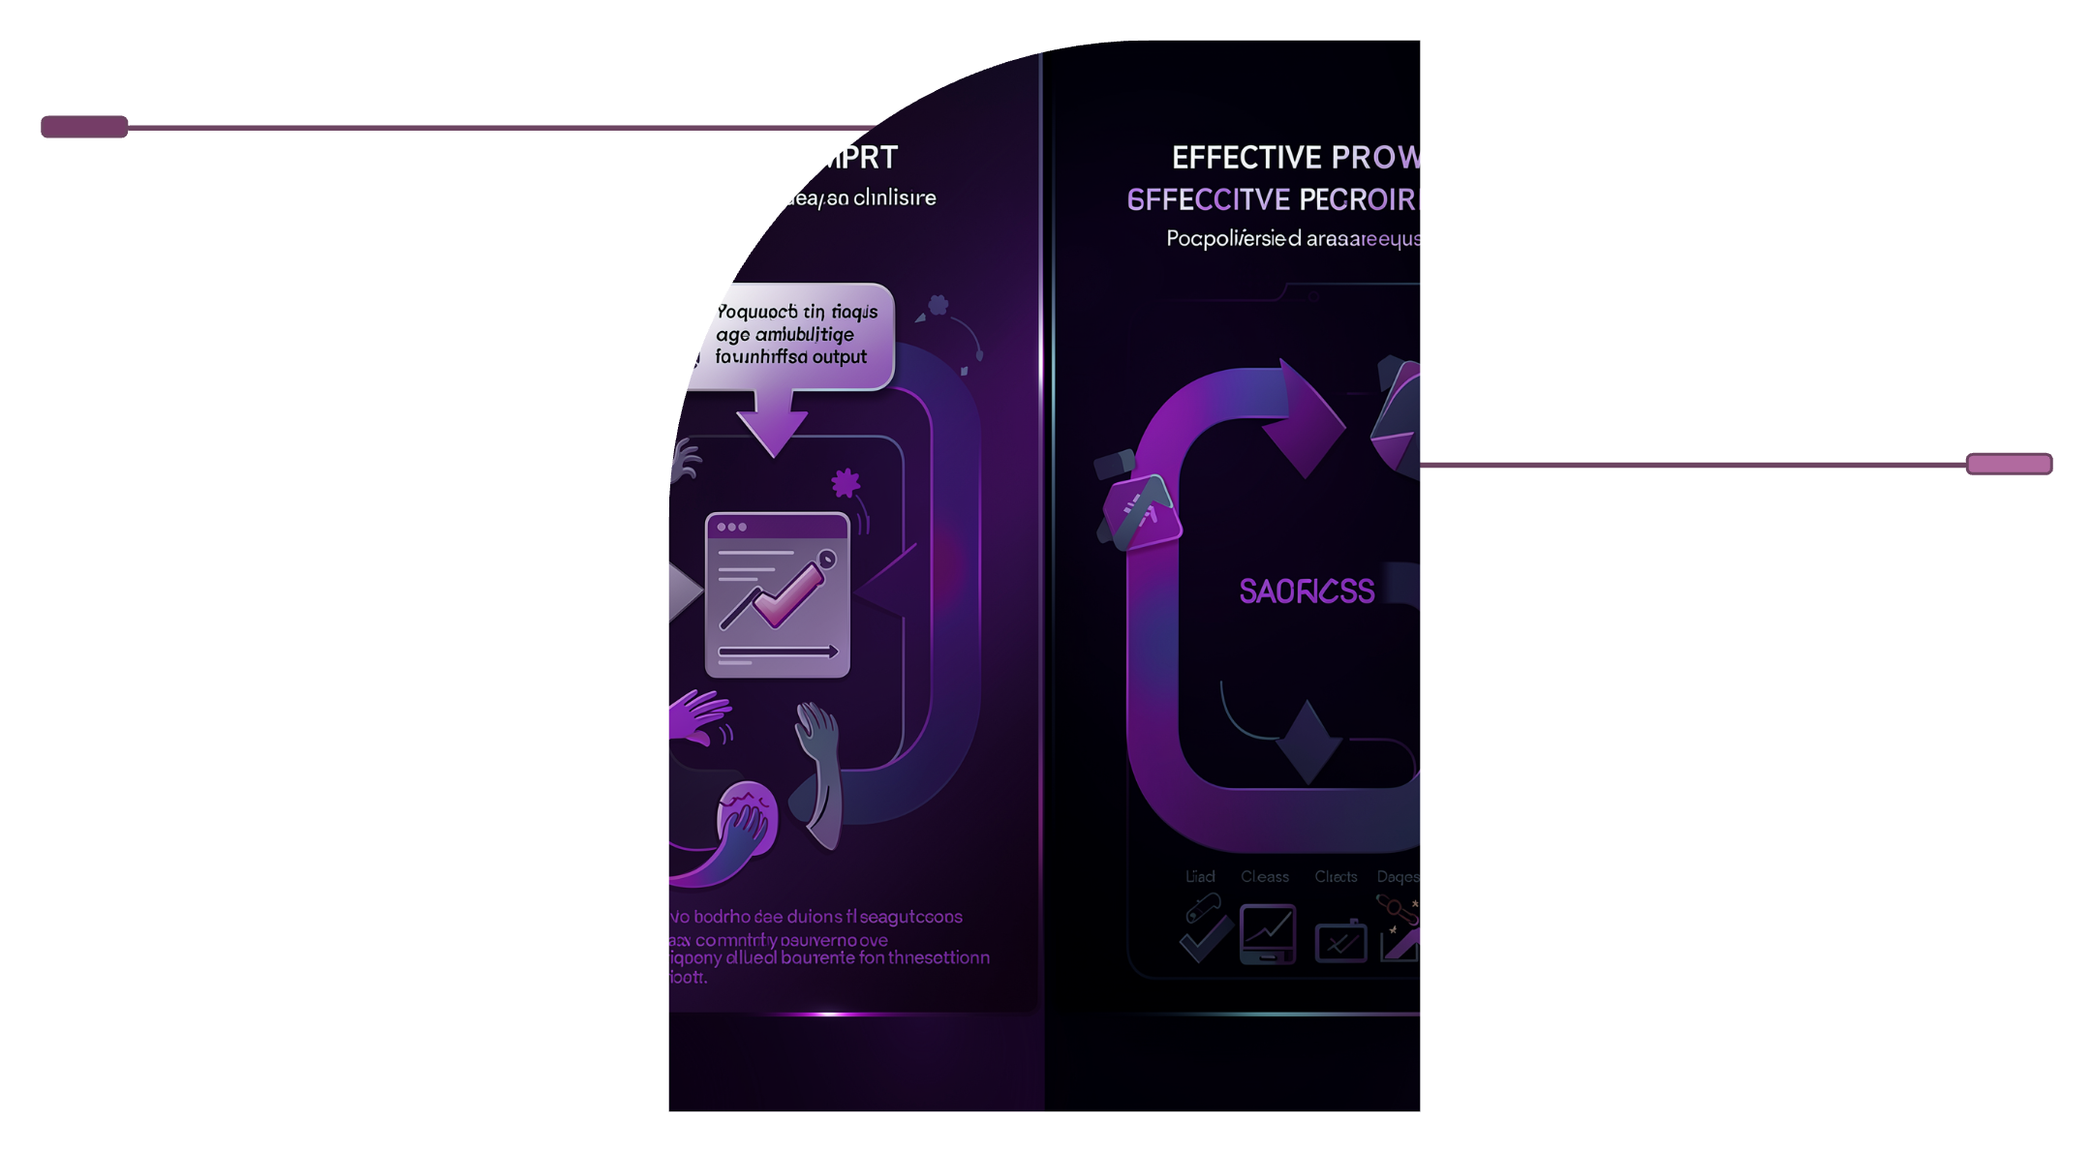

Prompt Engineering: Getting Better Results
Be Specific
Clear, detailed instructions produce better outputs than vague requests.
Poor Prompt
Vague request yields ambiguous output and frustration.
Provide Context
Give background information and examples of your desired format.
Effective Prompt
Specific instructions with context produce clear output and success.
Use Separators
Use ### or """ to clearly separate instructions from input text.
Iterate
Refine prompts based on results to continuously improve quality.

Slide 6
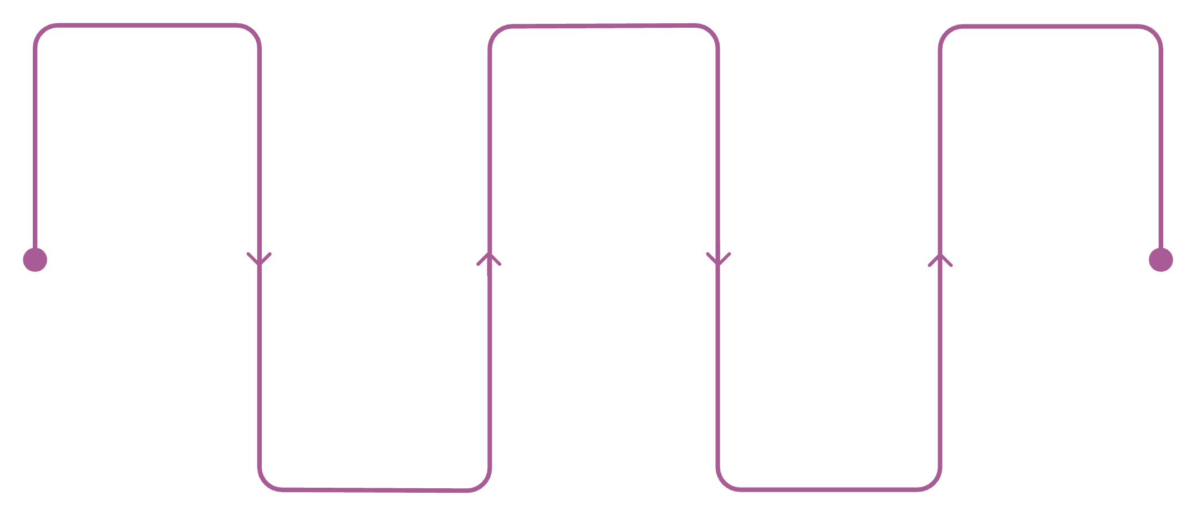
Training LLMs: From Data to Model
Raw Data
Pre-training
Alignment
Collect billions of text examples
Train on large-scale corpora
Safety evaluation and alignment
The Training Journey
Building an LLM is a multi-stage process requiring massive computational resources.
Preprocessing
Fine-tuning
Clean, filter, and normalize data
Adapt model for specific tasks
01
02
03
Data Collection
Pre-training
Fine-tuning
Billions of text examples gathered from the internet, books, and curated sources.
Teaches general language understanding — grammar, facts, and reasoning patterns.
Adapts the model for specific tasks, domains, or desired behaviors.

Slide 7

Key Limitations & Challenges
🧠 Hallucinations
Models can confidently generate false or completely made-up information — with no warning.
⚖️ Bias
Trained on internet data that reflects real-world societal biases and inequalities.
📏 Context Window
LLMs can only process a limited amount of text at once — long documents get truncated.
🕰️ Knowledge Cutoff
Training data has a cutoff date — the model doesn't know about recent events.

Slide 8


Ethical Considerations
Navigating the Responsibility
As LLMs become more powerful, the ethical stakes grow alongside their capabilities.
Misinformation
Copyright
AI-generated content can spread false information at unprecedented scale and speed.
Training on copyrighted works raises complex and unresolved legal questions.
Job Displacement
Transparency
Automation may significantly impact creative and knowledge work sectors.
Users deserve to know when they are interacting with AI — not a human.

Slide 9




The Future of Generative AI
Multimodal Models
Agentic AI
Systems that seamlessly work with text, images, audio, and video together in one model.
AI systems that can plan, execute multi-step tasks, and use tools autonomously without constant guidance.
Efficiency Gains
Specialization
Smaller, faster models that deliver great results while requiring far less computing power.
Custom models trained on domain-specific data for medicine, law, science, and beyond.

Slide 10
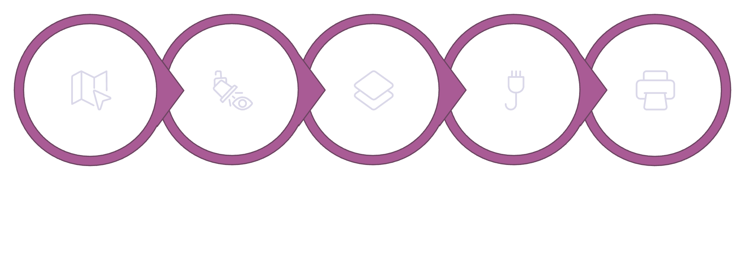
Transformer Architecture Deep Dive
Inside the Transformer Block
Transformers are the architectural breakthrough that made modern LLMs possible.
Input Embeddings
Multi‑Head Attention
Add & Normalize
Feed‑Forward
Output
Self-Attention
Multi-Head Attention
Feed-Forward Networks
Layer Stacking
Each token learns to focus on the most relevant words throughout the entire input sequence.
Multiple attention heads run in parallel, each capturing different linguistic relationships simultaneously.
Dozens of transformer blocks stacked together build progressively deeper language understanding.
Process and transform attention outputs, adding non-linear reasoning capability to each block.

