Slide 1
Digital Portfolio
STUDENT NAME: Yuvarani M
REGISTER NO AND NMID: 222402634 and asunm161222402634
DEPARTMENT: Computer Science with Data Science
COLLEGE: Prince Shri Venkateshwara Arts and Science College/ Madras University

Slide 2
PROJECT TITLE : Digital Portfolio
Subtitle: Showcasing My Projects, Skills, and Achievements

Slide 3


AGENDA
Problem Statement
Project Overview
End Users
Tools and Technologies
Portfolio design and Layout
Features and Functionality
Results and Screenshots
Conclusion
Github Link
3/21/2024 Annual Review

Slide 4

PROBLEM STATEMENT
Traditional resumes are:
Static and text-heavy
Hard to showcase creativity and projects
Not globally accessible
Need: A dynamic, interactive, and shareable portfolio

Slide 5

PROJECT OVERVIEW
Objective: Build an online portfolio to showcase skills & achievements
Scope:
Academic submissions
Career branding
Personal growth
Sections: About Me | Skills | Projects | Certificates | Contact

Slide 6

WHO ARE THE END USERS?
🎓 Professors/Evaluators – Assess projects
💼 Recruiters/Employers – Evaluate skills
🤝 Peers/Collaborators – Explore teamwork
🌐 Clients/General audience – View expertise

Slide 7

TOOLS AND TECHNIQUES
Frontend: HTML5, CSS3, JavaScript, Bootstrap
Design Tools: Canva, Photoshop, Figma
Development Tools: VS Code, Git, GitHub
Hosting: GitHub Pages

Slide 8
POTFOLIO DESIGN AND LAYOUT
Responsive, mobile-friendly design
Clean navigation bar
Consistent color palette & fonts
Sections included:
Home | About Me | Skills | Projects | Certificates | Contact
8

Slide 9
FEATURES AND FUNCTIONALITY
Interactive navigation & smooth scrolling
Clickable GitHub links
https://yuvarani58.github.io/TNSDC-FWD-DP/#home
Project showcase with screenshots
Certificates as image gallery
Resume download option
📌 Future scope: Dark mode | Blog | Analytics

Slide 10
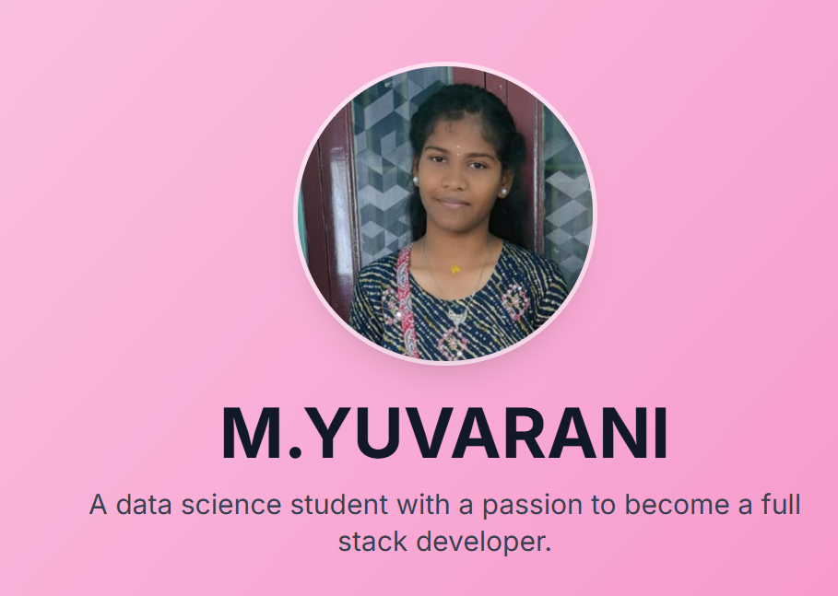
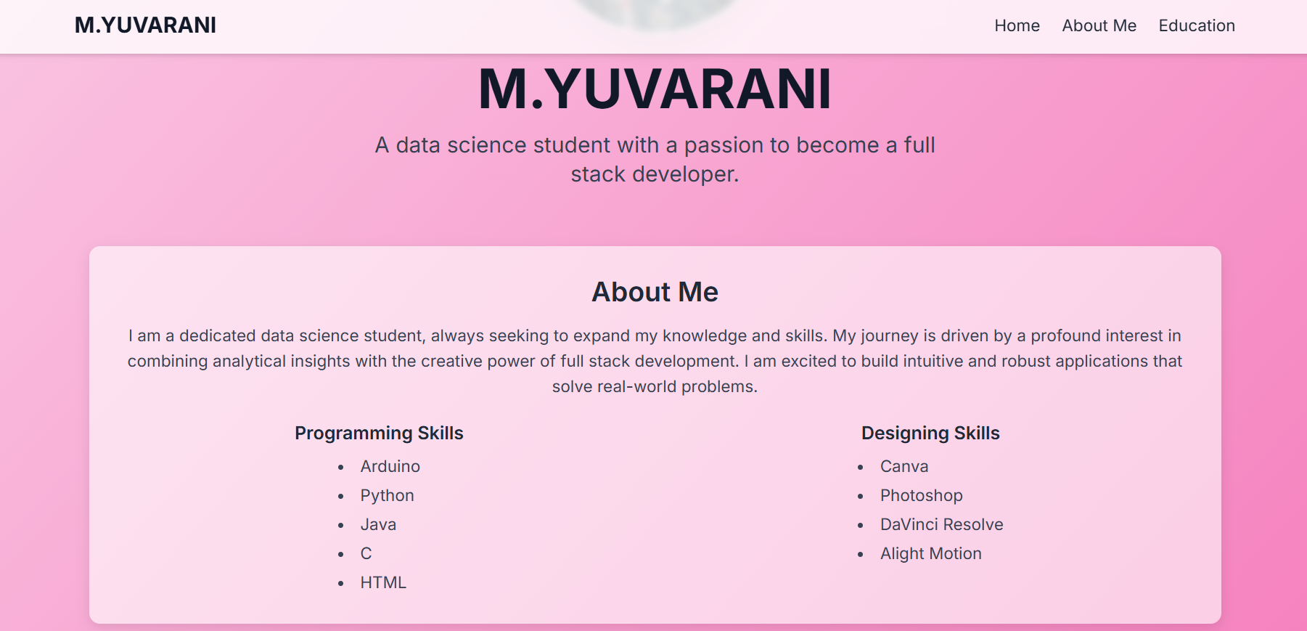

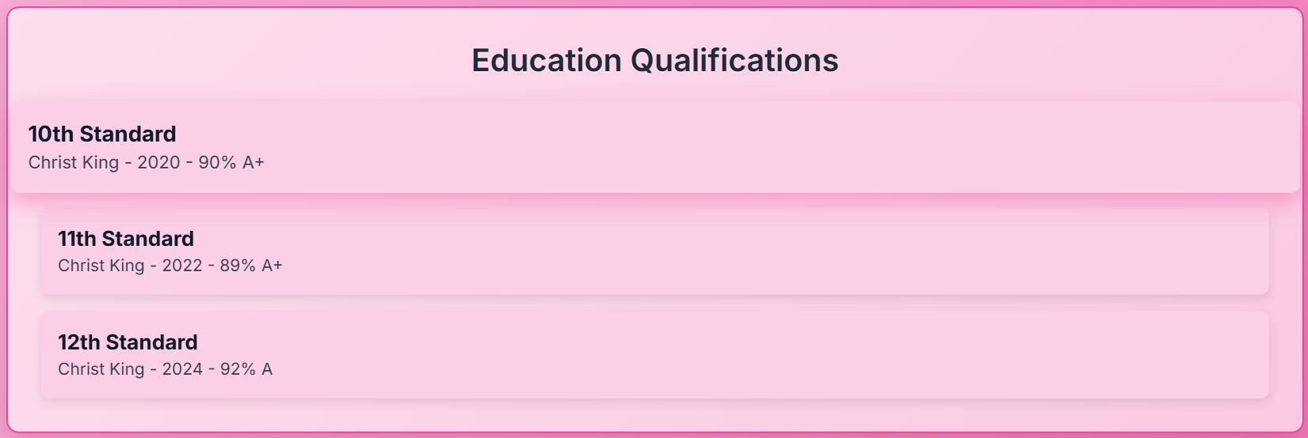
RESULTS AND SCREENSHOTS
3/21/2024 Annual Review
10

Slide 11
CONCLUSION
Portfolio replaces traditional resume limitations
Demonstrates both technical & creative skills
Accessible globally, anytime
Future scope: Animations, chatbots, custom domain
“Your work is your best resume – Show it, don’t just tell it.”
11

Slide 12
GitHub Link
Live Portfolio: 👉 https://yuvarani58.github.io/TNSDC-FWD-DP/#home
Source Code: https://github.com/yuvarani58/TNSDC-FWD-DP/tree/main
12

