Slide 1


NEXT GEN EMPLOYABILITY PROGRAM
Student Name :
YUVARANI S.K
Student ID :
College Name :
STU64a80993e6ccc1688734099
Rathinam Technical Campus

Slide 2
CAPSTONE PROJECT SHOWCASE
Project Title
MealMate – A Scalable Food Delivery Solution
Abstract | Problem Statement | Project Overview | Proposed Solution | Technology Used | Modelling & Results | Conclusion | Q&A

Slide 3
Abstract
1
Overview: A food delivery web app using MERN stack for browsing restaurants, ordering food, and tracking deliveries
2
Features: User authentication, dynamic restaurant listings, order management, and real-time tracking.
3
Tech Stack: React.js (Frontend), Node.js & Express.js (Backend), MongoDB (Database), Tailwind CSS (UI).
4
Future Scope: AI-based food recommendations, real-time chat support, and delivery partner tracking.

Slide 4


Problem Statement
In today's fast-paced world, users demand a seamless and efficient food ordering experience.
However, existing platforms often suffer from high costs, slow delivery, and limited restaurant choices.
This project aims to develop a feature-rich, cost-effective, and user-friendly food delivery platform using the MERN stack, providing real-time restaurant listings, secure order management, and live tracking to enhance the overall user experience.

Slide 5

Project Overview
This project is a food delivery web application built using the MERN stack (MongoDB, Express.js, React.js, Node.js).
It allows users to browse restaurants, place orders, and track deliveries in real-time.
The platform ensures a smooth user experience with a responsive UI, secure authentication, and dynamic restaurant listings.
Future enhancements include AI-based food recommendations and real-time chat support to improve customer engagement.

Slide 6
Proposed Solution
User-Friendly Interface: A responsive and intuitive UI using React.js & Tailwind CSS for seamless navigation.
Restaurant & Order Management: Users can browse restaurants, place orders, and track deliveries in real time.
Secure & Scalable Backend: Built with Node.js & Express.js, ensuring fast API responses and secure user authentication.
Efficient Database Management: MongoDB stores user, restaurant, and order data for quick retrieval and updates.
Future Enhancements: AI-powered food recommendations, real-time chat support, and delivery tracking integration.

Slide 7
Technology used
Frontend: React.js, Tailwind CSS (for UI design).
Backend: Node.js, Express.js (for API development).
Database: MongoDB (for storing user, restaurant, and order data).
Routing & State Management: React Router, Context API.
Authentication: JWT (JSON Web Token) for secure login/signup.
Hosting & Deployment: Netlify/Vercel (Frontend), Render/Heroku (Backend).

Slide 8
Modelling & Result
System Architecture:
Frontend (React.js): Handles user interactions, restaurant listings, and order placement.
Backend (Node.js & Express.js): Manages authentication, order processing, and API requests.
Database (MongoDB): Stores user profiles, restaurant details, and order history.
User Flow:
Users browse restaurants, select items, and place orders.
Orders are processed and stored in MongoDB.
Users receive real-time updates on order status.

Slide 9
Modelling & Result
Performance & Results:
Fast API responses ensure smooth ordering experience.Scalability:
The system efficiently handles multiple restaurant listings and orders
Security: JWT-based authentication ensures secure user login.
Future Scope:
AI-powered food recommendations for personalized user experience.
Live order tracking with real-time delivery updates.

Slide 10
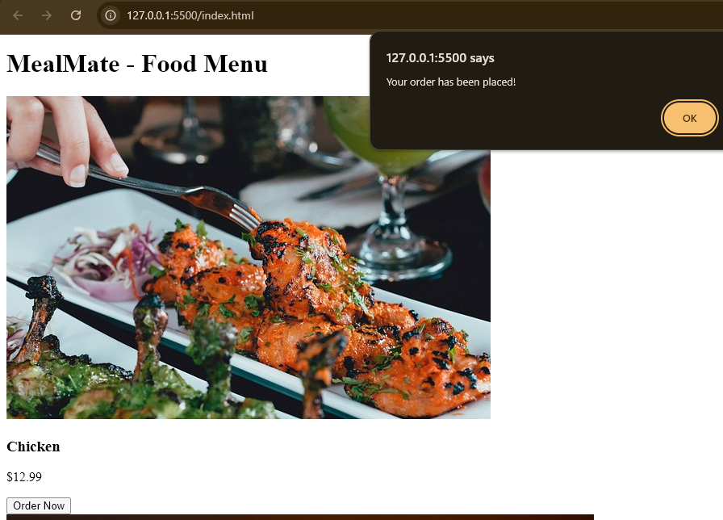
Modelling & Result
Successful Food Ordering System
Efficient Performance & User Experience
Secure & Scalable System
Scope for Future Enhancements

Slide 11

Conclusion
The Zomato Clone successfully provides a seamless and efficient food delivery platform using the MERN stack.
With features like restaurant browsing, secure authentication, real-time order management, and dynamic UI, it enhances the overall user experience.
The system ensures scalability, security, and fast performance, making it a viable solution for modern food delivery services.
Future improvements include AI-based food recommendations, live order tracking, and chat support to further enhance customer engagement and satisfaction.

Slide 12


Notes:
Thank You !!

