Slide 1
Student Productivity & Cognitive Efficiency Analysis Using EDA & Power BI

Slide 2
Introduction: In today’s digital era, students spend significant time on devices This affects: Focus Cognitive ability Productivity Need for data-driven understanding

Slide 3

PROBLEM STATEMENT
In today’s digital era, students are increasingly exposed to screen-based activities such as mobile usage and social media. This leads to several issues like reduced attention span, poor sleep quality, and increased stress levels.
These factors directly impact cognitive performance and productivity, but the exact relationship between them is not clearly understood.
Therefore, the problem is to analyze and quantify how lifestyle factors like screen time, sleep, and stress influence student productivity and cognitive efficiency using data analysis.

Slide 4
OBJECTIVES Analyze screen time vs cognitive score Study sleep impact on performance Evaluate stress effect on productivity Provide recommendations

Slide 5
TOOLS & TECHNOLOGIES
TOOLS & TECHNOLOGIES
🔹 Python (EDA in VS Code)
Pandas → data handling (df.head(), df.describe())
NumPy → numerical operations
Matplotlib & Seaborn → visualization
🔹 Power BI

Slide 6

EDA PROCESS (FROM YOUR FILE)
Checked missing values
Data summary
Distribution plots
Correlation matrix
Some visualization
And ml

Slide 7
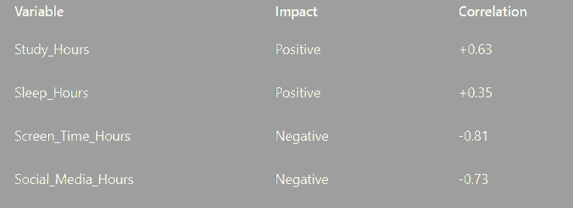
Note: Dependent variable→ target productivity Independent variable->screen_time_hours, sleep_hours ,social_media_hours, study_hours. intermediate variable →Coginitive_test_score

Slide 8
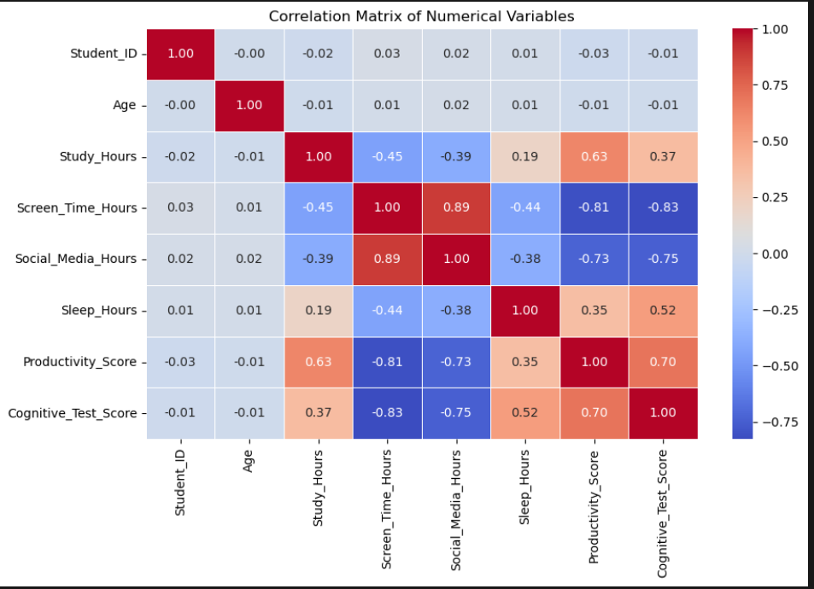
1. CORRELATION HEATMAP
Insights:
Screen Time vs Cognitive Score →
-0.81 (Strong negative)
Sleep → Positive relationship
Stress → Negative relationship

Slide 9
KPI DASHBOARD
Avg Screen Time → 5.97 hrs
Cognitive Score → 90.60
Productivity → 88.38
Sleep → 7.01 hrs

Slide 10
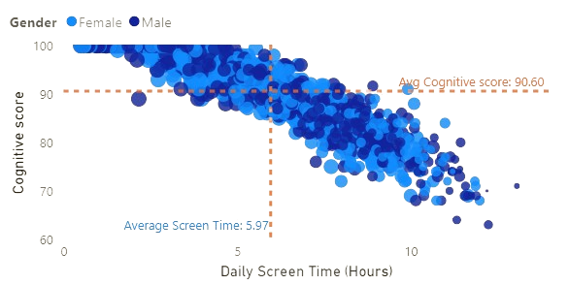
Screen Time on Cognitive Performance
Observation
Downward trend in data
Most students: 4–10 hrs screen time
Avg Screen Time → 5.97 hrs
Avg Cognitive Score → 90.60
Insights
Higher screen time → lower cognitive score
Lower screen time → better performance
Performance drops after ~6 hours
Same pattern for both genders

Slide 11
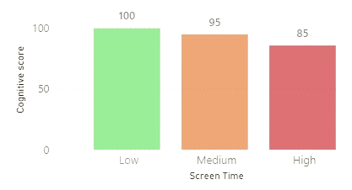
SCREEN TIME CATEGORY ANALYSIS
Insights
Performance decreases as screen time increases
Clear difference between categories

Slide 12
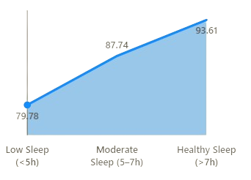
SLEEP ANALYSIS
Insights
Performance increases with sleep
Best performance at 7+ hours

Slide 13
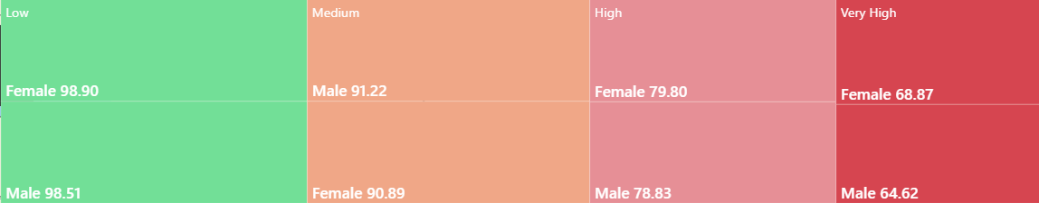
STRESS ANALYSIS
Insights
Productivity decreases with stress
High stress significantly reduces performance

Slide 14
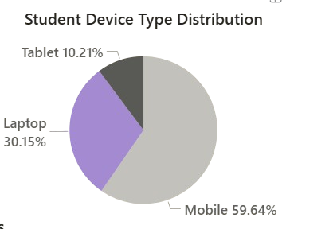
DEVICE USAGE
Insights
Mobile contributes most to screen time

Slide 15
Key insights
Key Insights (EDA)
- Screen time has a strong negative impact on both cognitive score and productivity
- Social media usage negatively affects productivity and increases variability
- Sleep has a positive effect on cognitive performance
- Study hours positively influence productivity
- Cognitive score strongly contributes to productivity
- High screen time and social media usage are the main factors reducing performance

Slide 16

Conclusion
Student performance is strongly influenced by daily habits
Excessive screen time and social media reduce productivity
Proper sleep and focused study improve performance
Managing these factors can significantly improve outcomes

