Slide 1

STUDENT NAME : V. YUVASHREE
REGISTER NO : 22924U09050
NMID : 71CC09CD76A8820AD4F4FD07E
DEPARTMENT : BCA [COMPUTER APPLICATION]
COLLEGE : SRI BHARATHI WOMEN’S ARTS AND
SCIENCE COLLEGE
UNIVERSITY : THIRUVALLUVAR UNIVERSITY

Slide 2


Slide 3


Slide 4


Slide 5


Slide 6


Slide 7


Slide 8
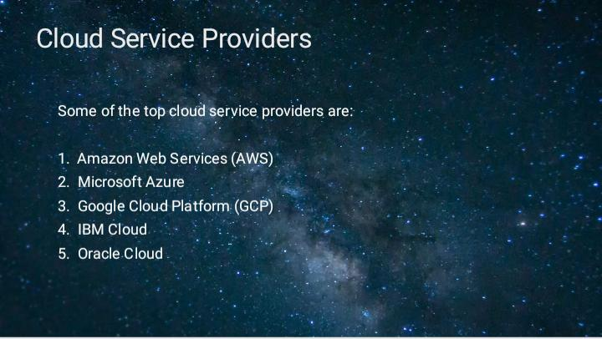

Slide 9


Slide 10


Slide 11


Slide 12


Slide 13


Slide 14


Slide 15
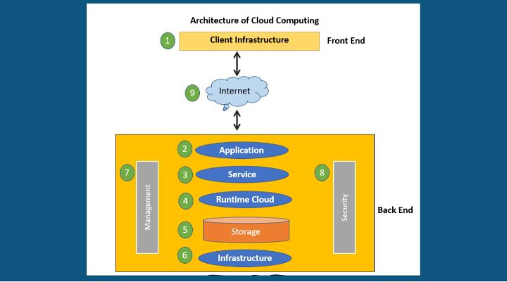

Slide 16
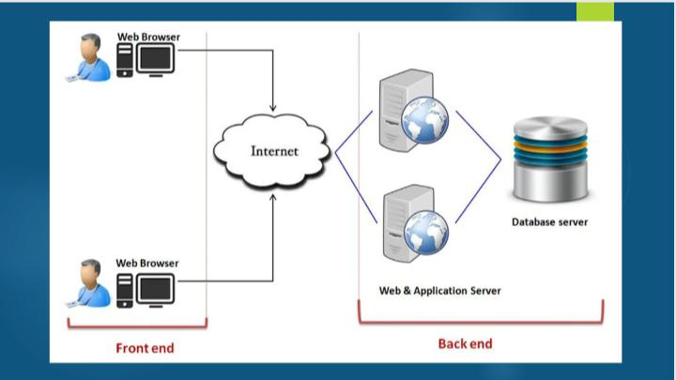

Slide 17
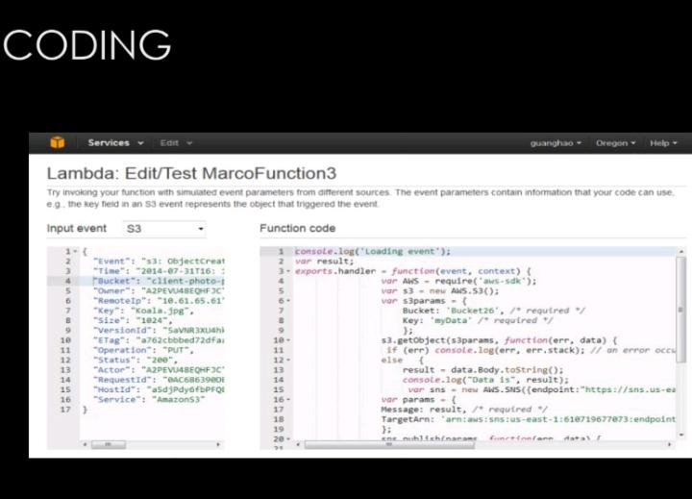

Slide 18
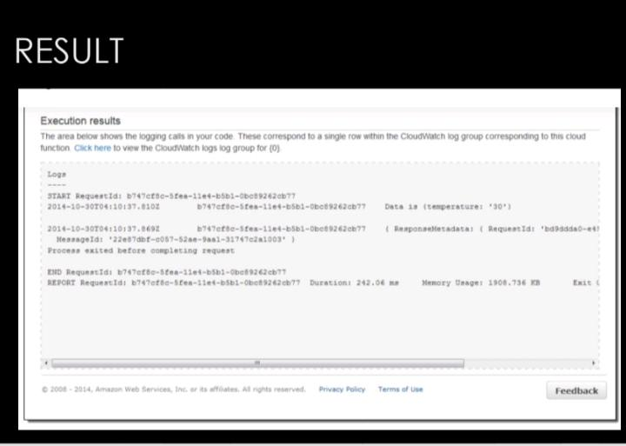

Slide 19


Slide 20


