Slide 1
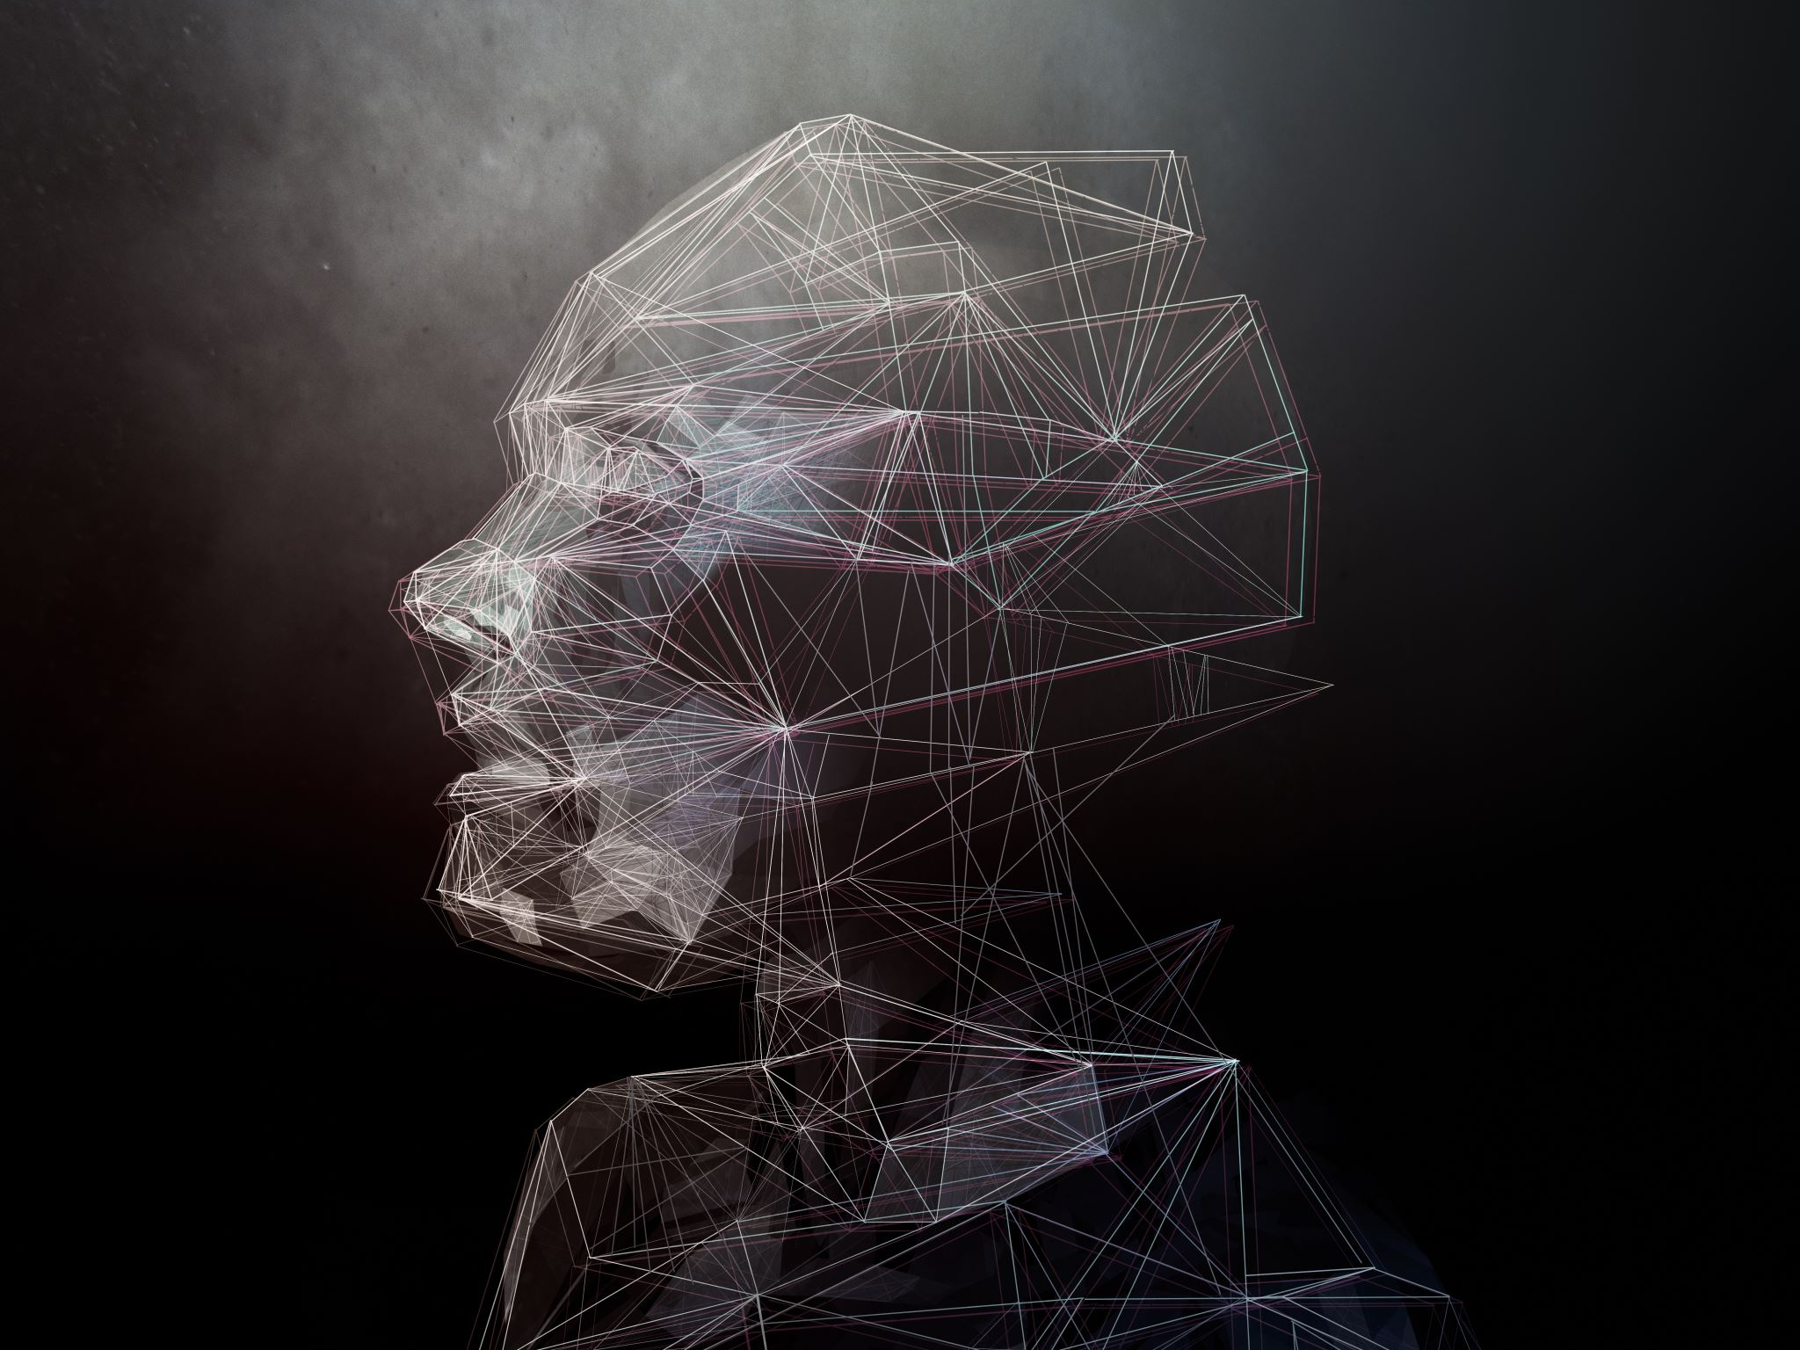
The Story of AI: From Dreams to Reality
Key Milestones and Advancements
Yuvashree Srinivas- #2845532
Mounika Bogadamidi - #2911373
Dhara Gediya - #2905040

Slide 2
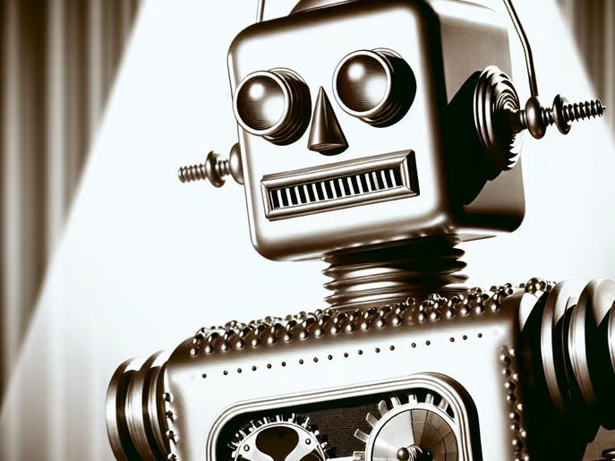
Act 1: The Birth of a Dream (1950s–1960s)
- Turing Test (1950): Proposed by Alan Turing to determine machine intelligence.
- Dartmouth Conference (1956): John McCarthy coined the term 'AI'; early programs focused on math and games.

Slide 3
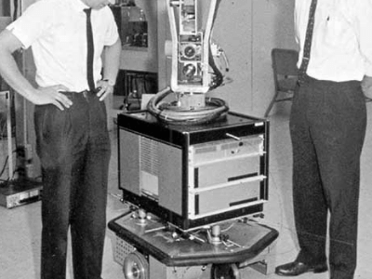
Act 2: The Rise and Fall (1970s–1980s)
- First AI Winter (1973): Lighthill Report criticized AI’s progress.
- Expert Systems (1980s): Used in healthcare and engineering.
- Second AI Winter (1987): Japan’s Fifth Generation Project failed.

Slide 4
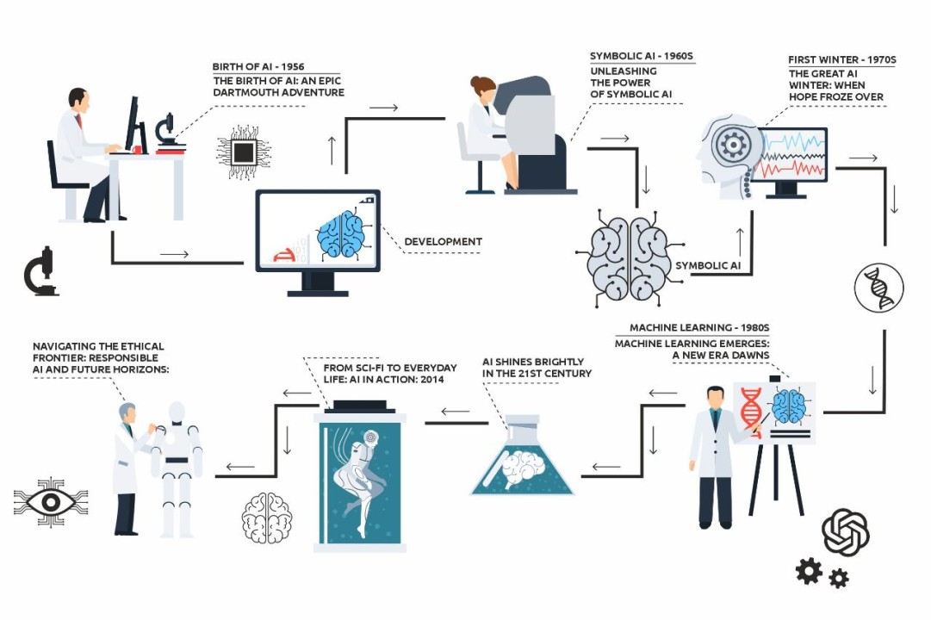

Slide 5
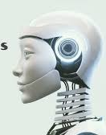
Act 3: The Awakening (1990s–2000s)
- Machine Learning: AI learned from data.
- Deep Blue vs. Kasparov (1997): AI defeated world chess champion.
- Deep Learning (2006): Neural networks improved AI accuracy.

Slide 6
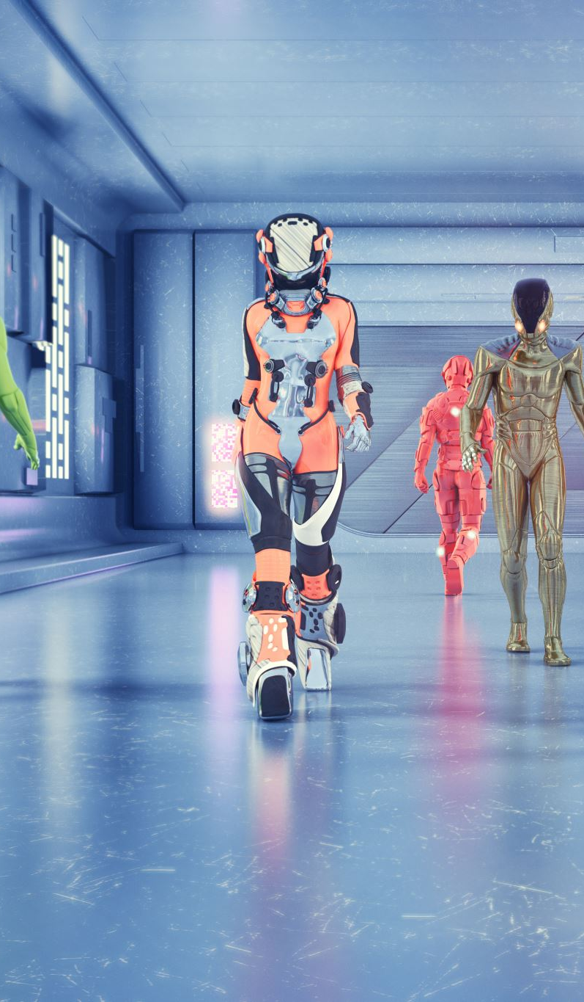
Act 4: The Revolution (2010s–2020s)
- AlexNet (2012): Deep neural network revolutionized image recognition.
- AlphaGo (2016): AI defeated Go champion.
- Transformer Models (2017): Enabled language models like GPT.

Slide 7
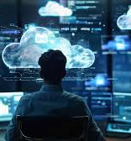
Cloud Computing's Role
- AWS, Google Cloud, Azure enabled large-scale AI training.
- Cloud-based data centers provided data storage and processing.

Slide 8
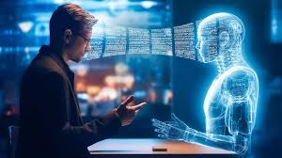
Act 5: AI Becomes Human-Like (2020s–Present)
- GPT-3 (2020): Human-like text generation.
- ChatGPT (2022): Engaged in natural conversations.
- DALL-E & Stable Diffusion: AI-generated realistic art.

Slide 9
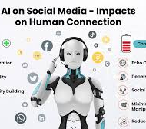
AI-Powered Smart Assistants
- Alexa (Amazon, 2014): Smart home control.
- Google Assistant (2016): Contextual understanding.
- Siri (Apple, 2011): iOS integration.
- Cortana (Microsoft, 2014): Productivity-focused (phased out).

Slide 10
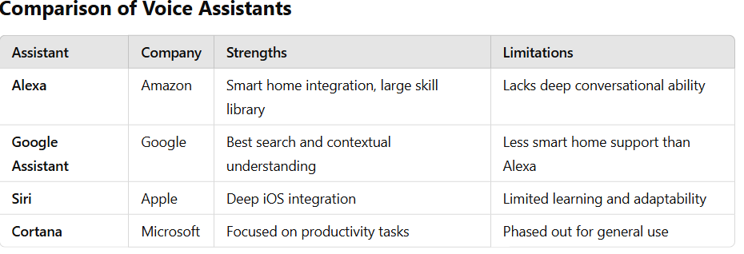

Slide 11
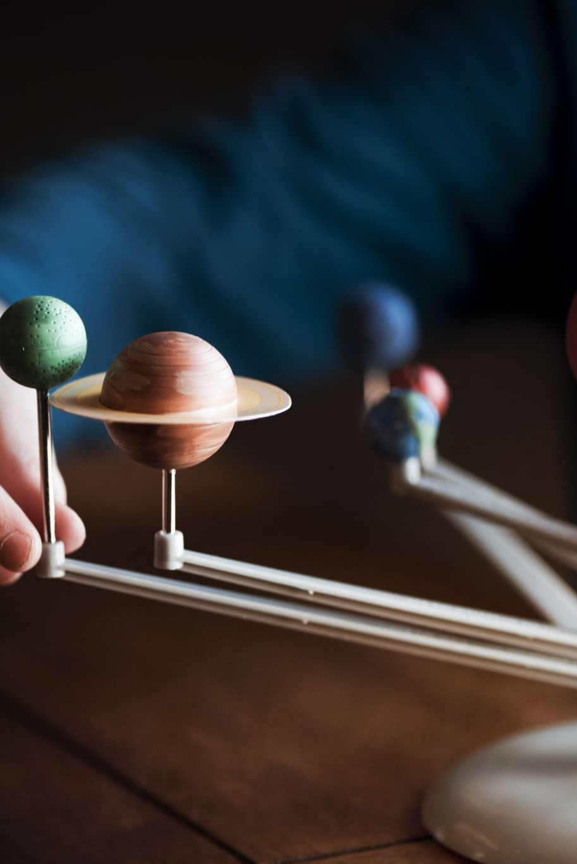
Key Players
- Geoffrey Hinton – Deep learning pioneer.
- Yann LeCun – Convolutional neural networks.
- Yoshua Bengio – Advanced deep learning.
- Demis Hassabis – Created AlphaGo.
- Fei-Fei Li – Developed ImageNet.
- Sam Altman – CEO of OpenAI.

Slide 12
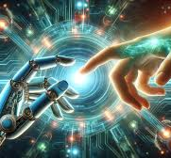
The Future
- AGI: Human-level intelligence.
- Ethics and Bias: Ensuring fairness and safety.
- Workforce Impact: AI could empower or replace human jobs.

Slide 13
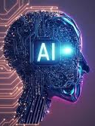
Thank you

