Slide 1
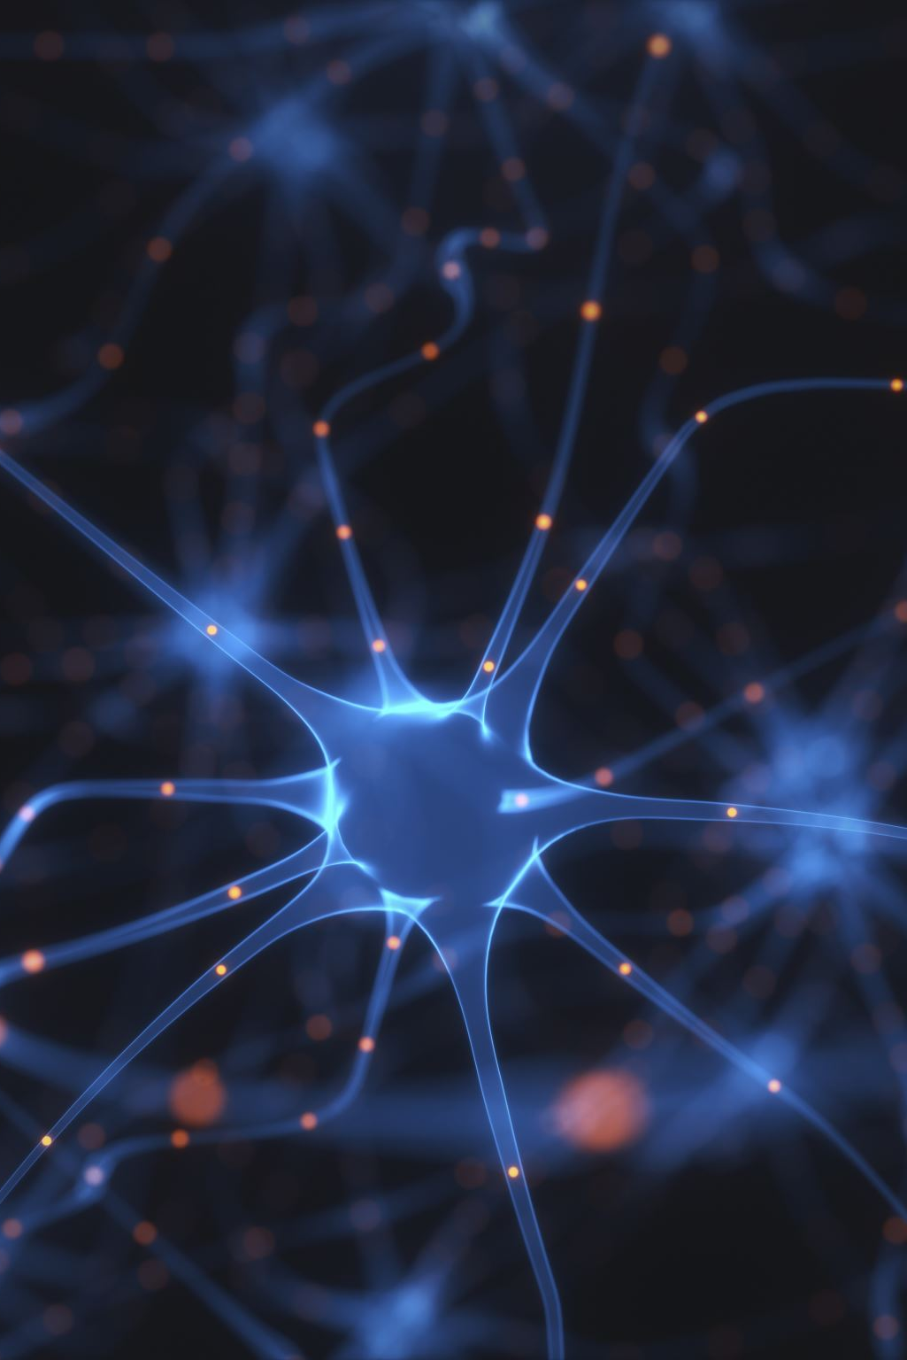
Understanding Neural Network Components
Portfolio Artifact 7
By: Yuvashree Srinivas

Slide 2
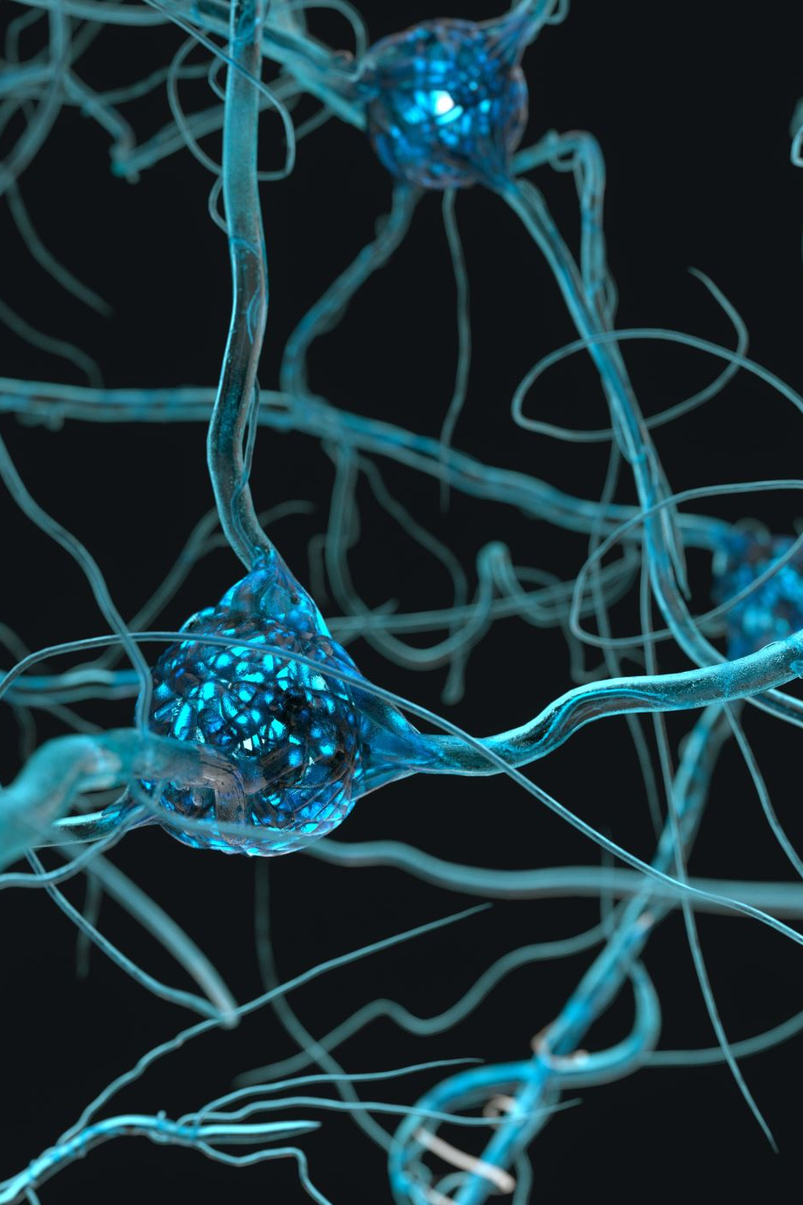
What is a Neural Network?
• A neural network is a computational model inspired by the human brain.
• It consists of layers of interconnected neurons that process input data to identify patterns and make predictions.
• Each connection between neurons carries a weight that determines the influence of the input.

Slide 3
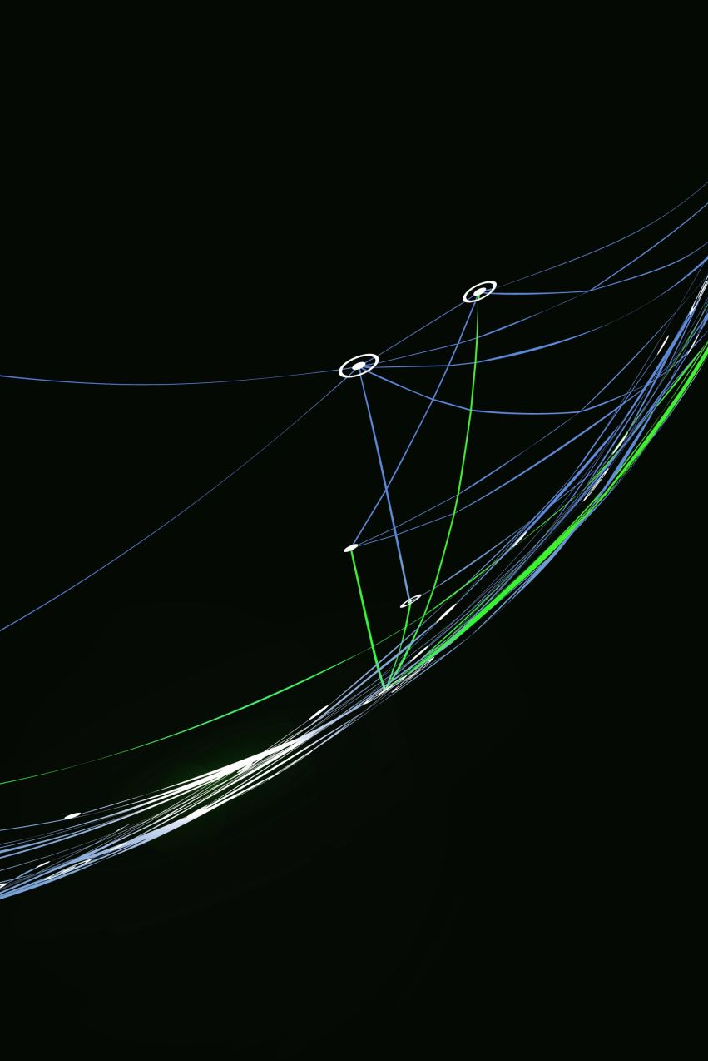
Structure of a Neural Network
• Input Layer – Receives raw data such as numbers or images.
• Hidden Layers – Perform intermediate processing and feature extraction.
• Output Layer – Produces the final prediction or classification result.
Visual: Simple diagram showing Input → Hidden Layers → Output.

Slide 4

Neurons
• Each neuron receives multiple inputs.
• It multiplies each input by a corresponding weight, adds a bias, and passes the result through an activation function.
• Output is then sent to the next layer.
Formula: Output = Activation(Σ(Weight × Input) + Bias)

Slide 5

Weights
• Weights control the strength of connections between neurons.
• Higher weights increase the influence of certain inputs.
• Adjusting weights during training allows the network to learn from errors.

Slide 6
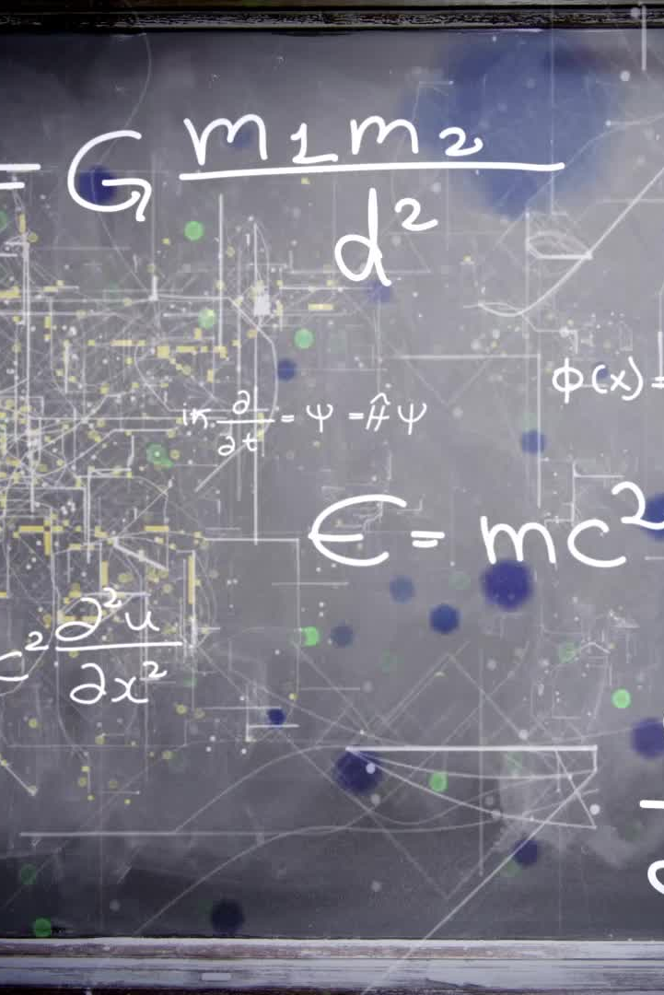
Activation Functions
• Introduce non-linearity to help the network learn complex relationships.
• Common examples:
- ReLU (Rectified Linear Unit): max(0, x)
- Sigmoid: 1 / (1 + e^-x)
- Tanh: (e^x - e^-x) / (e^x + e^-x)

Slide 7

Loss Function
• Measures how far the model’s predictions are from the true values.
• Lower loss = better model performance.
• Examples:
- Mean Squared Error (MSE) – used for regression tasks.
- Cross-Entropy Loss – used for classification problems.

Slide 8

Optimization Algorithms
• Optimization algorithms reduce loss by updating weights iteratively.
• Common optimizers include:
- Gradient Descent
- Stochastic Gradient Descent (SGD)
- Adam (Adaptive Moment Estimation)
• They improve model accuracy and speed up learning.

Slide 9

Neural Network Workflow
Data Flow:
Input Data → Weighted Connections → Activation Functions → Output → Compare with True Values → Adjust Weights via Optimizer.
Visual: A simple arrow flowchart showing how data and feedback loop through the network.

Slide 10
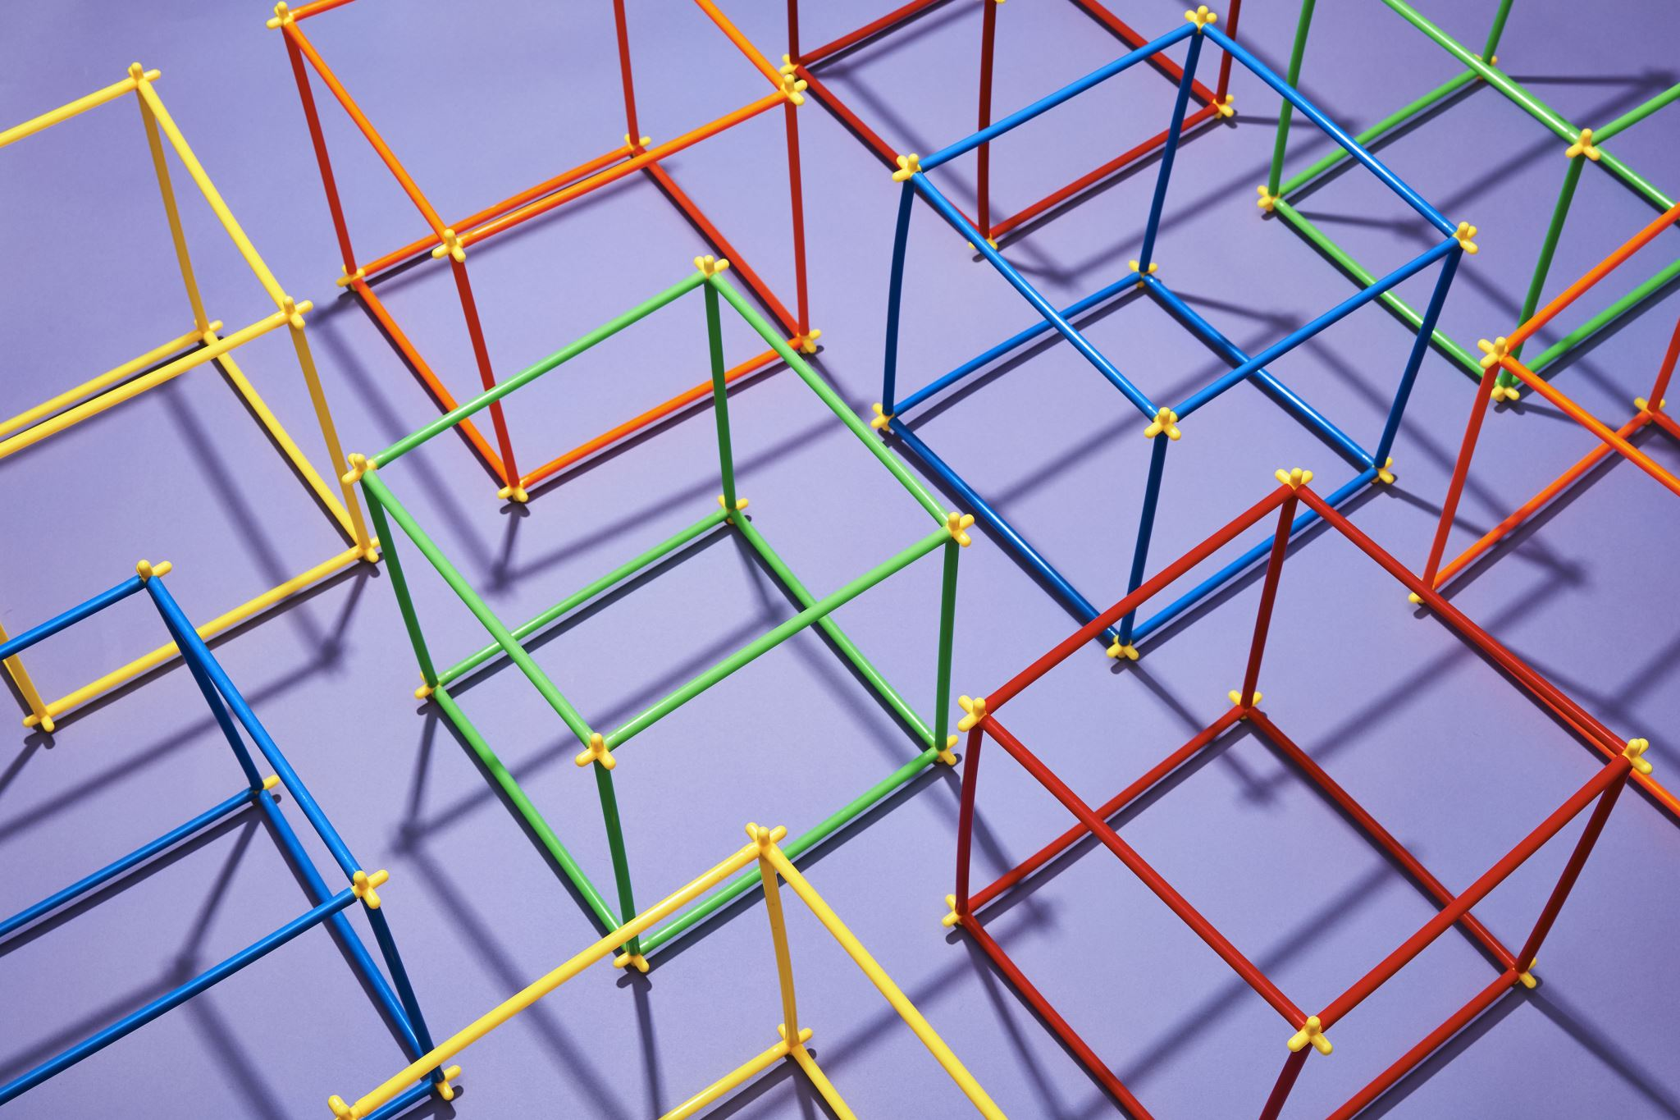
Insights from TensorFlow Playground
• Experimented with different data patterns, layers, and activations.
• Observed that more layers and neurons increase complexity but may slow training.
• Activation choice significantly impacts performance.
• Visualization enhanced understanding of model behavior.

Slide 11

Key Takeaways
• Neural networks learn by adjusting weights based on feedback.
• Activation functions and optimizers control how effectively learning occurs.
• Visualization tools like TensorFlow Playground simplify understanding of complex concepts.

Slide 12
Reflection
Creating this artifact deepened my understanding of how neural networks process and learn from data. Using TensorFlow Playground clarified how small architectural changes affect performance. This exercise improved my ability to explain AI concepts visually—a valuable skill for applying AI insights in my role as an AVP in Retail Banking.

