Slide 1
Employee Data Analysis using Excel
STUDENT NAME: YUVASREE S
REGISTER NO: 47E08D44D447FAAA6E64E009EEDCDA6F
COLLEGE REGISTER NO: 312208821 DEPARTMENT: B.COM [GENERAL] SHIFT II COLLEGE: MEENAKSHI COLLEGE FOR WOMEN

Slide 2
PROJECT TITLE
Employee Performance Analysis using Excel

Slide 3

AGENDA
Problem Statement
Project Overview
End Users
Our Solution and Proposition
Dataset Description
Modelling Approach
Results and Discussion
Conclusion
3/21/2024 Annual Review

Slide 4

PROBLEM STATEMENT
Organizations frequently have an incomplete understanding of the diverse demographics, skillsets, and allocation of their workforce across different departments and business units. This gap hinders their ability to effectively promote diversity, equity, and inclusion within the workplace. Although organizations may gather a significant amount of data on employee characteristics such as age, ethnicity, job title, and salary, they often face challenges in deriving valuable insights from this information. Consequently, they miss out on opportunities to uncover trends, correlations, and areas that need improvement.

Slide 5

PROJECT OVERVIEW
It is fully integrated with accounts to give you the benefits of simplified Payroll processing and accounting. It consists of user-defined classifications and sub-classifications related to the employees, employee groups, pay components, departments etc. It provides the facility to create user-defined earnings and deductions Pay Head. It allows flexible and user-defined criteria for simple to complex calculations attendance, production, time-based remuneration units. It provides flexible payroll processes based on departments, groups, employees, periods or pay components. It provides comprehensive cost centre as well as employee-wise costing report. It facilitates an accurate computation and deduction of Income Tax, ESI, EPF, Professional Tax, Gratuity etc. It facilitates generation of statutory forms, challans and returns of Income Tax, EPF, and ESI in the prescribed formats.

Slide 6

WHO ARE THE END USERS?
The end users of employee data analysis primarily include HR managers and senior management. HR managers use the insights to refine recruitment strategies, enhance employee development programs, and improve retention efforts. Senior management, such as CEOs and department heads, rely on this data for strategic decision-making, workforce optimization, and aligning HR initiatives with broader business objectives.

Slide 7

OUR SOLUTION AND ITS VALUE PROPOSITION
FILTERING : We monitor each department analysis report
with the help of filtering
CONDITIONAL FORMATTING: Makes it easy to highlight
certain values or to make particular cells easy to
identify.
PIVOT TABLE : we separate gender type in column table
With the help of pivot table analysis report. FORMULA : SUM Function in excel is useful for adding up a range of values such as a column or row of numbers.
PIE GRAPH – Final Report with the help of pivot table
analysis

Slide 8



Dataset Description
Employee Data Set- Nan Mudhalvan Portal9
Features In Total3 Features Being Used For
Analysis employee Id- Alphanumeric(text)name alphabetical (Text)gender alphabetical(text)department alphabetical(text)salary- Numerical start Date - Alphanumeric(text) fte- Numerical employee Type alphabetical (Text)employee Location alphabetical(text)

Slide 9

THE "WOW" IN OUR SOLUTION
The standout feature of our employee data analysis solution is its capability to transform complex and often overwhelming data into clear, visually engaging insights that lead to tangible business results. What differentiates our solution is the effortless combination of advanced analytics with a user-friendly interface, empowering even non-technical users to discover deep insights with minimal effort. The platform’s real-time data processing and predictive analytics functionalities enable organizations to comprehend not only historical and current workforce dynamics but also to foresee future trends and challenges. It's about converting that data into a strategic asset that drives the organization forward.
3/21/2024 Annual Review

Slide 10
MODELLING
Step 1 :Download The Employee Dataset In Naan Mudhalvan Portal And Open
The Excel.
Step 2 :Select The Data And Coverted Into Table
Step 3 :Select The Entire Data Table And Click On Insert Menu Then Select Pivot Table.
Step 4:the Pivot Table Shows Field Section And Drag The Field According To
Our Project.
Step 5 :The Final Report Given By PIE Graph With The Help Of Pivot Chart
Analysis Report Drag The Needed Data And Create A Pivot Table Step 6: The Table And Chart Is Being Created , Which Helps In Better Understanding And Interpretation Of Data.

Slide 11
RESULTS
1.TABLE
Sum of Salary | Column Labels
Row Labels | Fixed Term | Permanent | Temporary | Grand Total
Accounting | 210026.99 | 970133.38 | 195893.41 | 1376053.78
Business Development | 282340.75 | 1170550.39 | 146720.76 | 1599611.9
Engineering | 183397.77 | 578659.92 | 238334.53 | 1000392.22
Human Resources | 338518.85 | 403495.28 | 159716.94 | 901731.07
Legal | 103885.74 | 739156.17 | 238172.67 | 1081214.58
Marketing | 31816.57 | 549282.11 | 70755.5 | 651854.18
NULL | 51165.37 | 548965.36 |  | 600130.73
Product Management | 281368.42 | 763450.46 | 307401.35 | 1352220.23
Research and Development | 99683.67 | 523726.74 | 184150.5 | 807560.91
Sales | 84598.88 | 426234.76 | 83191.95 | 594025.59
Services | 121134.11 | 895624.29 | 223630.98 | 1240389.38
Support | 299427.31 | 605920.33 | 157212.28 | 1062559.92
Training | 499439.95 | 573746.17 | 476941.58 | 1550127.7
Grand Total | 6524646.04 | 6771621.94 | 2482122.45 | 13817872.19

Slide 12
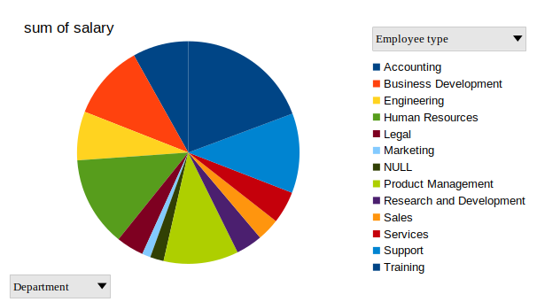
2.PIE DIAGRAM

Slide 13
conclusion
In summary, analyzing employee data is crucial for organizations looking to improve their workforce and boost overall business outcomes. By utilizing insights derived from data, companies can make well-informed choices regarding hiring, employee retention, performance evaluation, and pay structures. This leads to a more motivated and efficient workforce. In the end, effective analysis of employee data enables organizations to create a stronger and more adaptable team, fostering long-term success and a competitive advantage.

