Slide 1

TEAM NAME : HACKETTES
TEAM DETAILS: YUVIKA MISHRA
SADIYA FAIZAN

Slide 2

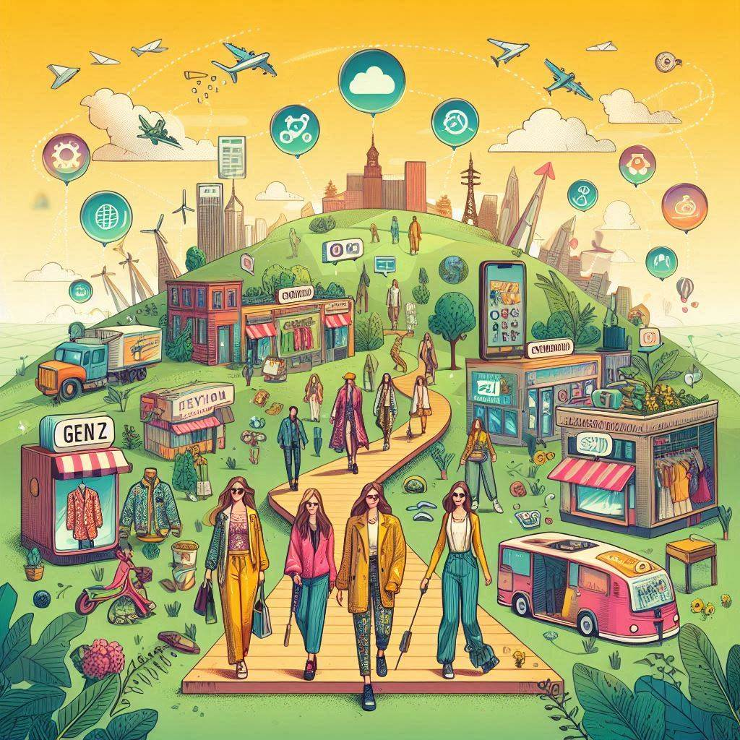
PROBLEM STATEMENT
Gen Z Craves unique, sustainable fashion experiences, requiring a revolutionary platform with cutting-edge tech and innovative engagement for social connectivity.
Develop an interactive platform tailored for fast fashion enthusiasts, positioning Myntra as the top destination for trend-savvy shoppers.
Create engagement constructs to connect with younger audiences, fostering a sense of community and virality with fashion-focused content.
Develop features that offer more than just transactional experiences, building a fashion ecosystem that combines shopping with lifestyle and trend content.
To address the growing demand for sustainability by promoting eco-friendly practices and community support.
Where Fashion Meets Social: The Future of Online Shopping

Slide 3
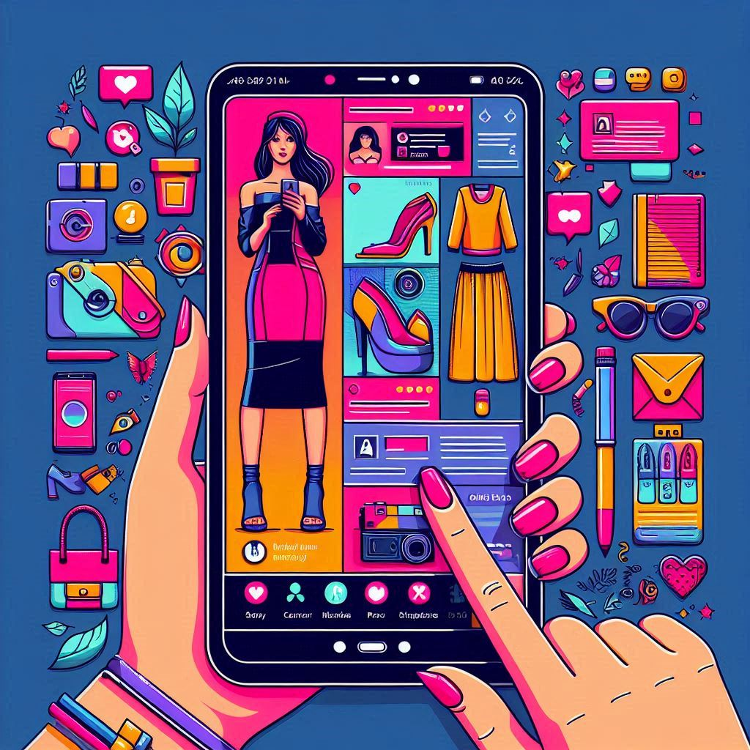
SOLUTION
TREND-MOSAIC
  Personalized Fashion Boards
    User-Created Boards: Allow users to create and organize their own fashion boards by category, such as "Summer Outfits," "Workwear," or "Party Dresses."
    Follow and Share Boards: Enable users to follow friends, influencers, or brands and share their boards on social media platforms.
    Influencer Boards: Curate boards from fashion influencers, allowing users to shop the looks directly from these boards.
  Outfit Inspiration
    Outfit Suggestions: Automatically generate outfit suggestions based on the items saved in a user's board.
C. Collaborative Boards
    Group Boards: Allow multiple users to contribute to a single board, ideal for planning events like weddings or group shopping experiences.
    Comment and Chat: Enable users to comment and chat on items within a board for collaborative decision-making.
    Interactive Polls: Allow users to create polls within boards to get opinions from friends and the community on what to buy.
D. Gamification
1. Rewards and Badges: Offer rewards and badges for users who frequently use boards, such as "Top Stylist" or
"Fashion Guru."
2. Challenges: Create style challenges where users can compete to create the best board for a chance to win discounts or prizes.
Where Fashion Meets Social: The Future of Online Shopping

Slide 4
E. Wishlist And Exclusive Collections
Early Access: Give users early access to new arrivals or sales for items saved in their boards. Notify users when items saved in their boards go on sale or come back in stock.
Seamless Wishlist: Integrate boards with the user's wishlist so they can easily move items between their wishlist and various boards.
II. WARM THREADS
A. Seamless Connections
Easily find local NGOs accepting clothing donations with a curated list of nearby organizations.
B. Simple Donation Process and Community Engagement
Select items to donate and arrange a drop-off or pick-up with your chosen NGO. Track the impact of your donations. Join a network of givers, share experiences, and support local efforts to strengthen your community.
III. CHIC MIRAGE
Design with Ease
Effortlessly mix and match your favorite pieces to create the perfect look. From chic dresses to stylish accessories, see how every item comes together on a lifelike AI model.Explore endless combinations and styles. Experiment with bold new trends or classic ensembles without the need for physical try-ons.
Where Fashion Meets Social: The Future of Online Shopping

Slide 5
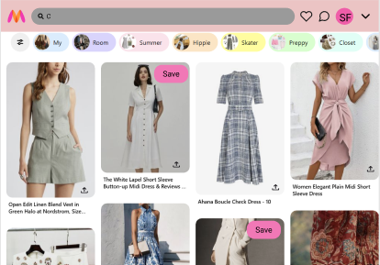
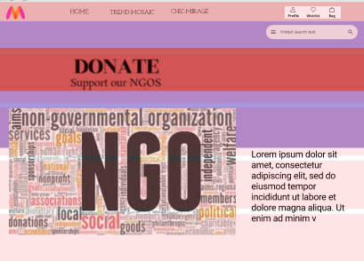
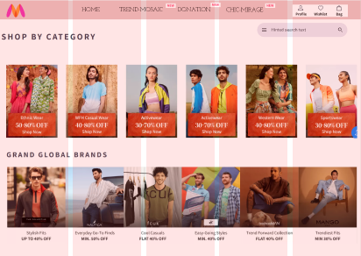
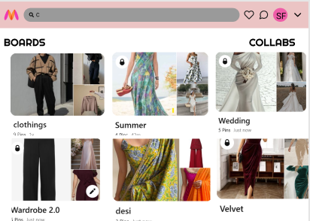
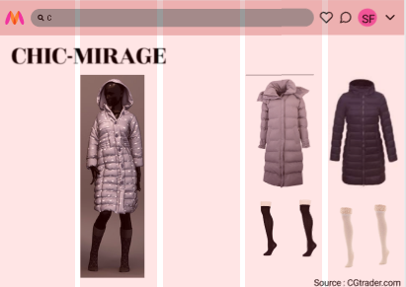
SAMPLE DESIGN
Where Fashion Meets Social: The Future of Online Shopping

Slide 6
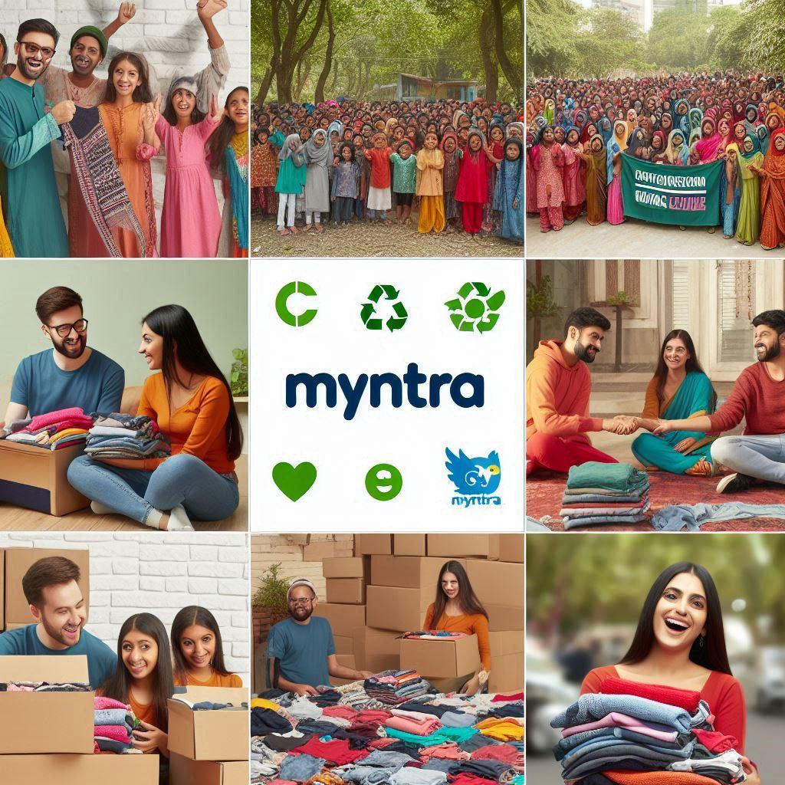
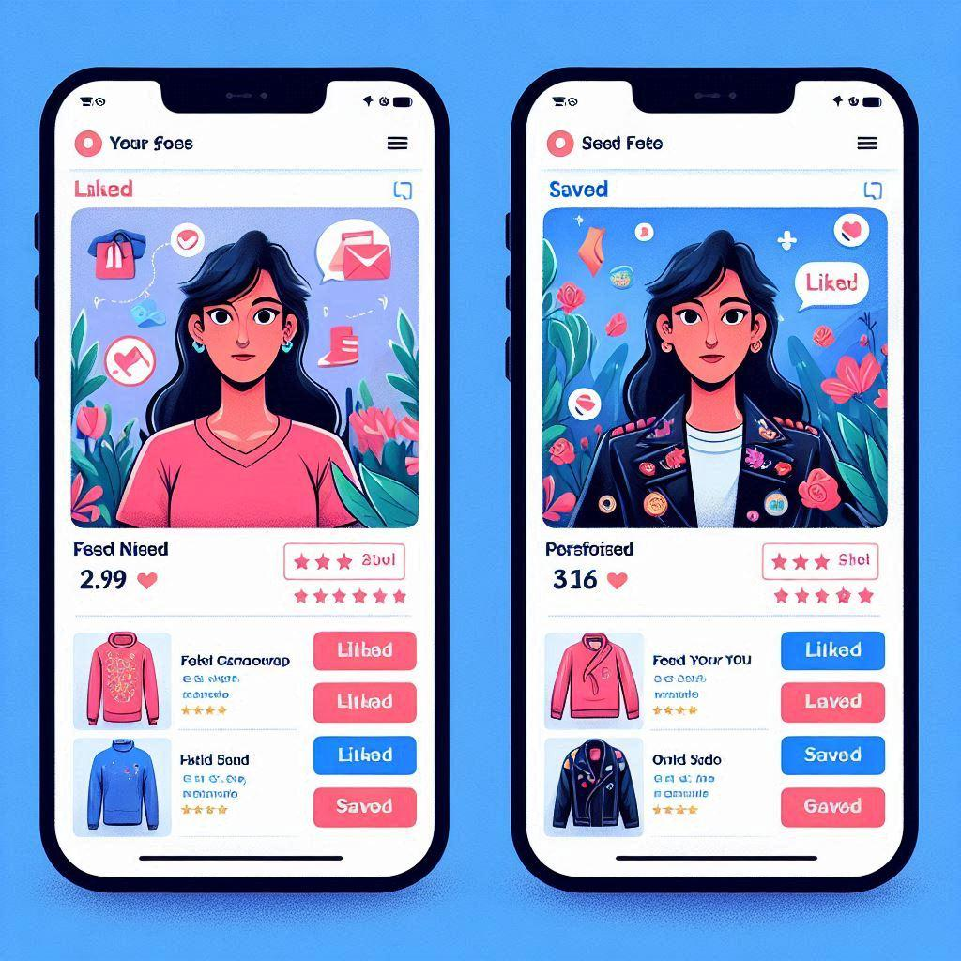
BENEFITS
1. Increased user engagement and time spent on app.
2. Enhanced personalization leading to higher customer satisfaction.
3. Improved social sharing and brand expanding .
4. Exclusive content driving brand loyalty and FOMO.
5. Sustainability initiative enhancing brand image and social responsibility.
6. Gamification elements encouraging regular app usage.
7. AR/VR features reducing return rates and improving fit satisfaction.
8. Creation of a fashion-focused community, positioning Myntra as a lifestyle brand.
9. Increased viral potential through user-generated content
10. Higher customer lifetime value through deeper platform integration.
11. Seamless cross-platform experience improving user retention.
Where Fashion Meets Social: The Future of Online Shopping

