Slide 1
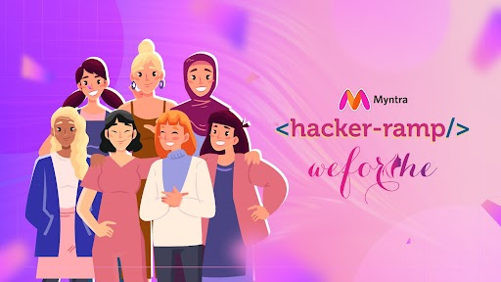
TEAM NAME : HACKETTES
TEAM DETAILS: YUVIKA MISHRA
SADIYA FAIZAN

Slide 2

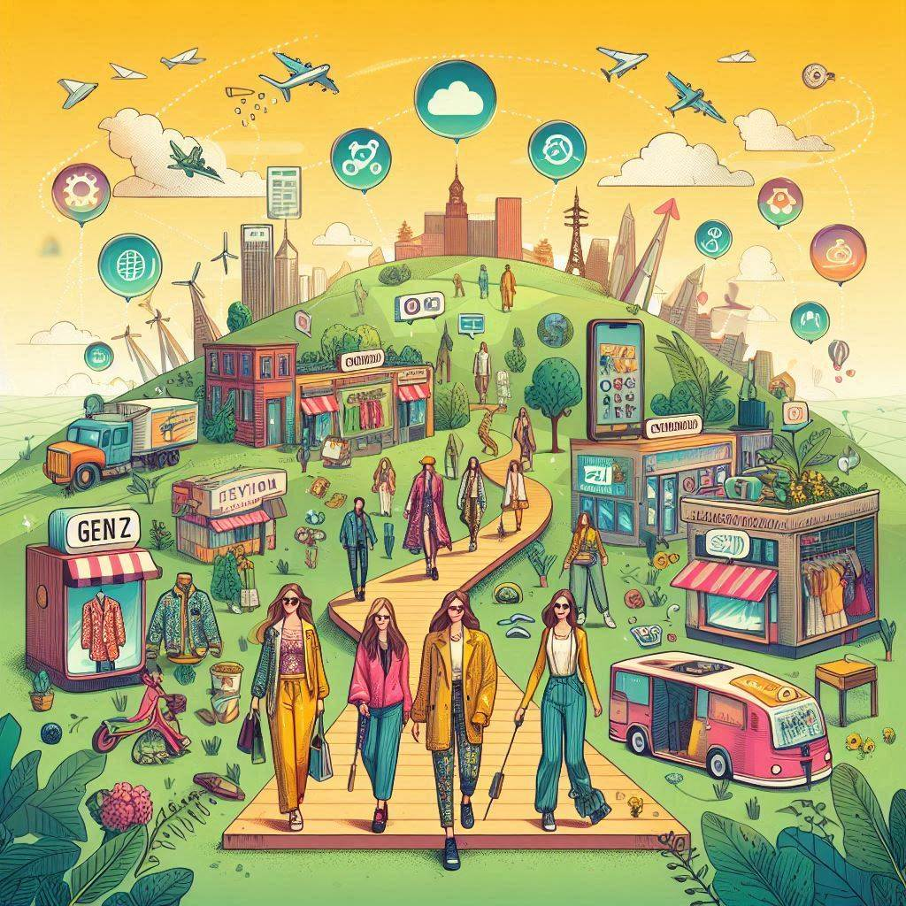
PROBLEM STATEMENT
Gen Z Craves unique, sustainable fashion experiences, requiring a revolutionary platform with cutting-edge tech and innovative engagement for social connectivity.
Develop an interactive platform tailored for fast fashion enthusiasts, positioning Myntra as the top destination for trend-savvy shoppers.
Create engagement constructs to connect with younger audiences, fostering a sense of community and virality with fashion-focused content.
Develop features that offer more than just transactional experiences, building a fashion ecosystem that combines shopping with lifestyle and trend content.
To address the growing demand for sustainability by promoting eco-friendly practices and community support.
Where Fashion Meets Social: The Future of Online Shopping

Slide 3
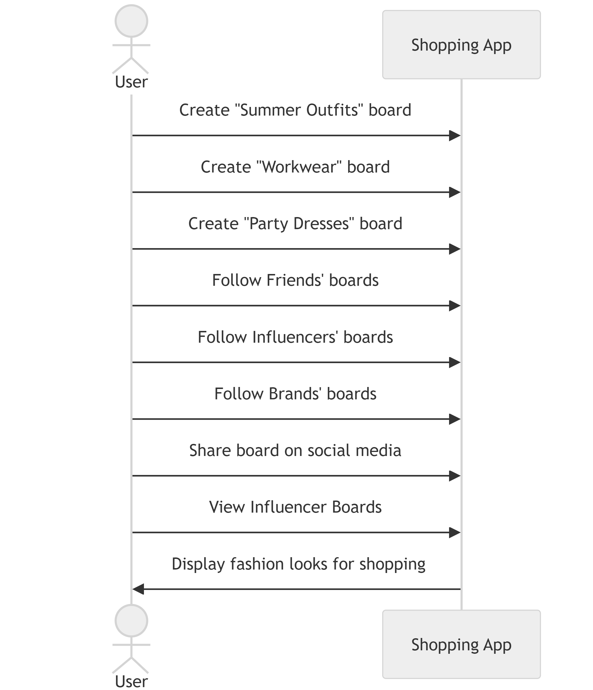
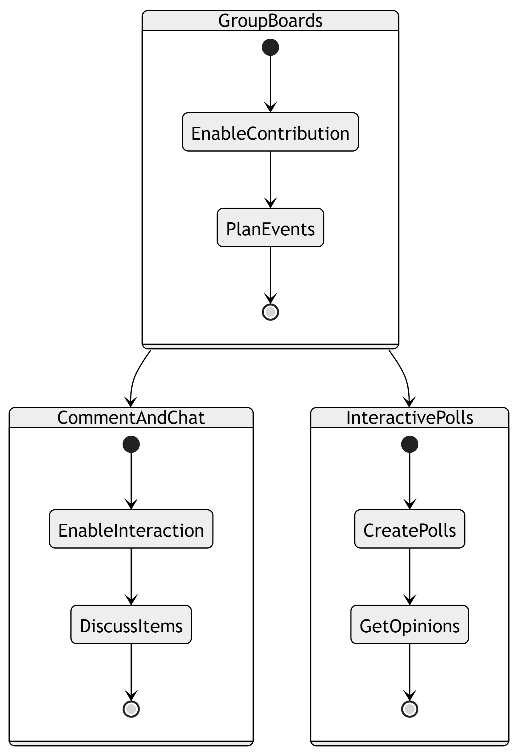


SOLUTION
I. TREND-MOSAIC
A. Personalized Fashion Boards
1.User-Created Boards: Users can create fashion boards .
2.Follow and Share Boards: Follow and share boards
on social media.
3. Influencer Boards: Curate and shop looks from influencers.
B. Collaborative Boards
1. Group Boards: Multiple users can contribute.
2. Comment and Chat: Comment and chat on items.
3. Interactive Polls: Create polls for opinions.
Where Fashion Meets Social: The Future of Online Shopping

Slide 4

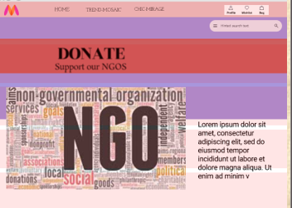

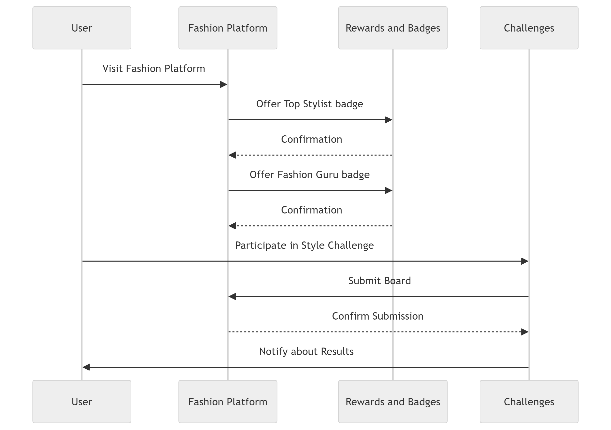
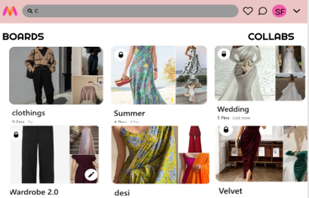
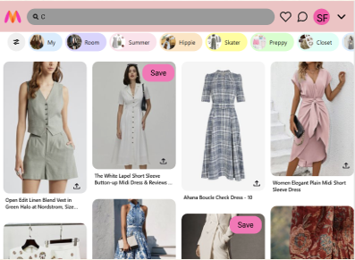
C. Gamification
1. Rewards and Badges: Offer rewards and badges for users who frequently use boards, such as "Top Stylist" or "Fashion Guru.“
2. Challenges: Create style challenges where users can compete to create the best board for a chance to win discounts or prizes.
D. Wishlist And Exclusive Collections
Early Access: Early access to new arrivals and sales.
Seamless Wishlist: Integrate boards with the user's wishlist for easy move
between wishlist and various boards.
Where Fashion Meets Social: The Future of Online Shopping
Sample Designs

Slide 5
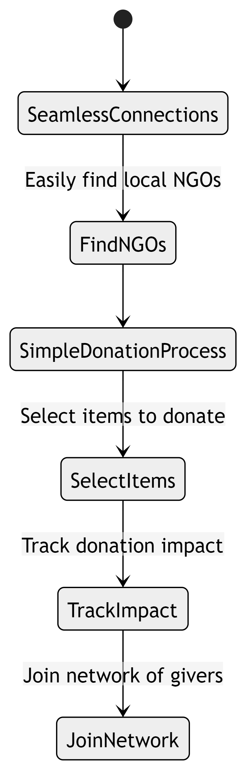

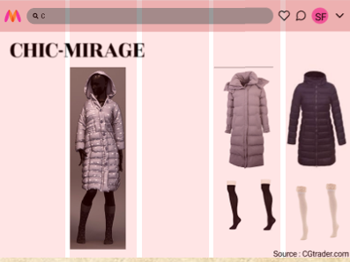
WARM THREADS
A. Seamless Connections
Find local NGOs for clothing donations.
B. Simple Donation Process and Community Engagement
1. Select items, arrange drop-off/pick-up.
2. Track impact and join a network of givers.
CHIC MIRAGE
Design with Ease
1. Mix and match pieces on a lifelike AI model.
2. Explore endless styles and trends.
Sample Design
Where Fashion Meets Social: The Future of Online Shopping

Slide 6
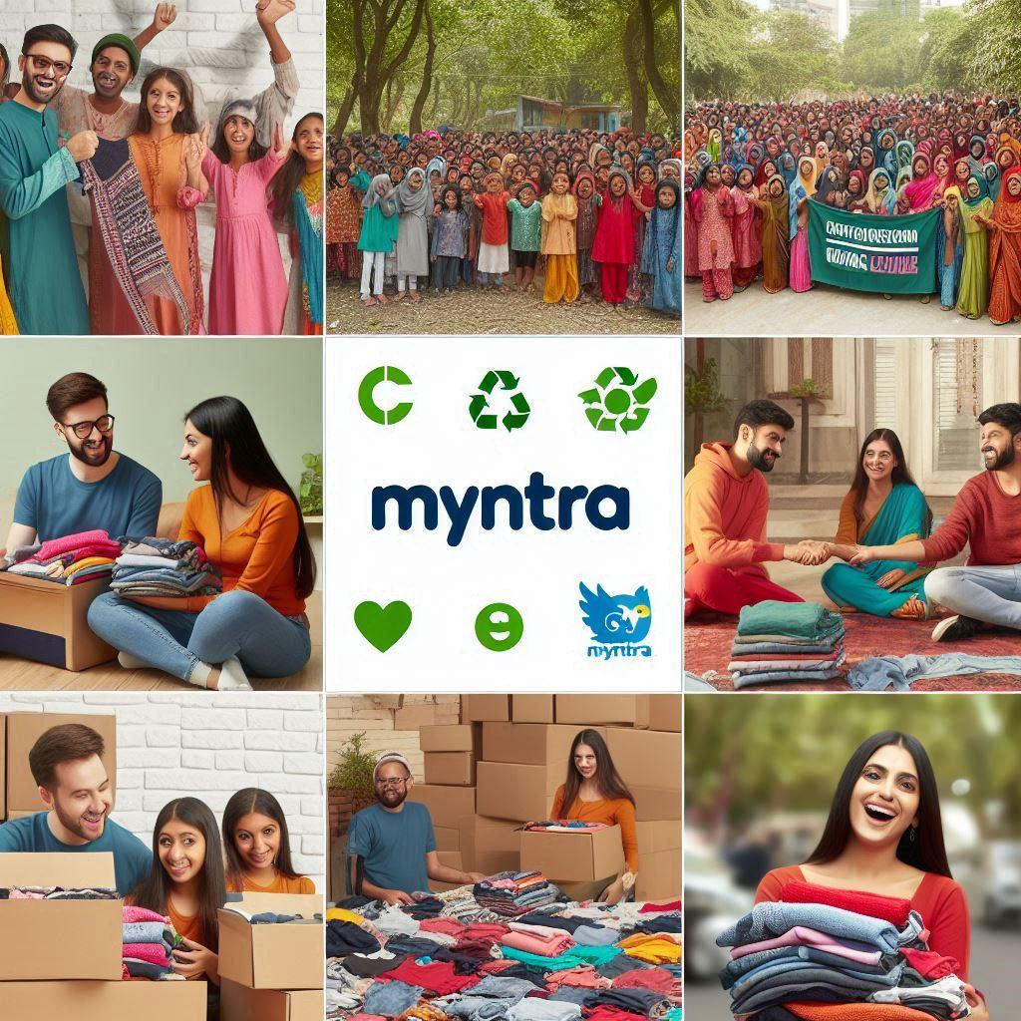
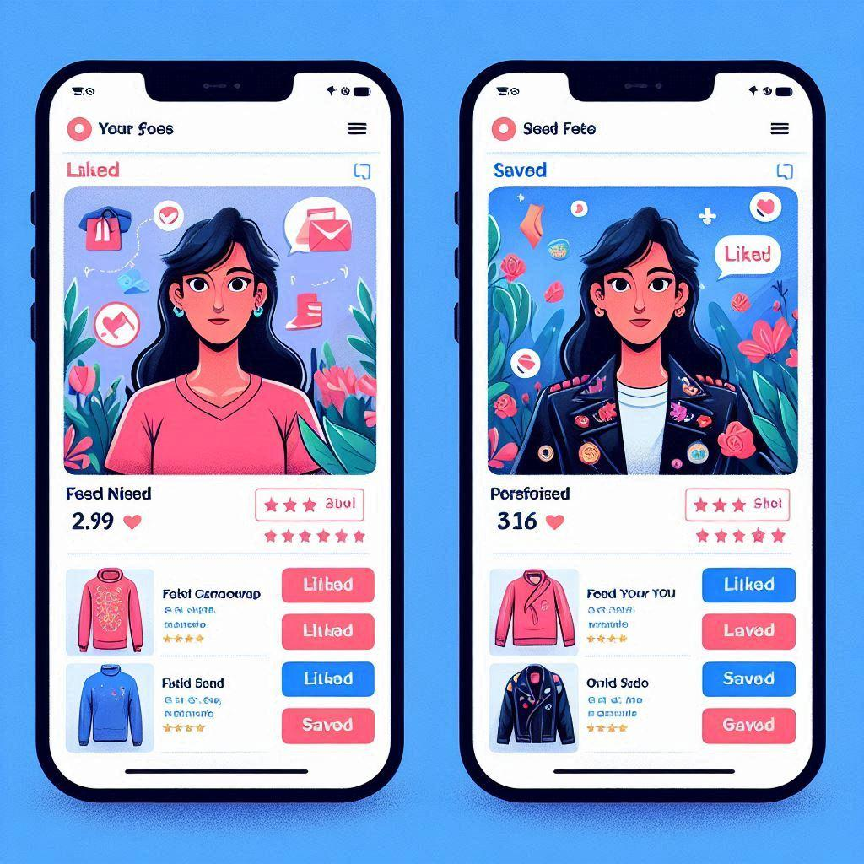
BENEFITS
1. Increased user engagement and time spent on app.
2. Enhanced personalization leading to higher customer satisfaction.
3. Improved social sharing and brand expanding .
4. Exclusive content driving brand loyalty and FOMO.
5. Sustainability initiative enhancing brand image and social responsibility.
6. Gamification elements encouraging regular app usage.
7. AR/VR features reducing return rates and improving fit satisfaction.
8. Creation of a fashion-focused community, positioning Myntra as a lifestyle brand.
9. Increased viral potential through user-generated content
10. Higher customer lifetime value through deeper platform integration.
11. Seamless cross-platform experience improving user retention.
Where Fashion Meets Social: The Future of Online Shopping

