Slide 1
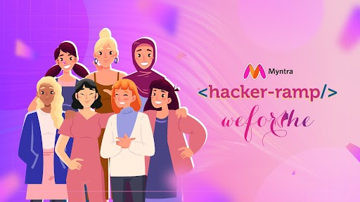
TEAM NAME : HACKETTES
TEAM DETAILS: YUVIKA MISHRA
SADIYA FAIZAN

Slide 2
PROBLEM STATEMENT
Gen Z Craves unique, sustainable fashion experiences, requiring a revolutionary platform with cutting-edge tech and innovative engagement for social connectivity.
Interactive Platform: Position Myntra as the top destination for trend-savvy shoppers..
Engagement: Connect with younger audiences through fashion-focused content..
Features: Build a fashion ecosystem combining shopping with lifestyle and trend content.
Sustainability: Promote eco-friendly practices and community support.
Where Fashion Meets Social: The Future of Online Shopping

Slide 3
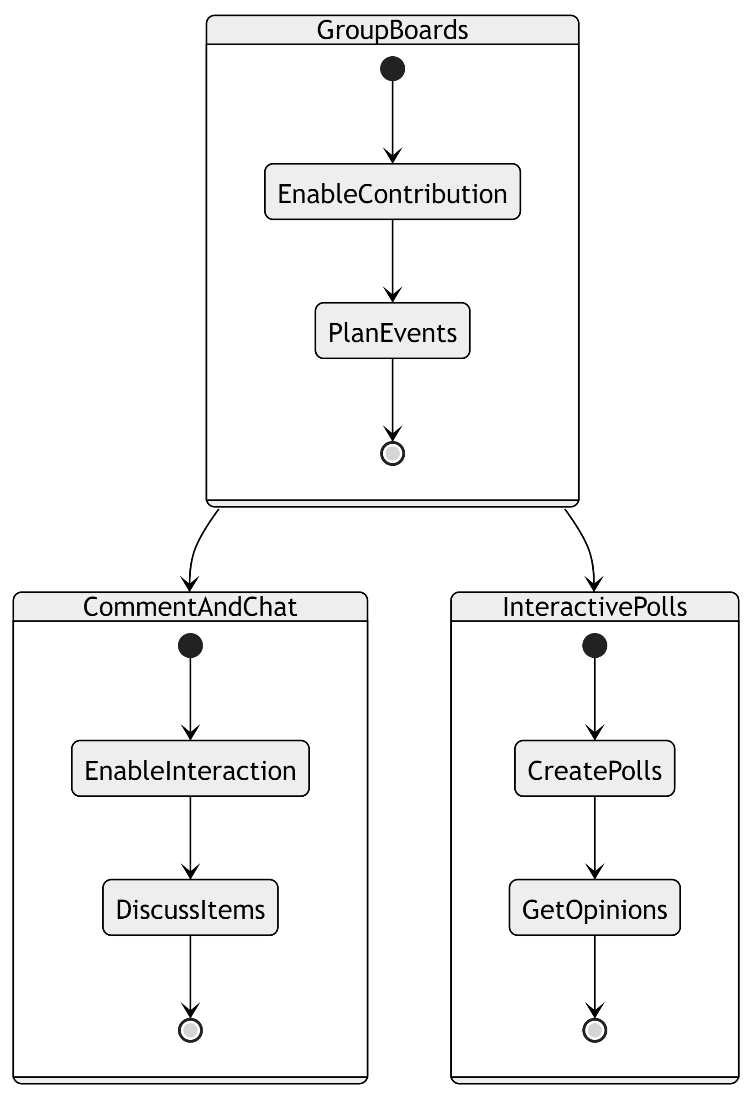



TREND-MOSAIC
1. Collaborative Boards
1. Group Boards: Multiple users can contribute.
2. Comment and Chat: Comment and chat on items.
3. Interactive Polls: Create polls for opinions.

Slide 4
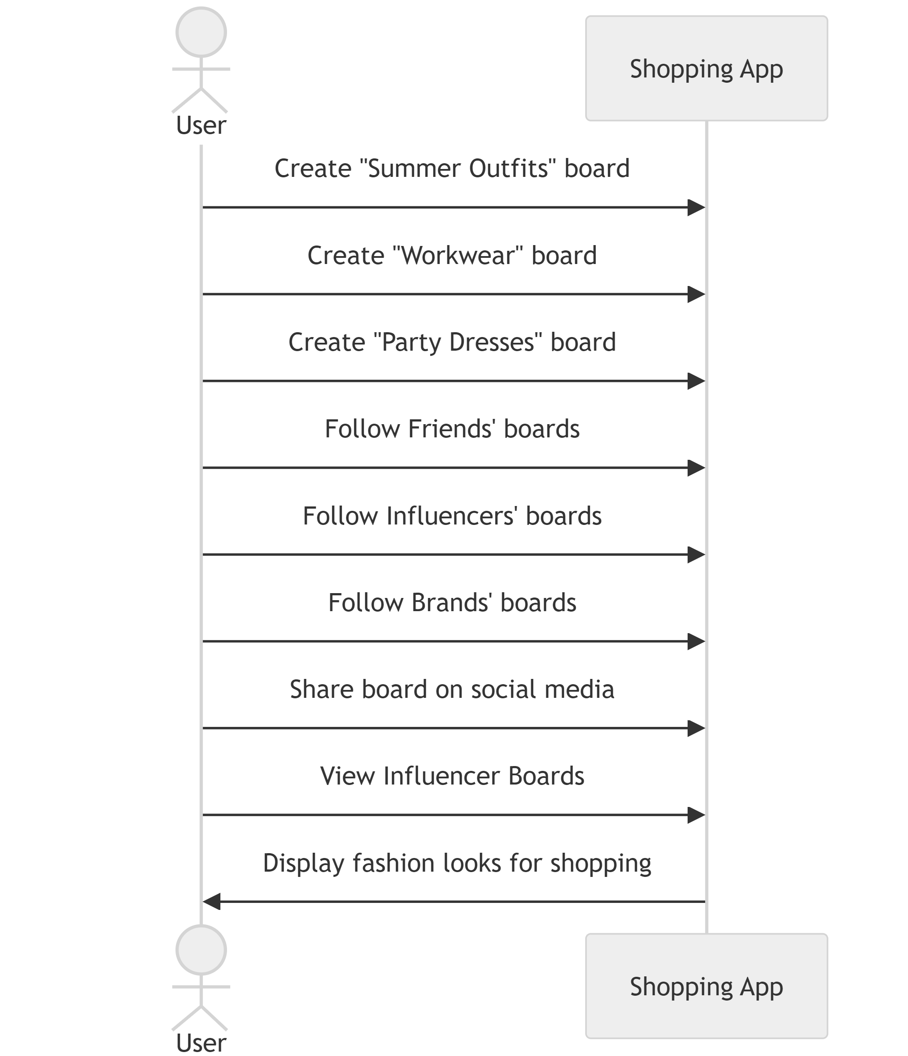
B. Personalized Fashion Boards
1.User-Created Boards: Users can create fashion boards .
2.Follow and Share Boards: Follow and share boards
on social media.
3. Influencer Boards: Curate and shop looks from influencers.

Slide 5
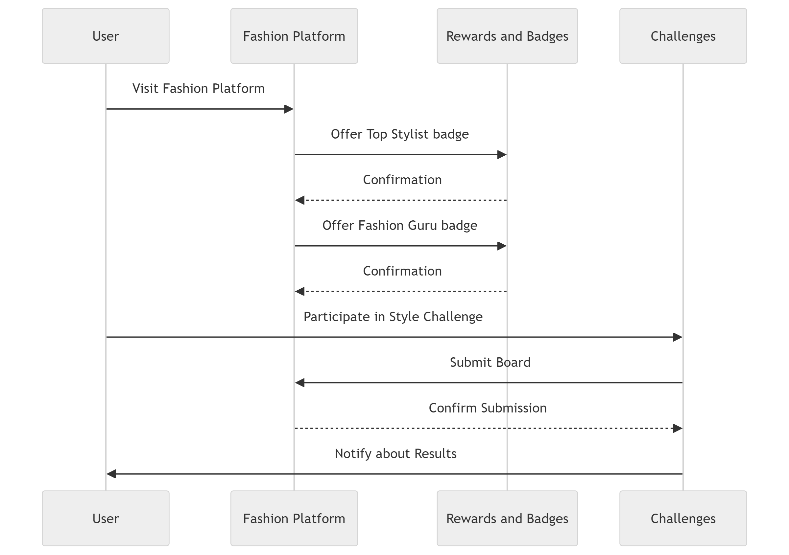
C. Gamification
1. Rewards and Badges: Offer rewards and badges for users who frequently use boards, such as "Top Stylist" or "Fashion Guru.“
2. Challenges: Create style challenges where users can compete to create the best board for a chance to win discounts or prizes

Slide 6
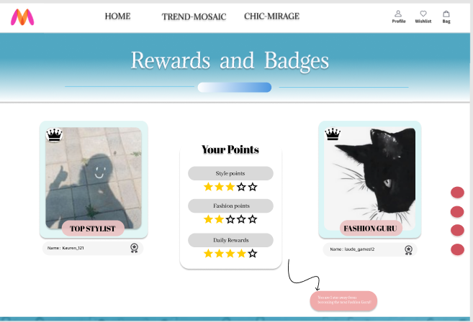
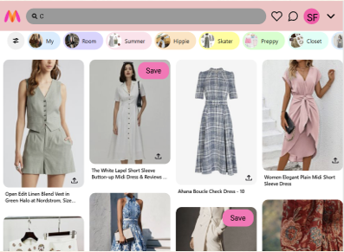
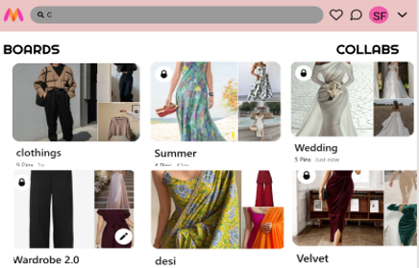
D. Wishlist And Exclusive Collections
Early Access: Early access to new arrivals and sales.
Seamless Wishlist: Integrate boards with the user's wishlist for easy move
between wishlist and various boards.

Slide 7
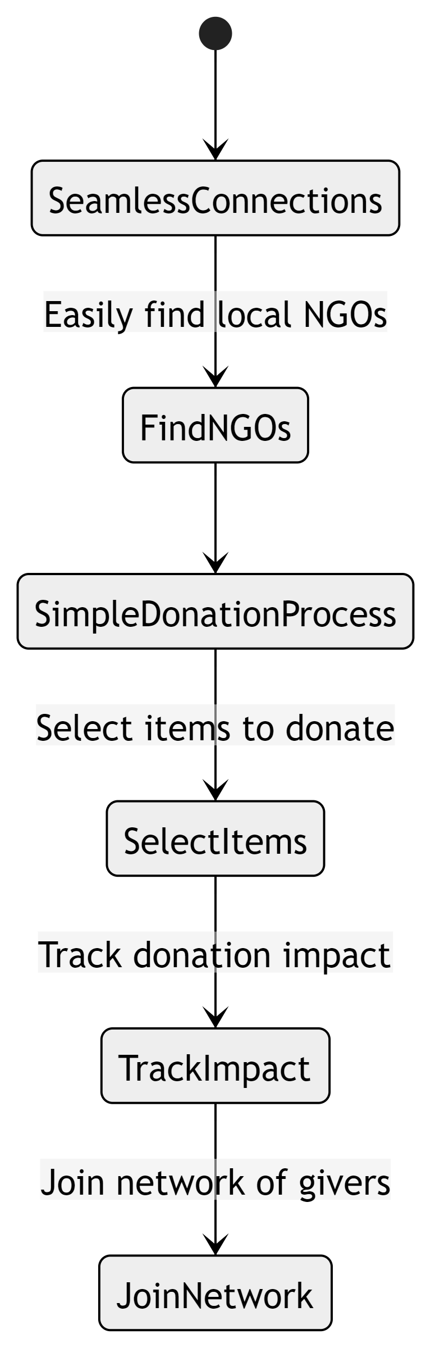
WARM THREADS
A. Seamless Connections
Find local NGOs for clothing donations.
B. Simple Donation Process and Community Engagement
1. Select items, arrange drop-off/pick-up.
2. Track impact and join a network of givers.

Slide 8




TECH - STACK
JavaScript
Bootstrap
React
Webpack
FRONTEND

Slide 9



BACKEND
Express.js
Node.js
DATABASE
Mongo DB

