Slide 1
Advanced Resume Builder
Build Your Resume Offline in 2 minutes

Slide 2
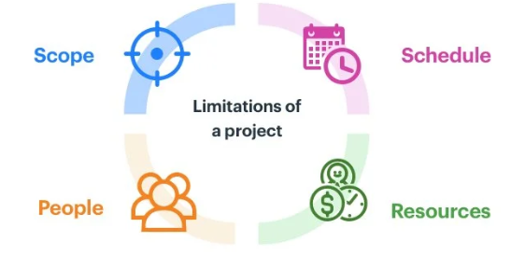
Project Overview
What is Advanced Resume Builder?
Professional resume creation tool
A4 PDF format output
Real-time preview functionality
Modern, responsive design
Client-side data processing (privacy-focused)
No server dependencies required

Slide 3

Problem Statement
Why This Project?
Traditional resume builders lack customization
Most tools require paid subscriptions
Limited template options available
No real-time preview functionality
Data privacy concerns with cloud storage
Complex interfaces for simple tasks

Slide 4
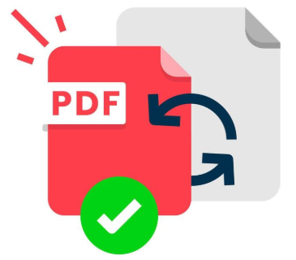



Project Objective
Essential Features
Real-time Resume Preview: Live A4 format preview
Multiple Templates: Modern and Classic layouts
PDF Export: Direct browser-based PDF generation
Drag & Drop: Reorder sections easily
Auto-save: Browser storage with no data loss
Mobile Responsive: Works on all devices

Slide 5





Key Features
Advanced Customization Options
Color Themes: Custom accent colors
Font Scaling: Adjustable text sizes
Page Breaks: Manual page break control
Section Reordering: Flexible layout arrangement
Photo Upload: Profile picture integration
Export/Import: JSON data backup

Slide 6


Use Technology
Technology Stack & Structure
Frontend:
HTML5 (Semantic markup)
CSS3 (Grid, Flexbox, Custom Properties)
Vanilla JavaScript (ES6+)
Features:
Component-based architecture
State management system
Local storage integration
Print-optimized CSS

Slide 7
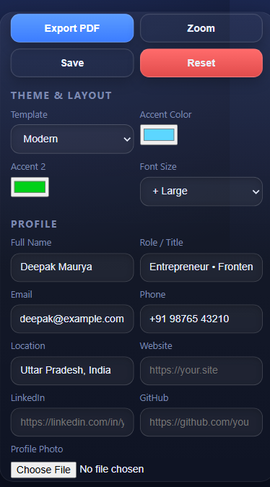
User Interface Design
Modern & Intuitive Design
Glassmorphism Effects: Modern visual design
Gradient Backgrounds: Eye-catching aesthetics
Responsive Layout: Grid-based structure
Interactive Elements: Hover effects and animations
Clean Typography: Readable font system
Go To Website :- https://inf-resume-builder.netlify.app/

Slide 8
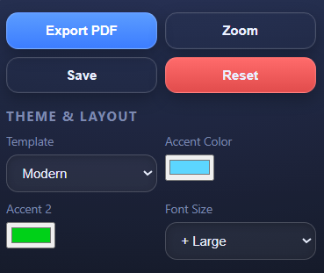
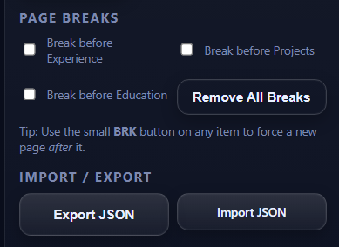
Advanced Features
Professional Capabilities
Force One Page: Auto-scaling for single page
Page Break Control: Manual pagination
Template Switching: Instant layout changes
Data Validation: Input error prevention
Accessibility: Screen reader friendly
Cross-browser Support: Universal compatibility

Slide 9

Data Management
Privacy & Storage
Local Storage: No server required
JSON Export/Import: Data portability
Auto-save: Automatic data preservation
No Data Transmission: Complete privacy
Offline Functionality: Works without internet
Reset Options: Clean slate capability

Slide 10

Technical Implementation
Key Code Components
State Management: Centralized data handling
Event Binding: Dynamic form interactions
Template System: Modular HTML generation
CSS Variables: Dynamic theming
Print Optimization: Media queries for PDF
Drag & Drop API: Native browser features

Slide 11
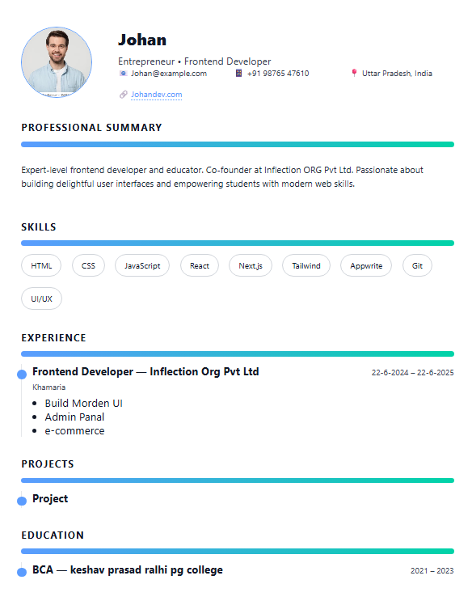
User Experience Flow
Application Workflow
Setup: Choose template and colors
Profile: Enter personal information
Content: Add sections (experience, education)
Customize: Adjust layout and breaks
Preview: Real-time A4 preview
Export: Generate PDF or save data

Slide 12

Testing & Compatibility
Quality Assurance
Browser Testing: Chrome, Firefox, Safari, Edge
Device Testing: Desktop, tablet, mobile
Print Testing: PDF generation accuracy
Performance Testing: Load time optimization
Accessibility Testing: Screen reader compatibility
Data Integrity: Save/load functionality

Slide 13

Challenges & Solutions
Development Hurdles
Challenges:
A4 PDF formatting accuracy
Cross-browser print compatibility
Complex state management
Responsive design for all devices
Solutions:
CSS mm units for precise sizing
Print-specific media queries
Centralized state object
Flexible grid layouts

Slide 14


Future Enhancements
Planned Updates & Features
Version 2.0 Features:
Additional Templates: 5+ new professional layouts
Theme Library: Pre-built color schemes
Cloud Sync: Optional cloud storage
AI Suggestions: Content recommendations
Multi-language: Internationalization support
Collaboration: Share and review features
Technical Improvements:
Performance: Faster rendering
Accessibility: WCAG 2.1 compliance
PWA: Progressive Web App features

Slide 15

Conclusion
Key Achievements:
Professional-grade resume builder
Zero-dependency web application
Modern UI/UX implementation
Skills Developed:
Advanced CSS techniques
Complex JavaScript applications
Print media optimization
User experience design

Slide 16
Thank you !

