Slide 1
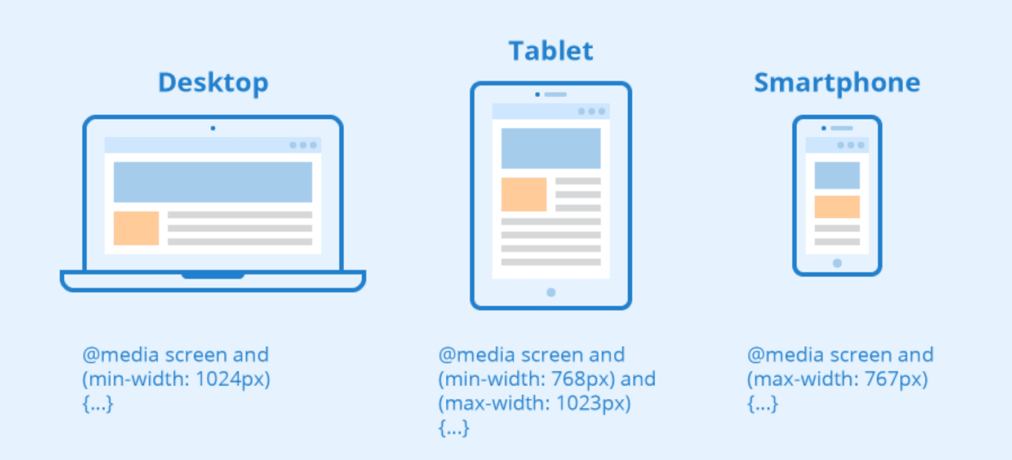
CSS Modules and Media Queries

Slide 2
Media-query-react
Media queries are a key part of responsive web design, as they allow you to create different layouts depending on the size of the viewport.
As you know how to install and use radium so now we can use media queries in our react component example.js or whatever JS file you are working on.
In the given example, we have added a query if the width of the device is less than 501px then our app will display nothing.

Slide 3
App.js file ->
import React, { Component } from "react";
import Radium, { StyleRoot } from "radium";
// Importing our Example component(src folder)
import Example from "./Example";
class App extends Component {
render() {
return (
// Wrapping in styleroot
<StyleRoot>
<div className="App">
<Example />
</div>
</StyleRoot>
);
}
}
export default Radium(App);

Slide 4
Example.js file->
import React, { Component } from "react";
import Radium, { StyleRoot } from "radium";
class App extends Component {
render() {
const style = {
// Adding media query..
"@media (max-width: 500px)": {
display: "none",
},
color: "red",
};
return (
// Wrapping under styleroot.
<StyleRoot>
<div className="App">
<h1 style={style}>
This text will disapper if width of screen is less than 500px.
</h1>
</div>
</StyleRoot>
);
}
}
export default Radium(App);

Slide 5
Combining multiple types in media query
The and keyword combines a media feature with a media type or other media features. This example combines two media features to restrict styles to landscape-oriented devices with a width of at least 768px.
@media (min-width: 768px) and (orientation: landscape) { ... }
You can have a set of CSS properties that will only apply when the browser window is wider than its height, a so called "Landscape" orientation.

Slide 6
CSS MODULES
What is CSS Modules?
CSS Modules in React
If you have some experience dealing with stylesheets in large web applications, then you likely know that, sometimes, naming classes can be challenging and conflicts are not only possible, but probable if you’re not careful enough. Have you ever asked yourself: How can I make CSS classes locally scoped to a component? In this article, you’ll find an excellent way of doing so, CSS Modules. Just keep reading!

Slide 7
What is CSS module?
A CSS module is, in simple words, a CSS file. But with a key difference: by default, when imported, every class name and animation inside a CSS module is scoped locally to the component that is importing it. This allows you to use virtually any valid name for your classes, without worrying about conflicts with other class names in your application. CSS modules also allow you to extend one or more classes, inheriting their styles. This concept is called class composition.

Slide 8
How to use CSS Modules?
Using CSS modules is really, really simple:
First, create a normal CSS file. If your application uses create-react-app v2+, you need to name this file following the [name].module.css convention.
Add CSS classes to this file. Any valid CSS class name is acceptable, but it’s recommend to use camelCase for classes with more than one word. The reason for this is that you’ll access these classes later as properties of a JS object and, if you want to use the dot notation (e.g. yourObj.someProperty), hyphens are not syntactically allowed. You could also use the brackets notation (e.g. yourObj[‘some-property-with_a-peculiar_name’]), but this additional verbosity can be avoided by simply naming your classes using plainOldCamelCase.

Slide 9
Import the module you’ve just created from within your component, like this:
import styles from ‘./data-grid.module.css’;
To use a class defined in your module, just refer to it as a normal property from the styles object, like:
<header className={styles.header}>…</header>
When your application runs, the class names in the rendered DOM will be automatically mangled to prevent global conflicts. The runtime name will be something like data-grid_cell__3ZxsR instead of just cell, for example.

Slide 10
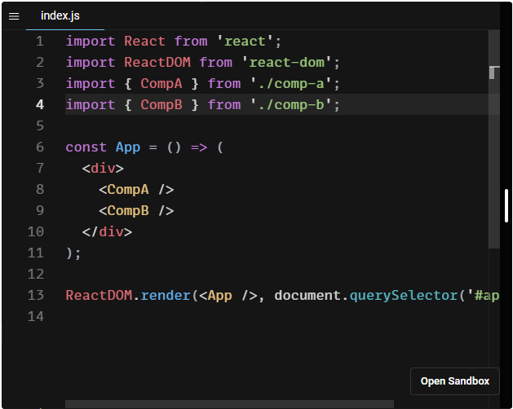

Slide 11
Class composition
Another great feature provided by CSS Modules is class composition. This allows developers to compose a new class by inheriting styles from other classes. Let’s understand it better with a Navbar component example:

Slide 12
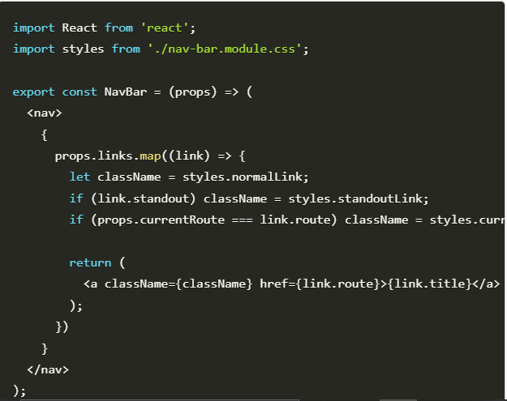

Slide 13
MODULES AND MEDIA QUERIES
.small {
opacity: 0.2;
}
.large {
opacity: 1.0;
}
@media (max-width: 600px) {
.small {
opacity: 1.0;
}
.large {
opacity: 0.2;
}
}

Slide 14
Widget7.js
import React from 'react';
import styles from './Widget7.css';
class Widget7 extends React.Component {
render() {
return (
<div>
<div className={styles.small}>
The Window is Small
</div>
<div className={styles.large}>
The Window is Big
</div>
</div>
);
}
}
export default Widget7;

Slide 15
.Widget7_small_2tsQ- {
opacity: 0.2;
}
.Widget7_large_1NLxE {
opacity: 1.0;
}
@media (max-width: 600px) {
.Widget7_small_2tsQ- {
opacity: 1.0;
}
.Widget7_large_1NLxE {
opacity: 0.2;
}
}

Slide 16
Thank You

