Slide 1

Fair AI in Loan Approval: Ensuring Responsible AI in Financial Decisions
Prsented By: Fair AI Alliance
Dikshat Phulpagar Ninad Jadhav Prajwal Wagh Shivendra Singh Yuvraj Singh

Slide 2
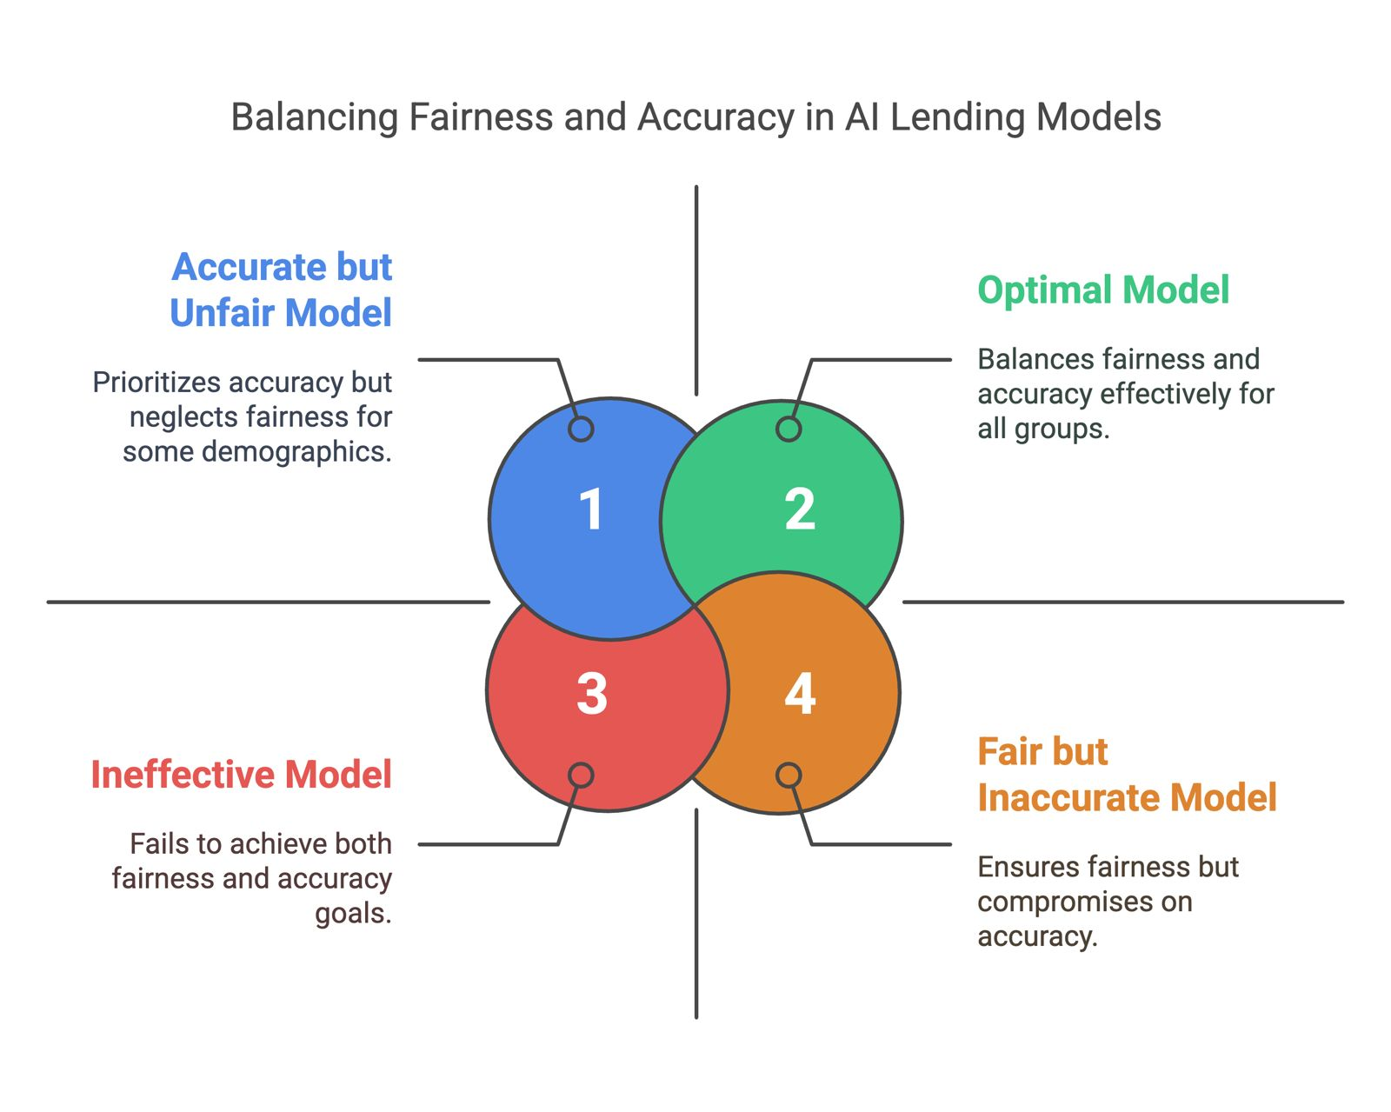
Key Problems:

Slide 3
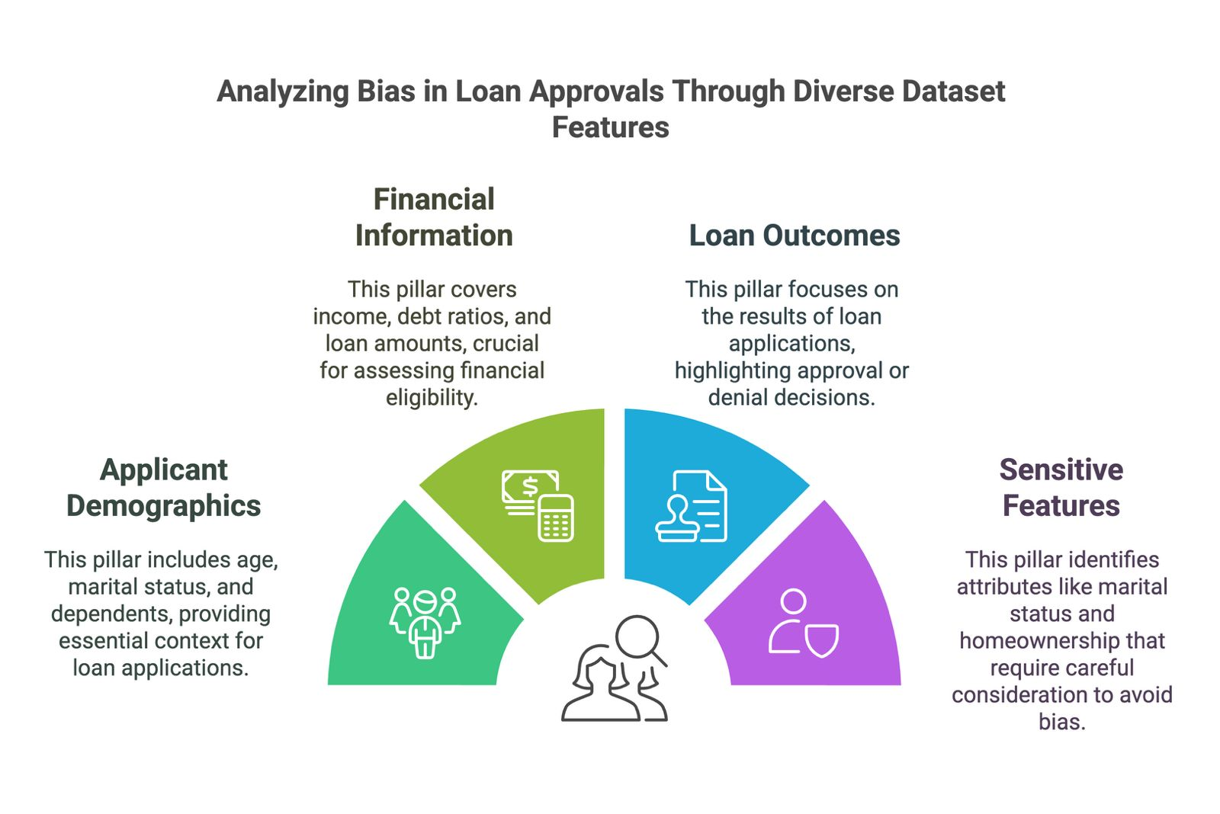
Key Factors in Loan Approval Bias

Slide 4
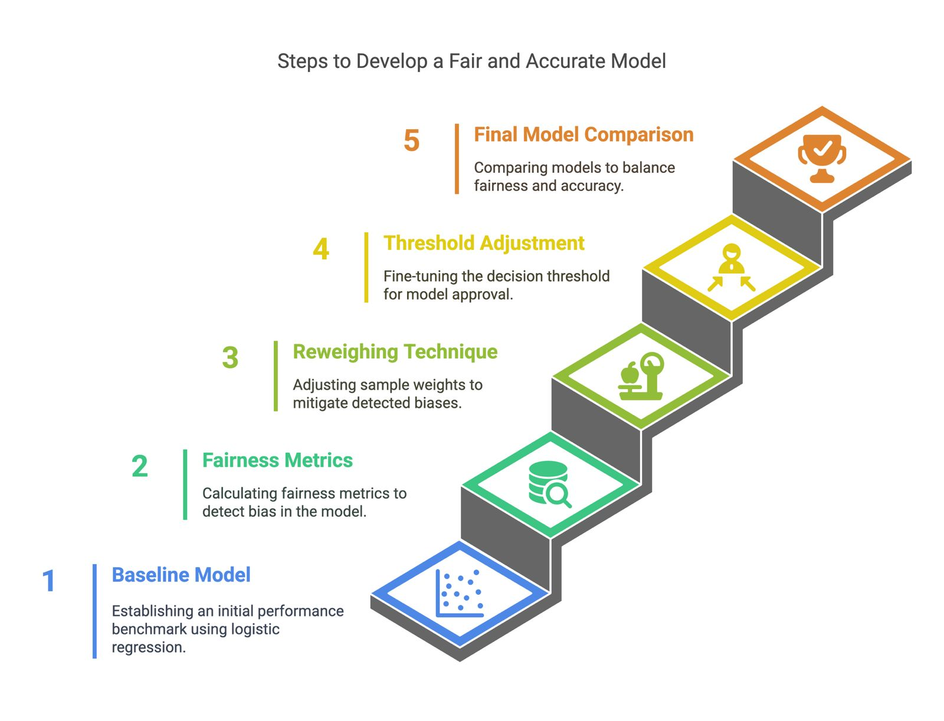
Model Development Approach

Slide 5
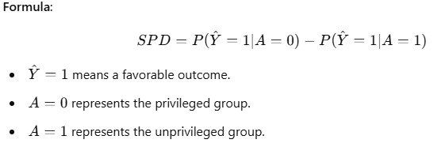
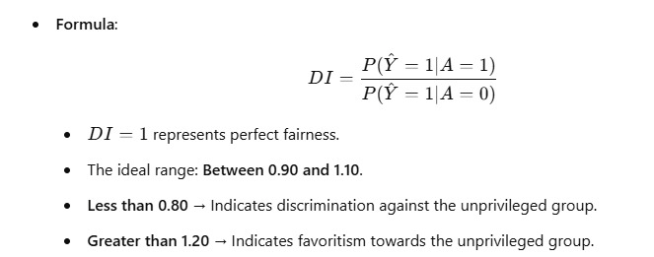
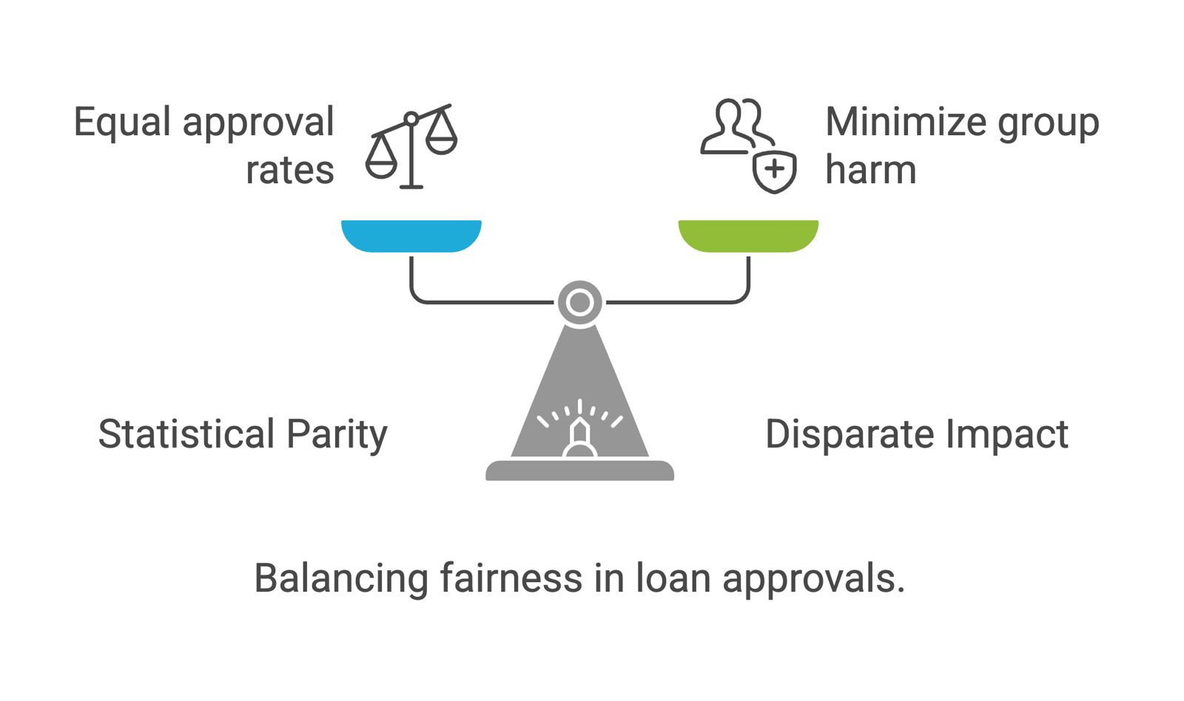
Bias Detection - Key Metrics Used
Statistical Parity Difference (SPD) Measures the difference in approval rates between privileged and unprivileged groups.
Ideal Range: -0.1 to 0.1
Disparate Impact (DI) Measures approval rate ratio of unprivileged vs. privileged groups.
Ideal Range: 0.90 to 1.10

Slide 6
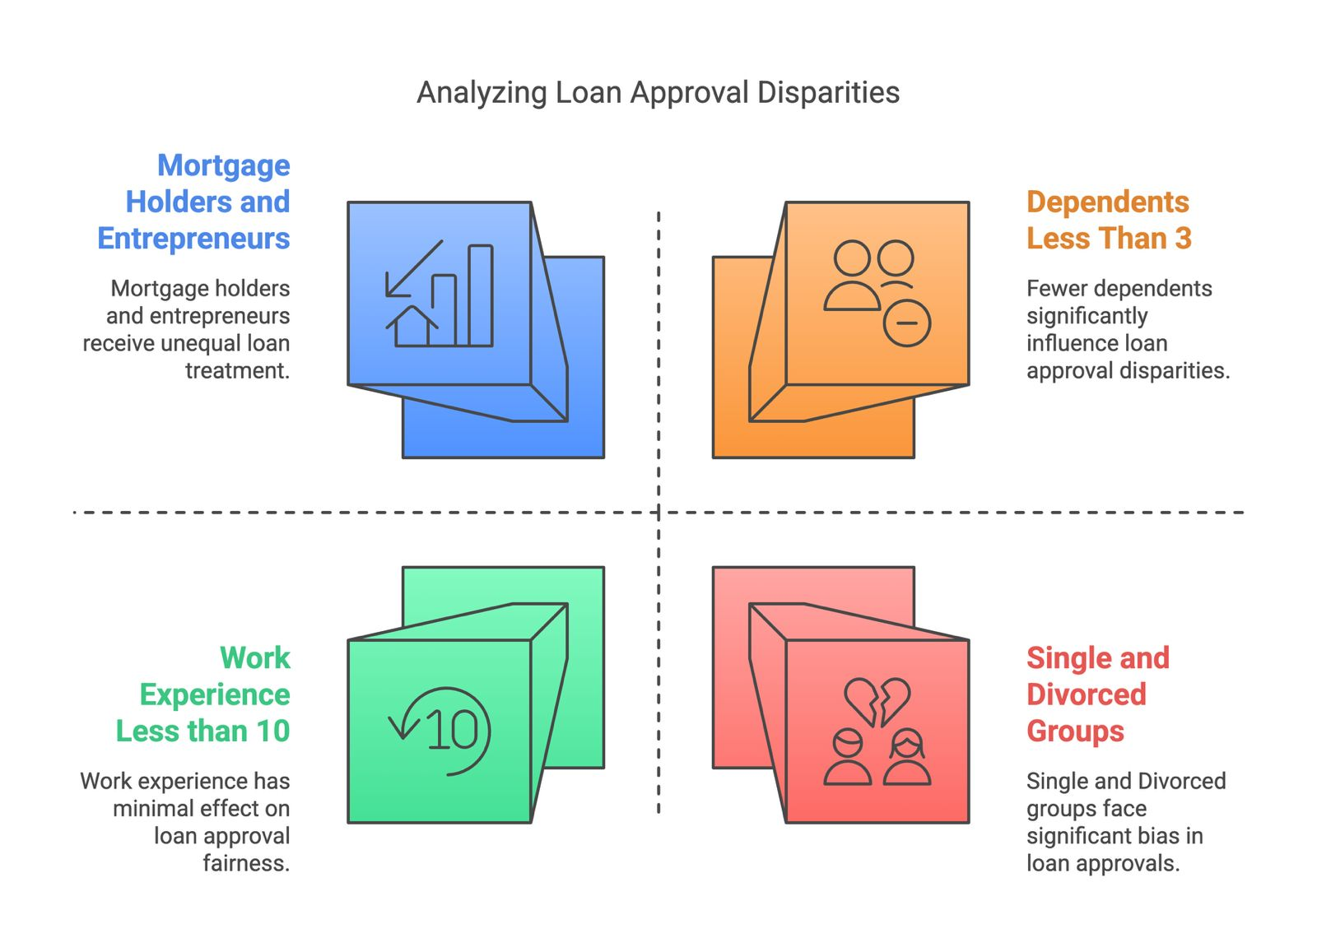
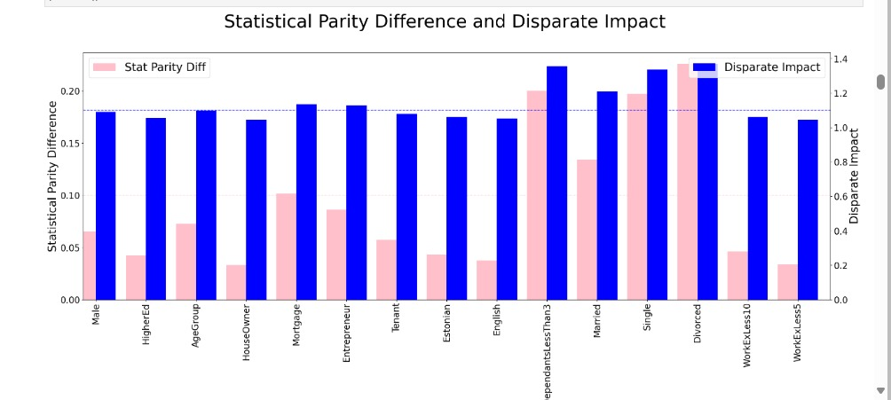
Bias Analysis: Statistical Parity, Disparate Impact & Loan Disparities

Slide 7
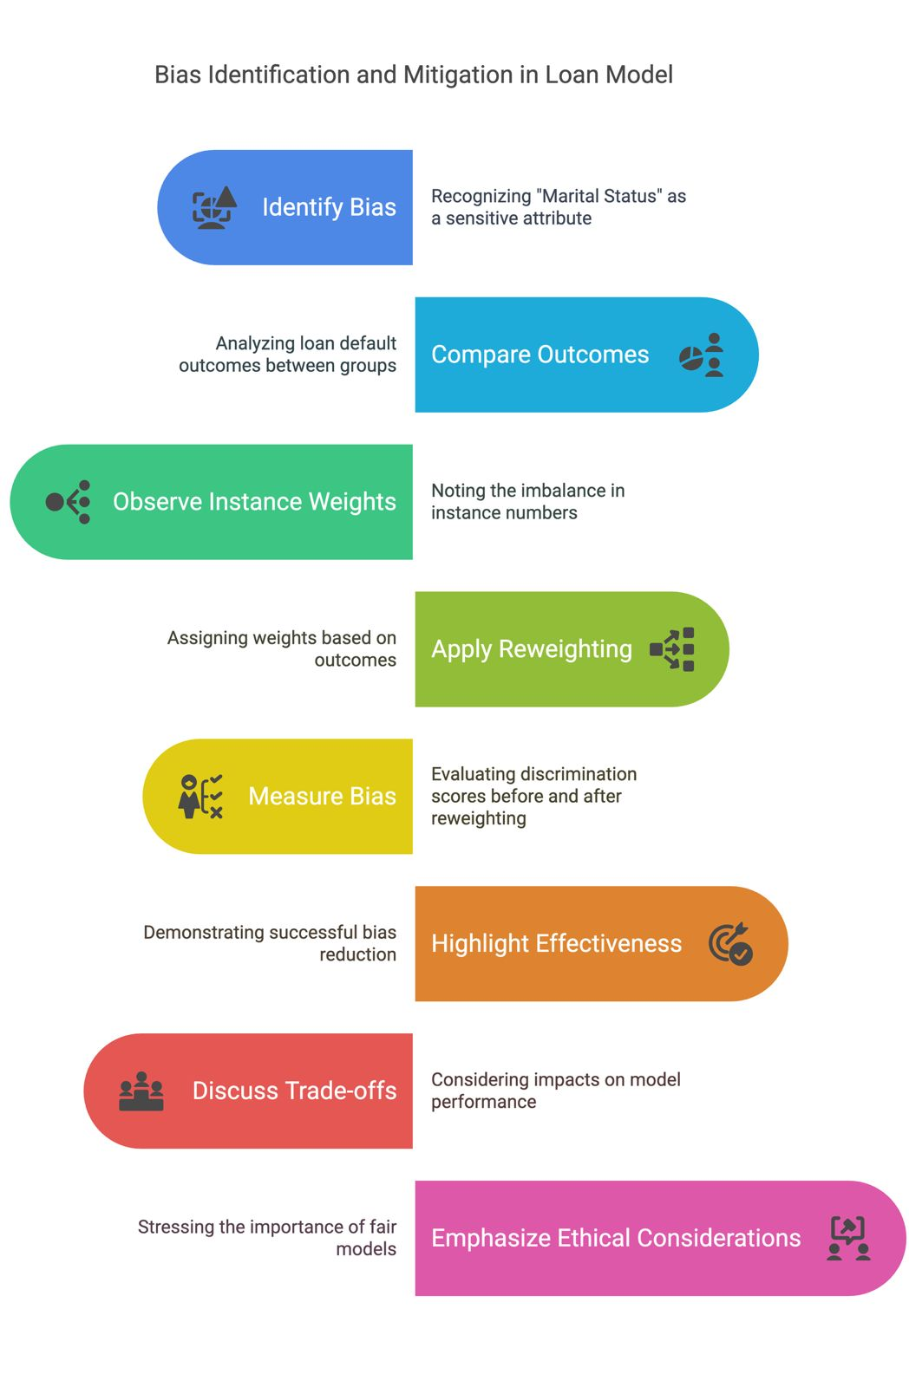
Bias Identification & Mitigation in Loan Model

Slide 8
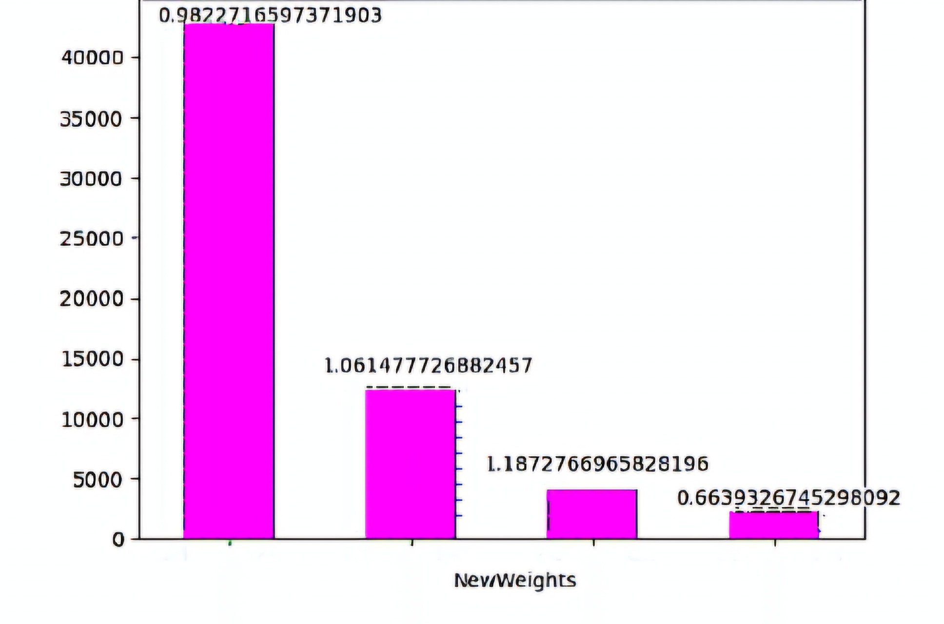
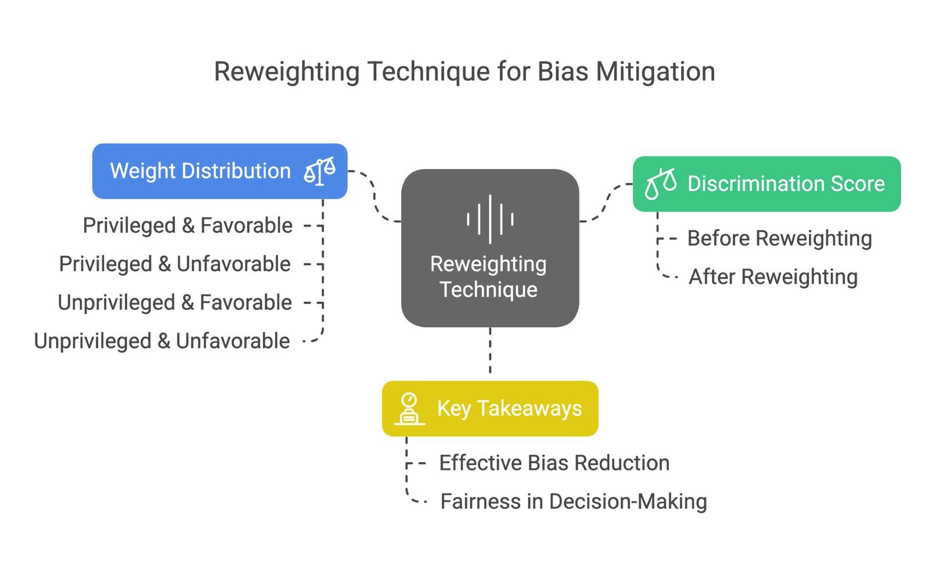
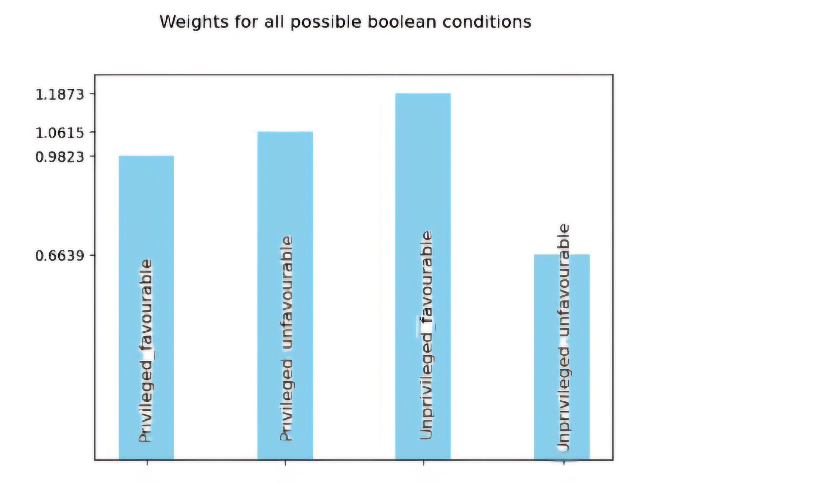
Reweighting Technique for Bias Mitigation

Slide 9
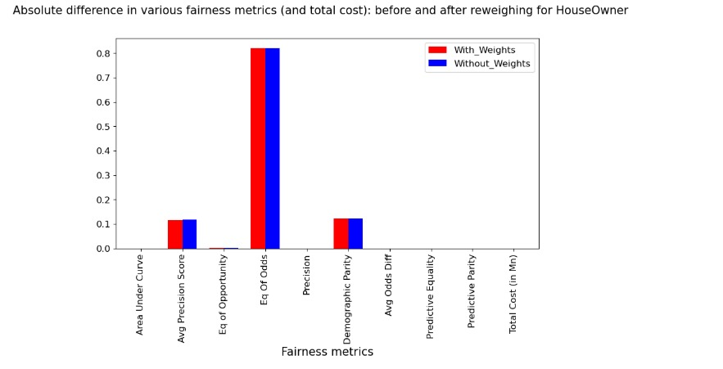
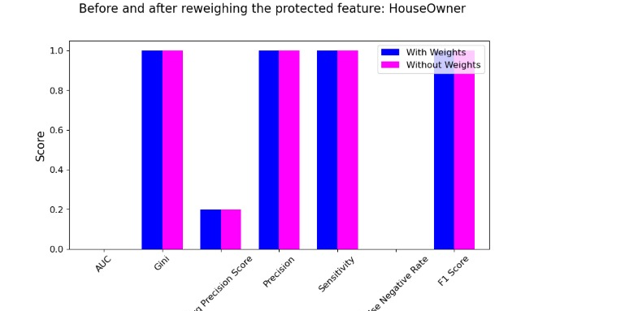
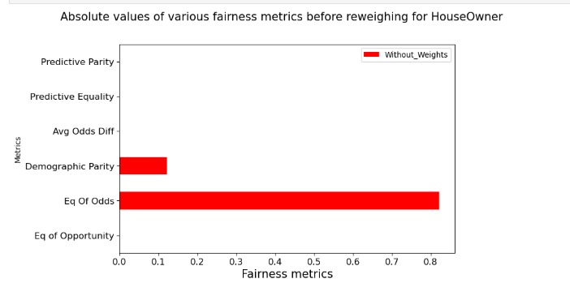
Impact of Reweighing on Fairness and Accuracy
Reweighing successfully reduced fairness disparities while keeping the overall accuracy of the model nearly unchanged.
The biggest bias correction occurred in Equality of Odds, showing that privileged and unprivileged groups now receive more equitable treatment.
False negatives and total cost remain stable, indicating that the intervention did not create new risks in misclassifications.
Fairness trade-offs are minimal: while fairness improved, there was no drastic impact on precision, sensitivity, or F1 score, which is a positive outcome.

Slide 10
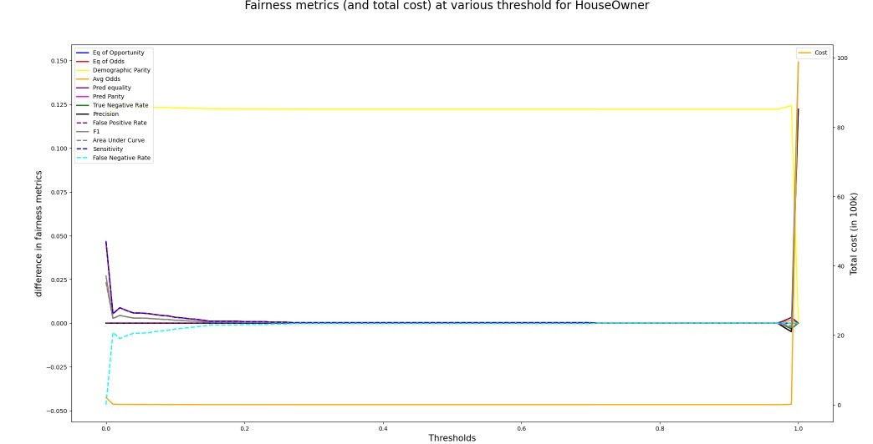
Optimizing Thresholds for Fairness & Cost Balance
Optimal thresholds help mitigate bias without significantly affecting cost.
Choosing extreme thresholds (too low or too high) can increase fairness disparities and financial costs.
The best approach is to find a middle threshold where fairness is improved while minimizing false negatives and controlling financial impact

Slide 11
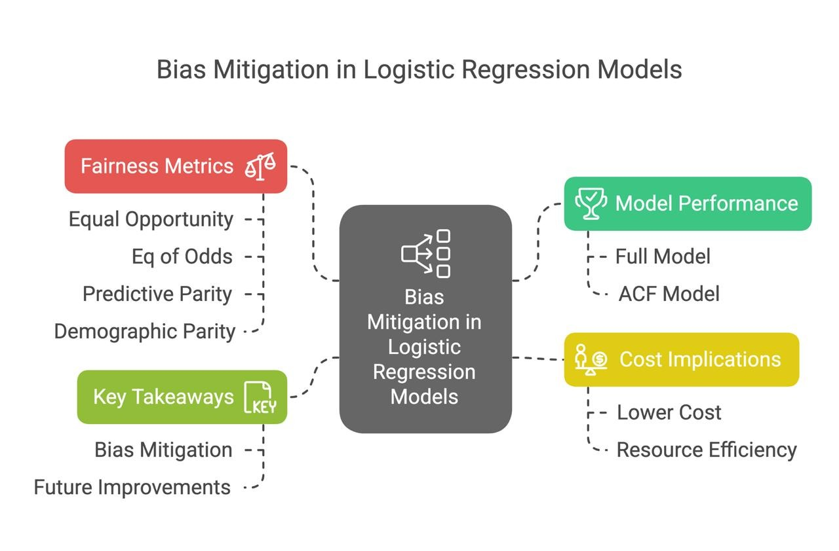
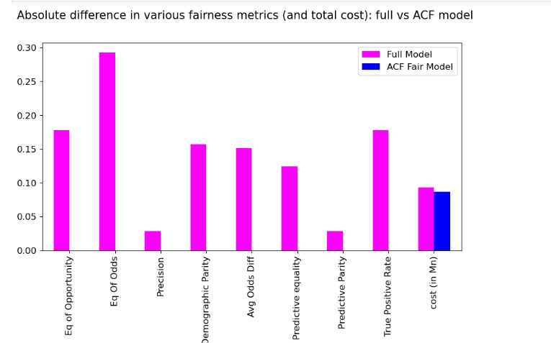
Bias Mitigation & Fairness Comparison: Full vs ACF Model
The ACF model mitigates bias but does not completely remove it. Some fairness metrics still need improvement, especially Predictive Parity and True Positive Rate.
The cost of implementing fairness is not prohibitive, making it a viable approach for ethical machine learning applications.

Slide 12
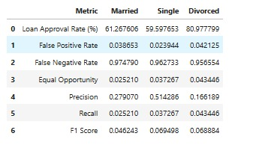
Fairness Disparities in Loan Approvals by Marital Status"
The divorced group gets the highest approval rate but also has the highest false positive rate, meaning many of their approvals may not be valid.
Married individuals face the highest rejection rates (FNR), meaning they are more likely to be unfairly denied loans. Single individuals have the best balance between precision and recall, making their approvals more reliable.
There is a clear disparity in fairness across marital status groups, suggesting a need for bias mitigation strategies.

Slide 13
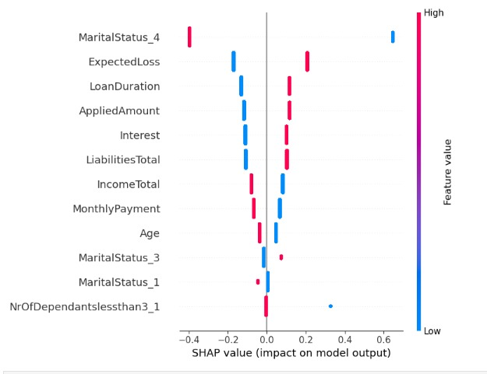
SHAP Analysis: Impact of Marital Status on Loan Approvals
Marital status heavily influences loan approval predictions, which could indicate potential bias.
Applicants with high liabilities, lower income, and longer loan durations face higher rejection risks.
Bias mitigation strategies should be explored, such as reweighting or fairness-aware models, to ensure fair loan approval decisions.
Regulators or financial institutions should analyze if marital status should be a key determinant of loan approvals.

Slide 14
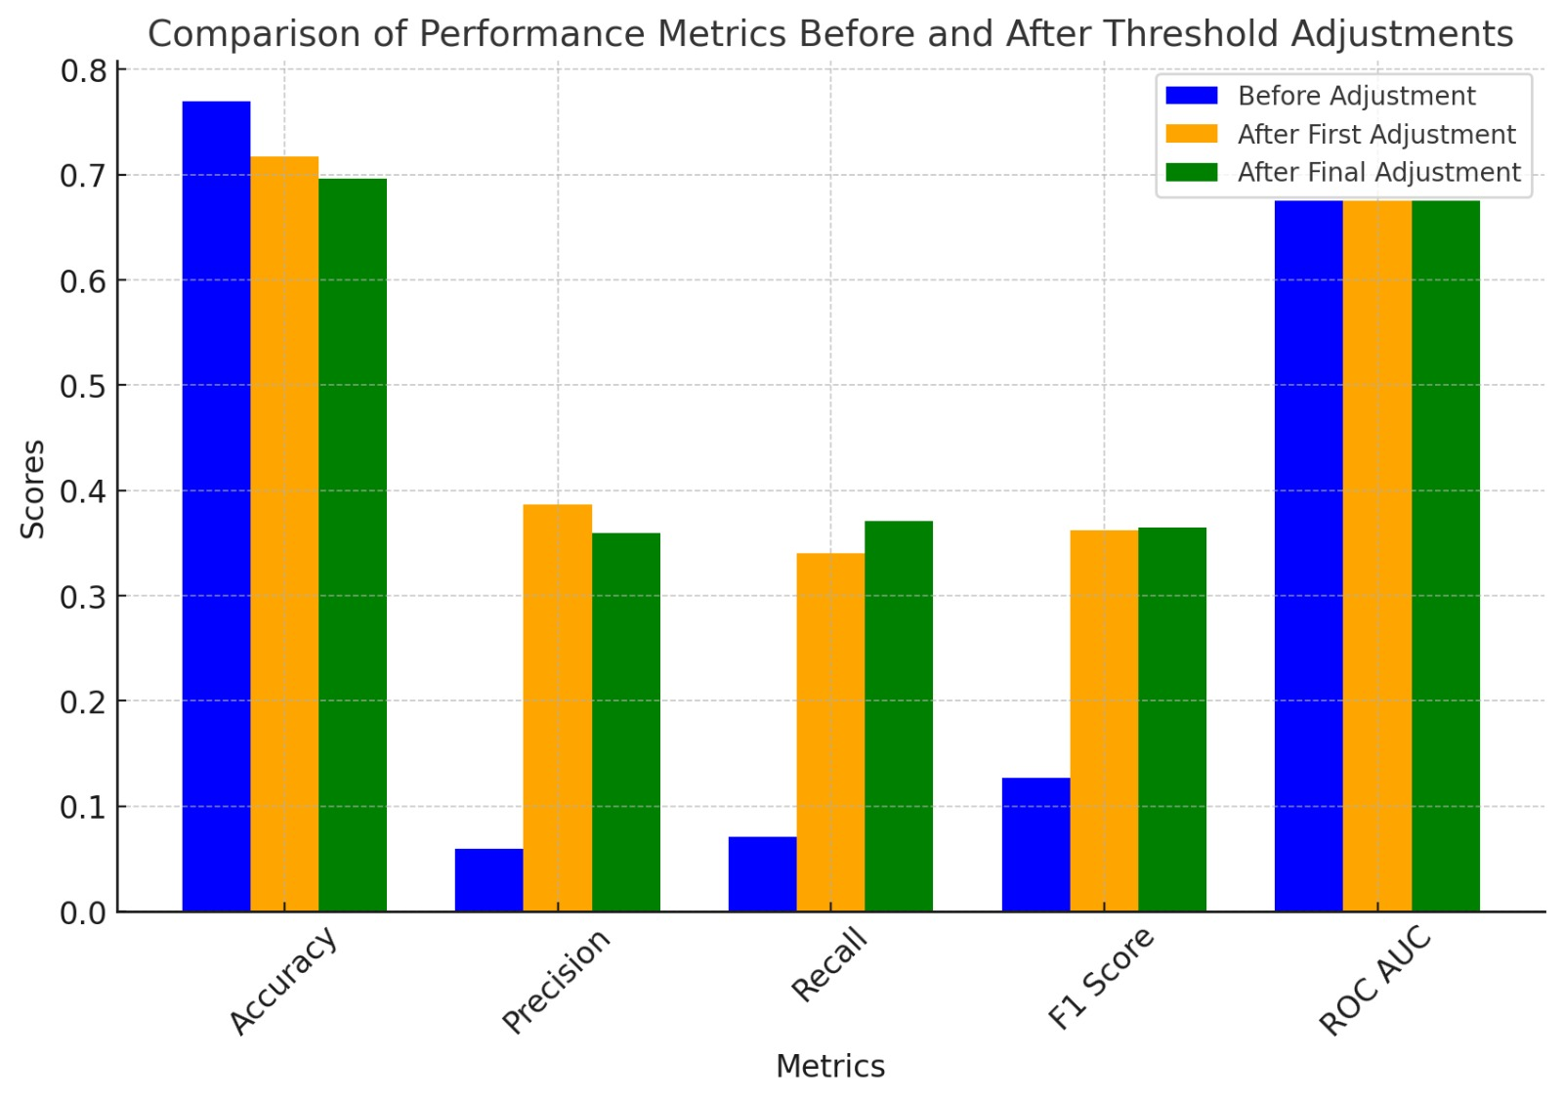
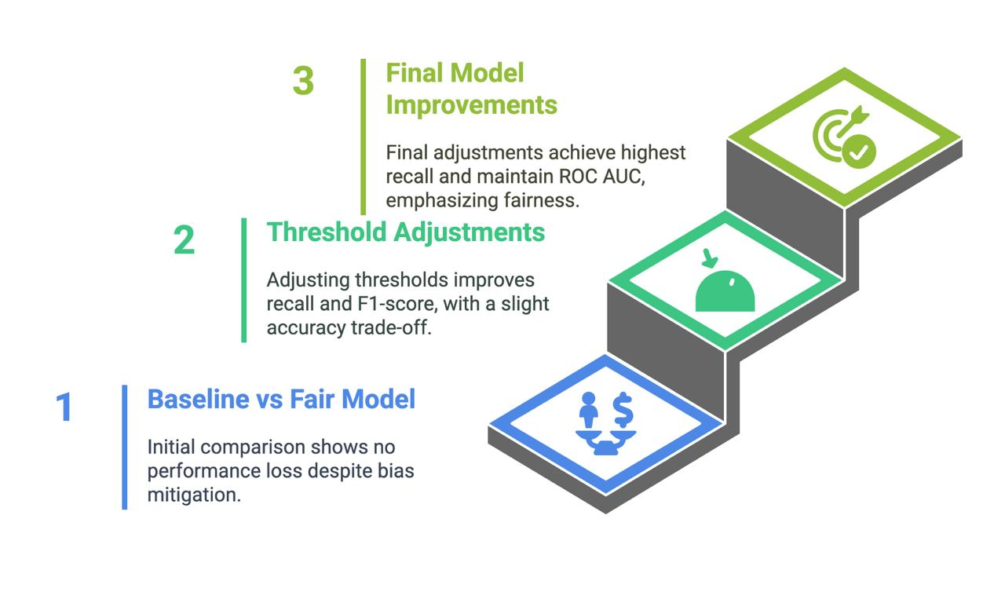
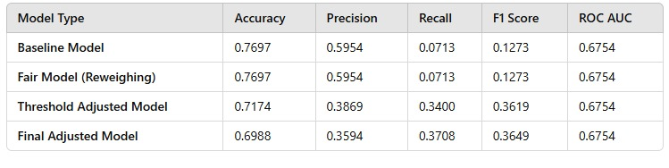
Enhancing Model Fairness & Performance

Slide 15
Thank You

