Slide 1

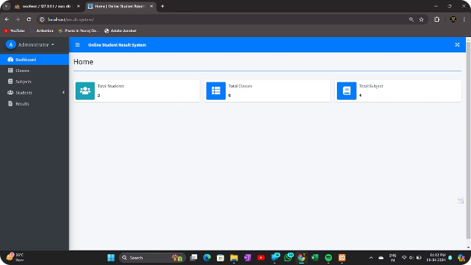
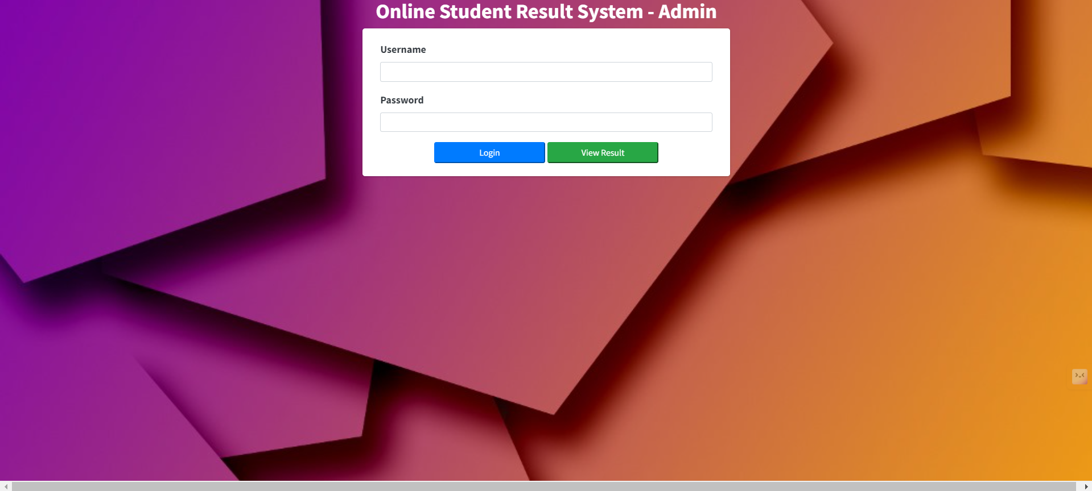
Online Student Result System
Welcome to comprehensive Online Student Result System, a powerful tool designed to streamline the management and access of student academic records. This innovative platform offers a user-friendly interface for students, faculty, and administrators to efficiently monitor and analyze student performance.
Snapshot of the website
YK
- by Yuvraj Kakde

Slide 2
Project Overview
Comprehensive Solution
Data-Driven Insights
The Online Student Result System is a comprehensive platform designed to streamline the management and reporting of student academic performance.
The system leverages data analytics to provide insightful reports and visualizations, empowering administrators and faculty to make informed decisions.
User-Friendly Interface
Scalable and Secure
With a clean, intuitive interface, the system ensures a seamless user experience for students, parents, and college staff.
The solution is built on a scalable architecture and incorporates robust security measures to protect sensitive student data.

Slide 3
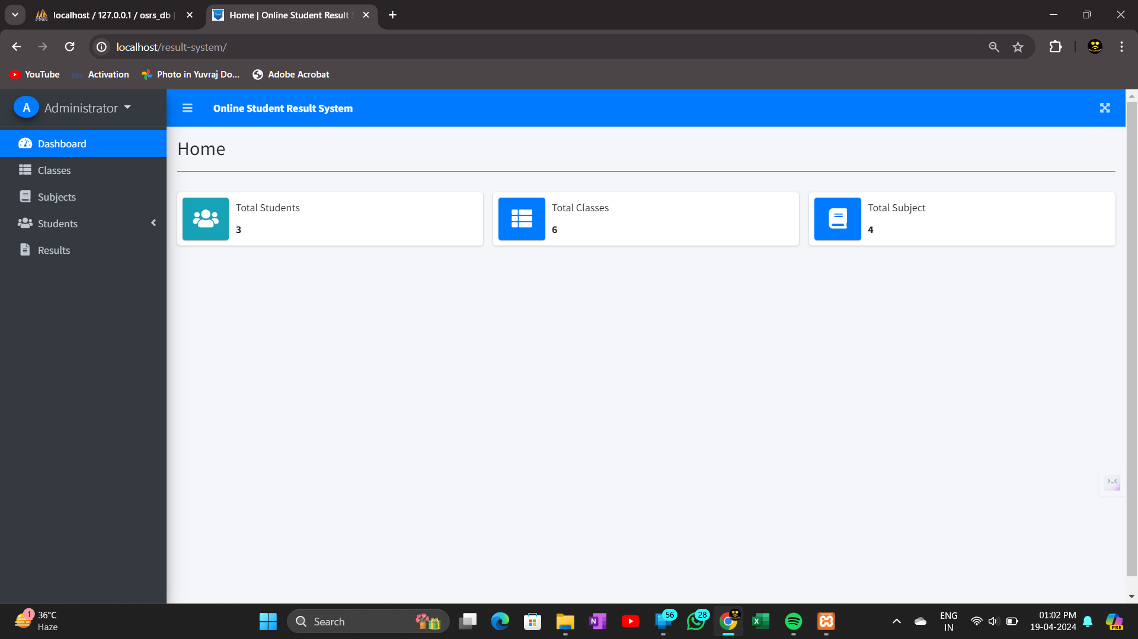
Key Features of the System
Intuitive student dashboard to view grades, attendance, and course details
Secure teacher grading portal with efficient tools to enter and update student marks
Automated reporting and analytics for administrators to monitor academic performance

Slide 4

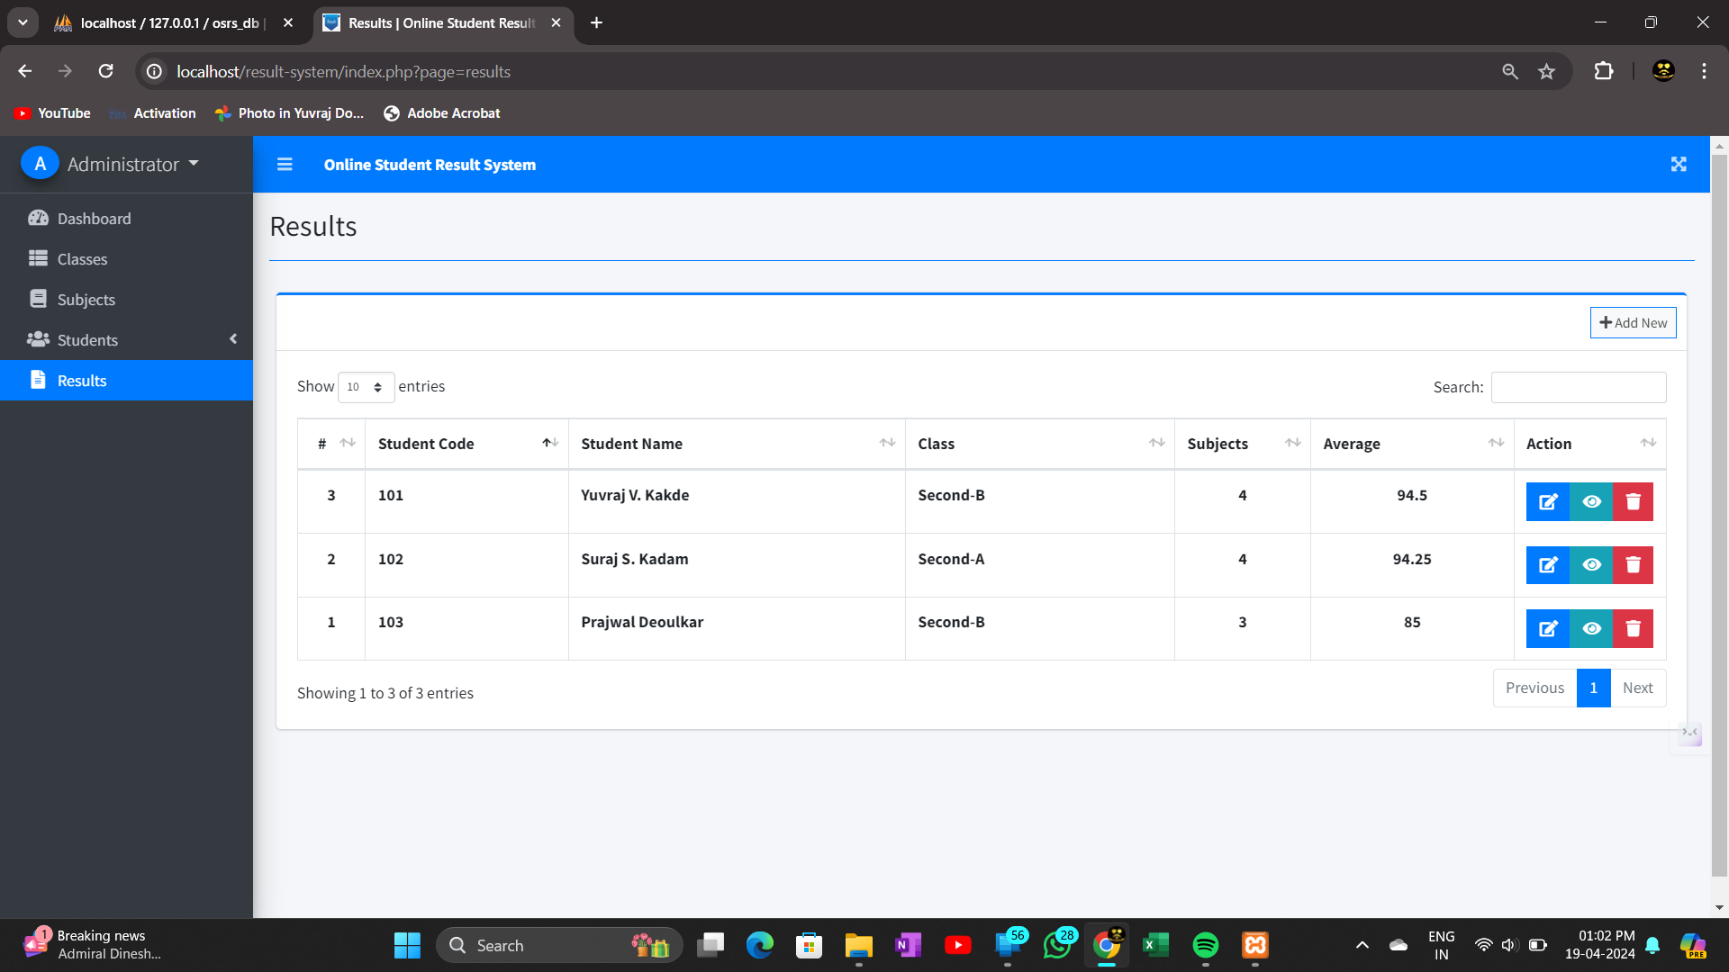
User Interface and Navigation
The online student result system features a modern, clean, and intuitive user interface that makes it easy for students and administrators to access and navigate the system. The well-designed navigation menu allows users to quickly find the information they need, whether it's checking grades, viewing course schedules, or accessing other system features.
The Clear labeling and intuitive icons guide users through the system, minimizing the learning curve and making it accessible to users of all technical abilities.

Slide 5

Data Management and Storage
The Online Student Result System uses a robust and secure database to store all student records and academic performance data.
The system employs advanced data encryption and access controls to ensure the privacy and integrity of the student information.
Regular backups and redundancy measures are in place to protect against data loss and ensure business continuity in case of system failures or natural disasters.

Slide 6

Grading and Reporting Functionalities
1
Grade Calculation
The system automatically calculates student grades based on their performance in various assessments and assignments. Complex algorithms ensure accurate and fair grading.
2
Result Generation
With a few clicks, the system generates comprehensive result reports for individual student in a downloadable PDF form. Reports include detailed breakdowns of marks and performance.
3
Accessable PDF Result
The system offers customizable report card templates that can be downloaded in PDF form to specific requirements. This ensures a professional and consistent look.

Slide 7
Generate a report card of the marks
1
Comprehensive Grading Breakdown
2
Personalized Feedback
In addition to the numerical grades, the report card will include personalized feedback from teachers, highlighting the student's strengths, areas for improvement, and recommendations for future academic growth.
The report card will provide a detailed breakdown of the student's performance across all subjects, including individual test scores, class participation, and overall grade.
3
Attendance of Test
4
Printing and Distribution
The report card will also track the student's attendance and punctuality, providing valuable insights into their overall commitment to their studies.
The report card can be easily printed by PDF and distributed to both the student and their parents or guardians, ensuring transparency and open communication.

Slide 8




Integration with College Infrastructure
Data Integration
Academic Calendar
IT Infrastructure
Data Security
Seamlessly integrate the student result system with the college's existing database, allowing for secure and automated data sharing.
Leverage the college's robust IT infrastructure to provide reliable, high-performance access to the student result system.
Implement robust security measures to protect student data and ensure compliance with the college's data privacy policies.
Synchronize the system with the college's academic calendar to ensure timely updates and notifications for students and faculty.

Slide 9

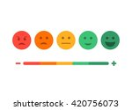
Feedback and Continuous Improvement
Gathering feedback from users is crucial for the ongoing enhancement of the Online Student Result System. Students and faculty can provide valuable insights through surveys and direct communication channels. These inputs drive continuous improvements to the system's functionality, user experience, and reporting capabilities.
The team behind the system is committed to an agile development approach, regularly analyzing feedback and implementing relevant upgrades. This ensures the system remains relevant, efficient, and tailored to the evolving needs of the college community.

Slide 10
Conclusion and Future Enhancements
In conclusion, the Online Student Result System has proven to be a highly effective and efficient tool for managing student information and grades. By leveraging cutting-edge technology, the system has streamlined the reporting process, enhanced data security, and provided a user-friendly interface for both students and administrators.
100
99.5%
4
Students
Satisfaction
Months
The system has served over 100 students across multiple campuses, providing them with real-time access to their academic records and performance.
The system has maintained a high satisfaction rate of 99.5% among users, thanks to its intuitive design and reliable functionality.
The system has been in operation, continuously evolving to meet the changing needs of the college and its students.
With a steadfast commitment to innovation and a deep understanding of the evolving needs of our students, we are confident that the Online Student Result System will continue to be a cornerstone of our college's academic excellence for years to come.

