Slide 1
Stock Market Analysis-TCS
Name:- Yashit Mittal Course:- Business Analysis

Slide 2
Objective: To analyze the financial performance of TCS over the past 5 years using key financial metrics and visualization tools.
Goal:
To identify growth trends, profitability, and financial stability.

Slide 3
DATA COLLECTION
Data Source: • Moneycontrol
Data Collected: • Revenue • Net Profit • EBITDA • Assets, Equity • Current Assets & Liabilities
Time Period: • 2021 – 2025

Slide 4
DATA CLEANING
Data Cleaning Steps:
• Removed commas from numeric values
• Standardized year format
• Removed empty/null values
• Ensured consistent data types

Slide 5
CALCULATIONS
Key Metrics Calculated:
• Revenue Growth = (Current - Previous) / Previous
• Profit Margin = Net Profit / Revenue
• ROE = Net Profit / Equity
• Current Ratio = Current Assets / Current Liabilities
• Debt-to-Equity Ratio = Debt / Equity

Slide 6
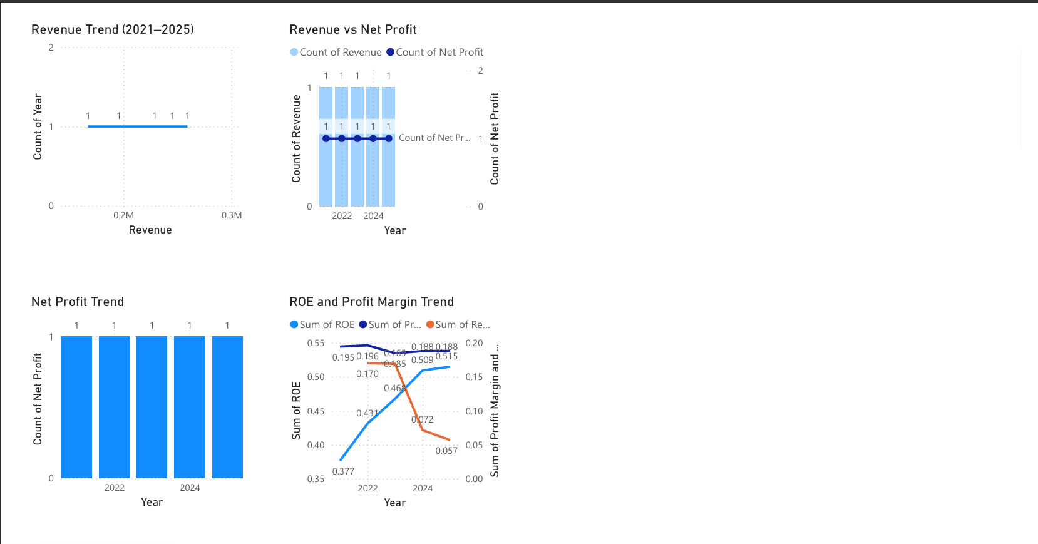
VISUALIZATION

Slide 7
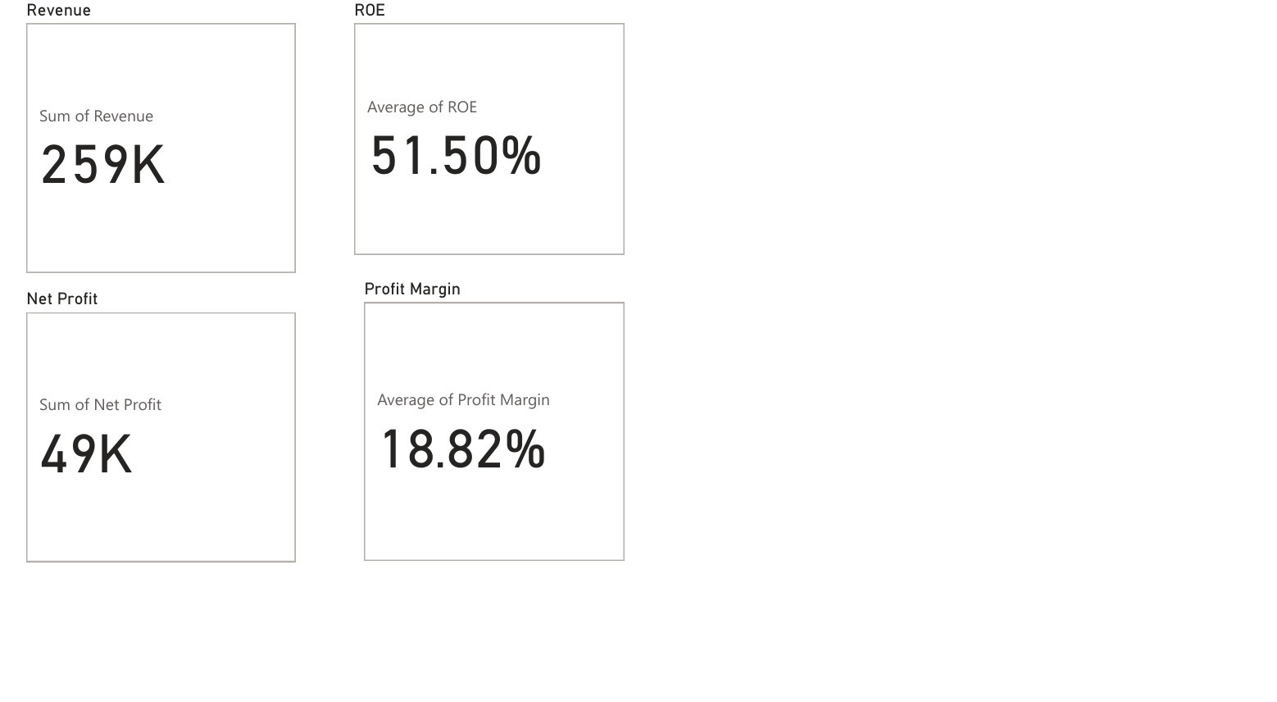
Dashboard Overview

Slide 8
KEY INSIGHTS
• Revenue shows steady growth over 5 years
• Profit margins remain stable (~18–19%)
• High ROE indicates efficient use of equity
• Company has zero debt, showing strong financial stability

Slide 9
CONCLUSION
TCS demonstrates strong financial performance with consistent growth,
stable profitability, and low financial risk.
The company is financially healthy and well-positioned for future growth.

Slide 10
TOOLS USED
Tools & Technologies:
• Microsoft Excel
• Power BI
• Data Analysis Techniques

Slide 11
THANK YOU

