Slide 1

Department of Computer Science and Engineering
Automatic License Plate Recognition using OpenCV
Submitted By –
1900290100201 YUVRAJ KASHYAP
1900290100164 SUHAIL BASHIR
1900290100130 SAKSHI SINGH DHANGAR
Mentor –
Prof. NEHA YADAV

Slide 2
TABLE OF CONTENTS
Introduction
Background history/ related work/literature survey
Work flow of designed system / proposed methodology
Result discussion / Experimental result analysis
Conclusion
References

Slide 3
INTRODUCTION
In this project we hope to achieve high accuracy of Object Detection and Image Identification using YOLO and Segmentation.
The aim of Object Detection is to detect all instances of objects from a known class, such as people, cars or faces in an image.
Each detection of the image is reported with some form of pose information defined in terms of bounding box.

Slide 4
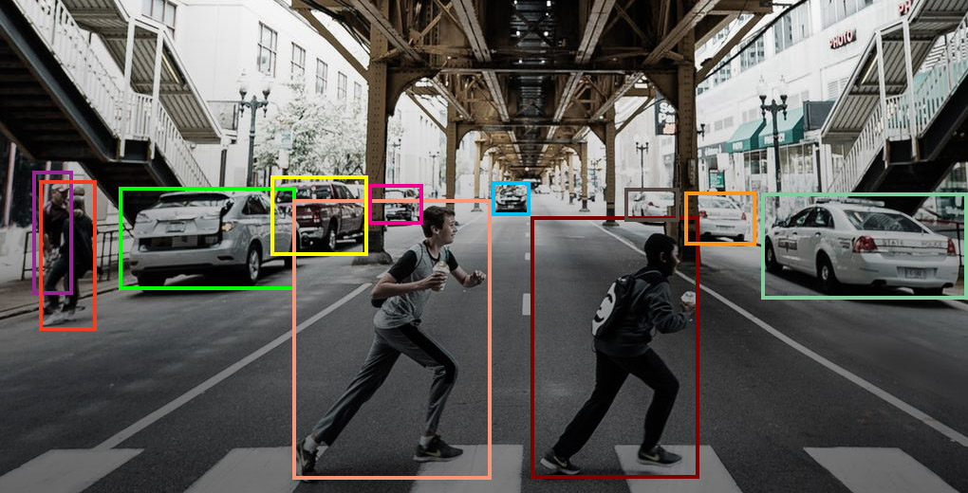
With the changing technology and advancement in the field of AI, Object Detection models will play an important role.
Some of the example are automated cars , face detection and everything that can be related to understand the environment.

Slide 5
Background History
The aim of object detection is to detect all instances of objects from a known class, such as people, cars or faces in an image. Generally, only a small number of instances of the object are present in the image, but there is a very large number of possible locations and scales at which they can occur and that need to somehow be explored.
Each detection of the image is reported with some form of pose information. This is as simple as the location of the object, a location and scale, or the extent of the object defined in terms of a bounding box. In some other situations, the pose information is more detailed and contains the parameters of a linear or non-linear transformation.
For example, for face detection in a face detector may compute the locations of the eyes, nose and mouth, in addition to the bounding box of the face. The pose can also be defined by a three-dimensional transformation specifying the location of the object relative to the camera. Object detection systems always construct a model for an object class from a set of training examples.

Slide 6
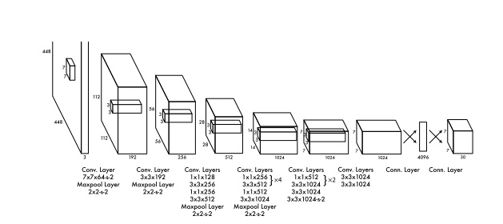
Object Detection
YOLO (You Only Look Once)
It unifies the separate components of object detection into a single neural network.
The network uses features from the entire image to predict each bounding box.

Slide 7
METHODOLOGY
Input Vehicle Image
RGB to Grayscale Conversion
Image Binarization
Edge Detection by Sobel Operator
Image Morphological Operations
Actual Number Plate Extraction
Enhancement of Extracted Plate Region
Output-Enhanced Plate Region

Slide 8
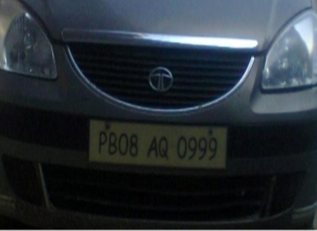
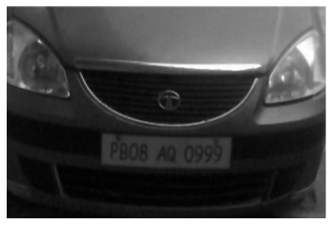
RGB to Grayscale Conversion
The basic purpose of applying color conversion is to reduce the number of colors.
The R, G and B components - 24-bit color.
8-bit gray value.

Slide 9
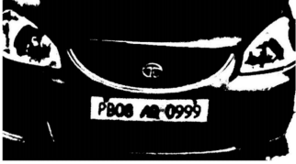
Image Binarization
A threshold value is chosen by taking mean of the pixels.
Above threshold means 1.
Below threshold means 0.

Slide 10
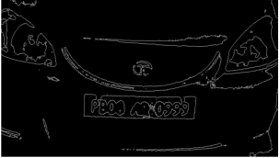

Edge Detection by Sobel Operator
Vertical edge is detected by sobel operator.

Slide 11
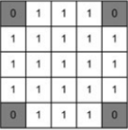

Image Morphological Operations
With morphological operations the unwanted objects in the image are removed.
Structuring Element : Template that defines neighbourhood of the processing pixel.
Eg. Disc
3X3
5X5

Slide 12
Dilation
Erosion
The assigned structuring element is used for probing and expanding the shapes contained in the input image.
Straight opposite to the dilation. The assigned structuring element is used for probing and reducing the shapes contained in the input image.

Slide 13
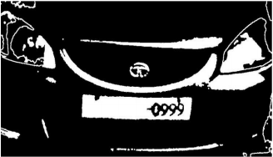
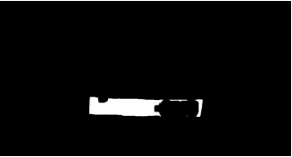
Image Morphological Operations
Dilation
Erosion

Slide 14

Actual Number Plate Area Extraction
After the detection of number plate area, that area is extracted from the image.

Slide 15

Character Segmentation
Finding non zero indexes horizontally and vertically and then summing
them up.
Finally when the characters are recognized,the License plate is predicted.

Slide 16

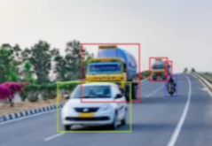
RESULTS
YOLO
Vehicle Detection
(a)Image before applying YOLO (b)Image after applying YOLO

Slide 17
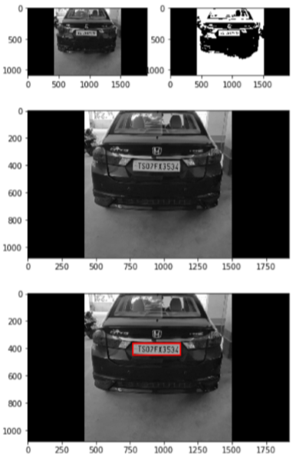
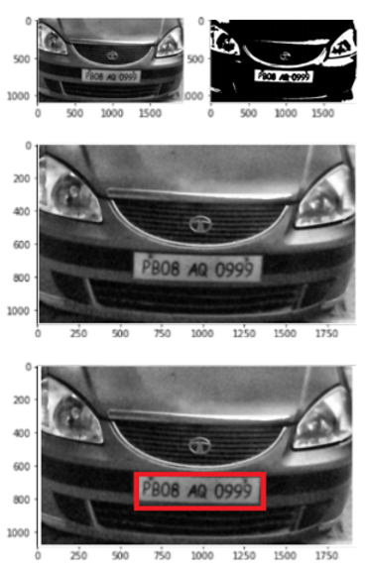
License Plate Detection

Slide 18




Image Segmentation
Training and segmentation
Segmented Characters of Plate
Prediction
Predicted License Plate

Slide 19
CONCLUSION
The system works satisfactorily for wide variations in illumination conditions and different types of number plates commonly found in India. It is definitely a better alternative to the existing proprietary systems, even though there are known restrictions. In addition, this system is a low-cost implementation and can be setup in many different places.

Slide 20
REFERENCES
Joseph Redmon, Santosh Divvala, Ross Girshick, “You Only Look Once: Uniﬁed, Real-Time Object Detection”,The IEEE Conference on Computer Vision and Pattern Recognition (CVPR), 2016.
YOLO Juan Du1,Understanding of Object Detection Based on CNN Family,New Research, and Development Center of Hisense, Qingdao 266071, China.
Matthew B. Blaschko Christoph H. Lampert, “Learning to Localize Objects with Structured Output Regression”, Published in Computer Vision – ECCV 2008.
M. J. Islam, S. Basalamah, M. Ahmadi, and M. A. S. hmed, ”Capsule image segmentation in pharmaceutical applications using edge-based techniques,” IEEE International Conference on Electro/Information Technology (EIT).
M. SHARIF, M. RAZA, and S. MOHSIN, ”Face recognition using edge information and DCT,Sindh Univ.

