Slide 1

Customer Shopping Behavior Analysis
Analyzing 3,900 purchases to uncover actionable insights on spending habits, customer segments, and product preferences for data-driven business strategies.

Slide 2

Dataset Overview
3,900
18
$59.76
Total Purchases
Data Dimensions
Average Purchase
Transactions analyzed across diverse product categories
Features covering demographics, products, and transactions
Mean transaction value in USD
44
Average Age
Mean customer age across all segments

Slide 3
Data Preparation Journey
01
02
Data Quality Check
Cleaning & Imputation
Identified 37 missing values in Review Rating column requiring attention
Filled missing ratings with category-specific medians to preserve data integrity
03
04
Feature Engineering
Database Publishing
Created age groups and numeric purchase frequency mappings for deeper analysis
Exported cleaned dataset to MySQL for advanced business intelligence queries

Slide 4
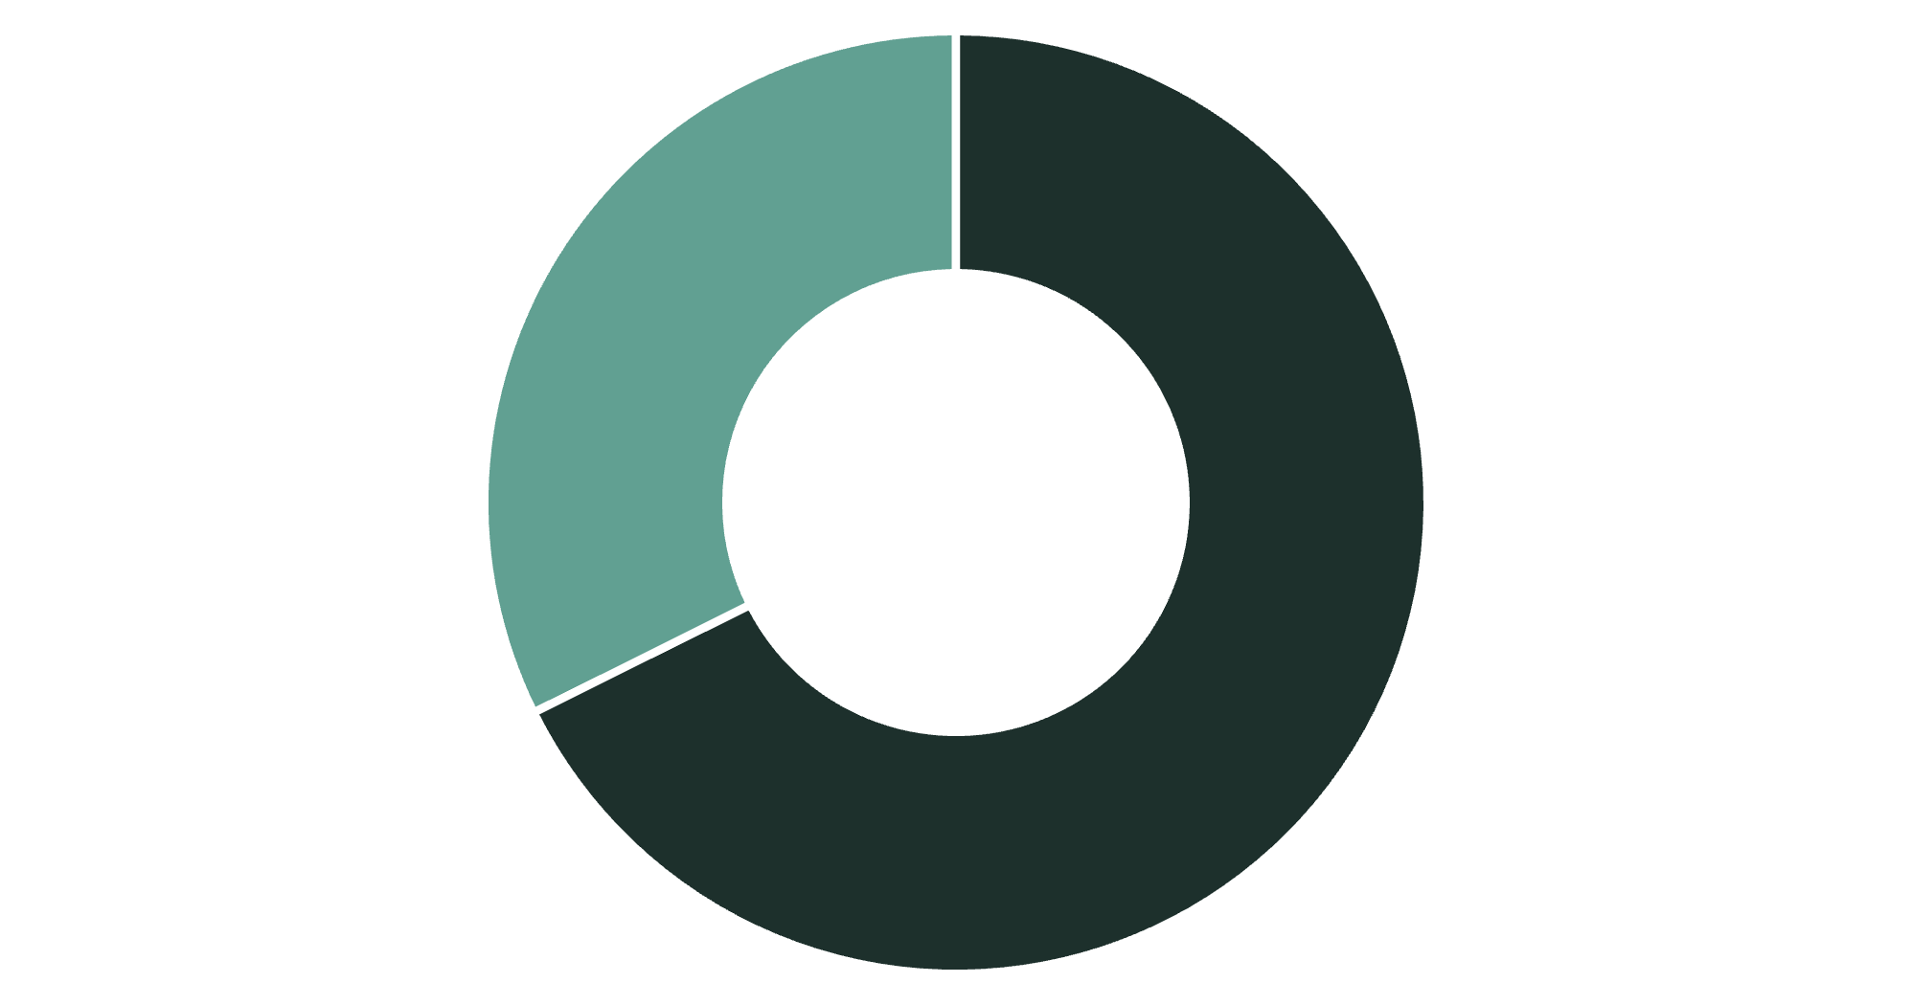
Revenue by Gender
Male Customers Drive Revenue
Male buyers contribute more than double the revenue compared to female buyers, generating $157,890 versus $75,191.
This significant gap presents opportunities for targeted marketing strategies.
Male
Female

Slide 5
Top-Rated Products
1
2
3
Gloves
Sandals
Boots
Average rating: 3.86 out of 5
Average rating: 3.84 out of 5
Average rating: 3.82 out of 5
4
5
Hat
Skirt
Average rating: 3.80 out of 5
Average rating: 3.78 out of 5
Customer satisfaction is highest in footwear and accessories categories, demonstrating strong product appeal.

Slide 6

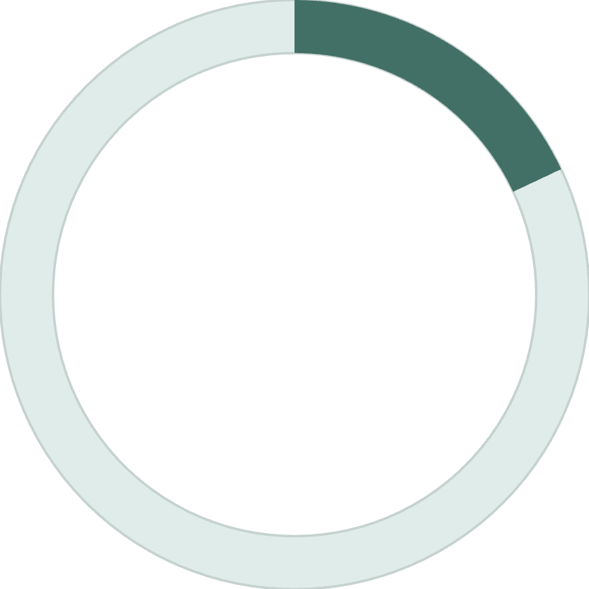

Customer Segmentation Insights
80%
18%
2%
Loyal Customers
Returning
New Customers
3,116 customers with 10+ purchases
701 customers with 2-10 purchases
83 customers with 1 purchase
Strong Retention Success
The large proportion of loyal customers indicates excellent retention and positive customer experience. Focus should shift to converting returning customers into loyal advocates.

Slide 7

Subscription Performance Gap
Subscribed Customers
Average spend: $59.49
Total revenue: $62,645
Among repeat buyers (5+ purchases): 958 subscribed
Unsubscribed Customers
Average spend: $59.87
Total revenue: $170,436
Among repeat buyers (5+ purchases): 2,518 unsubscribed
Critical Finding: Unsubscribed customers spend more and generate higher total sales. The subscription program is not effectively influencing spending behavior and needs enhancement.

Slide 8
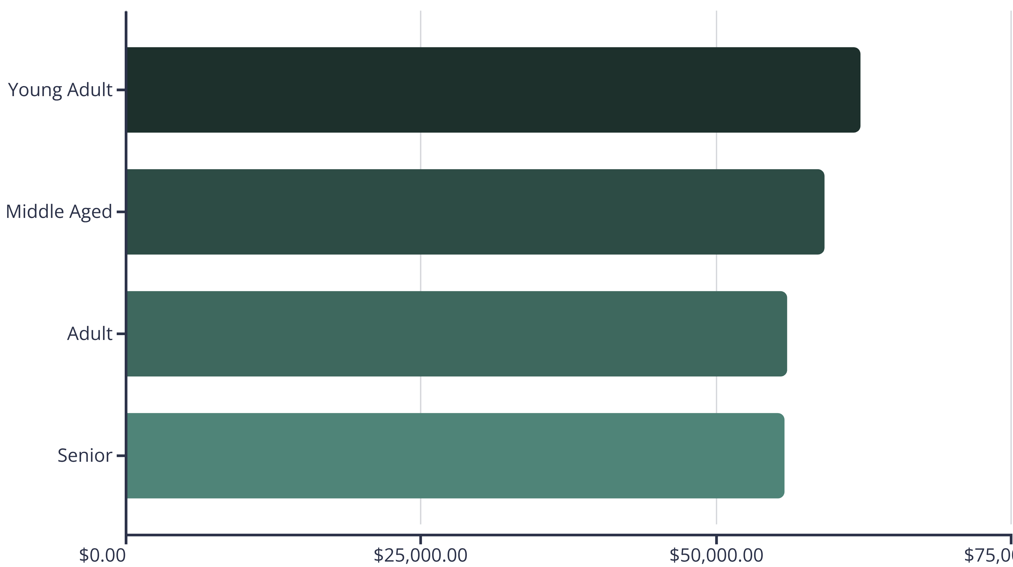
Revenue by Age Group
$75,000.00
Young adults are the largest revenue contributors at $62,143, forming the core customer base and primary driver of sales performance.

Slide 9



Dashboard Highlights
Customer Base
Category Leadership
Untapped Potential
4,000 customers with $59.76 average purchase value and 3.75 review rating
Clothing leads in both customer engagement and revenue, followed by accessories and footwear
Most customers not subscribed nor using discounts—significant opportunity for loyalty strategies

Slide 10
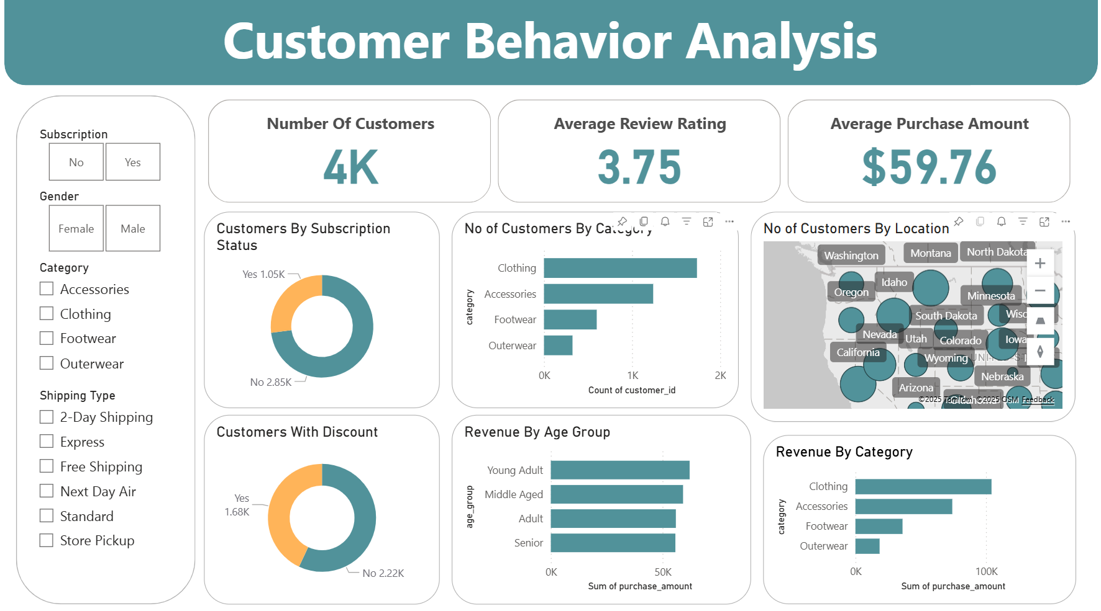

Slide 11






Strategic Recommendations
Target Young Adults
Revise Subscription Strategy
Focus marketing on young adults using social media and influencer channels to maximize revenue impact
Add compelling perks to boost subscription sign-ups and spending among repeat buyers
Expand Discount Offers
Enhance Top Products
Offer strategic discounts and bundle deals on popular apparel items like hats and sneakers
Prioritize inventory investment in highly rated items like gloves, sandals, and boots
Nurture Loyal Customers
Regional Marketing
Reward 3,116 loyal customers with personalized programs to maintain retention excellence
Deploy localized campaigns in high-density customer areas for targeted outreach

Slide 12

Conclusion
In conclusion, these insights offer a strategic framework for driving sustainable growth in the retail sector. By leveraging targeted marketing strategies, enhancing customer retention initiatives, and implementing effective product management practices, businesses can establish a competitive advantage and achieve long-term success in a dynamic retail market.

