Slide 1
Detection of Traffic Sign using Deep Learning for Smart Vehicles

Slide 2
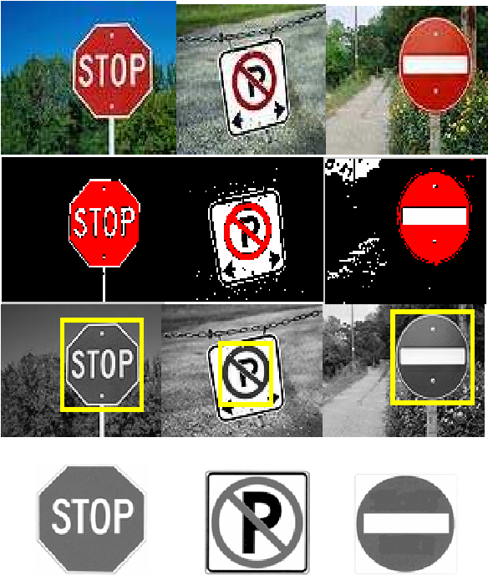
Contents
Introduction
Design
Methodology
Classification using various CNN Model
Ensemble Learning
Basic GUI & Website
Results & Discussion
Conclusion & Future work

Slide 3
Introduction
Motivation: It is developed to enhance road safety and reduce accidents by improving accuracy and efficiency in detecting traffic signs. This technology has the potential to save lives and reduce the economic impact of road accidents.
Scope: Developing a deep learning-based traffic sign identification system for intelligent cars, ensuring fast and accurate recognition. Exploring system applications beyond smart vehicles and evaluating performance using diverse datasets.
Objectives: To develop a fast and accurate deep learning-based traffic sign identification system for smart cars, utilizing convolutional neural networks (CNNs) to extract features and categorize traffic signs.
Difficulties: It is challenging due to traffic sign variability, varying lighting conditions, occlusion, real-time processing requirements, dataset size, and balancing accuracy with efficiency. Overcoming these difficulties is crucial for enhancing road safety and efficiency.

Slide 4
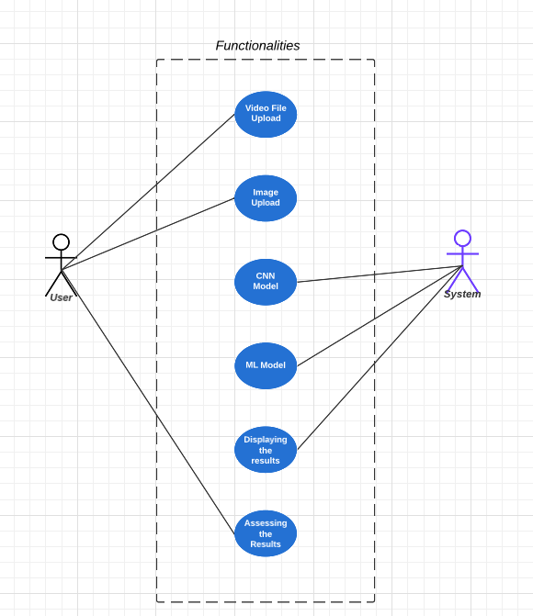
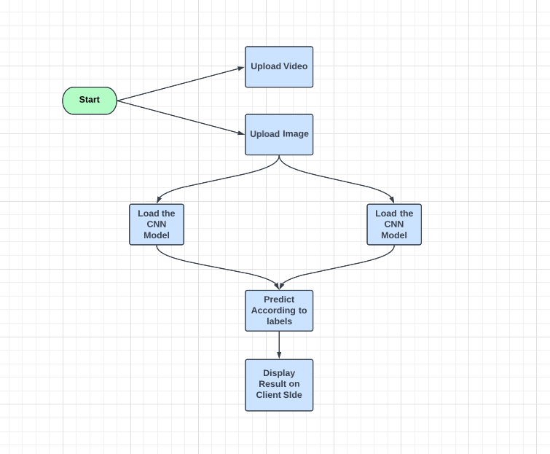
Design
Use Case Diagram
Project Flowchart

Slide 5
Methodology
CNNs are used for image identification tasks, specifically for recognizing traffic signs.
CNNs process input data hierarchically through layers designed for feature extraction.
Convolutional layers in CNNs extract important features from images.
Activation and pooling layers further enhance feature representation.
The network's weights are optimized during training using techniques like stochastic gradient descent.
Regularization methods such as dropout and weight decay prevent overfitting.
CNNs find practical applications in areas like driverless cars, improving road safety and traffic flow.
Key layers in CNN architecture include convolution, activation, pooling, and fully connected layers.
Techniques like hyperparameter tuning, data augmentation, model architecture modification, and transfer learning can enhance CNN performance.
The German Traffic Sign Recognition Benchmark (GTSRB) dataset is commonly used for traffic sign recognition tasks.

Slide 6
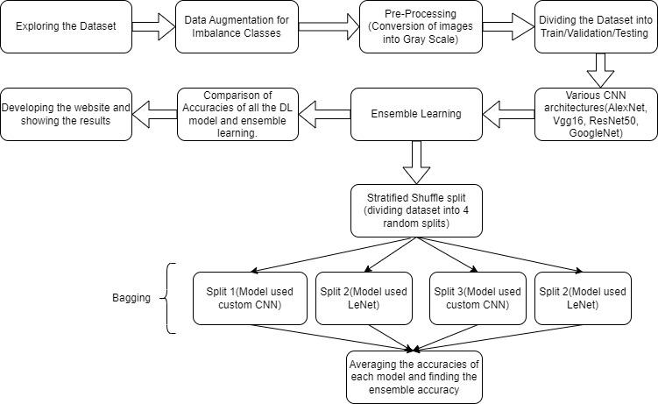
Flow of the Model

Slide 7
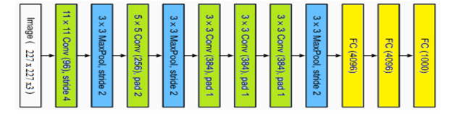
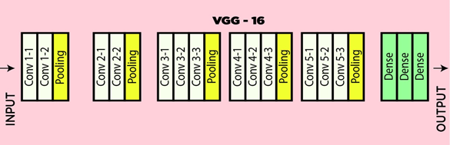
Classification using various CNN Models
Customized AlexNet:
Architecture: 5 Conv2D, 3 Max Pooling, 3 fully connected layers.
Input size: 227x227.
Dropout, batch normalization used.
Loss function: Sparse categorical cross entropy.
Optimizer: SGD, fixed LR (0.001). Trainable params: 58M.
Modified Vgg16:
Architecture: 16 layers (13 Conv2D, 3 fully connected).
Input size: 224x224x3. ReLU activation, He_normal initialization.
Loss function: Sparse categorical cross entropy.
Optimizer: Adam.
Params: 70M, Trainable: 56M.

Slide 8
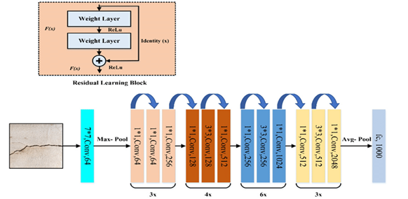
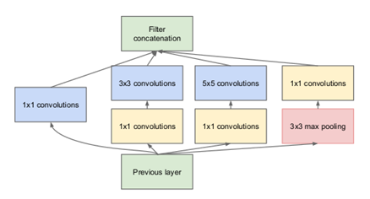
ResNet-50 with modification:
Architecture: 50 layers with skip connections.
Stages: convolutions, pooling, skip connections.
Batch normalization used.
Input size: 50x50x3.
Optimizer: Mini-batch SGD with momentum.
Params: 23M.
GoogleNet (22 Layers):
Architecture: 22 layers with Inception module.
Inception module combines convolutions and max pooling.
Convolutional and max pooling layers used.
Input size: 224x224. Params: 10M after dropout.

Slide 9
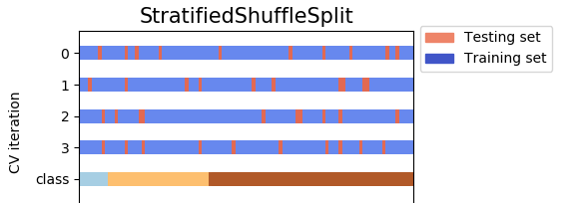
Ensemble Learning
Stratified shuffle split maintains class distribution while randomly splitting the dataset into training and testing sets.
Ensemble learning is used with custom CNN and LeNet architectures.
The models have convolutional and pooling layers, dropout layers, and dense output layers.
After training the models and running them on 20 epochs, individual accuracies are obtained.
Ensemble accuracy is determined by combining the predictions of all models.

Slide 10
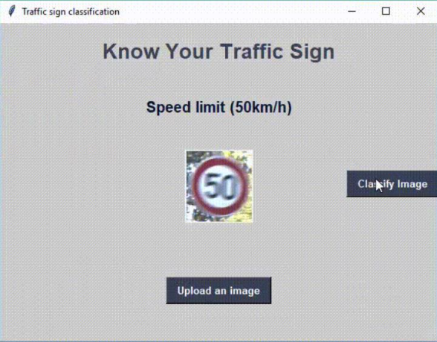
Basic GUI

Slide 11
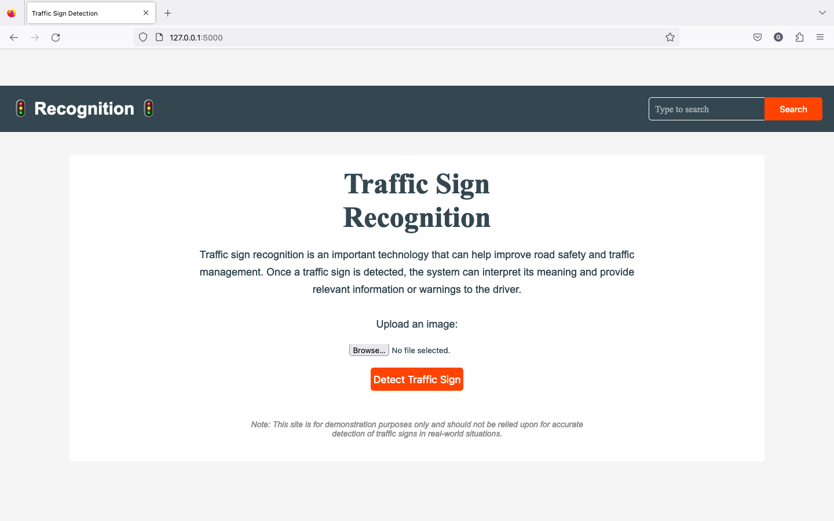
Website

Slide 12
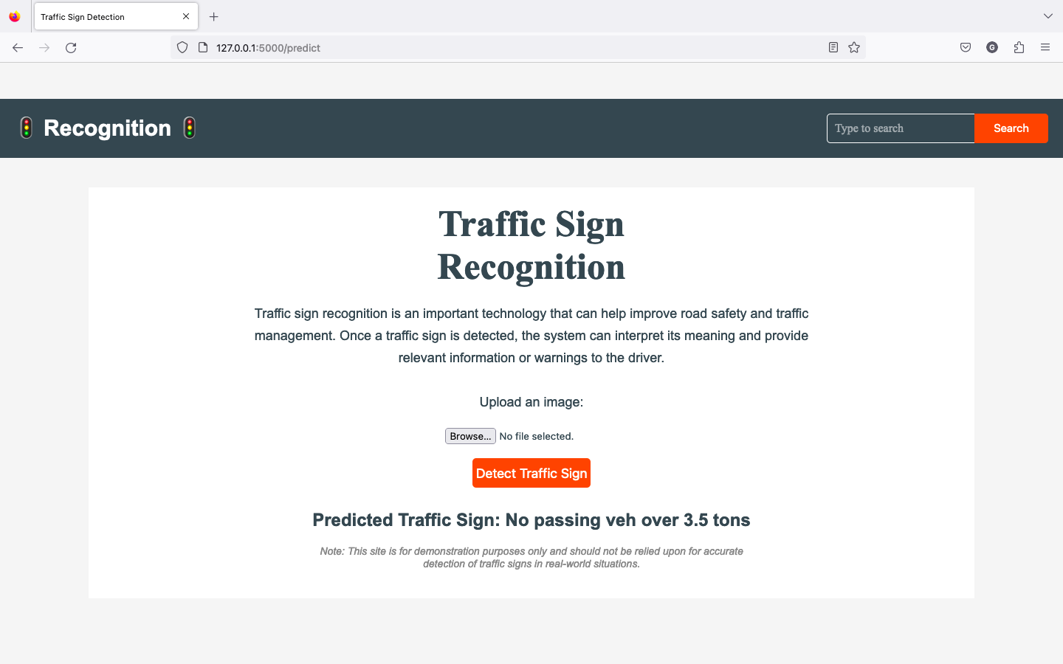

Slide 13
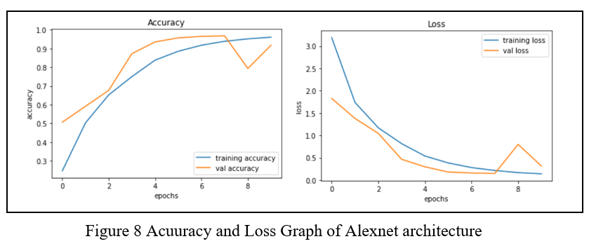
Results & Discussion
Accuracy and Loss Graph of Alexnet architecture
Customised AlexNet achieved 96.06% training accuracy and 91% validation accuracy.
Testing accuracy was 83.8%.
Training took around 8 hours.
The model showed a balanced performance in the accuracy and loss graph. Loss decreased gradually with increasing epochs.

Slide 14
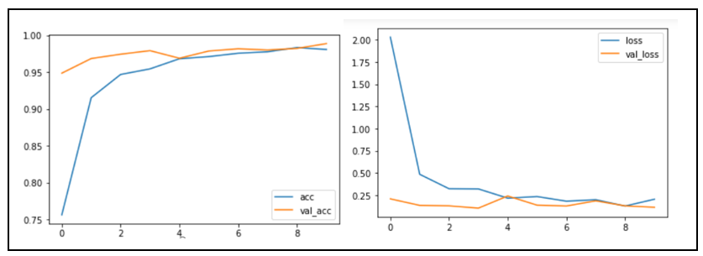
Accuracy and Loss Graph of Vgg16 architecture
Modified Vgg16 achieved 98% training accuracy and 98.9% validation accuracy.
Testing accuracy was 89.688%.
Training time exceeded one day due to high parameter count and image size.
The model performed well considering the high complexity, demonstrating its effectiveness.

Slide 15
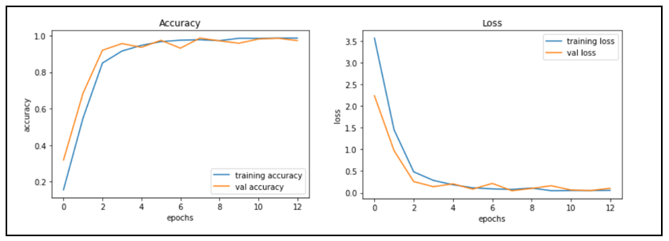
Accuracy and Loss Graph of Resnet50 architecture
Customized ResNet achieved a training accuracy of 98.6% and a validation accuracy of 97.33%.
Testing accuracy was measured at 93.96%.
ResNet50 demonstrated the highest accuracy on the training data.
The training process took approximately 15 hours. The model's performance on the testing data was also satisfactory.

Slide 16
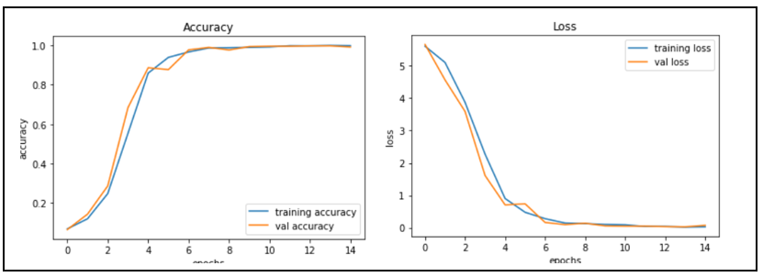
Accuracy and Loss Graph of google net architecture
Customized GoogleNet achieved a training accuracy of 99.8% and a validation accuracy of 99.1%.
Testing accuracy was measured at 95.92%.
The GoogleNet model with 22 layers had three dense layers, with the highest accuracy among them being 99%.
Among all the models, GoogleNet achieved the highest accuracy on the testing data.

Slide 17
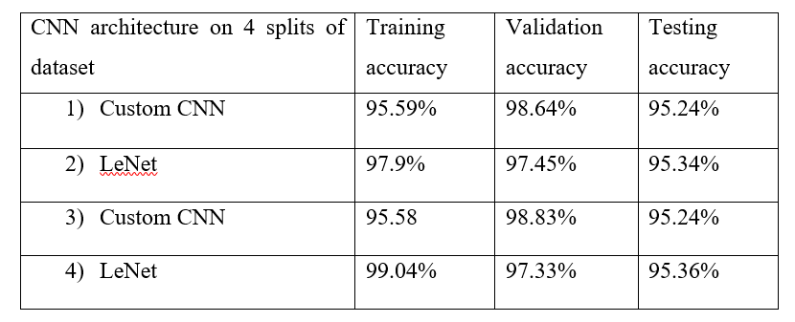
Models accuracy on 4 different random split of dataset
Two models, Custom CNN and LeNet, were trained on different dataset splits.
After combining the four models, the ensemble accuracy on the testing dataset was 96.31%.
Ensemble techniques improved the overall model efficiency.

Slide 18
Conclusion & Future Work
The recommended framework performs accurate characterization on both the GTSRB dataset and a recently created dataset.
Convolutional Neural Networks (CNN) are used in the proposed approach for training the model.
Histogram equalization is applied to pre-processed photos to improve contrast.
The highest accuracy achieved on the test dataset is 96.3% using ensemble methods.
Future work can involve fine-tuning models with more data and collecting data from different parts of the world to improve accuracy and robustness.
Real-time traffic sign detection can be explored for applications like autonomous driving. Multi-lingual traffic sign recognition could enhance safety on roads by recognizing signs in different languages.
Disadvantages of traffic sign categorization include obscured or difficult-to-see signs, which can pose risks and require further study.

Slide 19
Thank You

