Slide 1
STOCK MARKET TREND ANALYSIS
Team Details:
Yuvraj(2110993863)
Aniket Thakur (2110993872)
Faculty Coordinator:
Dr. Kamal Deep Garg
:
Chitkara University Institute of Engineering and Technology,
Chitkara University, Punjab

Slide 2
Table of Contents
Introduction
Problem Statement
Technical Details
Key Features
Project Highlights
Bonus Feature(optional)
Conclusion
References/Links used

Slide 3
Introduction
In the realm of financial markets, understanding and predicting stock market trends is a critical endeavor. Stock market trend analysis, at its core, involves the meticulous examination of historical data and current market conditions to discern patterns and forecast potential future price movements. In an era marked by the rapid evolution of financial landscapes, the significance of making well-informed investment decisions has never been more pronounced. It is within this context that we embark on a journey to explore the fusion of cutting-edge technologies—deep learning and natural language processing (NLP)—with traditional stock market analysis methods.
.

Slide 4
Problem Statement
Enhancing Investment Strategies through Stock Price Forecasting with Deep Learning and NLP.
In today's dynamic financial landscape, investors seek more accurate and timely information to optimize their investment decisions. This project aims to develop an advanced stock price prediction system that leverages deep learning techniques and NLP to provide investors with actionable insights for enhancing their investment strategies.

Slide 5
Technical Details
Deep Learning Frameworks:
TensorFlow: An open-source deep learning framework developed by Google.
Keras: A high-level neural networks API that runs on top of TensorFlow, Theano, or Microsoft Cognitive Toolkit (CNTK).
NLP Libraries:
NLTK (Natural Language Toolkit): A comprehensive library for NLP in Python.
spaCy: An open-source library for advanced NLP in Python, known for its efficiency.
Hugging Face Transformers: A library that provides pre-trained transformer-based models (e.g., BERT, GPT) for NLP tasks.
Data Processing and Analysis:
Pandas: A data manipulation library for handling and analyzing structured data, often used to preprocess stock price data.
NumPy: A fundamental library for numerical operations in Python, commonly used for numerical data manipulation.
Data Visualization:
Matplotlib: A popular library for creating static, animated, or interactive visualizations in Python.
Seaborn: A data visualization library based on Matplotlib, known for its attractive and informative statistical graphics.
Model Development:
Recurrent Neural Networks (RNNs): Effective for sequential data, RNNs are commonly used in time series analysis for stock price prediction.
Long Short-Term Memory (LSTM) Networks: A type of RNN designed to capture long-term dependencies, making them well-suited for time series data.

Slide 6
Key Features
Predictive Modeling with Deep Learning:
Neural Networks: Utilizing complex neural network architectures to analyze historical stock prices and predict future trends. Deep learning models, such as recurrent neural networks (RNNs) and long short-term memory networks (LSTMs), can capture intricate patterns in time-series data.
Time Series Analysis:
Temporal Patterns: Deep learning models are adept at recognizing temporal patterns in stock price movements. This allows for the identification of trends, seasonality, and other time-dependent factors that influence market behavior.
Sentiment Analysis using NLP:
Text Mining and Sentiment Analysis: Leveraging NLP techniques to analyze financial news, social media, and other textual data to gauge market sentiment. Positive or negative sentiment can impact stock prices, and NLP helps in quantifying and interpreting this sentiment.
Data Fusion and Integration:
Integration of Multiple Data Sources: Combining various data sources, including financial reports, news articles, social media feeds, and historical stock prices, to create a comprehensive dataset for analysis. This allows for a more holistic understanding of market trends.
Pattern Recognition and Anomaly Detection:
Identifying Anomalies: Deep learning algorithms excel at recognizing patterns and detecting anomalies in data. This feature helps in identifying unusual market behavior or events that may impact stock prices.

Slide 7
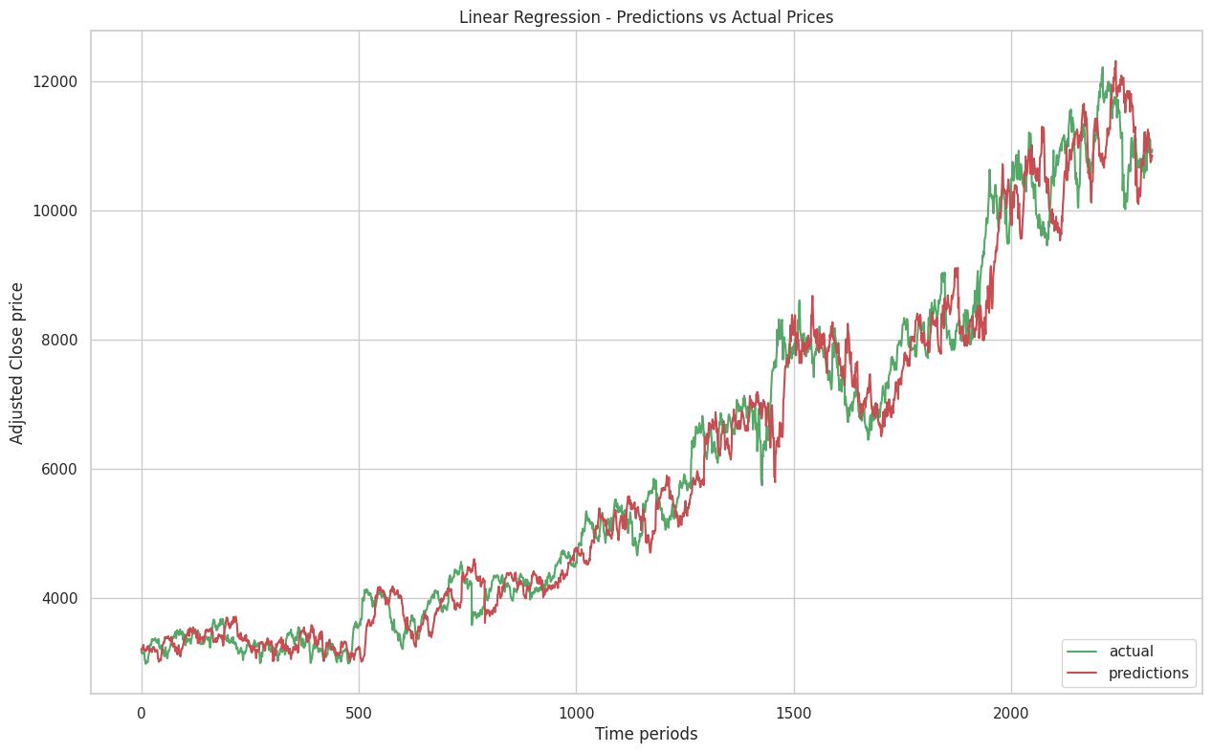
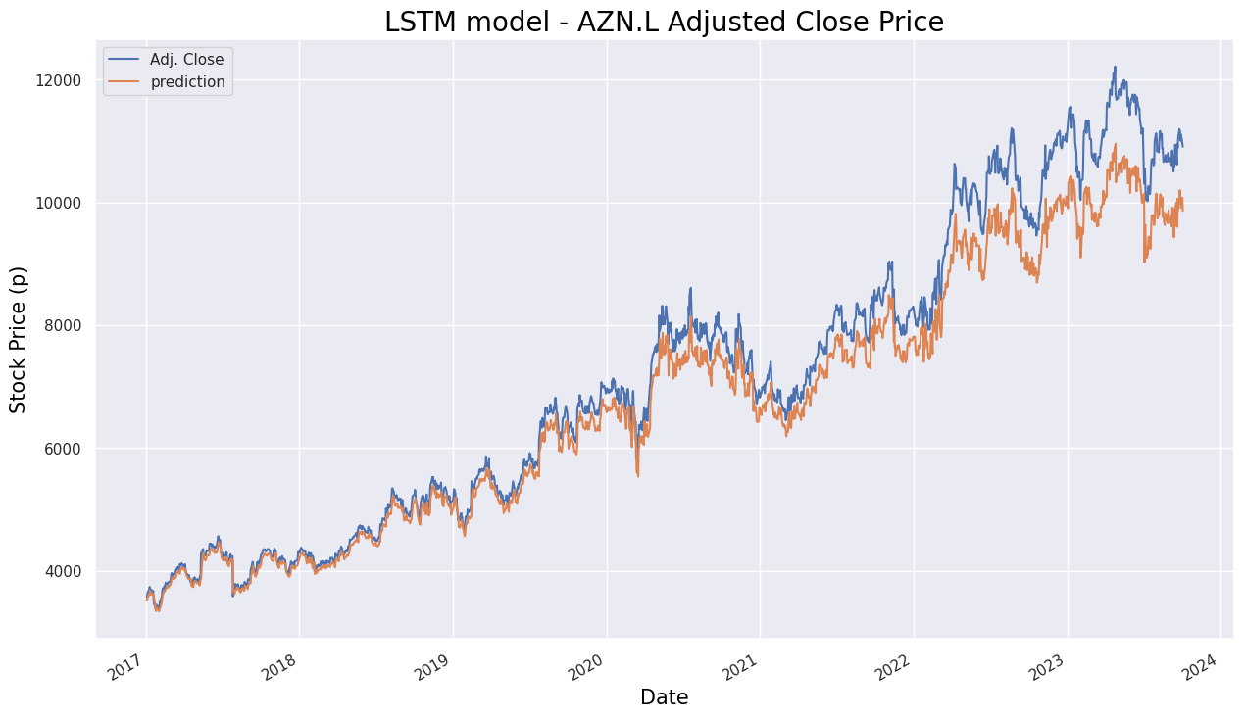
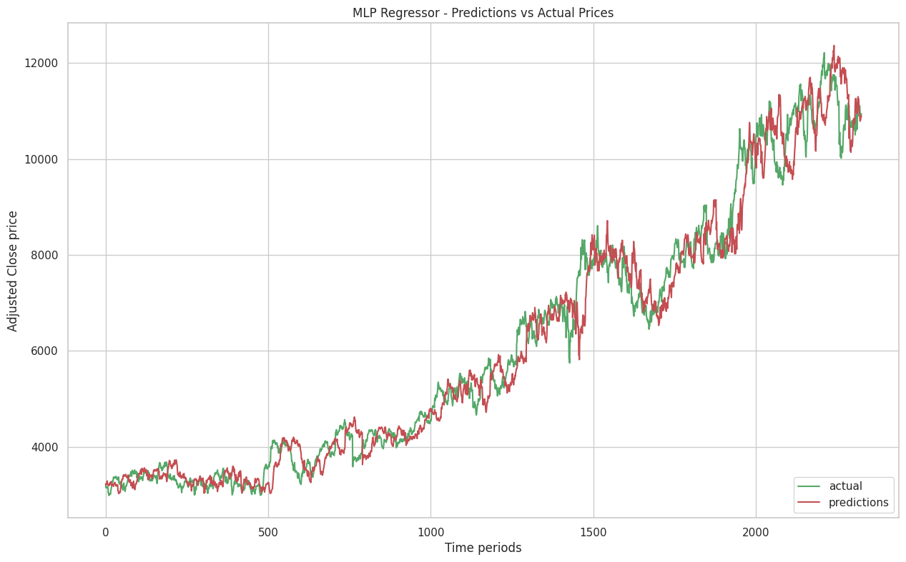
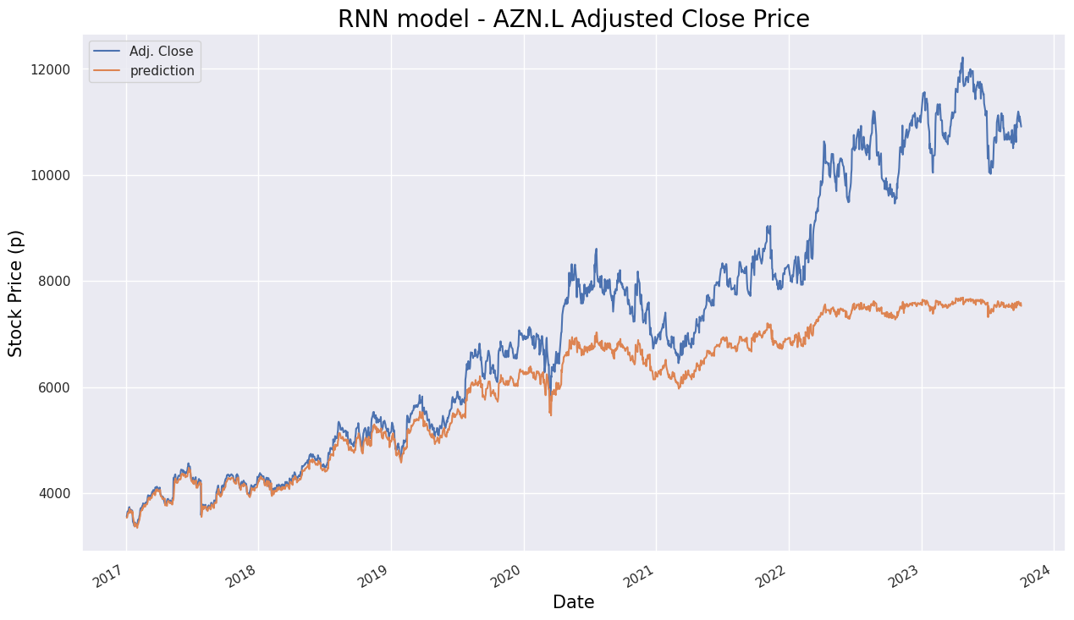
Project Highlights

Slide 8
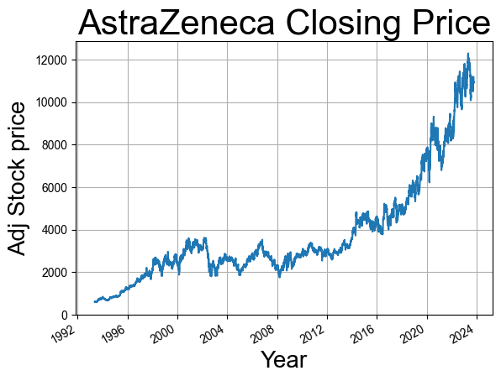
Project Highlights

Slide 9
Conclusion
In conclusion, the integration of deep learning and natural language processing (NLP) into stock market trend analysis marks a pivotal evolution in the landscape of financial decision-making. This synthesis of advanced technologies empowers investors, traders, and financial institutions with unprecedented capabilities to decipher the complexities of the market. Through the exploration of predictive modeling with deep learning, time series analysis, sentiment analysis using NLP, and algorithmic trading strategies, we unveil a transformative approach to understanding and anticipating market trends.
Using more advanced time series based models which are currently in demand to increase the performance of the model.
Improved data analysis using dashboarding tools such as Power BI.
Building or deploying our model on web based app.
Using famous NLP transformer based models such as BERT for sentiment analysis

Slide 10
References/Links used
https://www.sciencedirect.com/science/article/pii/S1877050918307828
https://ieeexplore.ieee.org/abstract/document/8703332?casa_token=gEzI3c7TpIYAAAAA:qAZe8MW-rf1ua8OYx4zYn1T768FpqhXmuBuj2mseXEPXwm8_aZYkwnF7QPeBVVO_O891ENJjkIk
https://ieeexplore.ieee.org/abstract/document/8346382

Slide 11


