Slide 1

ME 644
Machine Learning for Engineers
Prof: Malay K. Das
AERODYNAMIC DRAG COEFFICIENT PREDICTION USING MACHINE LEARNING
PRESENTED BY:-
Yuvraj kumar
Roll No.-231204

Slide 2
What Is Aerodynamic Drag and Why Should We Predict It?
INTRODUCTION
What is Aerodynamic Drag
The Real-World Cost of Getting It Wrong
Any object moving through air faces resistance — this is drag. For an aircraft flying at high speed, this force is enormous.
1% reduction in C_D saves ~100,000 litres of fuel/year per aircraft.
Drag acts opposite to motion. Think of it as air friction — the faster you go, the stronger it pushes back.
Higher drag forces larger engines, heavier structure, shorter range. Everything compounds.
The drag coefficient C_D is a dimensionless number that rates aerodynamic efficiency. Lower = cleaner shape.
For drones & UAVs: lower drag directly extends battery life and flight time.
The Drag Force Equation
Why Traditional Methods Are Too Slow
F_D = ½ · ρ · v²· C_D · A
✗ Wind tunnel test: Weeks + $500K–$1M per configuration
✗ CFD simulation: Hours to days per operating point
★ ML surrogate : < 1 millisecond — 100,000× faster than CFD

Slide 3
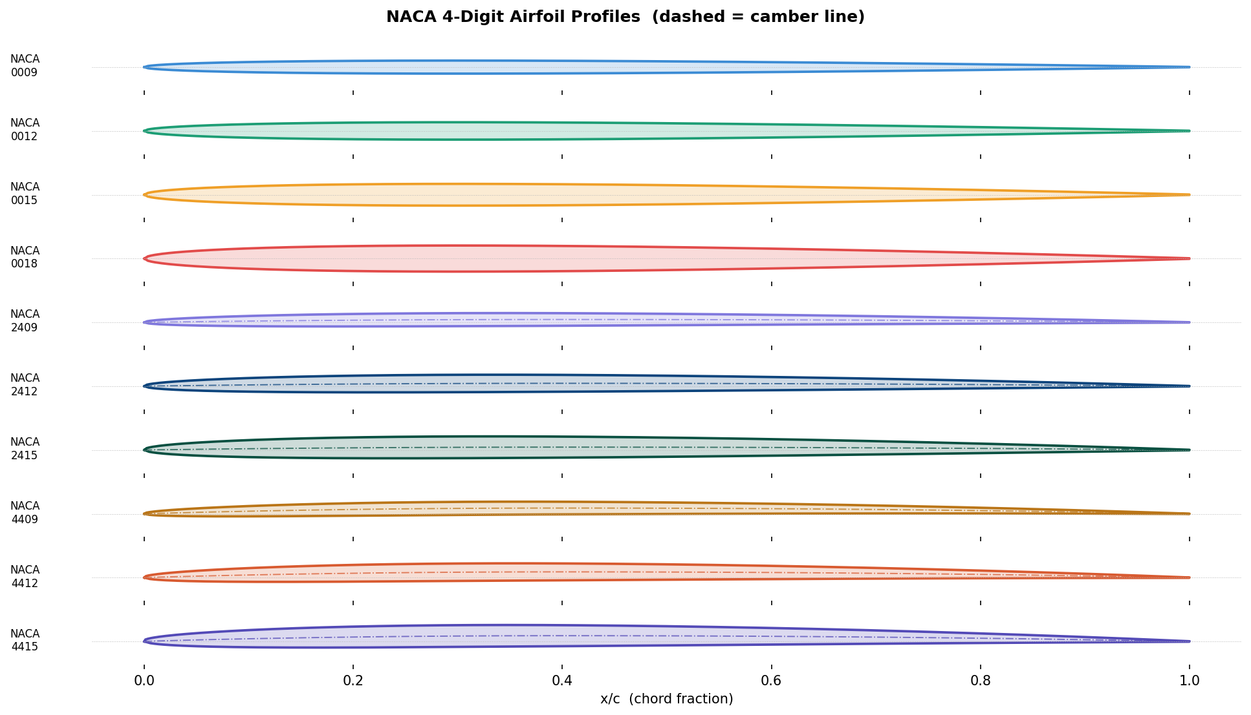
AIRFOIL GEOMETRY
NACA 4-Digit Airfoils for Our Wing Cross-Section Test
NACA M P T T
max camber camber pos Max thickness
▸ M = Max camber as % of chord (e.g. 2 → 2%)
▸ P = Camber position in tenths (e.g. 4 → 40% chord)
▸ TT = Max thickness as % of chord (e.g. 12 → 12%)
Examples of Profiles in This Study
NACA
Camber
t/c
0009
0%
9%
0012
0%
12%
2412
2%
12%
2415
2%
15%
4409
4%
9%

Slide 4
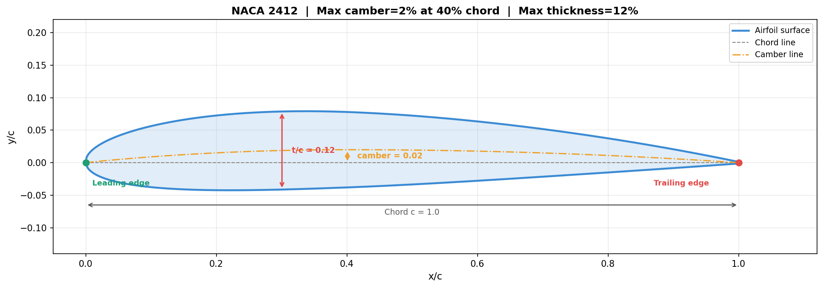
AIRFOIL GEOMETRY — ANNOTATED
Example:-NACA 2412
Chord line (grey dashed)
A straight line from leading edge to trailing edge. It is the reference line from which the angle of attack α is measured. .
Camber line (orange dashed)
The mean line equidistant from upper and lower surfaces. For NACA 2412, it peaks at 2% of chord length (0.02c) at 40% of chord (0.4c).
Thickness arrow (red)
The maximum perpendicular distance between upper and lower surfaces. For NACA 2412 it is 12% of chord
Leading edge (green dot)
The foremost point of the airfoil. In real wings, this has a finite radius to prevent sharp leading-edge stall.

Slide 5
PHYSICS — DRAG COMPONENTS
C_D = C_Df + C_Dp + C_Di + C_Dw + C_Ds
C_Df — Skin Friction
C_Dp — Pressure Drag
C_Di — Induced Drag
C_Dw — Wave Drag
C_Ds — Stall Drag
Air viscosity causes a thin boundary layer. Friction between slow near-wall air and fast outer flow creates a drag force on both surfaces.
High pressure at front, low-pressure wake at rear. Thicker airfoils have a bigger pressure difference and more form drag.
Finite wings shed tip vortices when lifting. These tilt the effective lift vector backward — a drag penalty for producing lift.
Near Ma=0.7, local shockwaves form even in subsonic flight. Energy is lost to compression — drag rises sharply.
Past stall angle (~14-16°), boundary layer separates. Smooth sigmoid chosen to keep gradients well-defined for ML training.
Blasius (laminar): Cf_lam = 1.328 / √Re
Hoerner: C_Dp = Cf·(2·t/c + 60·(t/c)⁴)
Prandtl (1918): C_Di = C_L² / (π·e·AR)
Prandtl-Glauert: C_D = C_D0/√(1-Ma²)
C_Ds = 0.15 / (1 + exp(-2.5·(α - α_stall)))
Prandtl-Schlichting: Cf_turb = 0.455/(log₁₀Re)²·⁵⁸
For NACA 2412 (t/c=0.12)
e = 0.85 (Oswald eff.), AR = 8.0 (aspect ratio)
Wave spike: C_Dw = max(0,((Ma-0.7)/0.3)³)·0.10
α_stall = 12 + 30·camber + 20·(t/c) [degrees]
Profile drag: C_D0 = C_Df + C_Dp
Drag polar: C_D = C_D0 + C_L²/(π·e·AR)
At Ma=0.7: factor=1.40 → C_D increases 40%
At stall: C_D spikes 3-5× above cruise value
C_Df = 2·Cf

Slide 6
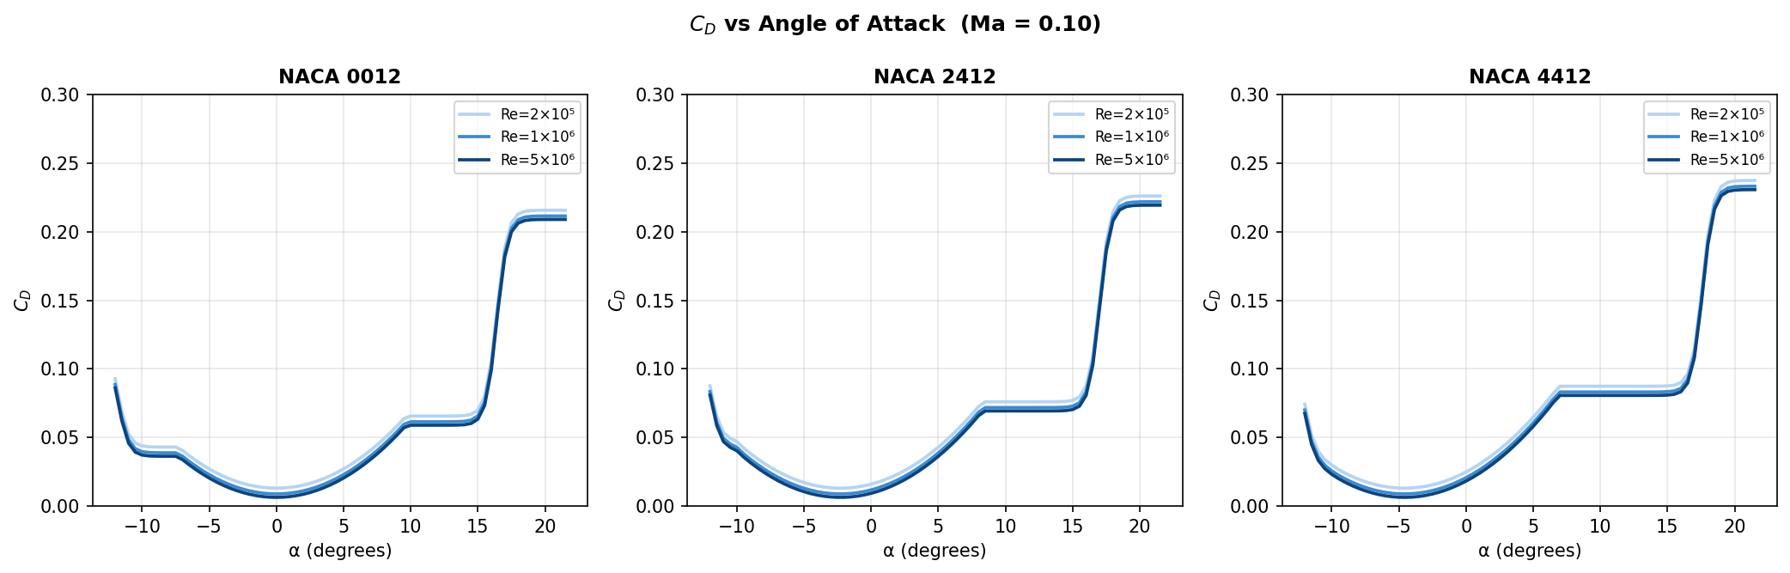
ANGLE OF ATTACK EFFECT
How C_D Changes with Angle of Attack (Why to Include C_Ds)
Regime 1 — Attached Flow (−12° to ~10°)
Regime 2 — Pre-Stall (10° to ~14°)
Regime 3 — Post-Stall (>14°)
C_D is low and nearly constant. Dominated by skin friction + small induced drag. This is the cruise condition. Higher Re gives lower C_D because turbulent C_f decreases: C_f ∝ (log Re)⁻²·⁵⁸.
C_D rises sharply as induced drag grows quadratically: C_Di = C_L²/(π·e·AR). The boundary layer also begins separating at the leading edge. This transition is the hardest region for ML models to learn.
C_D spikes 3–5× as flow fully separates. Models assuming smooth functions (SVR, Poly Ridge) under-predict here. Random Forest and ANN handle sharp regime boundaries with tree splits / ReLU activations.

Slide 7
DATASET GENERATION
Building the Dataset
C_D =f(alpha, Re, Mach, t/c, camber)
8 Input Features → 1 Output (C_D)
Feature
Range
Physical Meaning
alpha
-12° to +21.5°
Angle of attack — dominant predictor
log(Re)
5.0 to 6.7
Log Reynolds — skin friction level
Mach
0.05 to 0.70
Compressibility correction
t/c
0.09 to 0.18
Thickness → form drag (Hoerner)
camber
0 to 0.04
Zero-lift angle shift
C_L
-0.86 to 1.28
Pre-computed from thin airfoil theory
C_L²
0 to 1.63
Drag polar feature: C_Di ∝ C_L²
Re·Ma
0.005 to 3.5
Normalised interaction term

Slide 8
ML MODELS — OVERVIEW
Regression Models
1. Polynomial Ridge
2. Random Forest
3. SVR (RBF Kernel)
4. ANN 128→64→32
Degree-3 features + L2 penalty.
200 bootstrap trees, averaged.
Epsilon-tube + RBF kernel.
3 hidden layers, ReLU, Adam.
165 expanded features from 8 inputs (all cubic cross-terms). Closed-form solution. Fast but limited.
Each tree trained on different data sample. Random feature subsets decorrelate trees. No scaling needed.
Finds flattest function within ε=0.001 tolerance zone. RBF kernel implicitly maps to infinite dims.
Backpropagation + Adam optimiser with bias correction. Early stopping at 20 no-improve epochs.
min ‖y-Φw‖² + λ‖w‖²
ŷ = (1/200) Σ fₜ(x)
min ½‖w‖²+C·Σ(ξᵢ+ξᵢ*)
h⁽ˡ⁾ = ReLU(W⁽ˡ⁾h⁽ˡ⁻¹⁾+b⁽ˡ⁾)
✓ Fast, interpretable
✓ Best R²=0.9992
✓ Good for small data
✓ R²=0.9991
✗ Fails at sharp stall transitions
✓ Free feature importance
✗ Smooths stall spike
✓ Smooth nonlinear fits
R²=0.9439
R²=0.9992
R²=0.9528
R²=0.9991

Slide 9
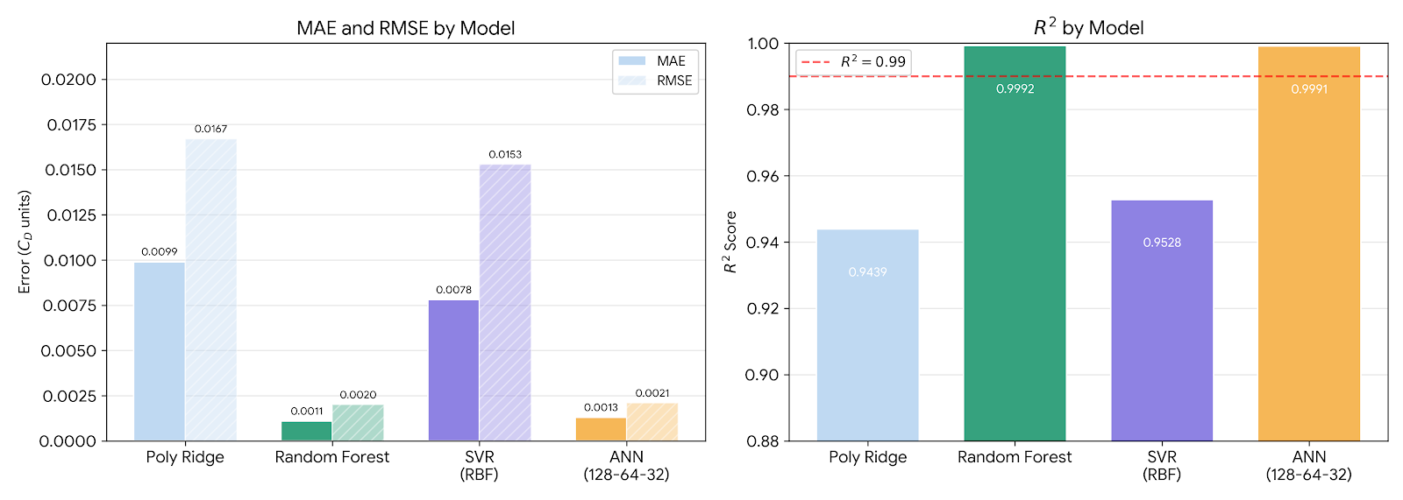
RESULTS — MODEL PERFORMANCE
All Models Evaluated
Metric Definitions
MAE = (1/N)Σ|yᵢ-ŷᵢ|
RMSE = √[(1/N)Σ(yᵢ-ŷᵢ)²]
R² = 1 - Σ(yᵢ-ŷᵢ)²/Σ(yᵢ-ȳ)²
R²=0.9992 means 99.92% of C_D variance explained. MAE=0.00113 means average error is 0.00113 in C_D units
Model
MAE
RMSE
R²
Max Error
Why It Performs This Way
Polynomial Ridge
0.00987
0.01670
0.9439
0.0783
Cubic polynomial cannot represent sharp stall sigmoid. Under-predicts C_D at high α.
Random Forest ★
0.00113
0.00199
0.9992
0.0189
Tree splits match regime boundaries. Ensemble of 200 trees captures every non-linearity.
SVR (RBF)
0.00778
0.01531
0.9528
0.0875
ε-tube smooths sharp transitions. Good in attached flow, worse near stall.
ANN (128-64-32)
0.00126
0.00210
0.9991
0.0203
Three ReLU layers approximate stall sigmoid via piecewise linear composition.

Slide 10
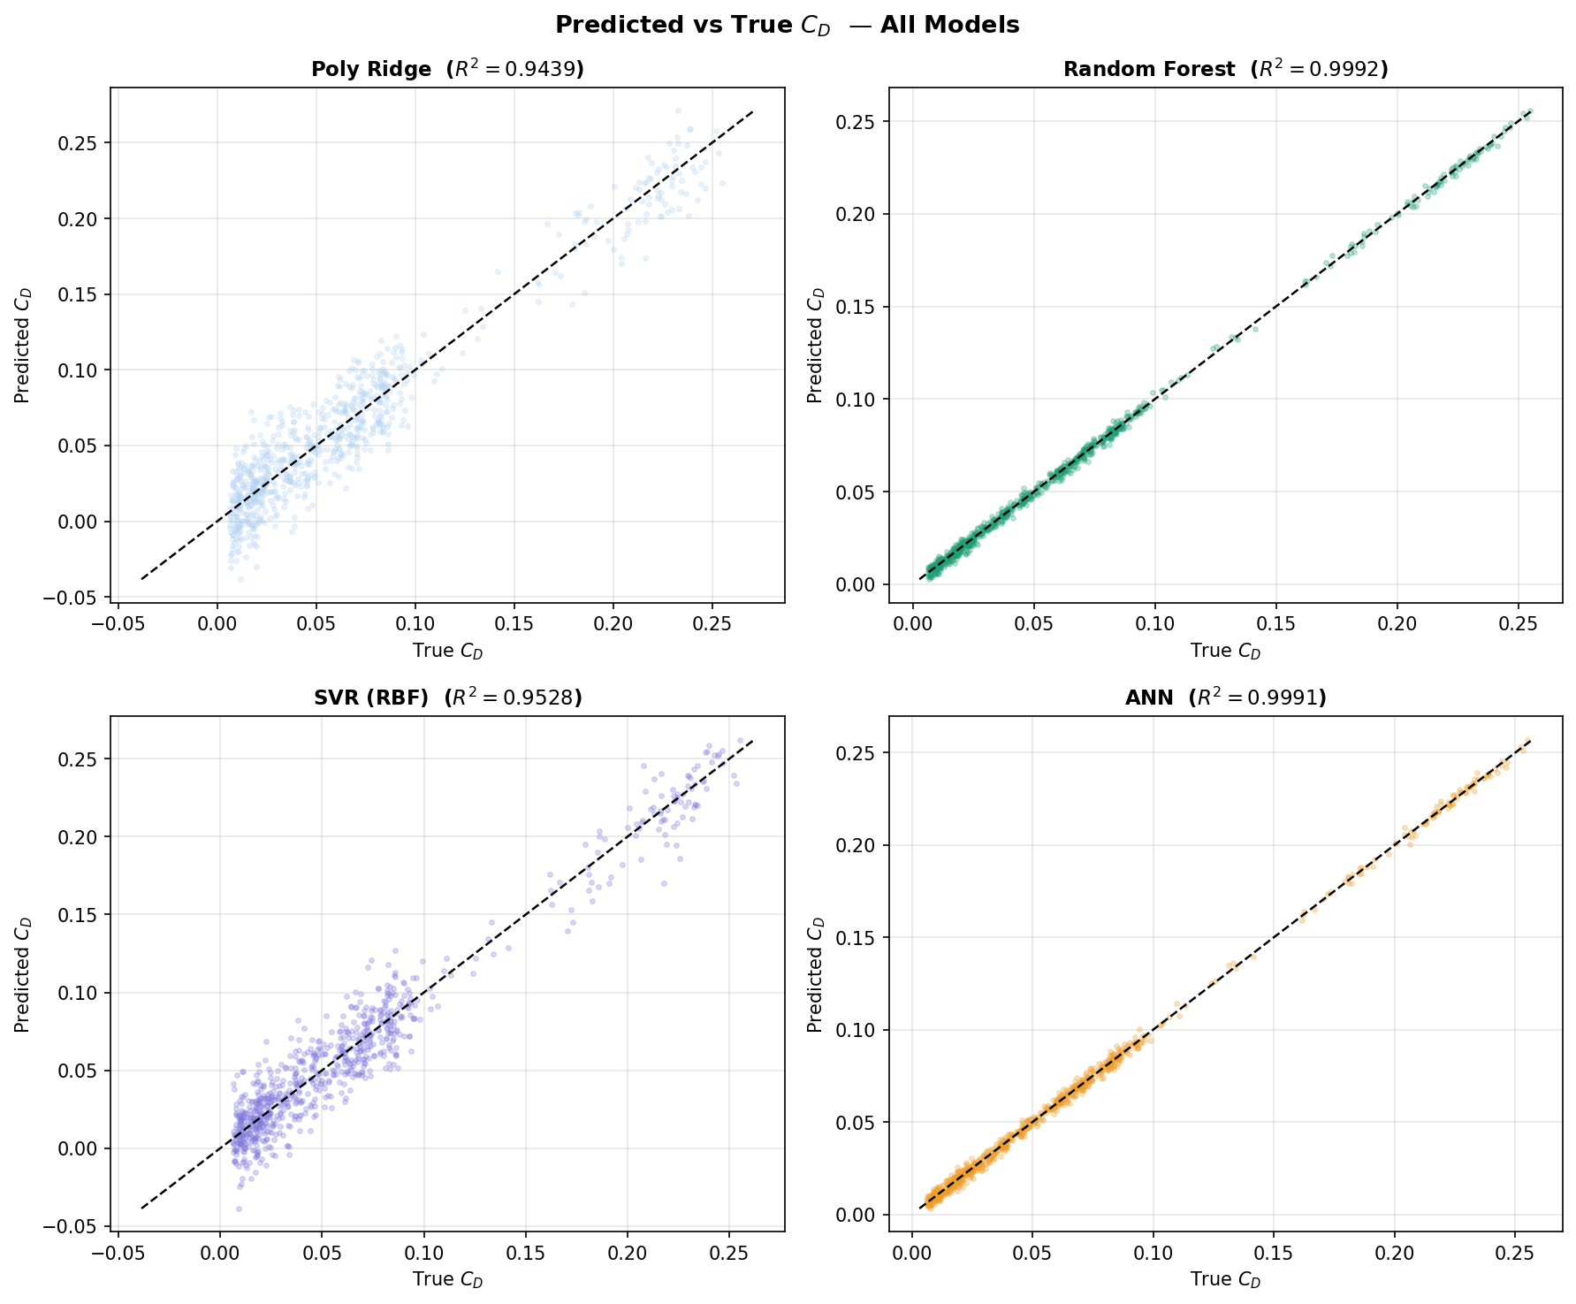
RESULTS — PREDICTED VS TRUE
Predicted vs True C_D Scatter Plots

Slide 11
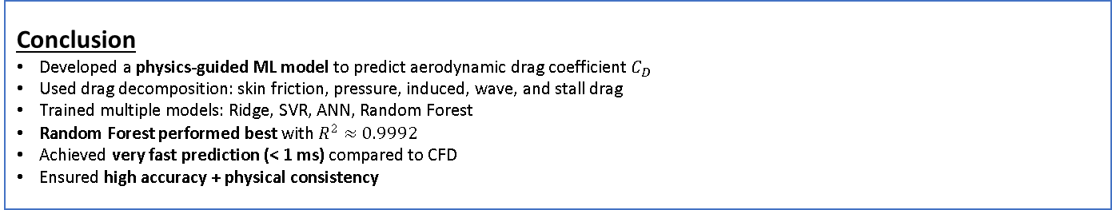
CONCLUSIONS AND FUTURE SCOPE
Conclusion and Future Scope
Conclusion
Developed a physics-guided ML model to predict aerodynamic drag coefficient $C_{D}$
Used drag decomposition: skin friction, pressure, induced, wave, and stall drag
Trained multiple models: Ridge, SVR, ANN, Random Forest
Random Forest performed best with $R^{2}≈0.9992$
Achieved very fast prediction (< 1 ms) compared to CFD
Ensured high accuracy + physical consistency
Future Scope
Extend from 2D airfoils to full 3D wing analysis
Use advanced models like CNNs / deep learning for geometry-based prediction
Expand to unsteady flow conditions
Develop real-time tools / software integration for practical use

