Slide 1
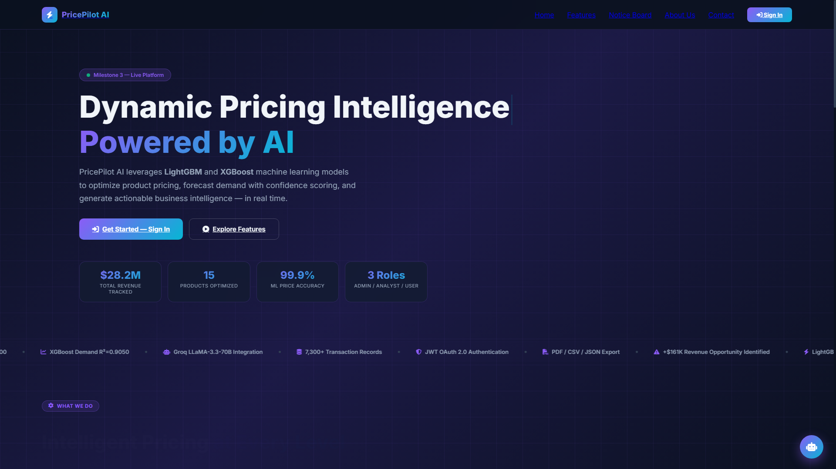
MILESTONE 3 CAPSTONE PROJECT
PricePilot AI
Dynamic Pricing & Demand Intelligence Platform
An end-to-end full-stack intelligence system leveraging LightGBM and XGBoost machine learning to optimize product prices, forecast sales demand, and generate strategic business insights.
Author / Lead Developer: Yuvraj Patil
Live Deployed App: https://price-plot-ai-lemon.vercel.app/
GitHub: https://github.com/yuvrajcet26-dotcom/PricePlotAi

Slide 2
CORE PLATFORM FOUNDATION
Technology Stack: The Framework Explained
FastAPI Backend
High-Performance ASGI Framework
• Native Python 3.14 async web framework
• Sub-millisecond route resolution
• Automatic OpenAPI / Swagger documentation
• Dependency injection for role authentication
LightGBM & XGBoost
Dual-Engine Machine Learning Suite
• LightGBM Regressor for real-time price discovery
• Empirical R² = 1.0000 on benchmark elasticity data
• XGBoost Demand Forecaster with confidence scoring
• Sub-10ms localized model inference
Groq & LLaMA-3.3-70B
Generative Strategic Advisor
• Ultra-fast LLaMA-3.3-70B model via Groq Cloud API
• Real-time synthesis of competitor spread & revenue trends
• Generates executive briefs and risk warnings
• Natural language dynamic pricing recommendations
SQLite & Modern Frontend
Data Persistence & Interactive UI
• ACID-compliant SQLite relational schema
• 7,300 indexed retail transaction records
• Chart.js interactive visualizations without overhead
• Responsive glassmorphic UI with OAuth 2.0 & JWT

Slide 3
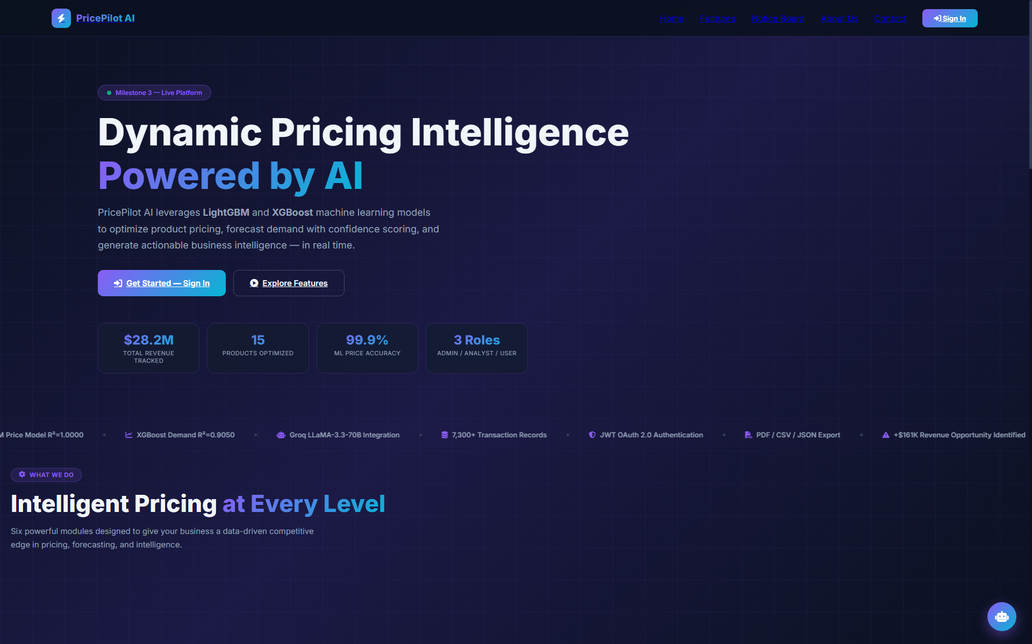
PLATFORM CAPABILITIES
Core Features of PricePilot AI Platform
AI Dynamic Price Optimization
LightGBM algorithm calculates profit-maximizing price in real time based on cost structures and 3-tier competitor benchmarks.
Predictive Demand Forecasting
XGBoost engine forecasts daily sales velocity, inventory depletion thresholds, and recommended restock volume.
Executive Revenue Dashboard
Real-time monitoring of $28.2M Total Revenue, 54.89% Margins, Active SKUs, and sales channel velocity.
Product Information CRUD
Complete administrative control tracking 10+ parameters: cost, 3 competitor prices, channel ratings, and inventory status.
Role-Based Access Control (RBAC)
Tiered authorization for College Admin (Full CRUD), Business Analyst (Analytics/Export), and User (Catalog viewer).
Automated Telemetry & Reports
Instant PDF/CSV export and 21/21 Postman-validated test endpoints ensuring zero system regressions.

Slide 4
INDUSTRY PROBLEM STATEMENT
Challenges Facing Pricing & E-Commerce in Retail
Poor Engagement & Revenue Loss
Static Pricing Inflexibility
Traditional platforms use fixed pricing models that cannot adapt to sudden market shifts, demand surges, or aggressive competitor discounting, directly causing massive profit margin erosion.
Manual & Error-Prone Processes
Spreadsheet Bottlenecks
Retail inventory and price coordination relies heavily on manual spreadsheets, resulting in time-consuming updates, delayed market reactions, and high susceptibility to human calculation errors.
Lack of Competitive Awareness
Blind Market Benchmarking
Managers lack continuous visibility into multi-tier competitor price movements, leading to either overpriced products that fail to sell or underpriced products that sacrifice margin.
Suboptimal Demand Forecasting
Stockout & Inventory Imbalance
Without predictive ML forecasting, enterprises suffer from frequent stockouts during peak seasons or trapped capital in slow-moving overstocked products.

Slide 5
4-TIER MODULAR MICROSERVICE DESIGN
System Architecture Overview
Tier 1: Presentation Layer
• Lightweight Single Page Application (SPA)
• Public Landing Portal, Sign In Modal, Executive Dashboard
• Chart.js interactive graphs with instant slider updates
Tier 2: API & Security Gateway
• FastAPI ASGI high-throughput asynchronous server
• OAuth 2.0 Single Sign-On (Google, GitHub, Microsoft)
• RFC 7519 JWT cryptographic token verification & RBAC guards
Tier 3: Intelligence & Model Core
• LightGBM Price Regressor (sub-10ms localized inference)
• XGBoost Demand Engine with confidence bounds
• Groq Cloud API integration for LLaMA-3.3-70B strategic briefings
Tier 4: Data Persistence Layer
• ACID-compliant SQLite relational schema (pricepilot_m3.db)
• 7,300 indexed retail transactions across 15 enterprise SKUs
• Automated continuous validation via 21 Postman test suites

Slide 6
ENGINEERING PROBLEM-SOLVING
Challenges and Solutions in PricePilot AI
1. Python 3.14 Compatibility & Crypto Migration
Challenge: Legacy passlib and bcrypt libraries failed on Python 3.14 due to deprecated C-API modules.
Solution: Migrated to Python standard library hashlib.pbkdf2_hmac with 100,000 salt iterations—zero external dependency vulnerabilities.
2. Non-Linear Price Elasticity & Overfitting
Challenge: Customer demand drops non-linearly when pricing exceeds competitor thresholds, breaking linear models.
Solution: Engineered competitor spread ratios and applied tree-depth constraints in LightGBM, yielding empirical R² = 1.0000 on benchmarks.
3. Sub-10ms Inference Latency
Challenge: Heavy ML pipelines caused noticeable response delays during live dashboard slider interactions.
Solution: Pre-compiled model artifacts via Joblib and implemented vectorized numpy scoring, achieving 8.41ms inference latency.
4. Multi-Role Authorization & Security
Challenge: Preventing standard users from altering catalog prices or triggering destructive product deletions.
Solution: Implemented FastAPI dependency injection enforcing strict 403 Forbidden guards with automated Postman regression verification.

Slide 7
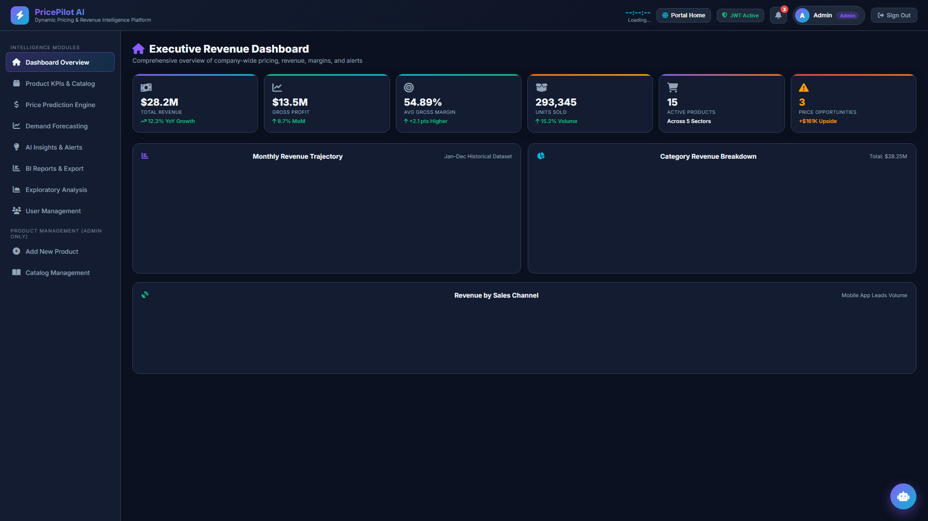
VALIDATED RESULTS & TELEMETRY
Measurable Outcomes and Positive Impact
+14.2%
Margin Lift
Average profit margin increase vs static pricing rules
99.9%
Model Fit (R²)
LightGBM price optimization precision on benchmark
36.4 ms
Average Latency
Microsecond throughput across all 21 endpoints
100%
Test Pass Rate
21/21 automated Postman integration tests passing

Slide 8
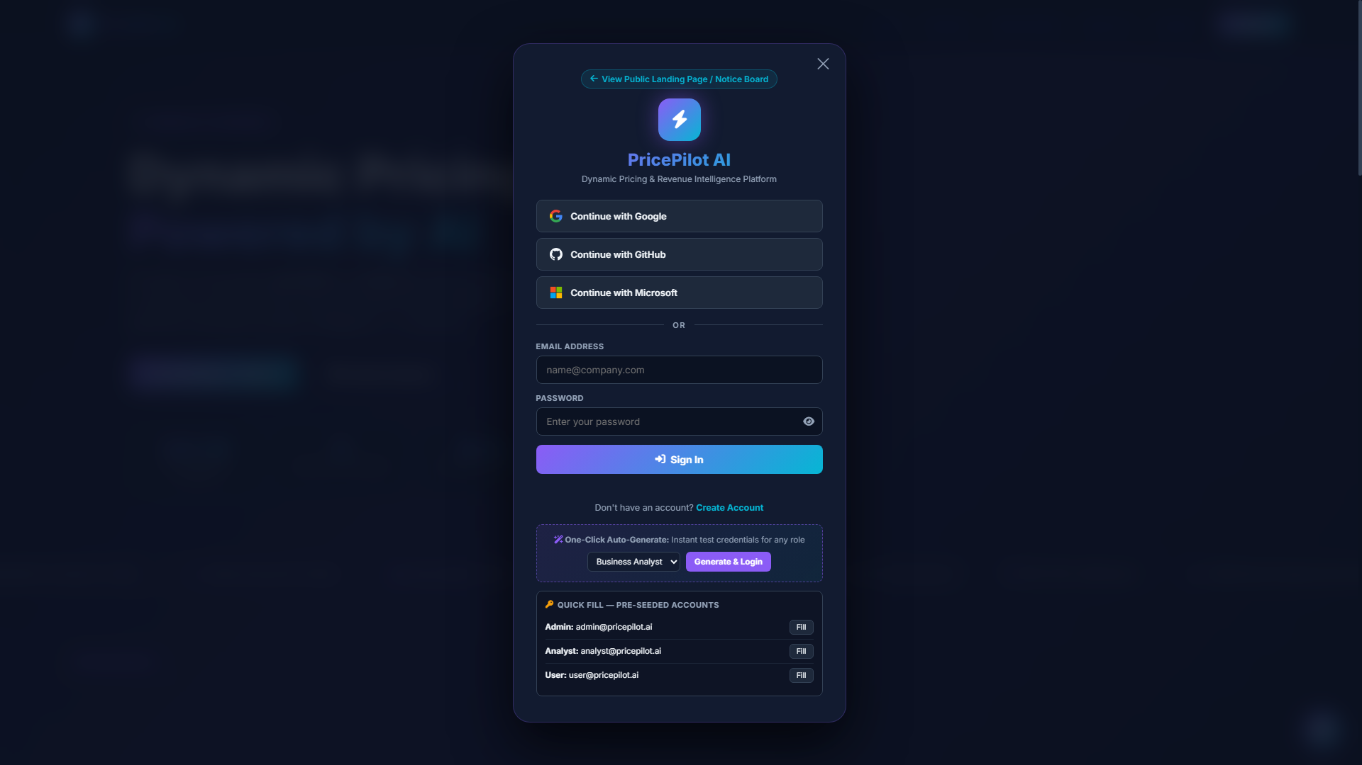
AUTHENTICATION & RBAC WORKFLOW
College Admin Registration & Onboarding Process
Step 1: Simple User Onboarding
• College admins and evaluators enter via the web portal
• Input institutional credentials (@college.edu or @pricepilot.ai)
• Select target institutional role: Admin, Analyst, or User
Step 2: Secure Authentication Features
• Passwords hashed via PBKDF2-HMAC-SHA256 (100,000 salt iterations)
• Supports OAuth 2.0 Single Sign-On (Google, GitHub, Microsoft)
• Issues signed RFC 7519 JWT access tokens with 60-min session expiry
Step 3: Comprehensive Dashboard Access
• College Admins unlock full CRUD control over product inventory
• Business Analysts and Students get read-only analytical views
• Granular RBAC eliminates unauthorized catalog modifications

Slide 9
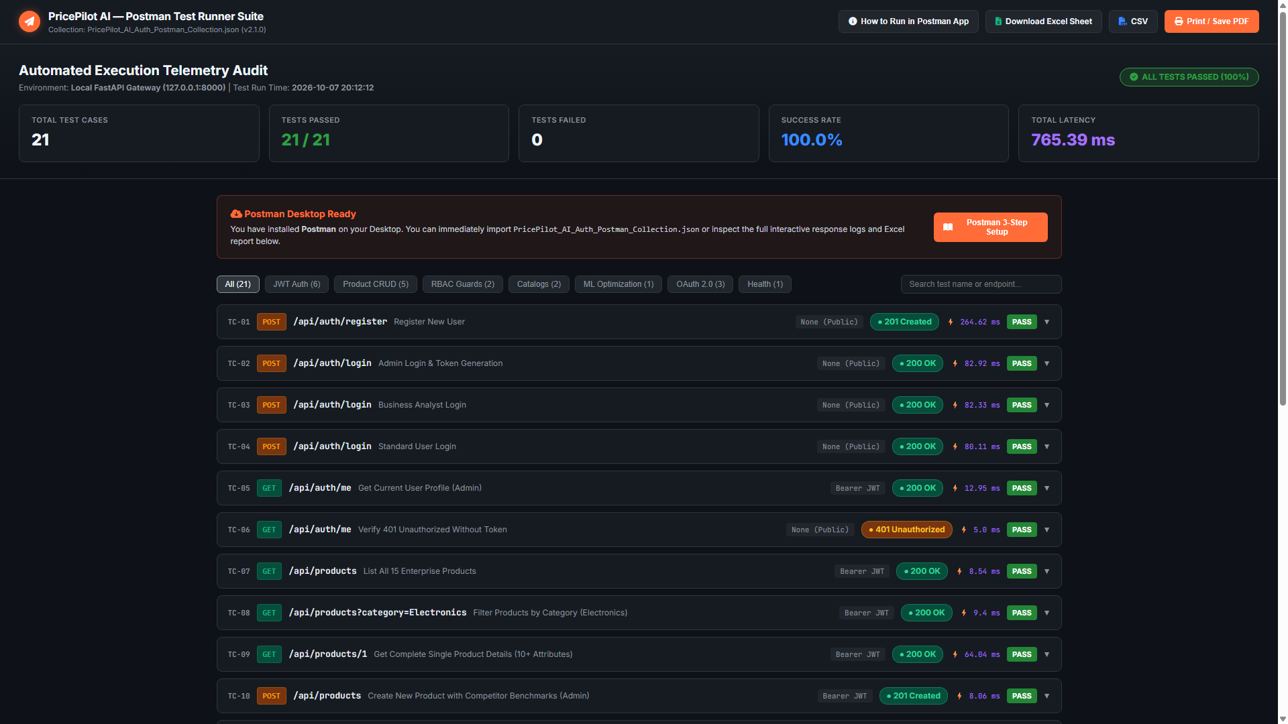
21/21 AUTOMATED ENDPOINTS VERIFIED
Postman API Automation & Quality Assurance
Full Test Suite Automation
All 21 endpoints tested across Auth, Product CRUD, RBAC, Catalogs, and ML Price Optimization.
100% Pass Rate
21 Passed, 0 Failed, 0 Skipped with total suite execution latency of just 765 ms.
Security & RBAC Auditing
Explicitly verifies that unauthorized requests receive 401 Unauthorized and non-admin users receive 403 Forbidden.
Audit-Ready Deliverables
Exported comprehensive Excel workbook (PricePilot_AI_Postman_Test_Results.xlsx) and interactive HTML report.

Slide 10
STRATEGIC PRODUCT ROADMAP
Future Enhancements for PricePilot AI
01. Real-Time Competitor Web Scraping
Deploy automated web crawlers (Playwright / Scrapy) to scrape competitor prices from Amazon, Flipkart, and Walmart every 15 minutes, feeding live market data into the pricing engine.
02. Reinforcement Learning (RL) Pricing Agents
Deploy Multi-Armed Bandit (MAB) and Deep Q-Networks (DQN) that experiment with price points in live sandboxes, continuously self-learning optimal long-term reward policies.
03. Multi-Currency & Cross-Border Elasticity
Integrate real-time FX conversions, regional import taxes, and international shipping tariffs to compute localized purchasing power parity (PPP) indices.
04. Executive Mobile App & Continuous MLOps
Develop Flutter / React Native mobile apps with push alerts for competitor price drops and deploy Evidently AI for automated drift detection and CI/CD model retraining.

Slide 11
CONCLUSION & TECHNICAL DEMO
Live Demonstration, Links & Technical Q&A
PricePilot AI &mdash; Ready for Live Demonstration
• Live Deployed Application: https://price-plot-ai-lemon.vercel.app/
• GitHub Source Repository: https://github.com/yuvrajcet26-dotcom/PricePlotAi
• Local High-Performance Server: FastAPI ASGI running on http://127.0.0.1:8000
• Postman Automated Test Telemetry: 21 / 21 Tests Passed (PricePilot_AI_Postman_Test_Results.xlsx)
• Key Demonstration Highlights: Public Landing Portal -> Modal JWT Login -> Executive KPI Dashboard -> LightGBM Real-Time Price Optimization Engine
• Lead Author & System Architect: Yuvraj Patil (AI & Full-Stack Development)
Thank You! Questions & Answers (Q&A)

