Slide 1
Fliipazon Retail
Sales and Support Analysis using SQL
Sales trends, customer behaviour and agent performance | MySQL Workbench
Presented by: Yuvraj Kumar Deo
Notes:
Project ka naam aur kya analyse kiya, ek line mein batao.

Slide 2
Business problem and dataset
Fliipazon Retail wants insights into sales, customers and agent performance to make better decisions
I cleaned the data and answered the business questions using SQL
Table | Rows | Description
agents | 12 | Sales agents and commission
customer | 25 | Customer details, grade, outstanding amount, agent
orders | 36 | Orders with amount, advance, date, customer and agent
Notes:
Brief mein sales, customers aur agents ka analysis maanga tha. Data 3 tables mein tha.

Slide 3
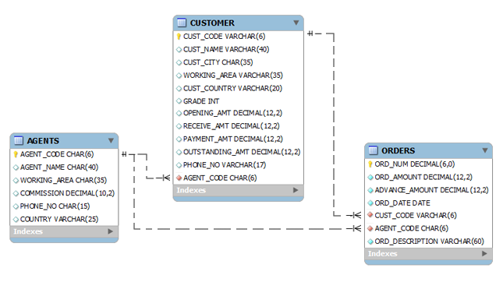
ER diagram
DATABASE SCHEMA
ER diagram
Chinook Music Store | Data Analysis

Slide 4
Data cleaning
Issue found | Fix
Trailing spaces in text columns | TRIM()
Hidden \r in country and order description | REPLACE(col, CHAR(13), '')
23 of 25 phone numbers were placeholders | Set to NULL using REGEXP
No primary keys on customer and orders | Added primary keys
Agent A013 missing from agents (2 orders) | Kept and flagged, no assumption
Duplicate records | None found (by ID and by order details)
Notes:
Analysis se pehle data saaf kiya. A013 jaisi inconsistency ko guess karke nahi badla, flag kiya.

Slide 5
Key business KPIs
78,600
36
2,183.33
Total revenue
Total orders
Average order value
25 customers | 12 agents | orders from Jan to Oct 2008
Notes:
Teen main numbers: 78,600 revenue, 36 orders, 2,183.33 average order value.

Slide 6
Sales trend: monthly revenue
July peak: 22,500 from 11 orders, about 29% of total revenue
Jan to Jun stayed between 1,000 and 6,200
Revenue fell after August; October has only 2 orders and data ends on 20 Oct
Notes:
July sabse bada peak hai. Data chhota hai isliye percentage swings bade dikhte hain.

Slide 7
Top cities by order amount
Chennai 17,000, Mumbai 12,700, London 12,500
Top 3 cities bring about 54% of total revenue (42,200 of 78,600)
Notes:
Top 3 cities lagbhag 54 percent revenue dete hain.

Slide 8
Customer behaviour
Only 32% (8 of 25) are repeat customers
Top spender: Ramanathan (10,500)
No customers in grades 4 and 5
Ravindran and Avinash tie at 5,000, so RANK() was used instead of LIMIT
Notes:
Sirf 32 percent customers repeat hain. Tie ki wajah se RANK use kiya.

Slide 9
Agent performance
Top 5 agents by total order amount
Mukesh handled the most orders (7)
Commission revision: Anderson 0.13 to 0.26, Alford 0.12 to 0.24
No agent falls in the 750 to 1,000 advance band
Notes:
Mukesh ne sabse zyada orders handle kiye. Commission sirf Anderson aur Alford ki badhi.

Slide 10
Advanced SQL
Task | What was built
New column | avg_rcv_amt: average receive amount per country
Function | avg_amt(agent_name): average outstanding amount of an agent's customers
Procedure | cust_detail(grade): all customers of a grade
Cursor | sp_name(cust_code): comma-separated order numbers of a customer
Skills: JOINs, CTEs, window functions (RANK, DENSE_RANK, LAG), CASE, functions, stored procedures, cursors
Notes:
Aakhri segment: naya column, function, procedure aur cursor.

Slide 11
Recommendations and next steps
Run loyalty or promotional offers to lift the 32% repeat rate
Strengthen agent coverage in Chennai, Mumbai and London
Reward high-advance collectors (Anderson, Alford) through the revised commission
Fix data quality at source: missing agent A013, placeholder phone numbers
Next steps: churn and product-level analysis once more data is available
Notes:
Data cleaning analysis se pehle sabse zaroori kaam tha, ye bolna.

Slide 12
THANK YOU
Notes:
Data cleaning analysis se pehle sabse zaroori kaam tha, ye bolna.

