Slide 1
Statistics - Adjusted R-Squared

Slide 2
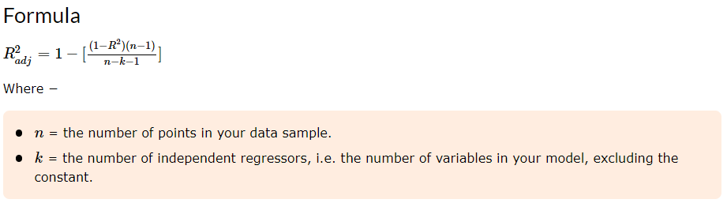
Adjusted R-Squared
R-squared measures the proportion of the variation in your dependent variable (Y) explained by your independent variables (X) for a linear regression model.
Adjusted R-squared adjusts the statistic based on the number of independent variables in the model. R² shows how well terms (data points) fit a curve or line. Adjusted R² also indicates how well terms fit a curve or line, but adjusts for the number of terms in a model.
If you add more and more useless variables to a model, adjusted r-squared will decrease. If you add more useful variables, adjusted r-squared will increase.
Adjusted R²_{adj} will always be less than or equal to R². You only need R² when working with samples. In other words, R² isn't necessary when you have data from an entire population.

Slide 3
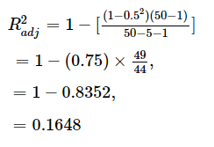
Example
Problem Statement −
A fund has a sample R-squared value close to 0.5 and it is doubtlessly offering higher risk adjusted returns with the sample size of 50 for 5 predictors. Find Adjusted R square value.
Solution −
Sample size = 50 Number of predictor = 5 Sample R - square = 0.5.Substitute the qualities in the equation,

Slide 4
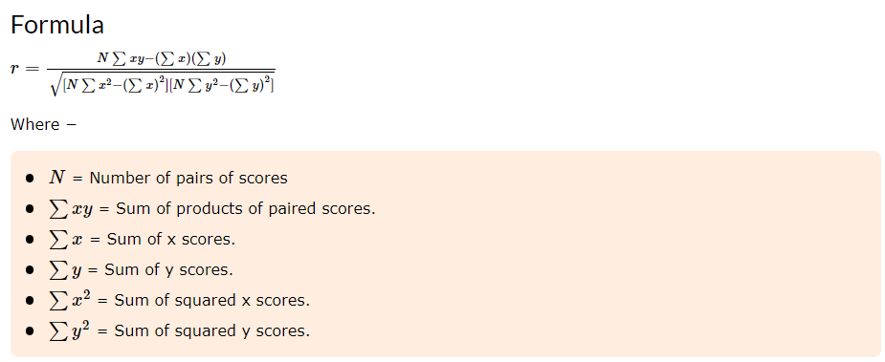
Correlation Co-efficient
A correlation coefficient is a statistical measure of the degree to which changes to the value of one variable predict change to the value of another. In positively correlated variables, the value increases or decreases in tandem. In negatively correlated variables, the value of one increases as the value of the other decreases.
Correlation coefficients are expressed as values between +1 and -1.
A coefficient of +1 indicates a perfect positive correlation: A change in the value of one variable will predict a change in the same direction in the second variable.
A coefficient of -1 indicates a perfect negative: A change in the value of one variable predicts a change in the opposite direction in the second variable. Lesser degrees of correlation are expressed as non-zero decimals. A coefficient of zero indicates there is no discernable relationship between fluctuations of the variables.

Slide 5
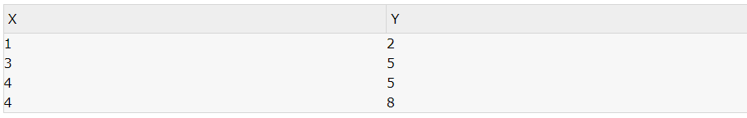
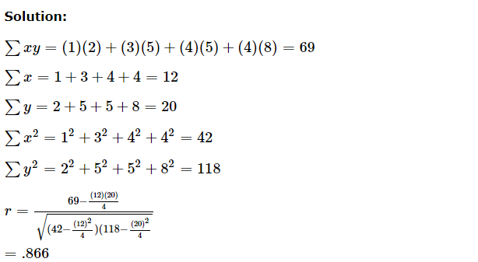
Example
Problem Statement:
Calculate the correlation co-efficient of the following:

Slide 6
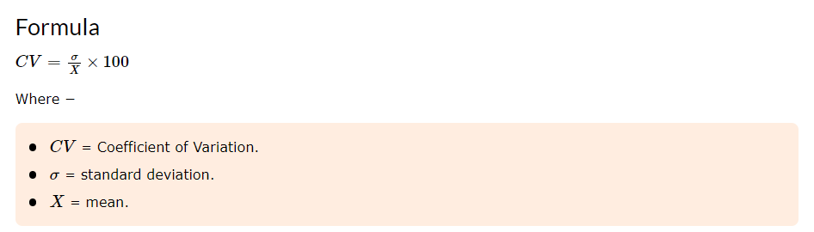
Co-efficient of Variation
Standard variation is an absolute measure of dispersion. When comparison has to be made between two series then the relative measure of dispersion, known as coeff.of variation is used.
Coefficient of Variation, CV is defined and given by the following function:

Slide 7
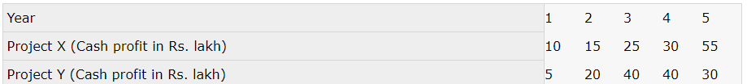
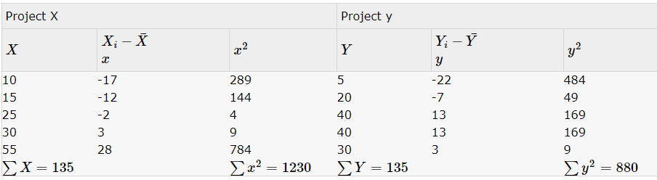
Example
Problem Statement:
From the following data. Identify the risky project, is more risky:
Solution:
In order to identify the risky project, we have to identify which of these projects is less consistent in yielding profits. Hence we work out the coefficient of variation.

Slide 8
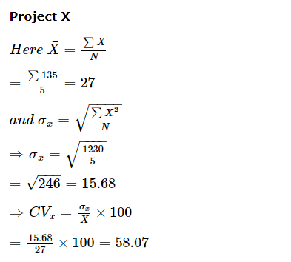
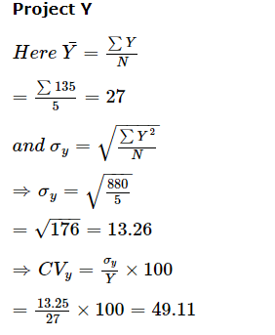
Since coeff.of variation is higher for project X than for project Y, hence despite the average profits being same, project X is more risky.

