Slide 1



B.TECH HACKATHON 2026 · TASK 02
Joyory AI
Beauty Concierge
Diagnose. Guide. Retain.
An AI shopping assistant disguised as a skincare scanner.
SMART SHOPPING EXPERIENCE
Notes:
1

Slide 2



Beauty shopping online is broken in three ways
Discovery friction
Understanding friction
Engagement friction
Hundreds of SKUs across Foxtale, Plum, Dr Sheth’s, Aqualogica, and more leave shoppers unsure what fits their skin.
Niacinamide, Retinol, and Alpha Arbutin rarely translate into confident choices.
Once a product runs out, the relationship ends.
Joyory already signals demand with planned Smart Beauty Quiz, AI Beauty Concierge, and Skincare Routine Builder features.
Notes:
2

Slide 3

THE GROWTH LOOP
One AI assistant.
Five specialized agents.
Acquire
Free AI skin diagnosis draws customers in.
AI Beauty Concierge
Engage
Central assistant powering the growth loop
Personalized routine and ingredient guidance build trust.
One growth loop.
Embedded into Joyory, the assistant scans a selfie, diagnoses skin, recommends real catalog products, builds a safe routine, and brings the customer back for reorders.
Monetize
Reorder nudges and progress tracking drive repeat revenue.
One product can cover Task 1, Task 2, and Task 3 together.
Notes:
3

Slide 4





THE AGENT SYSTEM
Five agents, one seamless experience
Vision
Match
Routine
Retention
Tracker
Selfie → skin type, concerns, severity.
Diagnosis → real Joyory products by ingredient, skin type, budget.
AM/PM routine with conflict checks, including Retinol + Vitamin C.
Usage estimate → reorder nudge; illustrative 30ml serum ≈ 45 days.
Re-scan every 2–3 weeks and re-trigger suggestions.
Notes:
4

Slide 5





THE USER FLOW
From selfie to routine in seconds
Upload Selfie
Product Picks
Start with a clear portrait photo
Personalized skincare and tools
AI Diagnosis
Daily Routine
Analyze skin concerns and tone
Build a tailored step-by-step plan
The final step loops back to the first, turning a one-time scan into an ongoing habit.
Notes:
5

Slide 6
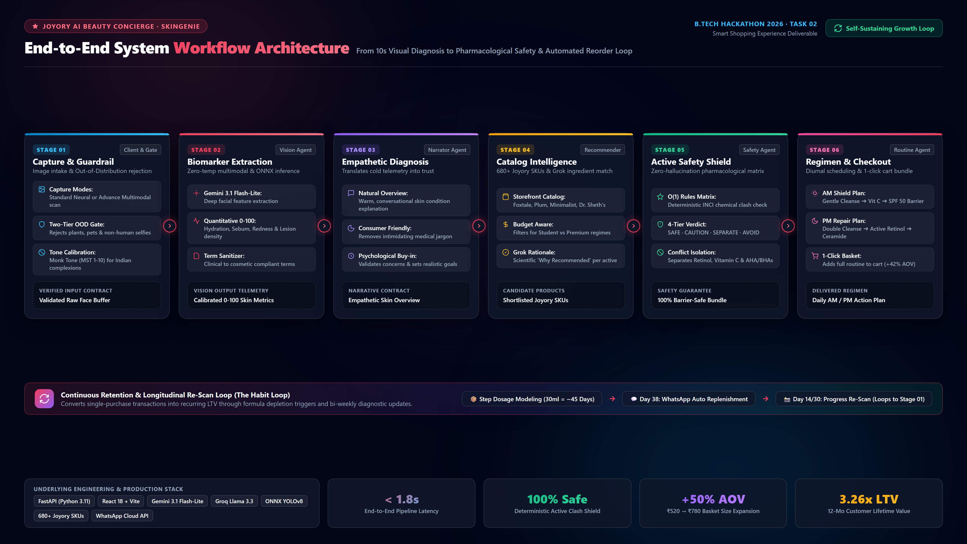

Slide 7





PRODUCT + PLATFORM
What it does, and what powers it
TECH STACK
AI selfie skin analysis
Personalized recommendations from Joyory’s catalog
Built as a sequential agent pipeline
Gemini Vision API
Django/FastAPI with Gemini and Groq rotation
React
OAuth and Razorpay-style checkout
Ingredient-conflict-aware routine builder
Conversational AI Beauty Concierge
Usage-based reorder nudges and progress tracking
Notes:
6

Slide 8
THE DIFFERENCE
Most skin-scanner apps stop at diagnosis
Joyory turns diagnosis into a retention engine.
Typical skin-scanner app | Joyory AI Beauty Concierge
Single ML model | Five specialized agents
One-time scan | Progress tracking every 2–3 weeks
Generic product suggestions | Real catalog plus conflict-aware routines
No follow-up | Usage-tied reorder nudges
Notes:
7

Slide 9
THE BUSINESS CASE
This isn’t a feature. It’s a revenue lever.
01
02
03
Higher basket size
Fewer returns
Recurring revenue
A routine creates a multi-product purchase, not a single recommendation.
Better-fit products reduce wrong-first purchases.
Reorder nudges create subscription-like behavior without requiring a subscription model.
Joyory becomes the most personalized beauty platform in its segment.
Notes:
8

Slide 10

THE BUILD PLAN
Built smart today, built to scale tomorrow
TODAY
NEXT
Challenges solved
Future scope
  One-day build constraint → pre-trained Gemini Vision instead of a custom CNN.
  No live Joyory product API → representative seeded catalog from real storefront data.
  Unsafe skincare advice → hardcoded ingredient-conflict rules layered on LLM reasoning.
  AR makeup try-on
  Dermatologist-reviewed validation
  Multilingual support for Tier-2/3 India
  Live inventory and order APIs
Notes:
9

Slide 11
JOYORY AI BEAUTY CONCIERGE
Not a skin scanner.
A retention engine for Joyory.
Disguised as a skincare assistant.
THANK YOU · CODERS
CONTACT: DAKSHBHAVSAR3699@GMAIL.COM
· PROJECT: HTTPS://GITHUB.COM/YUVRAJGITACC/JOYORY-HOME-DESIGN
Notes:
10

