Slide 1
IBM University Engagement Project Submission
“Exploring the Power of Agentic AI with IBM Granite and LangFlow”

Slide 2

Project Tile – IntelliResearch AI – Smart Research Assistant using IBM Granite
Domain of Project – Artificial Intelligence (AI) / Natural Language Processing (NLP) / Research Automation
Student Name | Recent Passport Photo | Email ID | Mobile number [WhatsApp]
Yuvrajjit Baruah |  | dev.yuvrajjitbaruah@gmail.com | +91 9395937774

Slide 3
Problem Statement -
Problem Statement : Research Agent
The Challenge
Researchers and students face difficulty in finding, analyzing, and organizing reliable research information quickly. Manual research takes a lot of time and effort.
The Objective
The main objective of this project is to develop an AI-powered Research Agent using IBM Granite and IBM Cloud Lite services that can help researchers, students, doctors, teachers, and professionals perform research tasks more efficiently and intelligently. The system aims to automate time-consuming activities such as searching for relevant research papers, summarizing lengthy documents, extracting important insights, organizing references, and generating structured research reports.
The Research Agent will use Natural Language Processing (NLP) and AI technologies to understand user queries and provide accurate, fast, and meaningful responses. It will help users access reliable information from multiple sources and reduce the manual effort required during the research process.
Another objective of the project is to improve productivity, research accuracy, knowledge management, and decision-making by providing smart AI-based assistance. The system will also support citation management, hypothesis generation, data extraction, and research content organization.
The project further aims to create a user-friendly and scalable platform that can be used in academic institutions, healthcare research, industrial R&D, and innovation-based environments. By integrating IBM Granite models and IBM Cloud services, the solution will demonstrate the practical use of AI in solving real-world research challenges efficiently and effectively.

Slide 4
Technology Used
LangFlow
IBM watsonx.ai
Granite Models
I used LangFlow + IBM watsonx.ai + Granite Models.

Slide 5
Proposed Solution -
Proposed Solution: AI-Powered Research Agent
The proposed solution is to develop an AI-powered Research Agent using IBM Granite models and IBM Cloud Lite services that can assist users in performing smart and efficient research activities. The system will allow users to enter research-related queries in natural language and automatically retrieve relevant information from trusted sources.
The Research Agent will analyze research papers, summarize lengthy documents, extract key insights, and organize references in a structured manner. It will also support citation management, report generation, and intelligent information retrieval to reduce manual effort and save time.
Using Natural Language Processing (NLP) and Machine Learning techniques, the system will understand user requirements and provide accurate and meaningful responses. The platform will feature an interactive and user-friendly interface where users can upload documents, search for topics, and receive AI-generated summaries and suggestions.
The solution will improve research productivity, accuracy, and accessibility for students, researchers, doctors, teachers, and professionals. By integrating IBM Granite AI models with cloud-based services, the project aims to create a scalable, intelligent, and real-world research assistance platform.

Slide 6
Langflow component Used -
1) Chat Input – Interface where users enter their queries, preferences, or meal details (text/voice/image).
2) IBM watsonx AI Agent - Processes user input using Granite models to generate personalized nutrition insights and recommendations.
3) Name of IBM Granite model - Granite-8B-Code-Instruct → Fast, efficient for real-time diet recommendations
4) Chat output -Displays AI-generated responses such as diet plans, nutritional analysis, and health suggestions.
5) File component - Stores and retrieves user data, meal logs, and nutritional datasets for analysis and tracking.

Slide 7
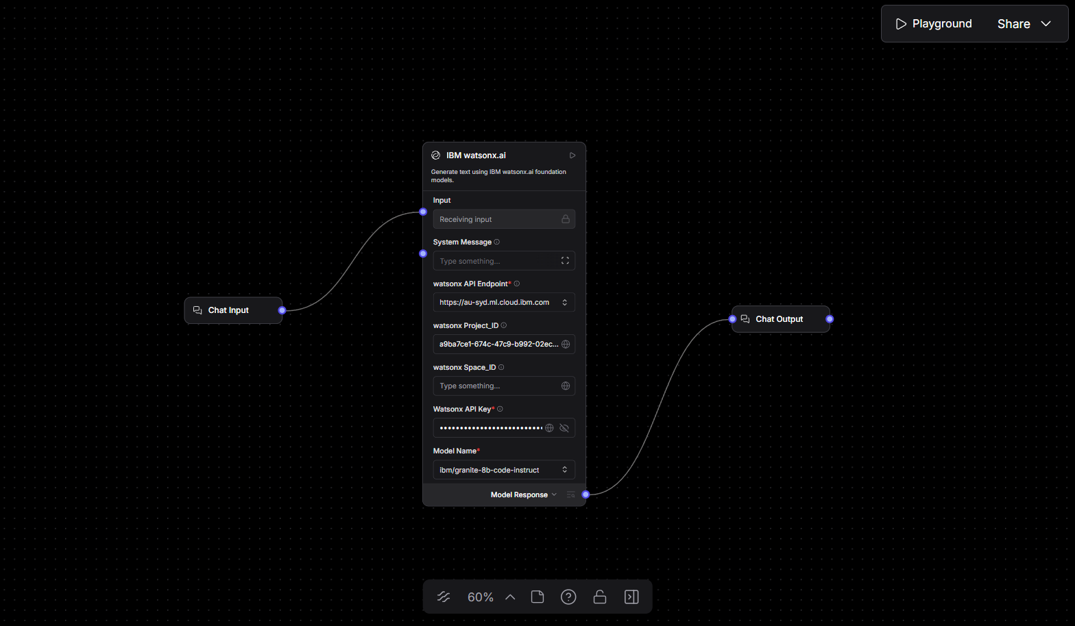
Langflow workflow -

Slide 8
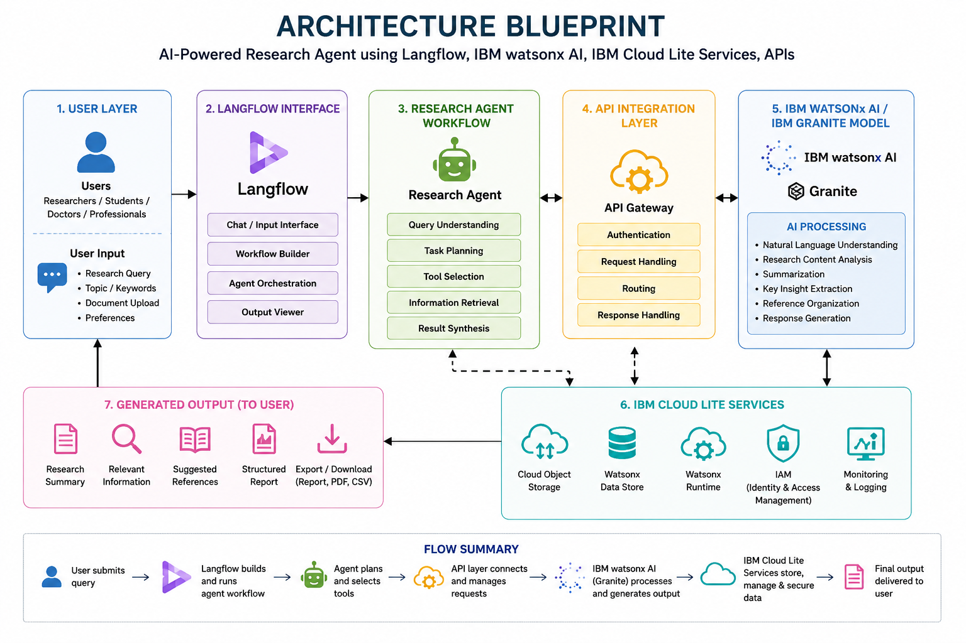
Architecture blueprint

Slide 9

Role of Agentic AI in the solution
Role of Agentic AI in Research Agent
Agentic AI plays a major role in the proposed Research Agent solution by enabling the system to perform research tasks intelligently and autonomously with minimal human intervention. Instead of only responding to commands, the Agentic AI system can analyze user queries, make decisions, plan actions, and execute multiple research-related tasks step by step.
The AI agent can automatically search for relevant research papers, extract important information, summarize content, organize references, and generate meaningful research reports. It can understand the research objective, identify suitable sources, and continuously improve responses based on user interaction.
Agentic AI also helps in reducing manual workload by automating repetitive tasks such as citation management, document analysis, and data extraction. With the support of IBM Granite models and NLP capabilities, the AI agent can provide context-aware, accurate, and intelligent assistance for academic and industrial research.
The use of Agentic AI makes the system more adaptive, efficient, scalable, and capable of handling complex research workflows in a smart and human-like manner.

Slide 10
Technology Used
Langflow platform - For designing and orchestrating multi-agent workflows visually
IBM Grainte model – ibm/granite-8b-code-instruct – For natural language understanding, reasoning, and personalization
IBM Cloud – It provides the infrastructure to build, deploy, and scale the Nutrition Agent efficiently. IBM Cloud enables a reliable, secure, and scalable environment for deploying the Nutrition Agent.
RAG – RAG to fetch real data first, then generate intelligent answers, making the Nutrition Agent more trustworthy and effective.
IBM Watsonx.ai - For model deployment, embeddings, and AI governance
Vector Database (FAISS/Chroma) – For RAG-based nutritional data retrieval

Slide 11
Novelty and Uniqueness
The proposed Research Agent stands out by combining Agentic AI, RAG, and personalization into a single intelligent system.
The uniqueness of this project lies in the integration of Agentic AI, IBM Granite models, and intelligent research automation into a single smart platform. Unlike traditional search systems that only provide links or static information, the proposed Research Agent can independently analyze user queries, search for relevant research content, summarize papers, extract key insights, and organize information intelligently.
The project introduces an AI-driven research workflow where the agent can perform multiple tasks autonomously with minimal human effort. It combines Natural Language Processing (NLP), intelligent document understanding, citation management, and report generation in one unified system.
Another innovative aspect of the solution is its ability to provide context-aware and personalized research assistance for students, researchers, doctors, teachers, and professionals across different domains. The use of IBM Granite foundation models and IBM Cloud Lite services makes the platform scalable, efficient, and capable of handling real-world research challenges.
The project aims to transform traditional research methods into a faster, smarter, and more interactive AI-powered experience, improving productivity, accuracy, and accessibility in academic and industrial research environments.

Slide 12
Git Hub Link
· GitHub repository (With README button) with format.
Here is the working GitHub URL – https://github.com/yuvrajjitbaruah/IntelliResearch-AI

Slide 13
Future Scope
The future scope of this project is to enhance the Research Agent with more advanced AI capabilities and real-time research support features. The system can be expanded to support multi-language research assistance, voice-based interaction, and AI-powered collaboration tools for research teams and institutions.
Future versions of the platform can include integration with global research databases, journals, cloud storage systems, and academic platforms to provide more accurate and up-to-date information. The Research Agent can also be improved with advanced data visualization, predictive analytics, and intelligent recommendation systems for suggesting research topics, hypotheses, and innovation ideas.
The project can further evolve into a domain-specific AI assistant for healthcare research, scientific analysis, industrial R&D, legal research, and educational institutions. Integration with generative AI and autonomous workflow systems can allow the agent to draft complete research papers, generate presentations, and automate documentation processes.
With continuous development, the solution has the potential to become a scalable enterprise-level AI research assistant that improves productivity, decision-making, and innovation across multiple industries and academic environments.

Slide 14


