Slide 1


Swami Keshvanand Institute of Technology, Management & Gramothan, Jaipur
(An Autonomous Institute Affiliated to Rajasthan Technical University, Kota)
Industrial Training
Presentation
TOPIC: Skill Swap
Organization: N code labs
Submitted By:
Name:- Yuvraj Meena (24ESKCS780)
Submitted To:
Name:- Mr. Vikash Dhankar
Assistant Professor
SKIT, JAIPUR
www.skit.ac.in

Slide 2
Index
1. Company Introduction
2. Certificate
3. Technology Used
4. Goal of Training
5. Project Overview
6. Working Project
7. Future Scope
8. Q&A
SKIT, JAIPUR
www.skit.ac.in

Slide 3
Company Introduction
[ COMPANY PROFILE & BACKGROUND ]
This slide is designated for organization details, industrial background, and training domain overview.
(Paste company overview text, leadership, client portfolios, or corporate brochure screenshot here)
SKIT, JAIPUR
www.skit.ac.in

Slide 4
Certificate
[ INDUSTRIAL TRAINING CERTIFICATE ]
Space reserved for training completion certificate awarded by the organization.
(Insert scanned certificate image or authorized letter of completion here)
SKIT, JAIPUR
www.skit.ac.in

Slide 5

Tech Stack
• Frontend Layer: React.js (Component Architecture), Tailwind CSS (Modern Glassmorphic UI), Vite (Build Tool), Axios (HTTP Client)
• Backend & APIs: Node.js (V8 Engine Runtime), Express.js (REST Routing), JWT (Encrypted Auth), Multer (File Handling)
• Database & Storage: MongoDB Atlas (Mongoose ODM, Replica Sets), Cloudinary (Cloud Media CDN for Profiles & Proofs)
SKIT, JAIPUR
www.skit.ac.in

Slide 6
Goal of Training
• Learn practical Full-Stack Web Development (MERN Stack architecture)
• Understand React frontend development with reusable components & hooks
• Develop Node.js & Express backend APIs with token security & validation
• Work with MongoDB and Cloudinary for scalable database schemas & media
• Design algorithmic peer-to-peer matching for reciprocal skill swaps
• Implement secure authentication workflows using JWT & dual verification
• Gain experience in building a complete real-world project from scratch to deployment
SKIT, JAIPUR
www.skit.ac.in

Slide 7
Project Overview
⚠️ The Problem Statement
• High Cost of Tutoring: Millions possess valuable skills (programming, languages, design) but lack funds for paid courses or coaching.
• Monetization Barriers: Monetizing talent requires formal freelance platforms with steep platform commissions (20%+).
• Underutilized Knowledge: Peer learning remains fragmented across informal social networks with no accountability or structure.
💡 The SkillSwap Solution
• Barter Economy for Knowledge: A direct peer-to-peer exchange where members trade skills without any financial transaction.
• Two-Way Reciprocal Matching: Smart algorithm matches users where 'Skill Offered by A' equals 'Skill Wanted by B' and vice-versa.
• Built-in Coordination Lifecycle: End-to-end request management, session scheduling, verified proof badges, and mutual reviews.
SKIT, JAIPUR
www.skit.ac.in

Slide 8
Working Project: System Architecture
1. Auth & Profiles
Secure signup with OTP verification, profile customization, and bio setup.
2. Skill Catalog
List skills under 'I Can Teach' & 'I Want to Learn' with levels & modalities.
3. Smart Match Engine
Algorithmic discovery pairing mutual reciprocal skill requirements.
4. Swap Proposal
Send 1-on-1 swap offers with customized introductory negotiation messages.
5. Session Coordination
Schedule dates, choose online meeting links or in-person venues.
6. Reviews & Trust Score
Mark completed, submit 1-5 star ratings, and earn verified status.
SKIT, JAIPUR
www.skit.ac.in

Slide 9
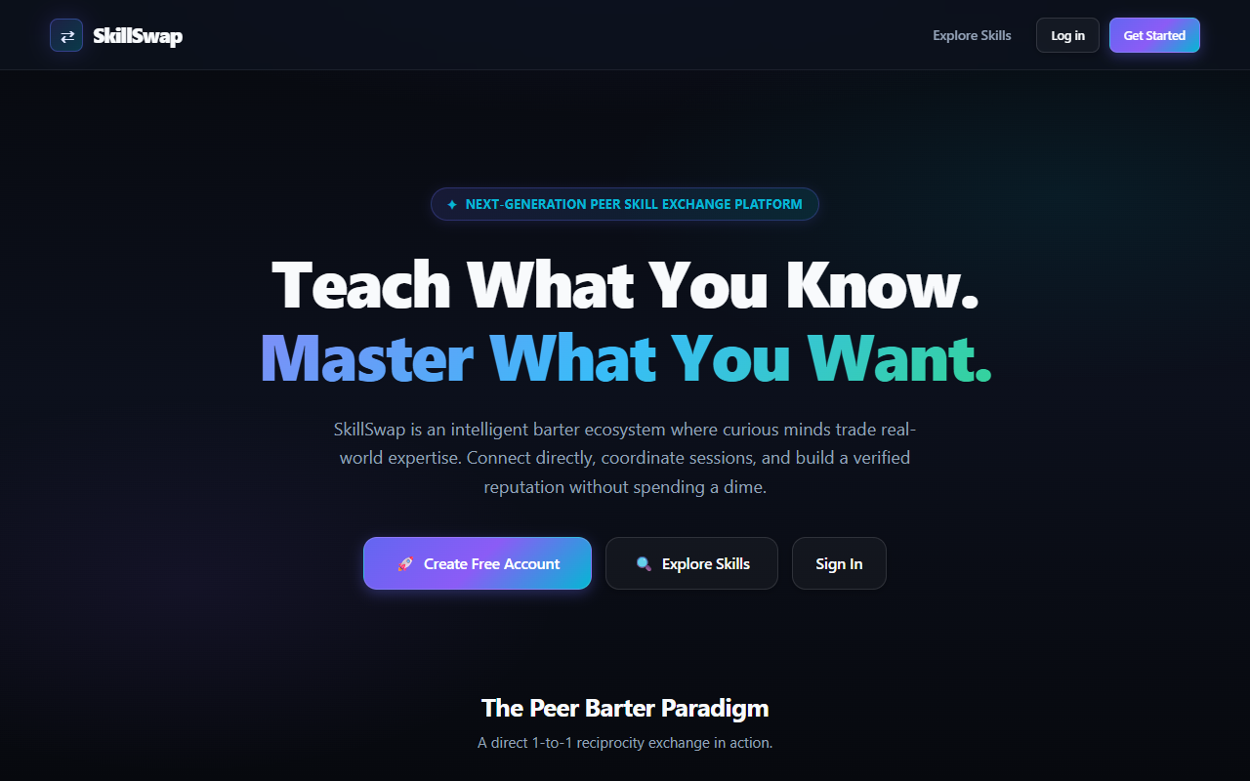
Working Project: Landing Page & UX
Features & Interface Functions
✔ Contemporary Glassmorphic Theme: Deep midnight aesthetic with glowing cyan accents and accessible typography.
✔ Value Proposition Display: Immediate clarity with 'Teach What You Know. Master What You Want' hero messaging.
✔ Interactive Barter Paradigm: Demonstrates real-time 1-to-1 reciprocity exchange tickets directly on the home feed.
✔ Public Directory Preview: Non-logged in visitors can browse public skill offerings with instant search capability.
✔ Direct Call to Action: Seamless onboarding flow directing users into registration or passwordless login.
SKIT, JAIPUR
www.skit.ac.in

Slide 10
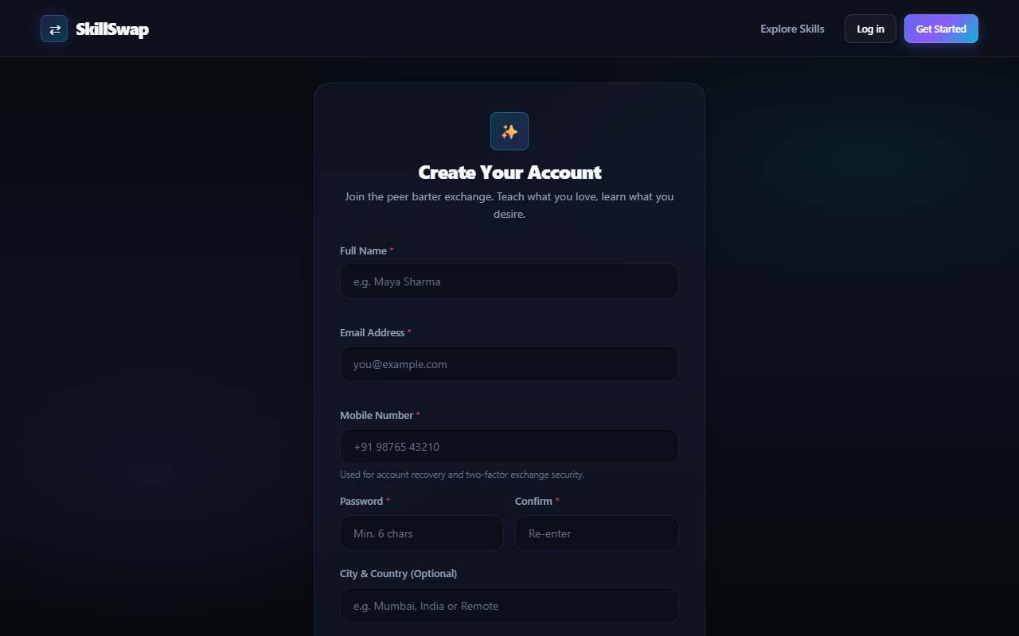
Working Project: Auth & Security
Security Architecture & Controls
🔒 Dual Authentication Channels: Supports both classic encrypted passwords and instantaneous Email OTP verification.
🔒 Mandatory Verification Checks: Form validation enforces RFC-compliant emails, 10-15 digit phone numbers, and min 6-char passwords.
🔒 Encrypted JWT Sessions: Issues JSON Web Tokens stored securely with 30-day expiry and automated HTTP Authorization headers.
🔒 Password Protection: Utilizes bcrypt with cryptographic salt rounds to prevent rainbow table and brute-force attacks.
🔒 Rate Limiting & Safety: OTP attempts throttled with dynamic 60-second cool-downs to block spamming.
SKIT, JAIPUR
www.skit.ac.in

Slide 11
Working Project: Core Modules
Skill Management System
• Dual taxonomy: 'I Can Teach' vs. 'I Want to Learn'
• Categorization: Tech, Music, Language, Fitness, Art, Cooking, Academic
• Proficiency levels: Beginner, Intermediate, Expert
• Modality configuration: Online, In-person, or Both
Smart Match & Barter Engine
• Dynamic reciprocal query engine matching complementary skills
• Mutual Match Badge: Instant visual indicator for 2-way compatibility
• Direct proposal modal selecting exact skills to trade
• Introductory message thread attached to incoming proposals
Session Coordination & Chat
• Proposal negotiation: Accept, Decline, or Counter-propose
• Session scheduling: Date picker, time slots, and virtual meeting links
• Real-time messaging per active swap transaction
• Two-party confirmation locking in scheduled dates
Trust, Reviews & Badges
• Mandatory swap completion confirmation by both learners
• 1 to 5 star rating system with detailed qualitative feedback
• Dynamic Trust Score algorithm displayed publicly on user profiles
• Verified Member Badge unlocked after 5 verified swaps
SKIT, JAIPUR
www.skit.ac.in

Slide 12
Future Scope
🤖 AI-Powered Smart Matchmaking
Integrate vector embeddings (LangChain + Gemini / Groq) to perform semantic matching based on syllabus content and user learning goals rather than exact keyword matches.
📹 Integrated WebRTC Video Classrooms
Build built-in audio/video calling with screen sharing directly inside SkillSwap, eliminating the need to redirect to external Zoom or Google Meet links.
🔄 Multi-Party Circular Barter Swaps
Implement circular matching algorithms (3-way or 4-way trades: User A teaches User B, User B teaches User C, and User C teaches User A) when direct 2-way swaps aren't available.
📱 Native Mobile Application (React Native)
Develop cross-platform iOS and Android applications with geolocation-based campus matching and push notifications for instant session coordination.
🏆 Gamified Learning Streaks & Badges
Introduce learning milestone badges, community leaderboards, and peer-endorsed certificates to foster long-term student engagement and accountability.
SKIT, JAIPUR
www.skit.ac.in

Slide 13
Q & A
Thank You!
Any Questions or Suggestions?
Project: Skill Swap (Full-Stack Peer Skill Exchange Platform)
Candidate: Yuvraj Meena (Roll No: 24ESKCS780)
Department of Computer Science & Engineering
Swami Keshvanand Institute of Technology, Management & Gramothan, Jaipur
SKIT, JAIPUR
www.skit.ac.in

