Slide 1
SUPPLY CHAIN DECISION BRIEF
HISTORICAL MARGIN
Protect margin.
Fix delivery promises.
12.00%
A practical decision plan from historical DataCo order data.
Protect margin already earned and align delivery promises with actual operations.
180,519 order lines · 65,752 orders · Jan 2015–Jan 2018

Slide 2
Protect the $33M revenue base
$33.05M
$3.97M
NET SALES · historical total
SUPPLIED PROFIT MEASURE
12.00%
54.82%
AGGREGATE NET MARGIN
LATE · share of all orders
DATA SCOPE
180,519 order lines · 65,752 orders · 118 products · Jan 2015–Jan 2018. Source reports 0 nulls and 0 duplicate rows.
Source: yuvrajrgv/supply-chain- report + EDA notebook. Historical data ends Jan 2018.

Slide 3
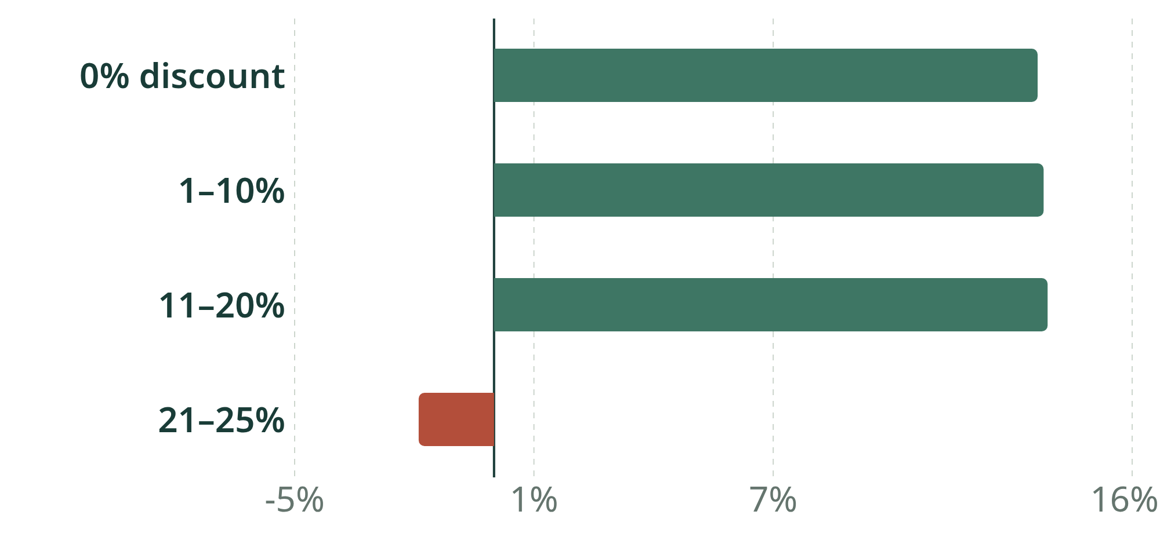
The deepest discount tier is loss-making
REPORTED PROFIT MARGIN BY DISCOUNT TIER
21–25% tier
−$65.2K
Margin −1.89%; loss $65.2K.
52.29% losses across 20,058 lines.
Block discounts >20% without approval.
Top 3 categories contribute ~46.8% of sales; top 10 products generate >60%.
Source: project report and README. Discount-tier association is not proof of causation.

Slide 4
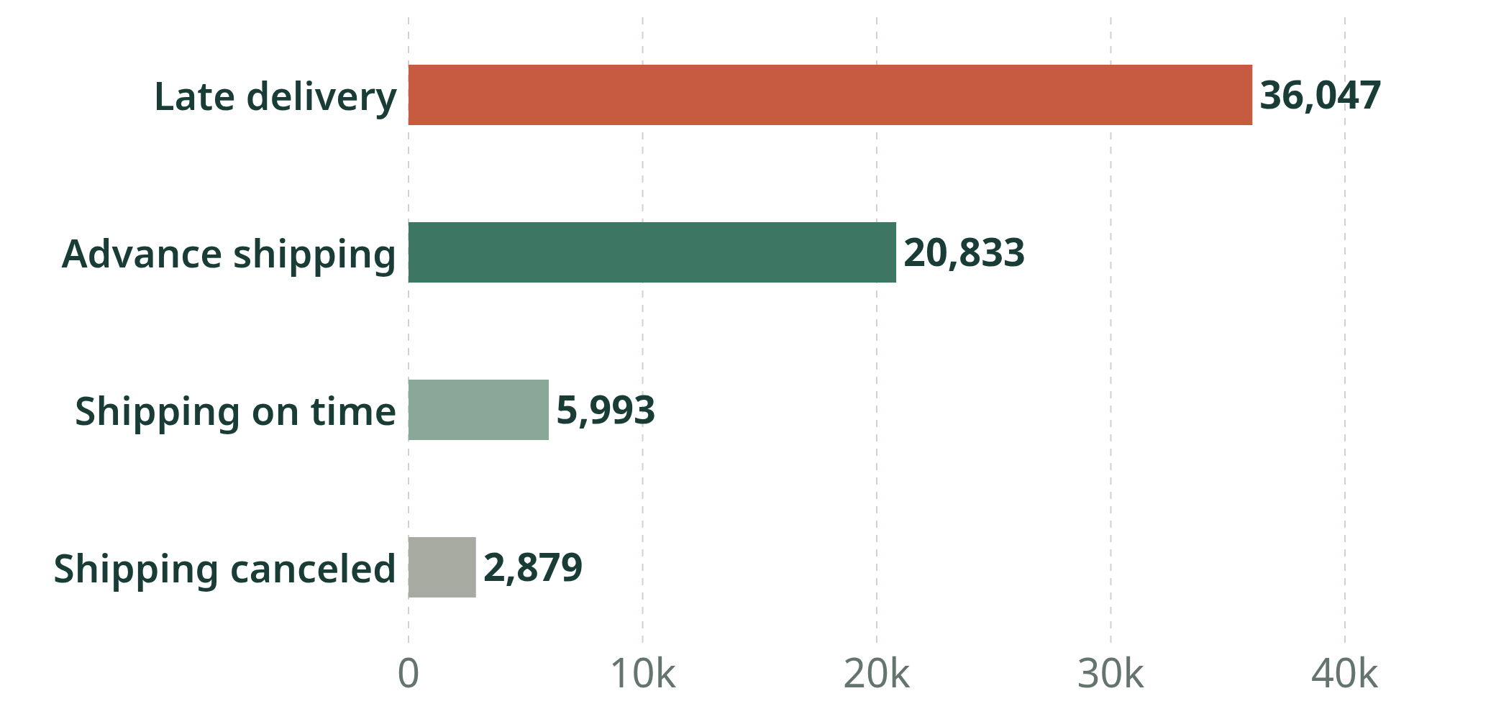
Late deliveries affect over half of orders
DISTINCT ORDERS BY DELIVERY STATUS
First Class audit
Report: 91.56%; notebook: 100%.
Average transit: 2.45d vs 1-day promise.
Audit denominator; align promise with current transit.
Late: 36,047 (54.82% all; 57.33% completed). Canceled: 2,879 (4.38%). Pilot a 24-hour dispatch alert.
Source: project report and notebook. First Class 91.56% vs 100% remains unresolved.

Slide 5
Validate, pilot, then scale over 90 days
STEP 01 · DAYS 0–14
STEP 02 · DAYS 15–45
STEP 03 · DAYS 46–90
Baseline first
Test controls
Scale evidence
Resolve First Class 91.56% vs 100%.
Recompute late rate per unique order.
Refresh 12 months of actual data.
Exclude simulations; note cost/customer gaps.
Commercial: gate discounts above 20%.
Fulfillment: alert at 24 hours unshipped.
Carrier: calibrate promise to current transit.
Finance: compare profit vs holdout.
Ops: validate stock on priority products.
Scale only if profit rises without service harm.
Proposed owners and sequence. Refresh the current baseline during the first two weeks.

Slide 6
Approve pilots; scale only on audited results
01 Margin
02 Delivery
03 Stock
Block unapproved discounts >20%; log exceptions.
KPI: tier loss-line share (baseline 52.29%).
Pilot gate: halve vs holdout; track conversion.
Reset promises with current transit data.
KPI: hit rate; pilot gate +10 pp vs baseline.
Track cancellations separately (historical 4.38%).
Prioritize stock after demand review.
Set fill-rate floor after a 2-week baseline.
Top 3 categories ~46.8%; top 10 products >60%.
APPROVE · 90-day pilots; scale on audited profit and service lift.
Pilot gates are proposals, not forecasts. Source ends Jan 2018; no customer IDs or full landed costs.

