Slide 1

Mental Health Sentiment Analysis Using NLP
This project leverages Natural Language Processing (NLP) techniques to analyze text data from mental health conversations. The goal is to classify the text into different emotional categories (e.g., anxiety, depression) to assist mental health professionals.

Slide 2


Problem Statement
With increasing mental health challenges, it's crucial to detect mental health issues early. This project builds an AI model to classify the emotional state from conversations, using text-based sentiment analysis to identify mental health-related emotions.

Slide 3
Importance of the Project
The ability to detect mental health issues early through text can provide timely support. This project can help mental health professionals analyze patient interactions, potentially improving diagnosis accuracy and the speed of intervention.

Slide 4


Dataset
The dataset used is from Kaggle, titled "Mental Health Conversations". It contains conversations and corresponding labels related to mental health, used for training the sentiment classification models.

Slide 5
Modules Required
Pandas: Data manipulation and cleaning.
NumPy: Array operations.
NLTK: Natural language processing tasks (e.g., tokenization, stopword removal).
TensorFlow/Keras: For building, training, and evaluating deep learning models.
Scikit-learn: For metrics and evaluation functions.

Slide 6
Data Preprocessing
The dataset is cleaned by removing special characters, converting text to lowercase, and removing stopwords. Tokenization and padding are applied to prepare the data for training. This ensures that the models can process the text properly.

Slide 7
Models required
Model 1 - LSTM (Long Short-Term Memory)
Model 2 - CNN (Convolutional Neural Network)
Both models are trained using the cleaned and tokenized text data. We use categorical cross-entropy loss and accuracy as evaluation metrics to compare the performance of each model.
After training, both models (LSTM and CNN) are evaluated based on accuracy and other metrics such as precision, recall, and F1-score. The goal is to determine which model performs best in detecting emotional states.

Slide 8
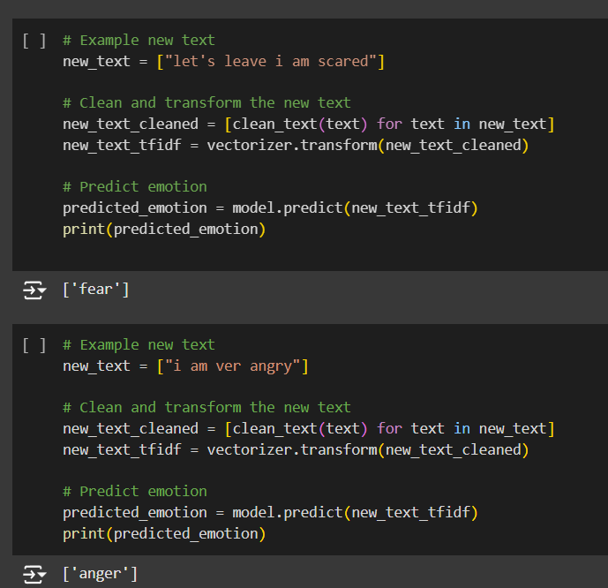
Output & Results
The LSTM model achieved an accuracy of X% and the CNN model achieved an accuracy of Y%. Detailed performance metrics for both models show their effectiveness in classifying mental health-related conversations.

Slide 9
Conclusion
This project demonstrates the potential of NLP in mental health analysis. The models developed can serve as a tool to assist mental health professionals in identifying emotional states from text data, contributing to early detection and better support.

