Slide 1
Coronavirus Sequence Comparison
NSP1 MERS
Fikter, Yuvraj, and Prakash
Notes:
1 – 9 Prakash
10 – 14, 27 – 31 Yuvraj
15 – 26 Fred

Slide 2
Sequence Comparison/Alignment
Notes:
What is sequence comparison/alignment?
An alignment is a mutual arrangement of sequences which exhibits where the sequences are similar and where they differ.
Why do Alignments?
Sequence Alignment is useful for discovering structural, functional and evolutional information in biological sequences.

Slide 3
An alignment is a mutual arrangement of sequences which exhibits where the sequences are similar and where they differ.
Sequence Alignment is useful for discovering structural, functional and evolutional information in biological sequences.
Notes:
What is sequence comparison/alignment?
An alignment is a mutual arrangement of sequences which exhibits where the sequences are similar and where they differ.
Why do Alignments?
Sequence Alignment is useful for discovering structural, functional and evolutional information in biological sequences.

Slide 4
SARS-COV-2 vs MERS-COV
What is SARS-COV-2?
Severe Acute Respiratory Syndrome(SARS)
The devastating respiratory illness of 2019 to current. Also known as COVID-19
What is MERS-COV?
Middle East Respiratory Syndrome(MERS)
Respiratory illness that is new to humans.
Notes:
SARS-COV-2
SARS was first reported in Asia in February 2003. The illness spread to more than two dozen countries in North America, South America, Europe, and Asia before the SARS global outbreak of 2003 was contained.
MERS-COV
It was first reported in Saudi Arabia in 2012 and has since spread to several other countries, including the United States. Most people infected with MERS-CoV developed severe respiratory illness, including fever, cough, and shortness of breath. Many of them have died.

Slide 5
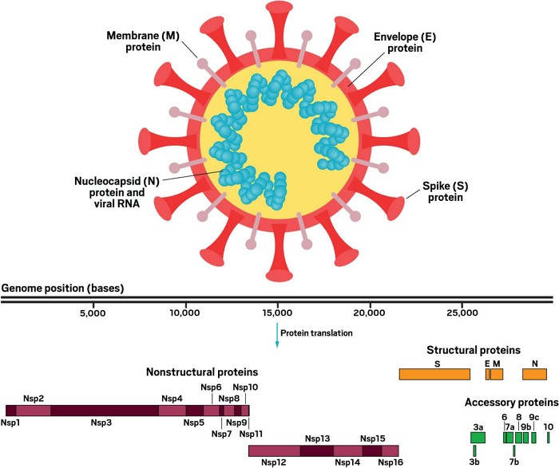
Proteins in SARS-COV-2
Notes:
SARS-CoV-2 contains 29 proteins, including 4 structural proteins, spike (S), envelope (E), membrane (M), and nucleocapsid (N) proteins.
These proteins share high sequence similarity to the sequences of the corresponding proteins of SARS-CoV, and MERS-CoV.

Slide 6
What gene will we study?
What is NSP1?
Nonstructural Protein 1, also referred to as the host shutoff factor, suppresses host innate immune functions.
Leader Protein
The NSP1 gene of the SARS COV-2 and MERS-COV

Slide 7
What does the NSP1 do?

Slide 8
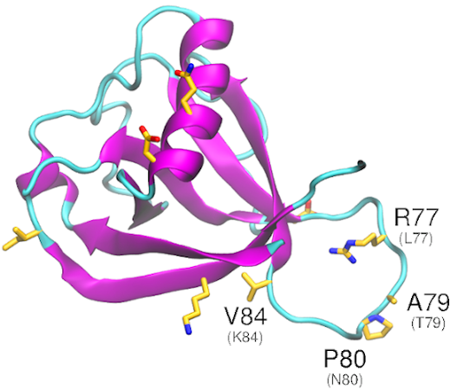
In SARS CoV2:
Nsp1 binds to the human 40S subunit in ribosomal complexes
The protein inserts its C-terminal domain into the mRNA channel, where it interferes with mRNA binding.
Model of NSP1

Slide 9
Understanding Genbank Entries

Slide 10
What’s the size/length of this virus genome?
Length of SARS-COV-2
29,903 (29 Kilobases)
They range from 26 Kilobases to 32 Kilobases
Length of MERS-COV
30,119(30 Kilobases)

Slide 11
What are SARS-COV-2 and MERS-COV made of?
SARS-COV-2 and MERS-COV are made up of unsegmented single-stranded RNA
SARS COV-2
29.86% adenosines 32.12% thymines 19.63% guanines 18.39% cytosines
MERS COV
26.23% adenines
32.53% thymines
20.93% guanines
20.31% cytosines

Slide 12
How many genes does SARS CoV-2 genome contain; what are their names? SARS CoV-2 contains total of 11 genes and their names are as follows:
Gene = ORF1ab, GeneID:43740578
Gene = S, GeneID:43740568
Gene = ORF3a, GeneID:43740569
Gene = E, GeneID:43740570
Gene = M, GeneID:43740571
Gene = ORF6, GeneID:43740572
Gene = ORF7a, GeneID:43740573
Gene = ORF7b, GeneID:43740574
Gene = ORF8, GeneID:43740577
Gene = N, GeneID:43740575
Gene = ORF10, GeneID:43740576

Slide 13
How many genes does MERS genome contain; what are their names? MERS contains total of 10 genes and their names are as follows:
Gene = Orf1ab, GeneID: 14254602
Gene = S, GeneID: 14254594
Gene = ORF3, GeneID: 14254595
Gene = ORF4a, GeneID: 14254596
Gene = ORF4b, GeneID: 14254597
Gene = ORF5, GeneID: 14254598
Gene = E, GeneID: 14254599
Gene = M, GeneID: 14254600
Gene = N, GeneID: 14254601
Gene = ORF8b, GeneID: 19910005

Slide 14
CDS – Coding Sequences
SARS Cov-2: 12 coding sequences
Proteins coded:
ORF1ab polyprotein
ORF1a polyprotein
Surface glycoprotein
ORF3a protein
Envelope protein
Membrane glycoprotein
ORF6 protein
ORF7a protein
ORF7b
ORF8 protein
Structural protein
ORF10 protein
MERS COV: 11 coding sequences
Proteins coded:
1AB polyprotein
1A polyprotein
Spike protein
NS3 protein
NS4A protein
NS4B protein
NS5 protein
Envelope protein
Membrane protein
Nucleocapsid protein
ORF8b protein
Notes:
1 and 2 are coded by ORF1ab gene in both cases.

Slide 15
Methods

Slide 16
get_cov(): and get_mers():
These two methods are implemented to get the nsp1 gene from respective fasta files for the comparison.
The genomes are extracted and validated from the files.

Slide 17
get_alignment_matrix(gene1, gene2):
get_alignment_matrix completes the first step of needleman-wunsch algorithm and creates the alignment grid for the two genes.
gene1 and gene2 are the genes to compare and are passed as parameters.
This method returns a tuple of matrixes with the comparisons and direction.

Slide 18
trace_back(gene_matxs,gene1,gene2):
The method trace_back() traces the alignment in the gene_matx.
gene_matxs, gene1, and gene2 are passed as parameters to the method.
gene_matxs: the tuple containing the alignment and direction martrix
gene1,gene2: the two genes we are comparing
This method returns a tuple containing aligned genes.

Slide 19
get_stats():
The method get_stats() calculates the statistics of the comparison:
1. Codons
2. Identical codons
3. Indel
4. Synonymous mutations
5. Nonsynonymous mutations

Slide 20
codon_similarity(g1_codon, g2_codon):
This method checks if two codons are similar.
g1_codon and g2_codon are the codons to be checked and are passed as parameters.
Returns 1 if the codons are synonymous.
Returns 0 if the codons are nonsynonymous.

Slide 21
Implementation

Slide 22
Needleman-wunsch algorithm
The Needleman–Wunsch algorithm is an algorithm used in bioinformatics to align protein or nucleotide sequences.
It is also sometimes referred to as the optimal matching algorithm and the global alignment technique.
The algorithm assigns a score to every possible alignment, and the purpose of the algorithm is to find all possible alignments having the highest score.
Alignment scoring:
gap = -2
mismatch = -1
match = 1

Slide 23
BLAST (Basic Local Alignment Search Tool)
BLAST is an algorithm and program for comparing primary biological sequence information, such as the amino-acid sequences of proteins or the nucleotides of DNA and/or RNA sequences.
BLAST is actually a family of programs. These include:
Nucleotide-nucleotide BLAST (blastn)
Protein-protein BLAST (blastp)
Position-Specific Iterative BLAST (PSI-BLAST) (blastpgp)
Nucleotide 6-frame translation-protein (blastx)
Nucleotide 6-frame translation-nucleotide 6-frame translation (tblastx)
Protein-nucleotide 6-frame translation (tblastn)
Large numbers of query sequences (megablast)

Slide 24
Results

Slide 25
Global alignment (Needleman-wunsch):
NSP1 gene comparison between SARS CoV2 and MERS CoV assuming MERS CoV as ancestor gene:
Codons: 174
Identical codons: 19
Indel: 65
Synonymous mutations: 10
Nonsynonymous mutations: 80

Slide 26
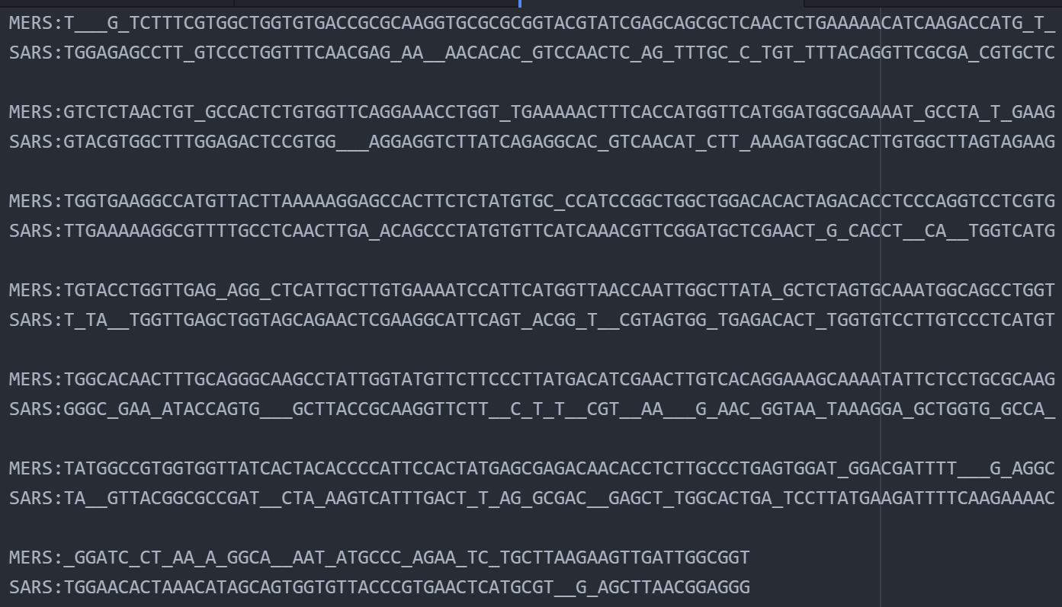
Global Alignment Result

Slide 27
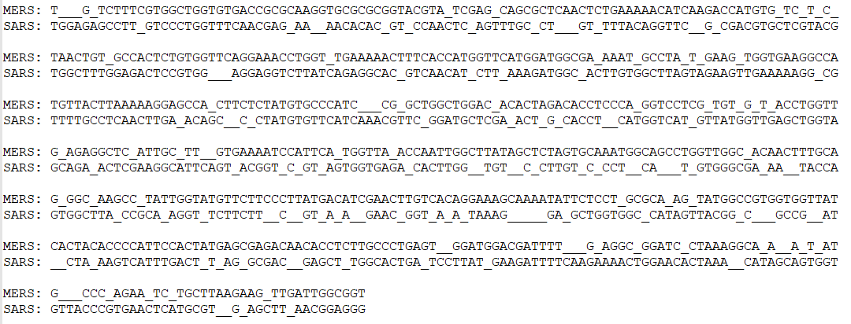
Global alignment (Contd.)
Sequence alignment result:

Slide 28
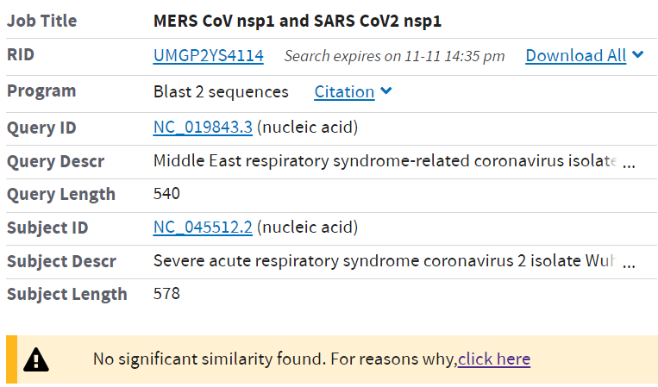
BLAST(Local Alignment Algorithm):
Since two sequences (SARS CoV2 nsp1 and MERS CoV nsp1) are very different and BLAST aligns highly similar sequences, it didn’t produce any alignment result.

Slide 29
Difference in SARS CoV2 nsp1 and MERS nsp1:
While SARS-CoV2 nsp1 is localized exclusively in the cytoplasm and binds to the 40S ribosomal subunit to gain access to translating mRNAs, MERS-CoV nsp1 was distributed in both the nucleus and the cytoplasm and did not bind stably to the 40S subunit, suggesting a distinctly different mode of targeting translating mRNAs.
MERS nsp1 – 578 in length:
24.74% adenines, 26.3% thymines, 25.1% guanines, 23.9% cytosines.
SARS CoV2 nsp1 – 540 in length:
24.9% adenines, 26.5% thymines, 27.1% guanines, 21.5% cytosines.

Slide 30
Conclusion
Sequence alignment is a way of arranging the sequences of DNA, RNA, or protein to identify regions of similarity that may be a consequence of functional, structural, or evolutionary relationships between the sequences.
Needleman-wunsch algorithm uses the global alignment technique. For this project, the global alignment algorithm has been implemented to compare nsp1 gene sequence alignment between SARS CoV2 and MERS.
BLAST(Basic Local Alignment Search Tool) uses smith-waterman algorithm (local alignment technique) to search high scoring sequence alignments between two or more sequences.

Slide 31
Conclusion(Contd.)
SARS-CoV2 nsp1 is localized exclusively in the cytoplasm whereas MERS-CoV nsp1 was distributed in both the nucleus and the cytoplasm.
SARS-CoV2 binds to the 40S ribosomal subunit to gain access to translating mRNAs, but MERS-CoV nsp1 did not bind stably to the 40S subunit, suggesting a distinctly different mode of targeting translating mRNAs.
Apart from their functional differences, they differ in structure and sequences too.
Global alignment algorithm resulted in best possible alignment of sequences, but BLAST (local alignment) didn’t output any result as the sequences are very different.

Slide 32
Sources
https://cen.acs.org/biological-chemistry/infectious-disease/know-novel-coronaviruss-29-proteins/9
https://www.ncbi.nlm.nih.gov/sars-cov-2/
https://www.ncbi.nlm.nih.gov/nuccore/NC_045512.2?report=fasta
https://www.ncbi.nlm.nih.gov/nuccore/30271926
https://www.ncbi.nlm.nih.gov/nuccore/667489388
https://www.nature.com/articles/d41586-020-01315-7
https://www.ncbi.nlm.nih.gov/nuccore/NC_045512.2?report=genbank&to=29903
https://en.wikipedia.org/wiki/Needleman%E2%80%93Wunsch_algorithm

