Slide 1
IBM DATA SCIENCE PROFESSIONAL CERTIFICATE.
Applied Data Science Capstone
-Yuvraj Thakare

Slide 2
Introduction
Pune is very populated city and it has a lot of educational institutions.Therefore it has a large student population which comes to pune for educational purpose. It also has large IT sectors, attracting large amount of employees all around the India.

Slide 3
Introduction
Considering all these factors there is more of youth population in Pune. In today’s generation, youth is giving importance to “Healthy Living” and more into Gym’s and workouts stuff. One more reason behind this is Social Media, youth is constantly active on social media posting pictures, making videos, etc. Hence, to look good fitness is really important. There is a lot of demand for gyms in pune but accordingly proper professional gyms are really less as compared to people.

Slide 4
Business Problem
The main objective of this project is to help the investors and Gym franchises by segmenting the area of Pune and providing them the list of areas where there is lack of Gyms so as to defend them from high Competition and also helping them achieve great turnout of customers. If a Gym franchise is interested to open an outlet in Pune what are the areas they should be targeting..??

Slide 5
Target Audience
Gym franchise interested for an outlet in Pune.
Gym lovers who like to spend time working at Gym.(Secondary Audience)

Slide 6
Data :
List of Neighborhoods in Pune .This basically sets a scope of our project .
Area Markers i.e Longitudes and Latitude of the Scope and also the neighborhoods targeted for analysis.
Venue data , for calculation of customer occurrences and availability of specific venue in an area.

Slide 7
Sources for Data Availability
First and foremost Source for list of neighborhood in Pune can be made available through Wikipedia . A csv file is created containing the list which is further merged with area markers.
The Coordinates of Neighborhood can be extracted from Python Geocoder Package.
Venue data can be extracted from Foursquare.com site , which is prestigious site four venue details , ratings etc. A Developer account needs to be created so as to avail API calls.

Slide 8
Results
The results after clustering (k=2) clearly exhibits that we can categorize the neighborhoods into 2 clusters based on the frequency of occurrence for “Gym ”:
Cluster 0(RED): Neighborhoods with moderate number of Gyms .
Cluster 1(PURPLE): Neighborhoods with high concentration of Gyms.

Slide 9
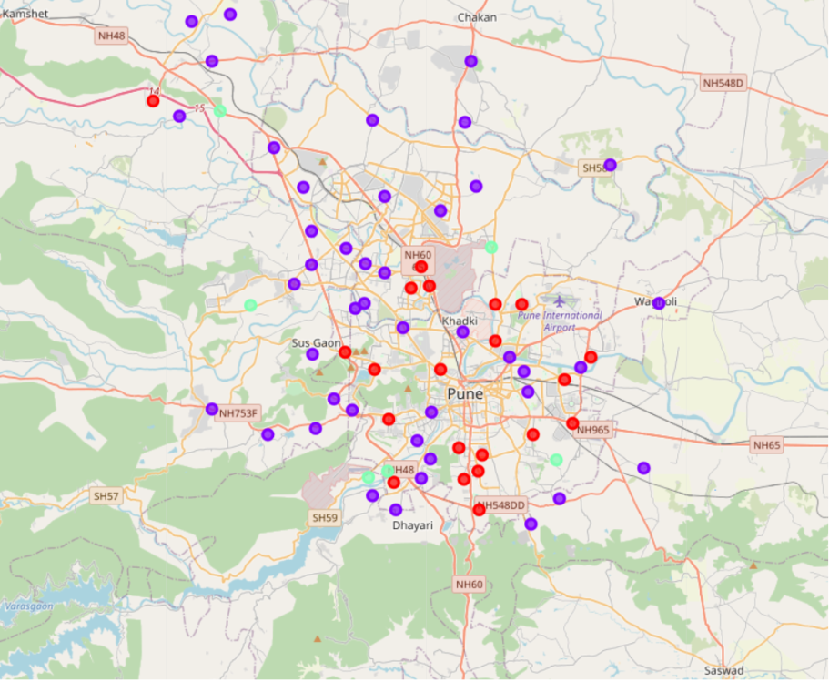
All the clusters are visualized with markers

Slide 10
Discussion :
As inferred from the visualization of clusters it is clear that the franchise targeting the areas in Cluster 1 will be facing a lot of competition from its peers as the number of Gyms in this areas is highly concentrated whereas Cluster 0 serves to be the new market for Gyms as these areas gravely lack in those amenities.
Best Areas to be targeted : Areas in Cluster 0

Slide 11
Conclusion :
In this project, we have gone through the process of identifying the business problem, specifying the data required, extracting and preparing the data, performing machine learning by clustering the data into 2 clusters based on their similarities, and lastly providing recommendations to the relevant stakeholders i.e Gym franchise eager to invest in Pune region by opening a new outlet. To answer the business question that was raised in the introduction section, the answer proposed by this project is: The neighborhoods in cluster 0 are the most preferred locations to open a new Gym . The findings of this project will help the relevant stakeholders to capitalize on the opportunities on high potential locations while avoiding overcrowded areas in their decisions to open a new Gym .

Slide 12
References
Category: Neighborhoods in Pune , India .Retrieved fro (https://en.wikipedia.org/wiki/List_of_neighbourhoods_in_Pune)
Foursquare Developers Documentation. Foursquare. Retrieved from https://developer.foursquare.com/docs.

