Slide 1
Project: Predicting Heart Disease with Classification Machine Learning Algorithms
Presented By – Yuvraj Yadav
UE198119

Slide 2
Goal:
Creating a Classification Model that can predict whether or not a person has presence of heart disease based on physical features of that person(age , sex , cholesterol , etc.)

Slide 3
What is Classification ?
Classification is a form of data analysis that extracts models(classifiers) describing important data classes.
It classifies the data into two or more categories based on class labels.
( Yes/No , Male/Female , Positive/Negative, etc.)

Slide 4
Process of Classification:
Classification is a two step process –
Training the classifier / Model construction
Testing the classifier / Model usage

Slide 5
Dataset:
This database contains 14 physical attributes based on physical testing of a patient. Blood samples are taken and the patient also conducts a brief exercise test . The goal field refers to presence of heart disease in the patient. In general , to confirm 100% if a patient has heart disease can be quite an invasive process , so if we can create a model that accurately predicts the likelihood of heart disease , we can help avoid expensive and invasive procedures.
Content:
Attribute Information-
-age
-sex
-chest pain type(4 values)
-resting blood pressure
-serum cholestrol in mg/dl
-fasting blood sugar>120 mg/dl
-resting electrocardiographic results(values 0,1,2)
-maximum heart rate achieved
-exercise induced angina
-oldpeak = ST depression induced by exercise realtive to rest
-the slope of the peak exercise ST segment
-number of major vessels (0-3) colored by flourosopy
-thal:3=normal ; 6=fixed defect; 7=reversable defect
-target:0 for no presence of heart disease , 1 for presence of heart disease

Slide 6
Important Libraries Used:
Pandas is an open-source library, specifically developed for data science and analysis. It is built upon the Numpy (to handle numeric data in tabular form) package and has inbuilt data structures to ease up the process of data munging/wrangling, aka data manipulation.
NumPy , which stands for Numerical Python, is a library consisting of multidimensional array objects and a collection of routines for processing those arrays. Using NumPy, mathematical and logical operations on arrays can be performed.
Matplotlib is an amazing visualization library in Python for 2D plots of arrays. Matplotlib is a multi-platform data visualization library built on NumPy arrays.
Seaborn is one of an amazing library for visualization of the graphical statistical plotting in Python. Seaborn provides many color palettes and defaults beautiful styles to make the creation of many statistical plots in Python more attractive.

Slide 7
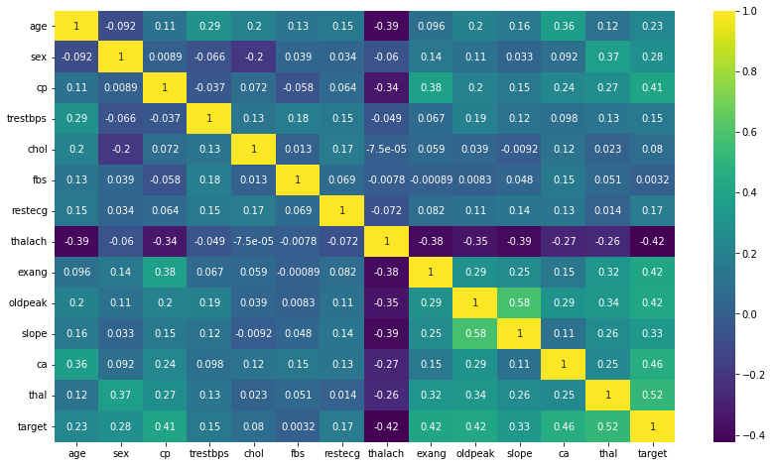
Exploratory Data Analysis:

Slide 8
Train | Test Split and Scaling
Using the train_test_split function, split the dataset into training and testing sets. The training set will be used to train the ML model, whereas the testing set will be used to check how well our model performs in “unseen data” also known as real-world data.
Performed a train test split on the data , with the test size of 10% and a random_state of 101.
Created a StandardScaler object and normalizing the x train and test set feature data.

Slide 9
Logistic Regression Model
Logistic regression is one of the most popular Machine Learning algorithms, which comes under the Supervised Learning technique. It is used for predicting the categorical dependent variable using a given set of independent variables.
Logistic regression predicts the output of a categorical dependent variable. Therefore the outcome must be a categorical or discrete value. It can be either Yes or No, 0 or 1, true or False, etc. but instead of giving the exact value as 0 and 1, it gives the probabilistic values which lie between 0 and 1.
Logistic Regression is much similar to the Linear Regression except that how they are used. Linear Regression is used for solving Regression problems, whereas Logistic regression is used for solving the classification problems.
Created a Logistic Regression model and using cross-validation to find a well-performing C value for the hyper-parameter search. Here , used LogisticRegressionCV.

Slide 10
Model Performance Evaluation
Evaluated model on the remaining 10% of the data , the test set.
Created the following evaluations.
-Confusion Matrix Array
-Confusion Matrix Plot
-Classification Report

Slide 11
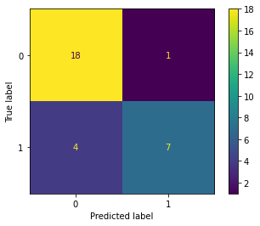
Confusion Matrix:

Slide 12
How To Interpret Confusion Matrix:
18 is the amount of True Positives in our data, while 7 is the amount of True Negatives.
1 & 4 are the number of errors.
There are 1 Type 1 errors (False Positives)- You predicted positive and it’s false.
There are 4 Type 2 errors (False Negatives)- You predicted negative and it’s false.
Hence, if we calculate the accuracy its # Correct Predicted/ # Total. In other words, where TP, FN, FP and TN represent the number of true positives, false negatives, false positives and true negatives.
Accuracy = (TP + TN)/(TP + TN + FP + FN). Accuracy =(18+7)/(21+28+1+4) = 0.83 = 83% accuracy

Slide 13
Performance Curves:
A Precision Recall curve is simply a graph with Precision values on the y-axis and Recall values on the x-axis. In other words, the PR curve contains TP/(TP+FN) on the y-axis and TP/(TP+FP) on the x-axis.
It is important to note that Precision is also called the Positive Predictive Value (PPV).
Recall is also called Sensitivity, Hit Rate or True Positive Rate (TPR).
ROC curve is a graph that shows the performance of a classification model at all possible thresholds( threshold is a particular value beyond which you say a point belongs to a particular class). The curve is plotted between two parameters:-
TRUE POSITIVE RATE
FALSE POSITIVE RATE

Slide 14
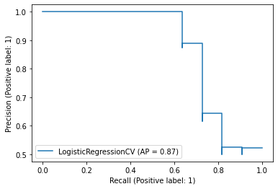
Precision Recall Curve:

Slide 15
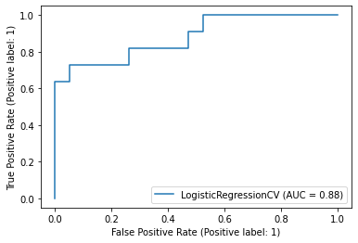
ROC Curve:

Slide 16
Conclusion:
Out of the 13 features I examined, the top 4 significant features that helped us classify between a positive & negative Diagnosis were chest pain type (cp), maximum heart rate achieved (thalach), number of major vessels (ca), and ST depression induced by exercise relative to rest (oldpeak).
Model can now classify patients with Heart Disease. Now we can properly diagnose patients, & get them the help they needs to recover. By diagnosing detecting these features early, we may prevent worse symptoms from arising later.
Model yields the highest accuracy, 82%. Any accuracy above 70% is considered good, but be careful because if your accuracy is extremely high, it may be too good to be true (an example of Over fitting). Thus, 80% is the ideal accuracy!

