Slide 1



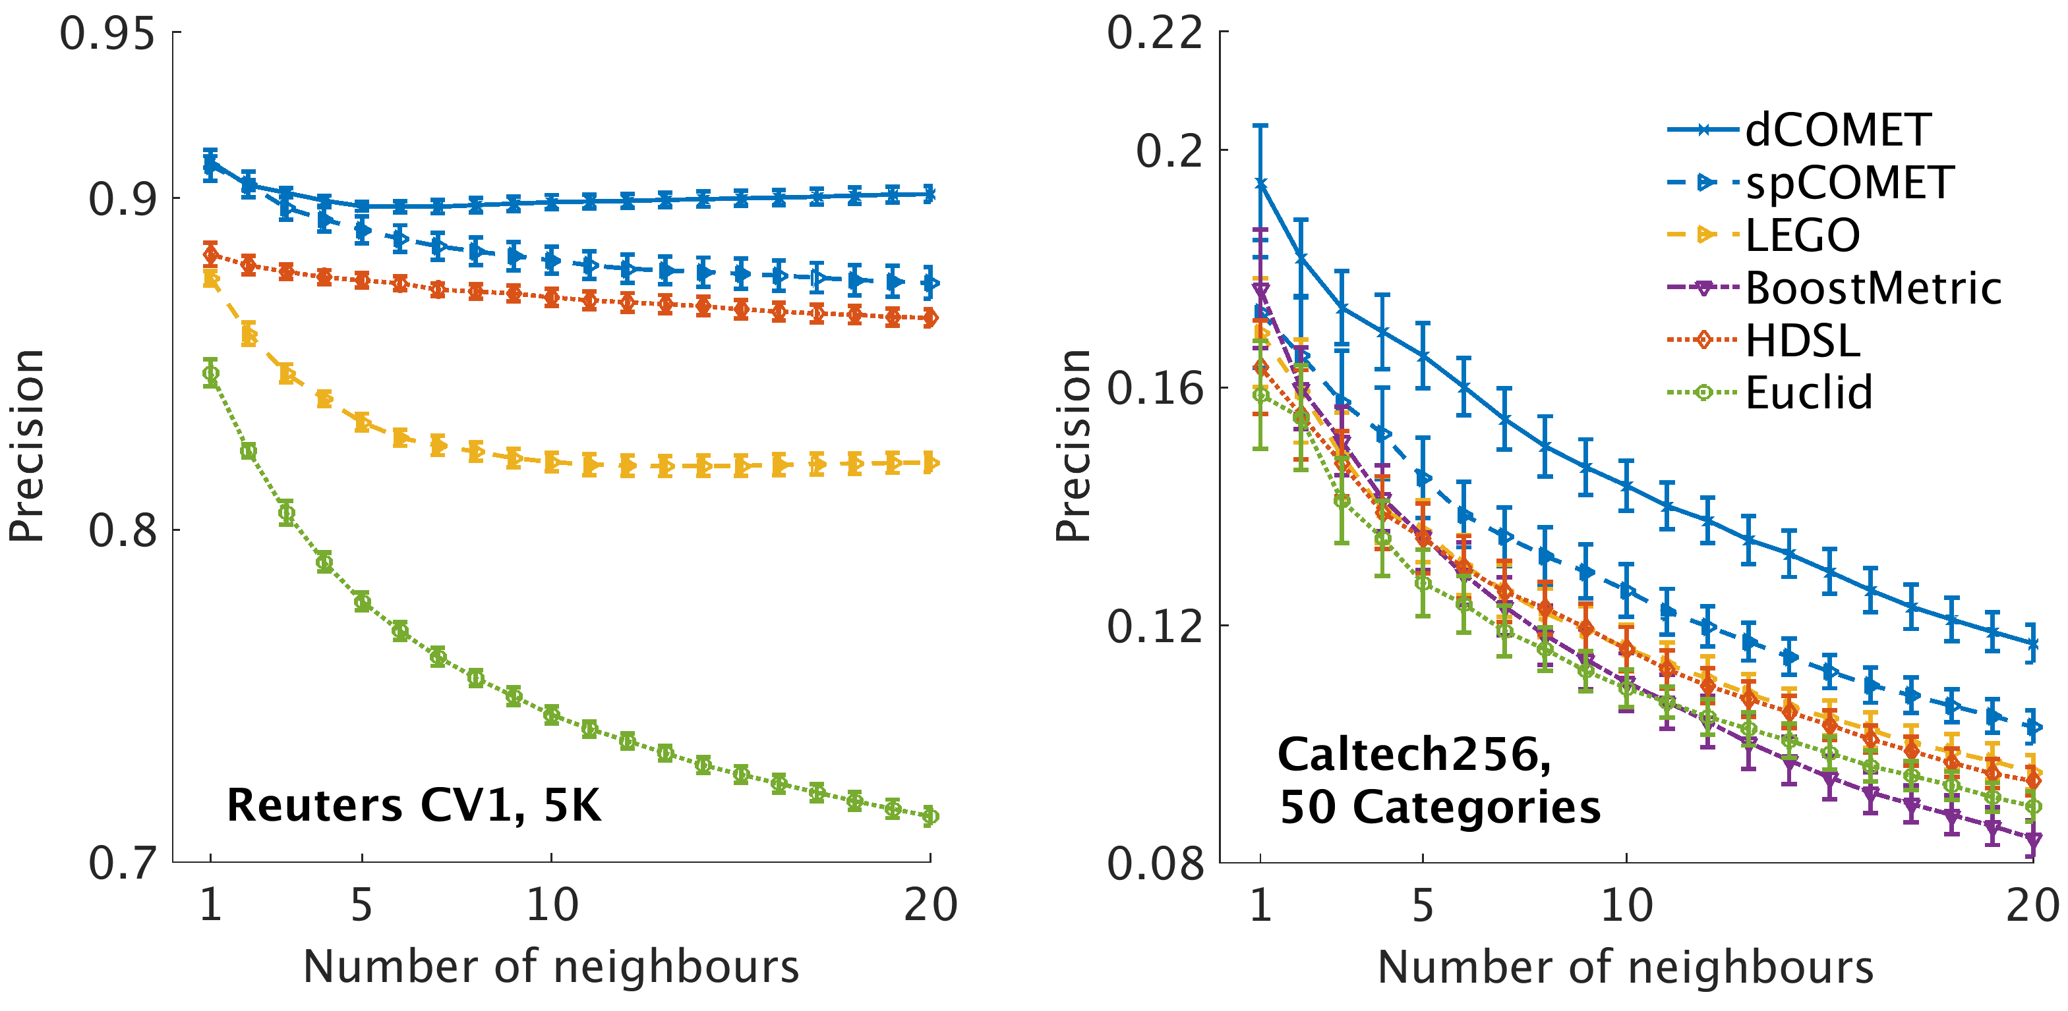

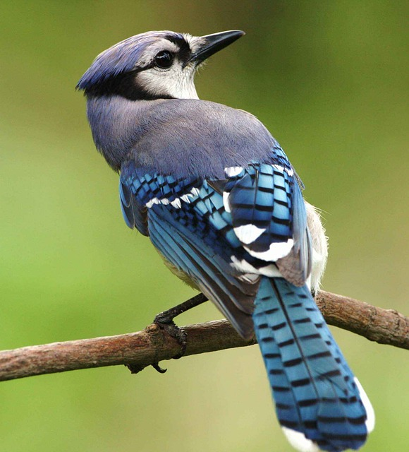

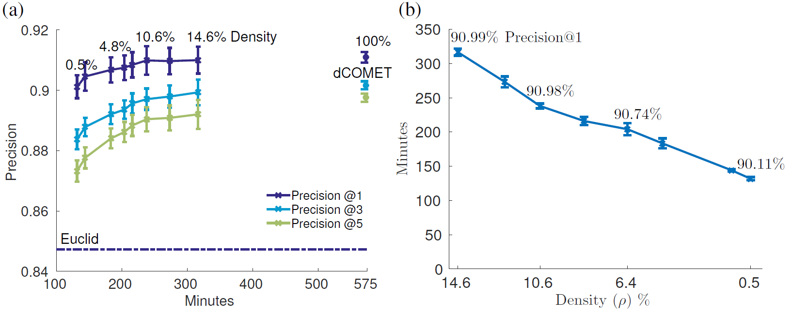
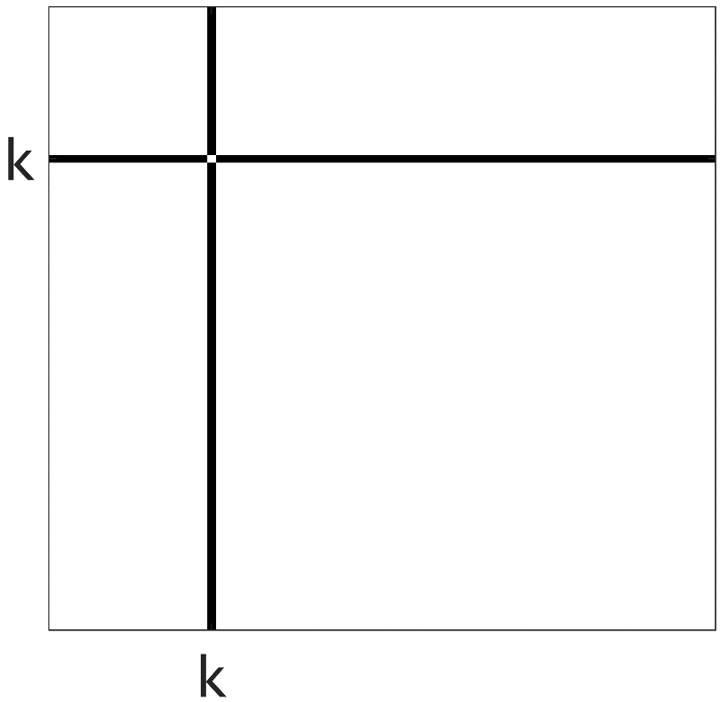
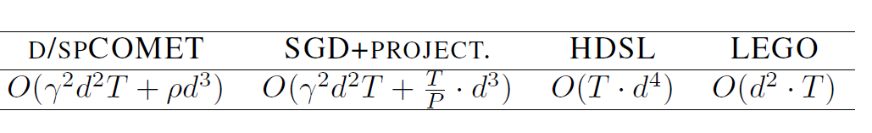

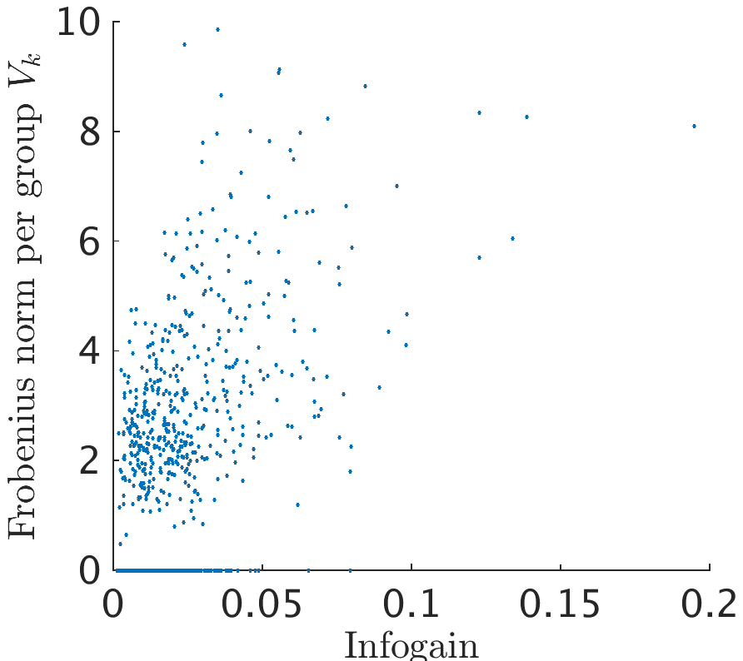



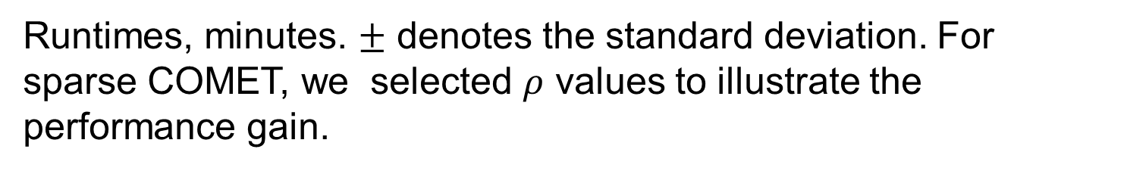
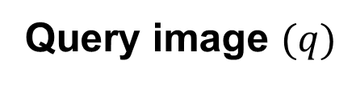

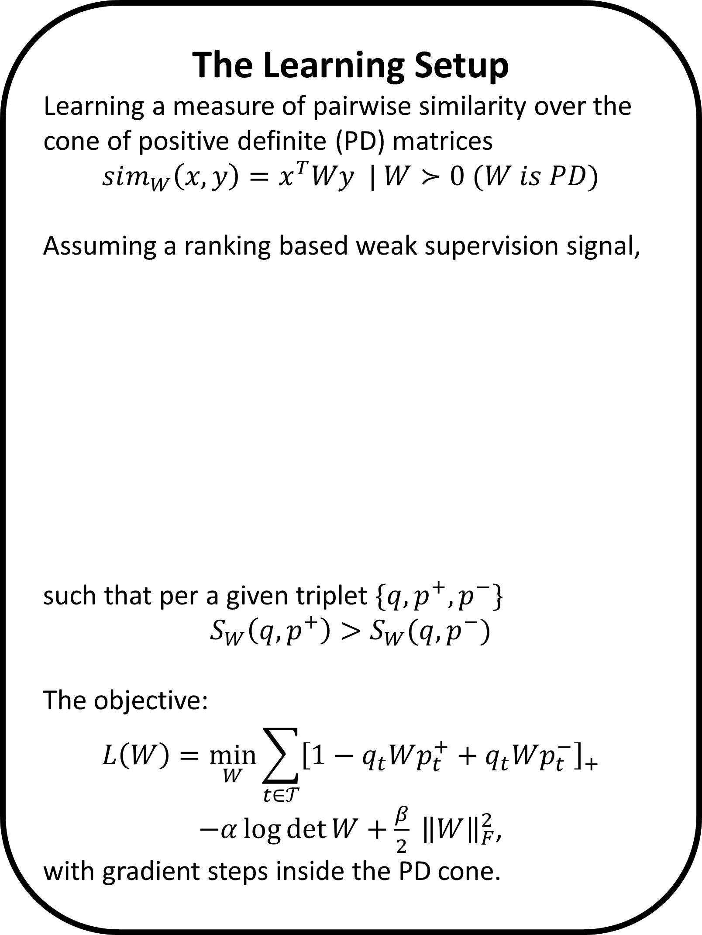



Learning Sparse Metrics, One Feature at a Time
The Leslie and Susan Gonda Multidisciplinary Brain Research Center
Yuval Atzmon ¹, Uri Shalit ², Gal Chechik ^{1,3}
¹ Gonda Multidisciplinary Brain Research Center, Bar-Ilan University, ² NYU, ³ Google CA
The Learning Setup
Learning a measure of pairwise similarity over the cone of positive definite (PD) matrices
$$sim_{W}\left(x,y\right)=x^{T}Wy | W≻0 (W is PD)$$
Assuming a ranking based weak supervision signal,
such that per a given triplet $\{q, p^{+}, p^{−}\}$
$$S_{W}\left(q,p^{+}\right)>S_{W}(q, p^{−})$$
The objective:
$$L\left(W\right)=\min_{W}{\sum_{t∈𝒯}{{\left[1−q_{t}Wp_{t}^{+}+q_{t}Wp_{t}^{−}\right]}_{+}}}$$
$−α\log{\det{W}}+\frac{β}{2} {\left\|W\right\|}_{F}^{2}$,
with gradient steps inside the PD cone.
Sparse COMET
We propose a new type of structured sparsity, that allows only a small set of features to interact with any of the other features. We also maintain weights for the individual features, corresponding to the diagonal of the learned similarity matrix.
COMET achieves better precision in every dataset tested.
Query image $(q)$
Structured sparsity: A heat map of the absolute values of the elements of $W$ trained on RCV1, illustrating the structured sparseness of the learned metric. Features are ordered by their information gain.
more similar ${(p}^{+})$
less similar ${(p}^{−})$
80%/20% train/test split, 5-fold cross-validation for hyper parameters. Compared methods: Euclidean metric (baseline)‏. HDSL: Similarity Learning for High Dimensional Sparse Data [Liu et al, 2015], LEGO (ITML): Log-Det Exact Gradient Online [Jain et al. 2008], BoostMetric positive-semidefinite metric learning with boosting [Shen et al. 2009]
We use an overlapping decomposition of $W$ into ${\left\{V_{k}\right\}}_{k=0}^{d}$ group components: The matrix $V_{0}$ is a diagonal matrix, and each matrix $V_{k} \left(k>0\right)$ is a symmetric matrix of non-zero values only on the $k^{th}$ row and column, with an all-zeros diagonal.
$W$ is the sum $W=\sum_{k=0}^{d}{V_{k}}$
The effect of sparsity on precision and runtime
We add a group-sparse norm penalty to the loss to encourage solutions with fewer features and obtain the following objective and optimization :
$${\min_{{\left\{V_{k}\right\}}_{k=0}^{d}}{L(\left\{V_{k}\right\}}}_{k=0}^{d})=\min_{{\left\{V_{k}\right\}}_{k=0}^{d}}{\sum_{t∈𝒯}{[1−q_{t}Wp_{t}^{+}+q_{t}Wp_{t}^{−}]} }$$
$$−α\log{\det{W}}+λ\sum_{k=0}^{d}{{\left\|V_{k}\right\|}_{F}}$$
For encouraging exact all-zeros updates, we solve on each coordinate step the following proximal problem, which admits a closed form solution.
$$V_{k}^{new}=\underset{V∈𝒱_{k}}{argmin}\left\langle \frac{∂L}{∂V_{k}},V\right\rangle +\frac{1}{2θ}{\left\|{V−V}_{k}\right\|}_{F}^{2} +λ\left\|V\right\|$$
and set $W^{new}=W+V_{k}^{new}−V_{k}$, where $θ$ corresponds to the step size of the proximal update.
COMET row-column coordinate step
Computational Complexity
We compared COMET with approaches that avoid repeated projections to the PD cone and to the Euclidean metric baseline.
Updating the learned matrix one column and row at a time.
The PD condition of the Schur complement guarantees that the steps reside inside the PD cone:
RCV1 dataset with 5K features.(a) Precision at 1, 3 and 5 nearest neighbor evaluated on the test set vs. the mean training run time of COMET. Percentiles denote the density of the learned matrix. Error bars denote the standard error of the mean across 5 random train/test partitions (80\%/20\%). Dashed line denotes the precision-at-1 of the Euclidean baseline. (b) Mean training time as a function of the learned matrix density. Percentiles denote the Precision-at-1
$$W^{new}≻0 ⟺ c^{∗}−{b^{∗}}^{T}A^{−1}b^{∗}>0,$$
where $c^{∗}=W_{\left(1,1\right)}^{new}$(a scalar), $b^{∗}=W_{\left(2:d,1\right)}^{new}$ and $A^{∗}=A=W_{(2:d,2:d)}$. Resulting with $η^{max}$an upper limit to the allowable step size.
Keeping an updated Cholesky root $L$of $W=L^{T}L$to solve the condition, also result with a continues embedding $Lx$of the features into the metric space.
Runtimes
Sparse COMET is fastest on the RCV1 5K features dataset. LEGO is fastest on the smaller datasets; HDSL is mostly slower than COMET. Importantly, both sparse and dense COMET converged to a significantly better optimum.
Informative features are non-zeros
Frobenius norm of the groups $V_{k}$ against the information gain of feature $k$.
Sparse COMET assigns zero weights to less-informative features.
Runtimes, minutes. $±$ denotes the standard deviation. For sparse COMET, we selected $ρ$ values to illustrate the performance gain.
Contact and code: yuval.atzmon@biu.ac.il, http://chechiklab.biu.ac.il/yuvval

