Slide 1




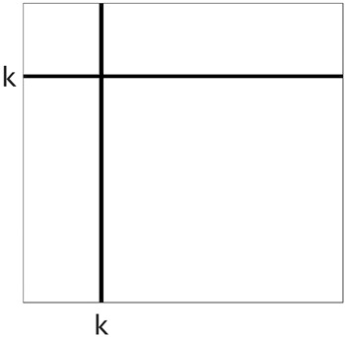
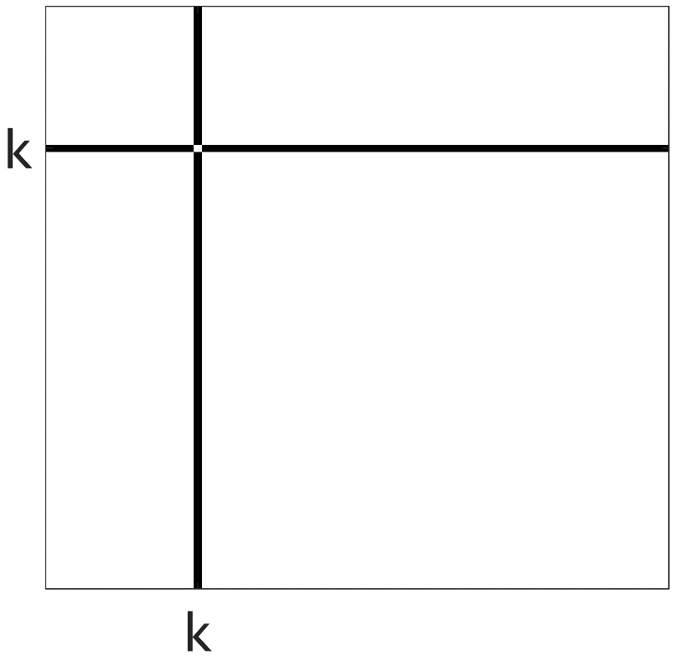
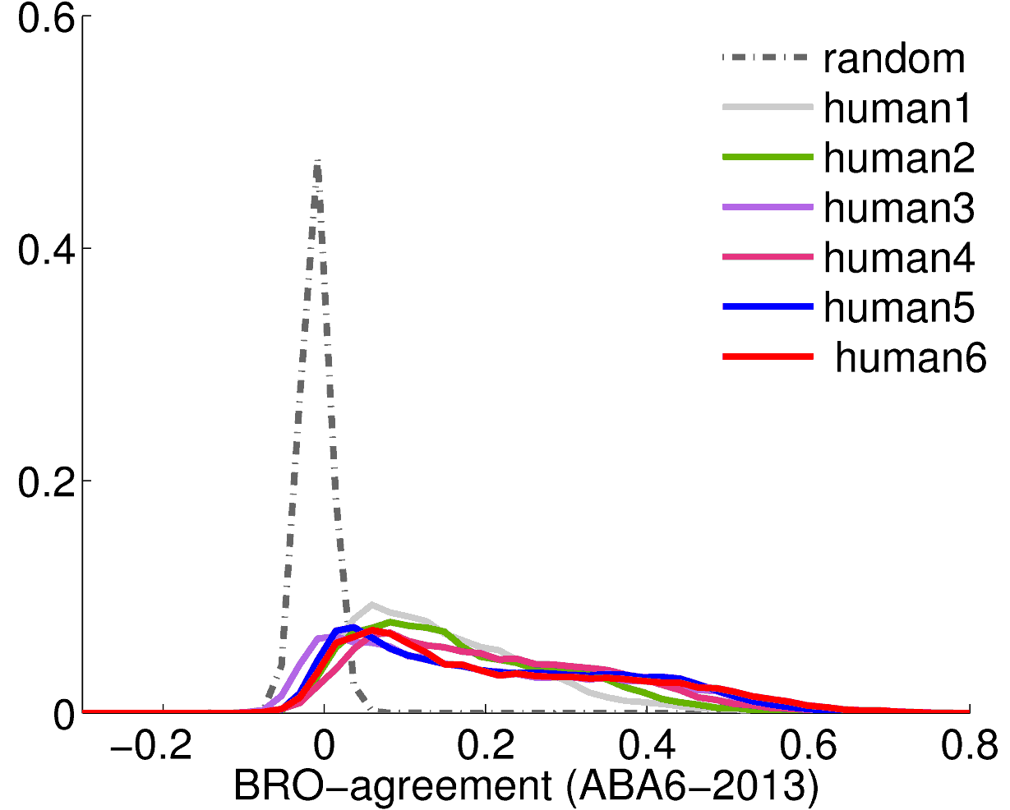
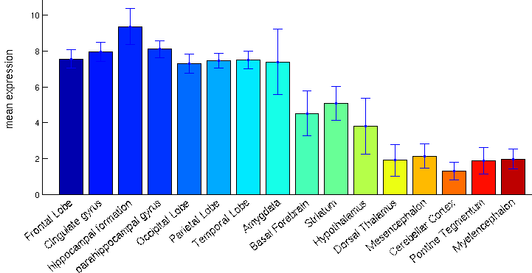
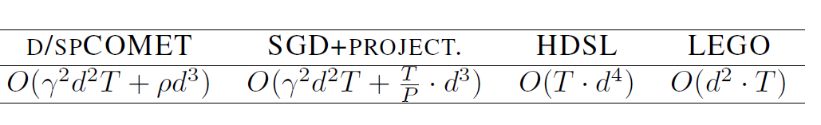
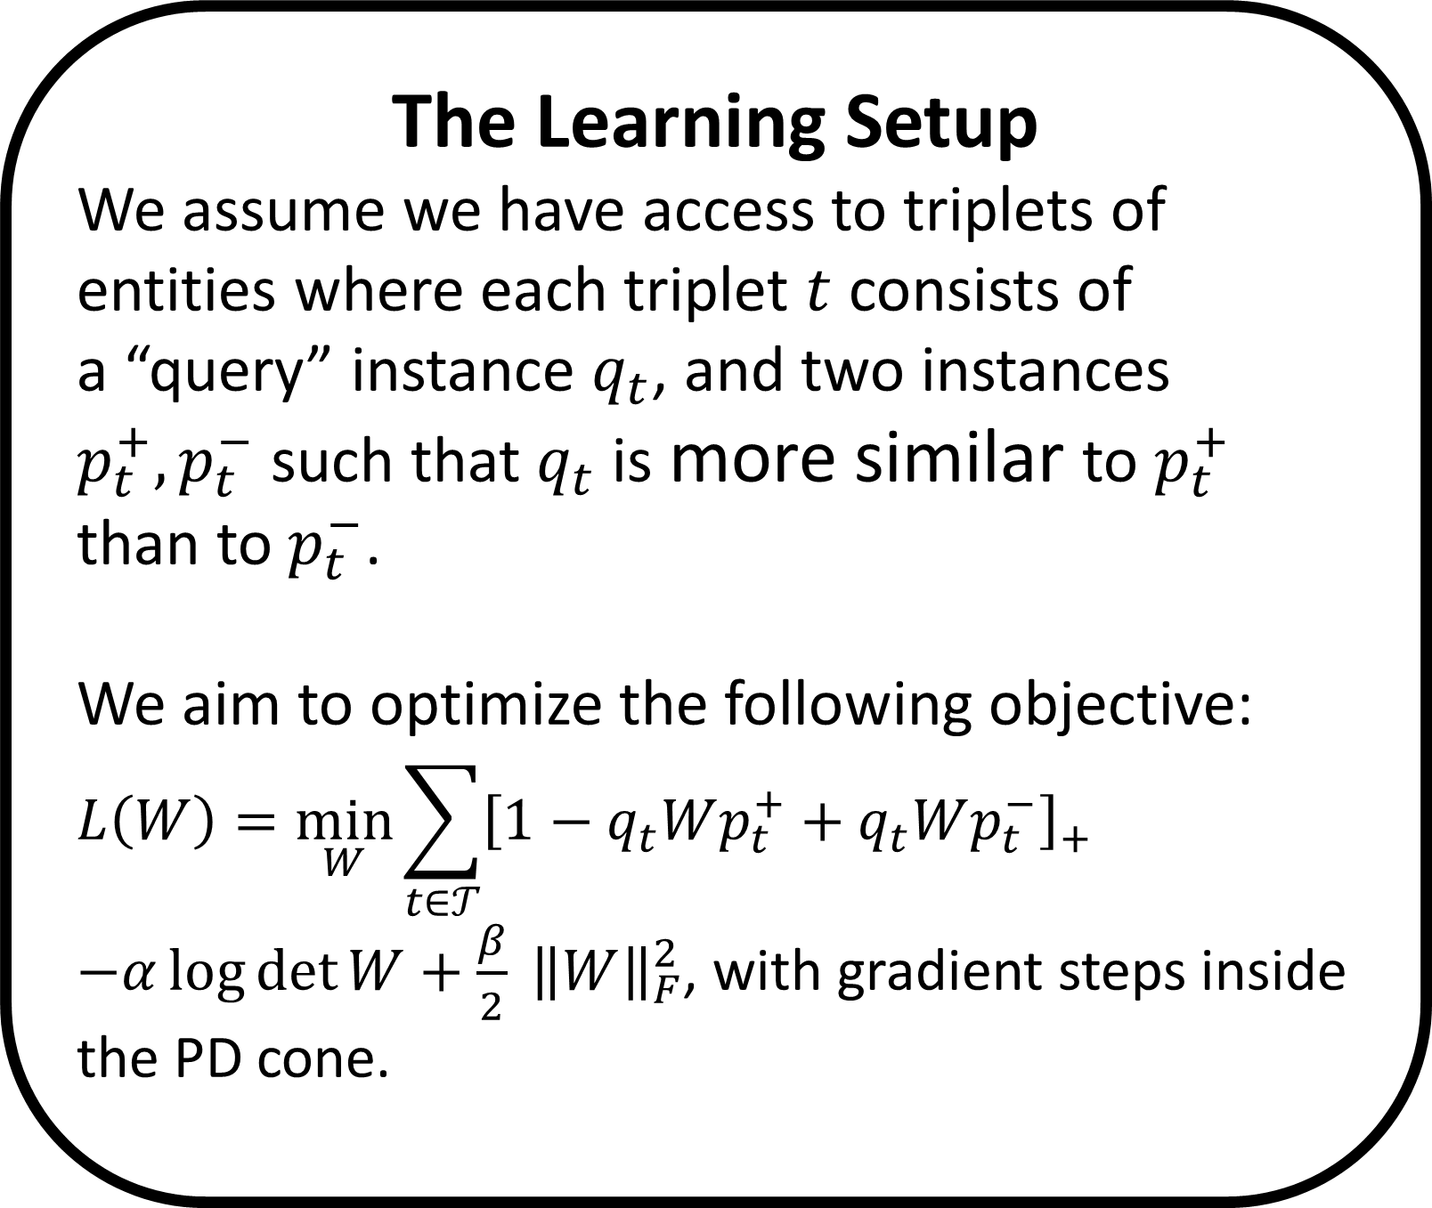
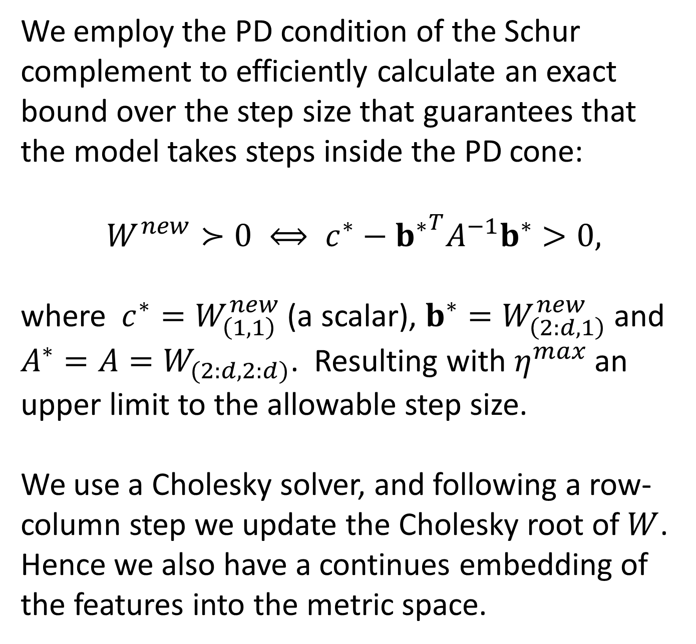
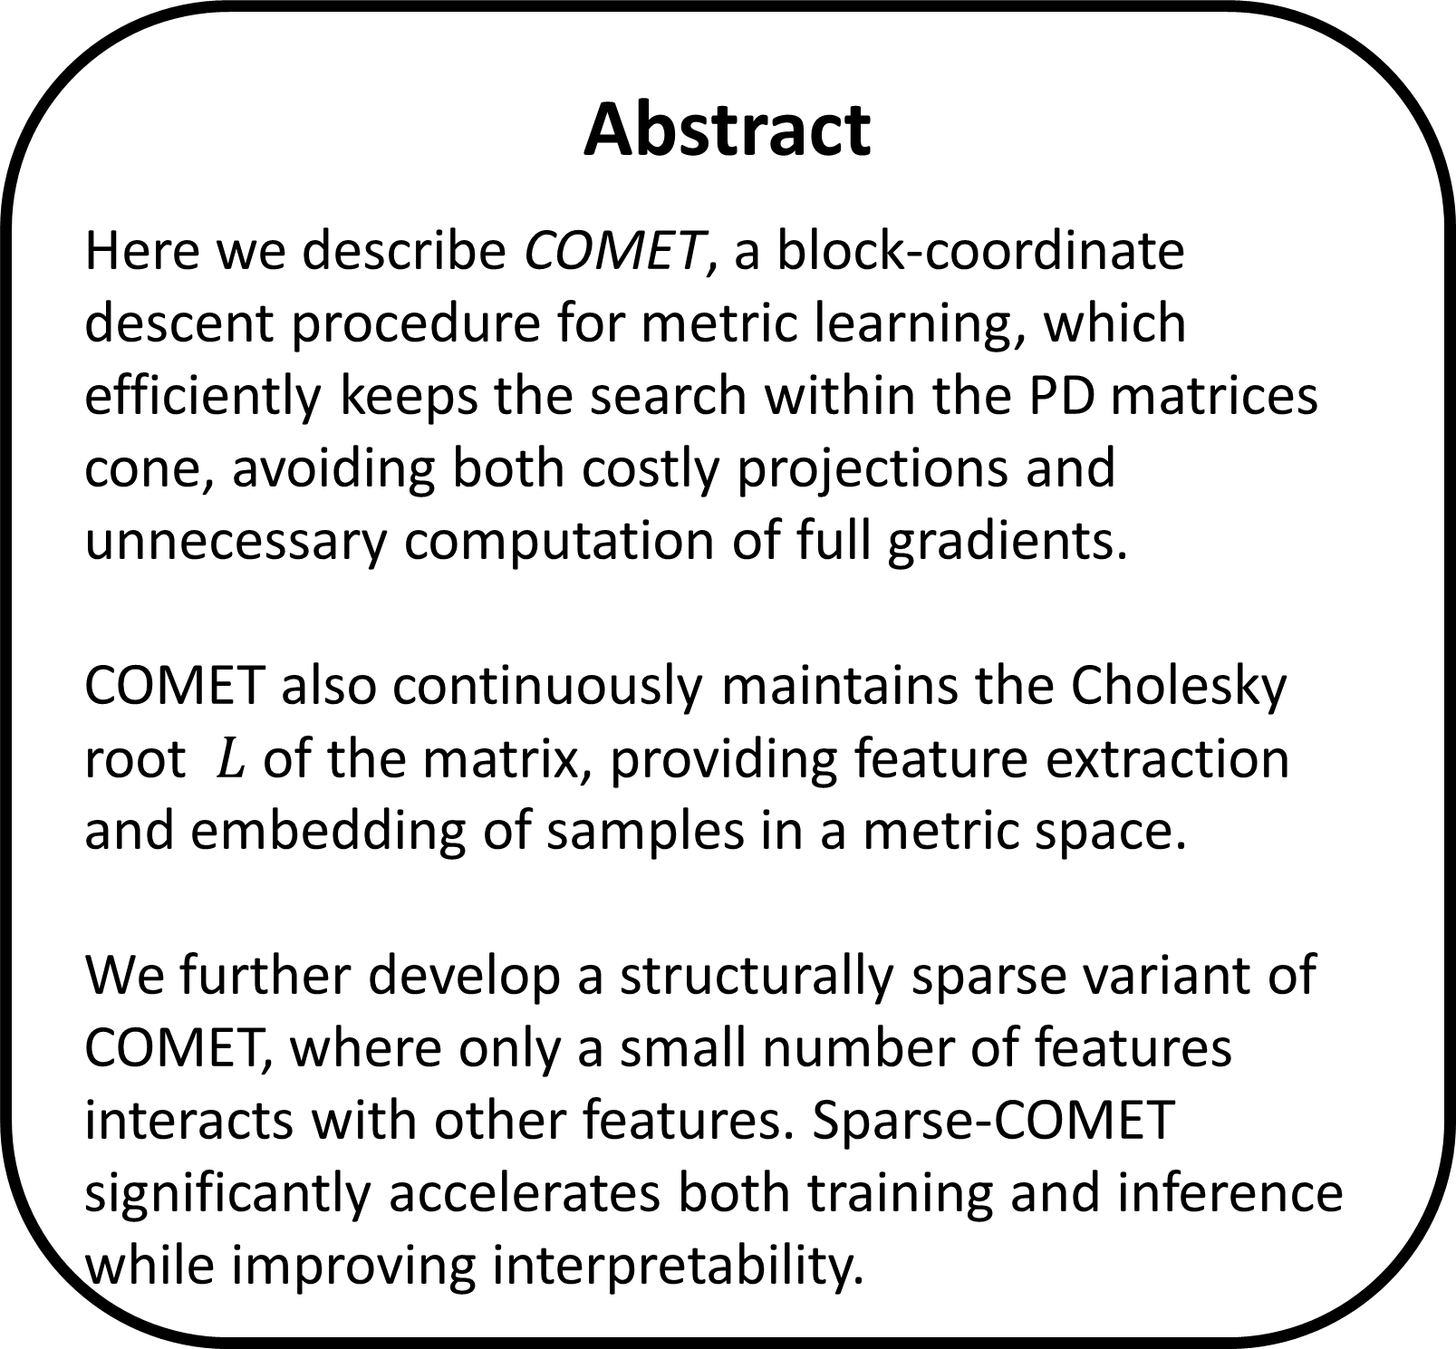

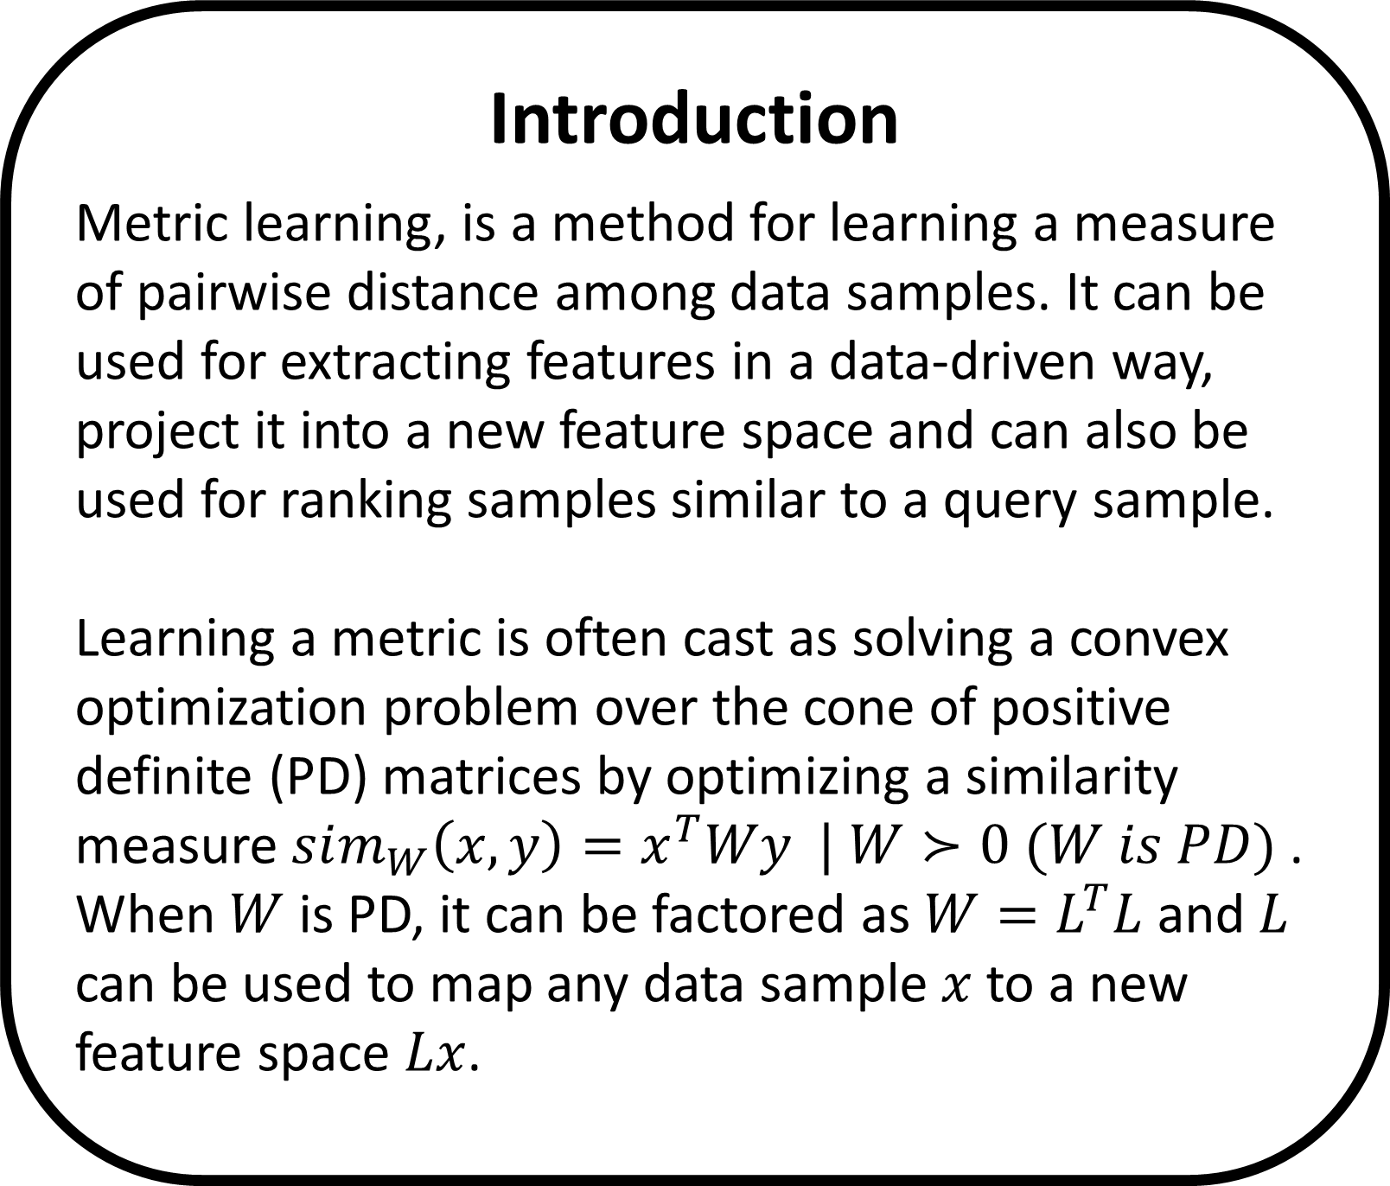


Learning Sparse Metrics
One Feature at a Time - COMET
The Leslie and Susan Gonda Multidisciplinary Brain Research Center
Yuval Atzmon ¹, Uri Shalit ², Gal Chechik ^{1,3}
¹ Gonda Multidisciplinary Brain Research Center, Bar-Ilan University, ² NYU, ³ Google CA
Introduction
Metric learning, is a method for learning a measure of pairwise distance among data samples. It can be used for extracting features in a data-driven way, project it into a new feature space and can also be used for ranking samples similar to a query sample.
Learning a metric is often cast as solving a convex optimization problem over the cone of positive definite (PD) matrices by optimizing a similarity measure $sim_{W}\left(x,y\right)=x^{T}Wy | W≻0 (W is PD)$ .
When $W$ is PD, it can be factored as $W=L^{T}L$ and $L$ can be used to map any data sample $x$ to a new feature space $Lx$.
A row-column coordinate step
Sparse COMET
Precision-Density-Runtime
COMET operates by updating the learned matrix one column and row at a time, thus updating the terms relating to one feature at each iteration.
We use an overlapping decomposition of $W$ into ${\left\{V_{k}\right\}}_{k=0}^{d}$ group components: The matrix $V_{0}$ is a diagonal matrix, and each matrix $V_{k} \left(k>0\right)$ is a symmetric matrix of non-zero values only on the $k^{th}$ row and column, with an all-zeros diagonal.
$W$ is the sum $W=\sum_{k=0}^{d}{V_{k}}$
11% of the human genes show distinct expression patterns that agree with the cortex region ontology
We employ the PD condition of the Schur complement to efficiently calculate an exact bound over the step size that guarantees that the model takes steps inside the PD cone:
$$W^{new}≻0 ⟺ c^{∗}−{b^{∗}}^{T}A^{−1}b^{∗}>0,$$
where $c^{∗}=W_{\left(1,1\right)}^{new}$(a scalar), $b^{∗}=W_{\left(2:d,1\right)}^{new}$ and $A^{∗}=A=W_{(2:d,2:d)}$. Resulting with $η^{max}$an upper limit to the allowable step size.
We use a Cholesky solver, and following a row-column step we update the Cholesky root of $W$. Hence we also have a continues embedding of the features into the metric space.
We add a group-sparse norm penalty to the loss to encourage solutions with fewer features and obtain the following objective and optimization :
$${\min_{{\left\{V_{k}\right\}}_{k=0}^{d}}{L(\left\{V_{k}\right\}}}_{k=0}^{d})=\min_{{\left\{V_{k}\right\}}_{k=0}^{d}}{\sum_{t∈𝒯}{[1−q_{t}Wp_{t}^{+}+q_{t}Wp_{t}^{−}]} }$$
$$−α\log{\det{W}}+λ\sum_{k=0}^{d}{{\left\|V_{k}\right\|}_{F}}$$
For encouraging exact all-zeros updates, we solve on each coordinate step the following proximal problem, which admits a closed form solution.
$$V_{k}^{new}=\underset{V∈𝒱_{k}}{argmin}\left\langle \frac{∂L}{∂V_{k}},V\right\rangle +\frac{1}{2θ}{\left\|{V−V}_{k}\right\|}_{F}^{2} +λ\left\|V\right\|$$
and set $W^{new}=W+V_{k}^{new}−V_{k}$, where $θ$ corresponds to the step size of the proximal update.
Astrocytes and neuronal markers are in stronger agreement with BRO than the average gene.
Abstract
Here we describe COMET, a block-coordinate descent procedure for metric learning, which efficiently keeps the search within the PD matrices cone, avoiding both costly projections and unnecessary computation of full gradients.
COMET also continuously maintains the Cholesky root $L$ of the matrix, providing feature extraction and embedding of samples in a metric space.
We further develop a structurally sparse variant of COMET, where only a small number of features interacts with other features. Sparse-COMET significantly accelerates both training and inference while improving interpretability.
Sparsity Structure
The percent of BRO-significant genes is stable when we compute the BRO score for each subject separately
(89%, 90%, 76%, 91%, 83%, 86%).
Dense COMET
We randomly draw a coordinate for each step, and take a row-column gradient step accordingly. We repeat it $N∙d$ times.
Example: FEZF2 (ZNF312)
The Learning Setup
We assume we have access to triplets of entities where each triplet $t$ consists of
a “query” instance $q_{t}$, and two instances $p_{t}^{+}, p_{t}^{−}$ such that $q_{t}$ is more similar to $p_{t}^{+}$
than to $p_{t}^{−}$.
We aim to optimize the following objective:
$$L\left(W\right)=\min_{W}{\sum_{t∈𝒯}{{\left[1−q_{t}Wp_{t}^{+}+q_{t}Wp_{t}^{−}\right]}_{+}}}$$
$−α\log{\det{W}}+\frac{β}{2} {\left\|W\right\|}_{F}^{2}$, with gradient steps inside the PD cone.
Sparse COMET
We propose a new type of structured sparsity, that allows only a small set of features to interact with any of the other features. We also maintain weights for the individual features, corresponding to the diagonal of the learned similarity matrix.
FEZF2 is known to regulate the axon targeting of layer 5 subcortical projection neurons.
Computational Complexity
We compared COMET with LEGO, HDSL and the Euclidean metric baseline.
Hawrylycz et al., An anatomically comprehensive atlas of the adult human brain transcriptome, Nature 2012
Kang et al., Spatio-temporal transcriptome of the human brain, Nature 2011
Cahoy et al., A transcriptome database for astrocytes, neurons, and oligodendrocytes, J. neuroscience 2008.
Eisenberg et al., Human housekeeping genes are compact, Trends in genetics. 2003
Contact: yuval.atzmon@biu.ac.il, http://chechiklab.biu.ac.il/yuvval

