Slide 1



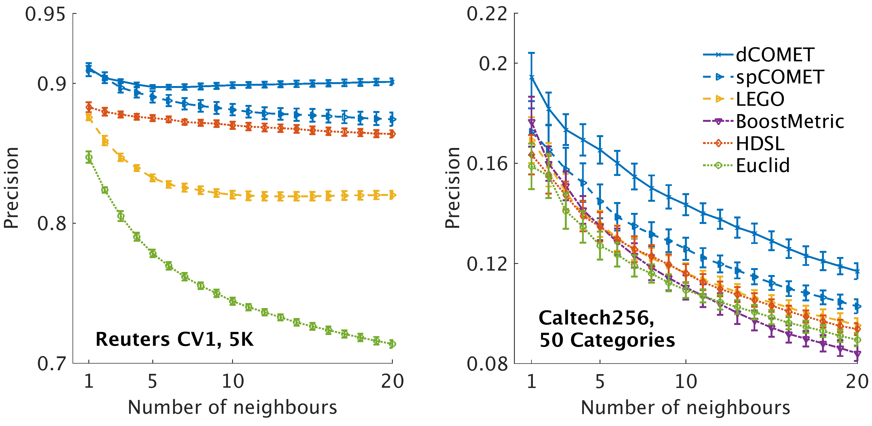

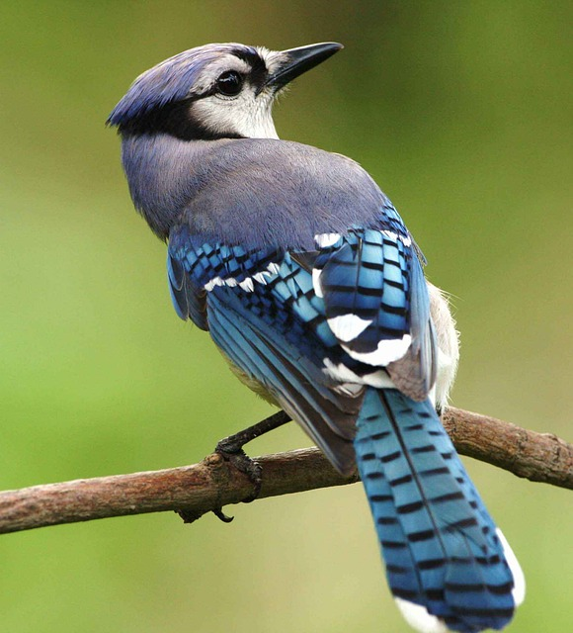

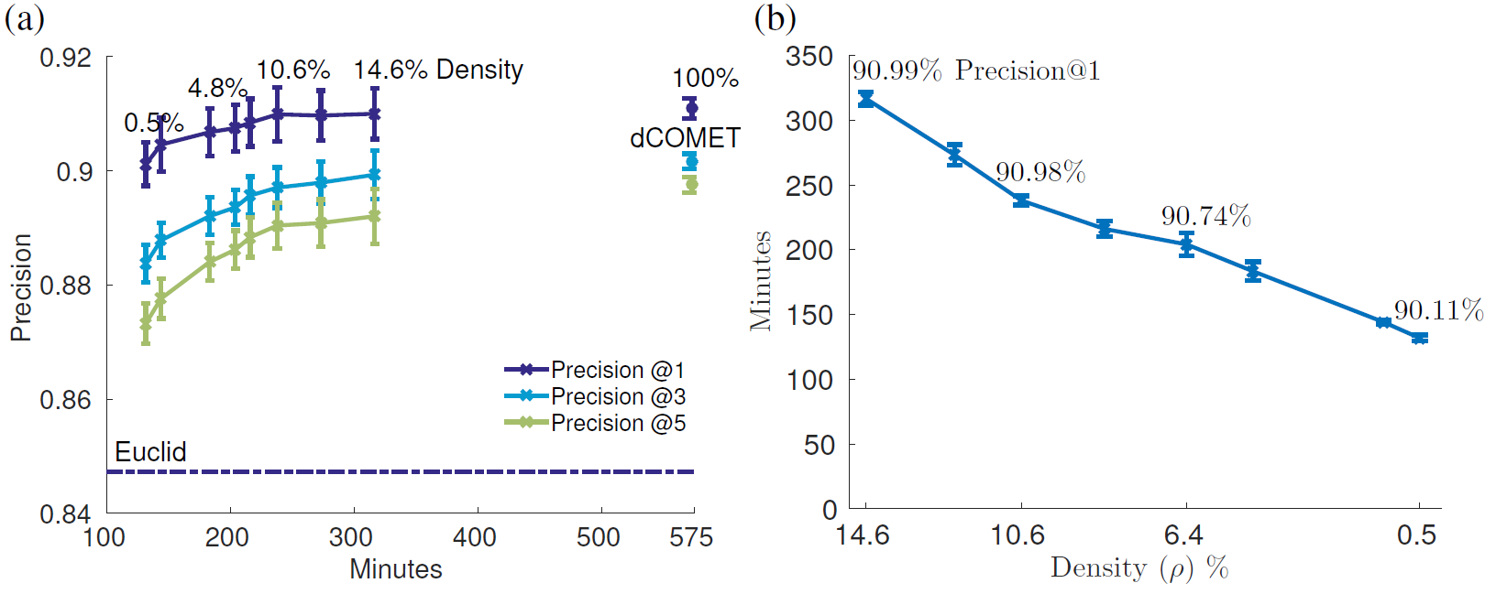
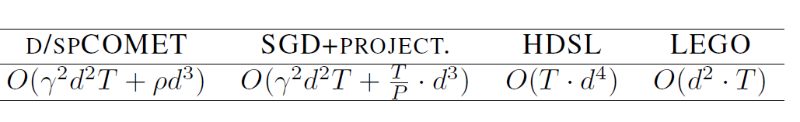
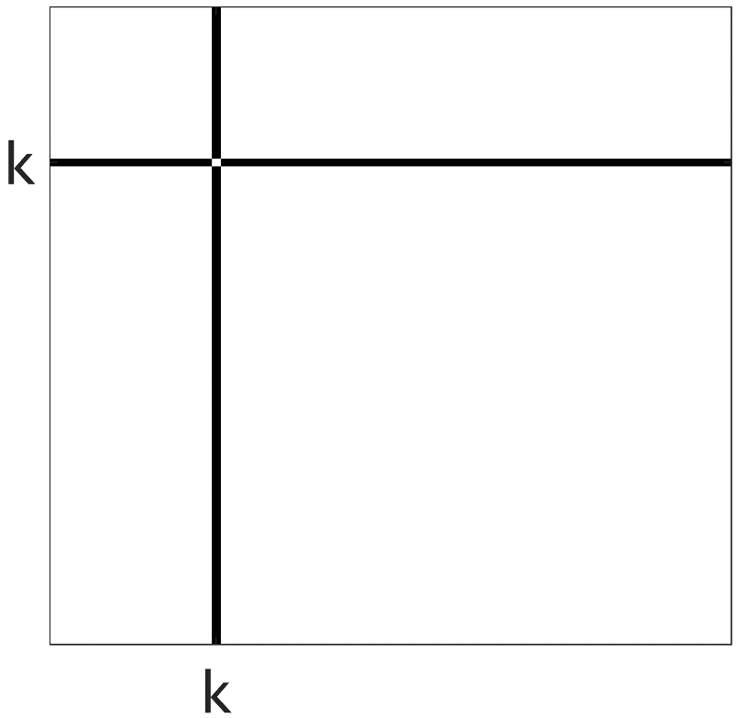
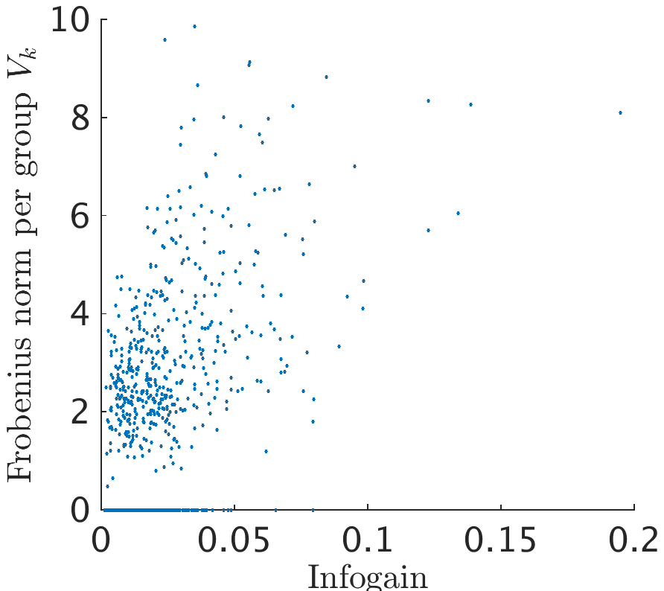
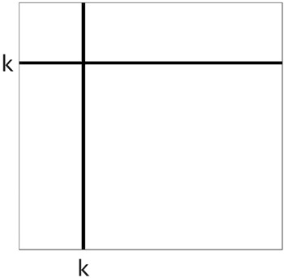

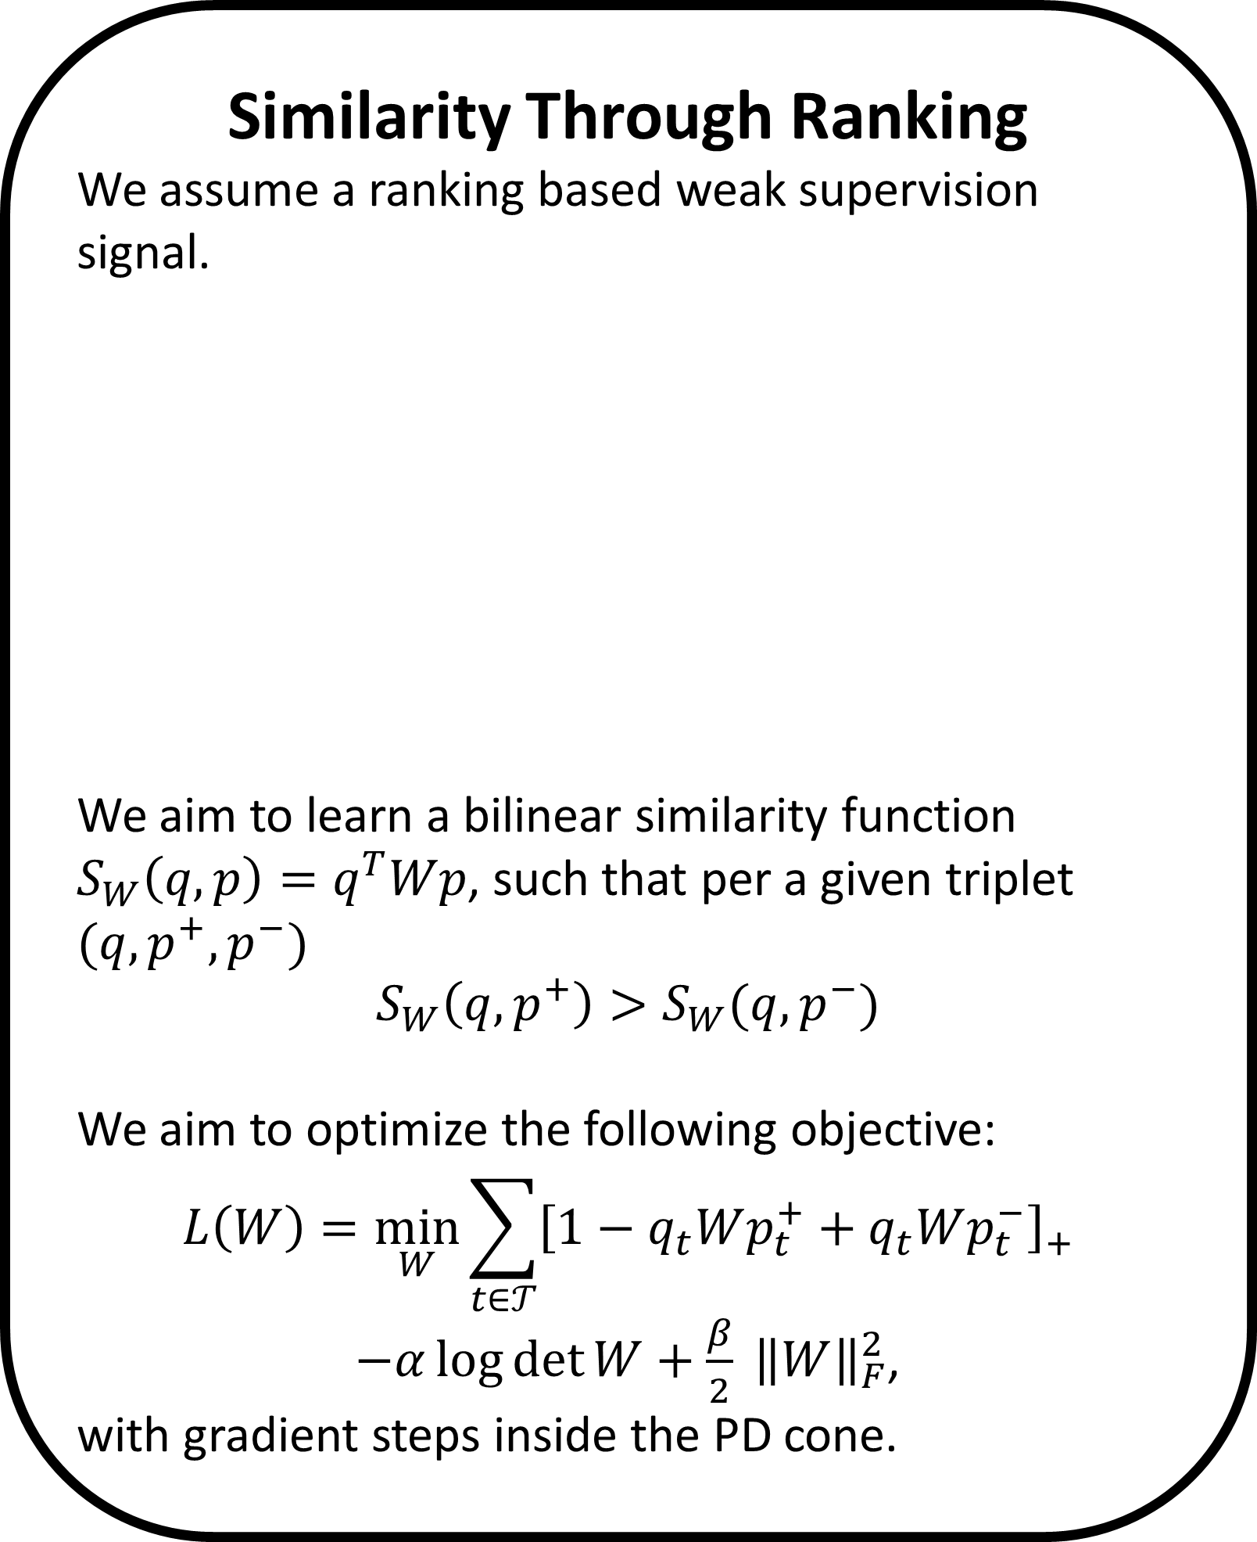


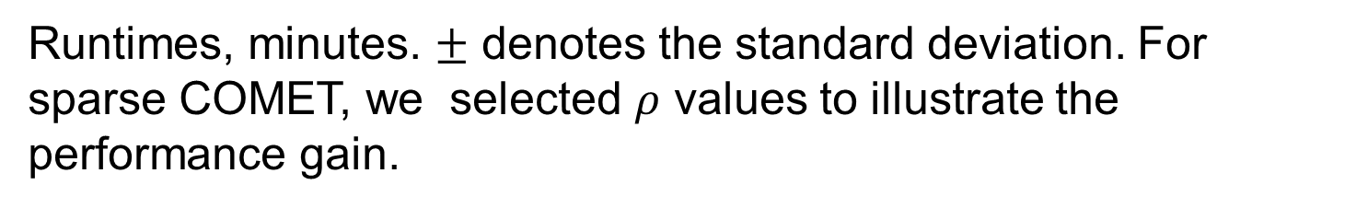


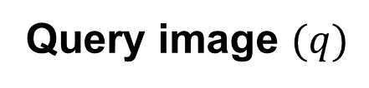



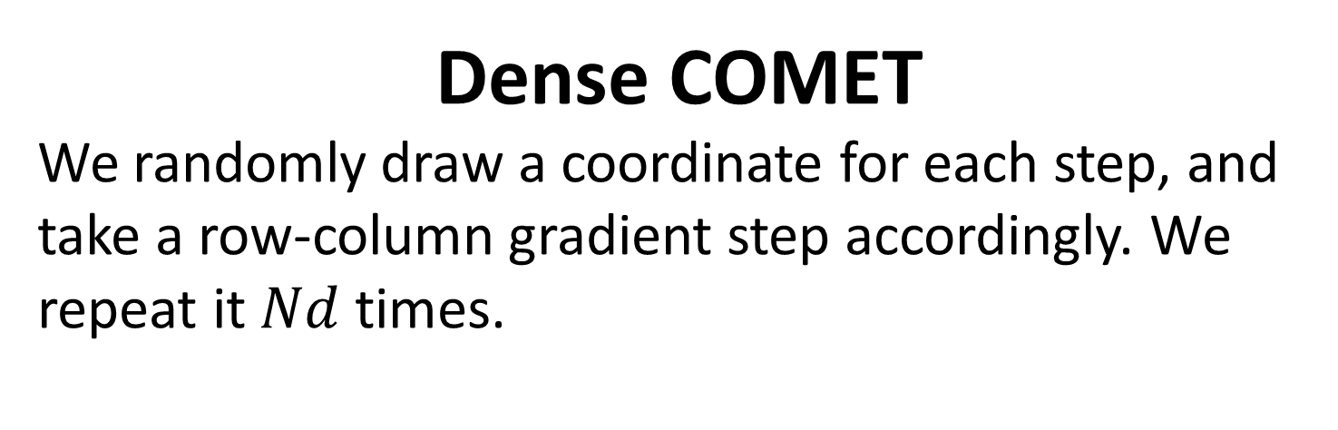
Learning Sparse Metrics, One Feature at a Time
The Leslie and Susan Gonda Multidisciplinary Brain Research Center
Yuval Atzmon ¹, Uri Shalit ², Gal Chechik ^{1,3}
¹ Gonda Multidisciplinary Brain Research Center, Bar-Ilan University, ² NYU, ³ Google CA
Introduction
In metric learning we learn a measure of pairwise distance among data samples. It can be used for extracting features in a data-driven way, project it into a new feature space and ranking samples similar to a query sample.
It is often cast as solving a convex optimization problem over the cone of positive definite (PD) matrices by optimizing a similarity measure $sim_{W}\left(x,y\right)=x^{T}Wy | W≻0 (W is PD)$ .
When $W$ is PD, it can be factored as $W=L^{T}L$ and then map any sample $x$ to a new feature space $Lx$.
A row-column coordinate step
We employ the PD condition of the Schur complement to calculate a bound over the step size. It guarantees that the steps reside inside the PD cone:
$$W^{new}≻0 ⟺ c^{∗}−{b^{∗}}^{T}A^{−1}b^{∗}>0,$$
where $c^{∗}=W_{\left(1,1\right)}^{new}$(a scalar), $b^{∗}=W_{\left(2:d,1\right)}^{new}$ and $A^{∗}=A=W_{(2:d,2:d)}$. Resulting with $η^{max}$an upper limit to the allowable step size.
We use a Cholesky solver, and following a row-column step we update the Cholesky root of $W$. Hence we also have a continues embedding of the features into the metric space.
Sparse COMET
We add a group-sparse norm penalty to the loss to encourage solutions with fewer features and obtain the following objective and optimization :
$${\min_{{\left\{V_{k}\right\}}_{k=0}^{d}}{L(\left\{V_{k}\right\}}}_{k=0}^{d})=\min_{{\left\{V_{k}\right\}}_{k=0}^{d}}{\sum_{t∈𝒯}{[1−q_{t}Wp_{t}^{+}+q_{t}Wp_{t}^{−}]} }$$
$$−α\log{\det{W}}+λ\sum_{k=0}^{d}{{\left\|V_{k}\right\|}_{F}}$$
For encouraging exact all-zeros updates, we solve on each coordinate step the following proximal problem, which admits a closed form solution.
$$V_{k}^{new}=\underset{V∈𝒱_{k}}{argmin}\left\langle \frac{∂L}{∂V_{k}},V\right\rangle +\frac{1}{2θ}{\left\|{V−V}_{k}\right\|}_{F}^{2} +λ\left\|V\right\|$$
and set $W^{new}=W+V_{k}^{new}−V_{k}$, where $θ$ corresponds to the step size of the proximal update.
COMET achieves better precision in every dataset tested.
80%/20% train/test split, 5-fold cross-validation for hyper parameters. Compared methods: Euclidean metric (baseline)‏. HDSL: Similarity Learning for High Dimensional Sparse Data [Liu et al, 2015], LEGO (ITML): Log-Det Exact Gradient Online [Jain et al. 2008], BoostMetric positive-semidefinite metric learning with boosting [Shen et al. 2009]
Similarity Through Ranking
We assume a ranking based weak supervision signal.
We aim to learn a bilinear similarity function $S_{W}\left(q,p\right)=q^{T}Wp$, such that per a given triplet
$$(q, p^{+}, p^{−})$$
$$S_{W}\left(q,p^{+}\right)>S_{W}(q, p^{−})$$
We aim to optimize the following objective:
$$L\left(W\right)=\min_{W}{\sum_{t∈𝒯}{{\left[1−q_{t}Wp_{t}^{+}+q_{t}Wp_{t}^{−}\right]}_{+}}}$$
$−α\log{\det{W}}+\frac{β}{2} {\left\|W\right\|}_{F}^{2}$,
with gradient steps inside the PD cone.
Dense COMET
We randomly draw a coordinate for each step, and take a row-column gradient step accordingly. We repeat it $Nd$ times.
Query image $(q)$
The effect of sparsity on precision and runtime
more similar ${(p}^{+})$
less similar ${(p}^{−})$
Sparse COMET
We propose a new type of structured sparsity, that allows only a small set of features to interact with any of the other features. We also maintain weights for the individual features, corresponding to the diagonal of the learned similarity matrix.
Computational Complexity
We compared COMET with approaches that avoid repeated projections to the PD cone and to the Euclidean metric baseline.
RCV1 dataset with 5K features.(a) Precision at 1, 3 and 5 nearest neighbor evaluated on the test set vs. the mean training run time of COMET. Percentiles denote the density of the learned matrix. Error bars denote the standard error of the mean across 5 random train/test partitions (80\%/20\%). Dashed line denotes the precision-at-1 of the Euclidean baseline. (b) Mean training time as a function of the learned matrix density. Percentiles denote the Precision-at-1
Structured sparsity: A heat map of the absolute values of the elements of $W$ trained on RCV1, illustrating the structured sparseness of the learned metric. Features are ordered by their information gain.
Runtimes
Sparse COMET is fastest on the RCV1 5K features dataset. LEGO is fastest on the smaller datasets; HDSL is mostly slower than COMET. Importantly, both sparse and dense COMET converged to a significantly better optimum.
Informative features are non-zeros
A row-column coordinate step
We use an overlapping decomposition of $W$ into ${\left\{V_{k}\right\}}_{k=0}^{d}$ group components: The matrix $V_{0}$ is a diagonal matrix, and each matrix $V_{k} \left(k>0\right)$ is a symmetric matrix of non-zero values only on the $k^{th}$ row and column, with an all-zeros diagonal.
$W$ is the sum $W=\sum_{k=0}^{d}{V_{k}}$
Frobenius norm of the groups $V_{k}$ against the information gain of feature $k$.
Sparse COMET assigns zero weights to less-informative features.
COMET operates by updating the learned matrix one column and row at a time, thus relating to one feature at each iteration.
Runtimes, minutes. $±$ denotes the standard deviation. For sparse COMET, we selected $ρ$ values to illustrate the performance gain.
Contact and code: yuval.atzmon@biu.ac.il, http://chechiklab.biu.ac.il/yuvval

