Slide 1



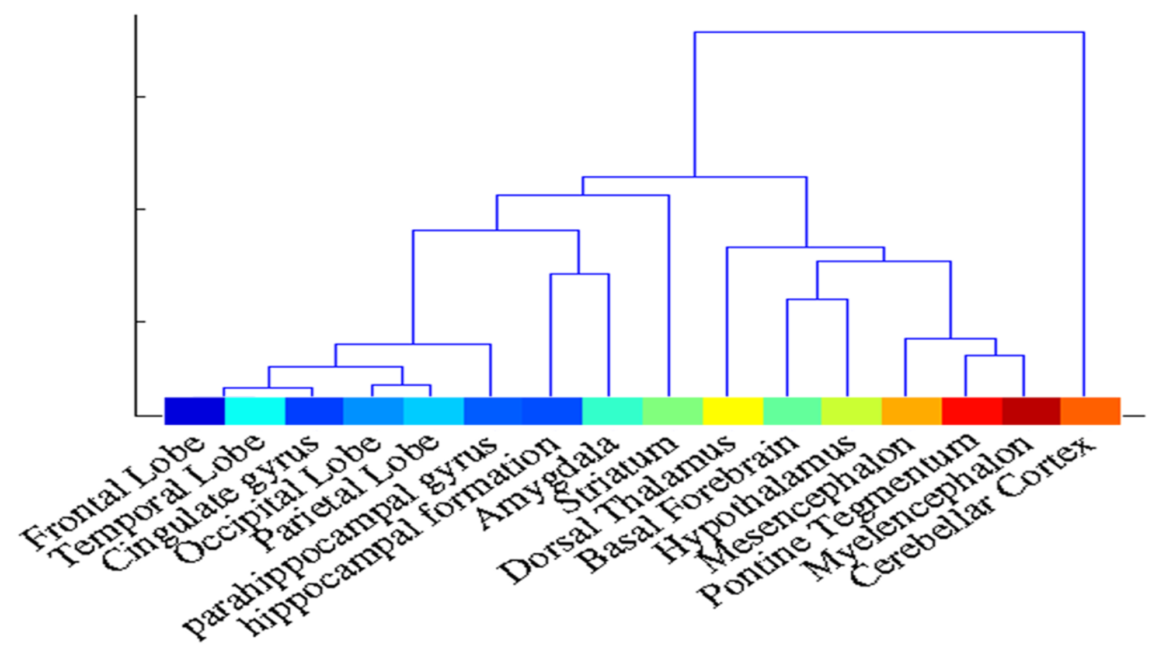

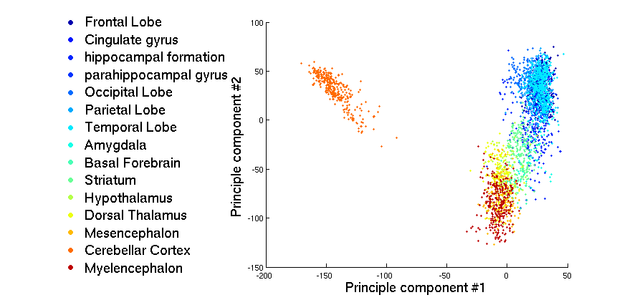
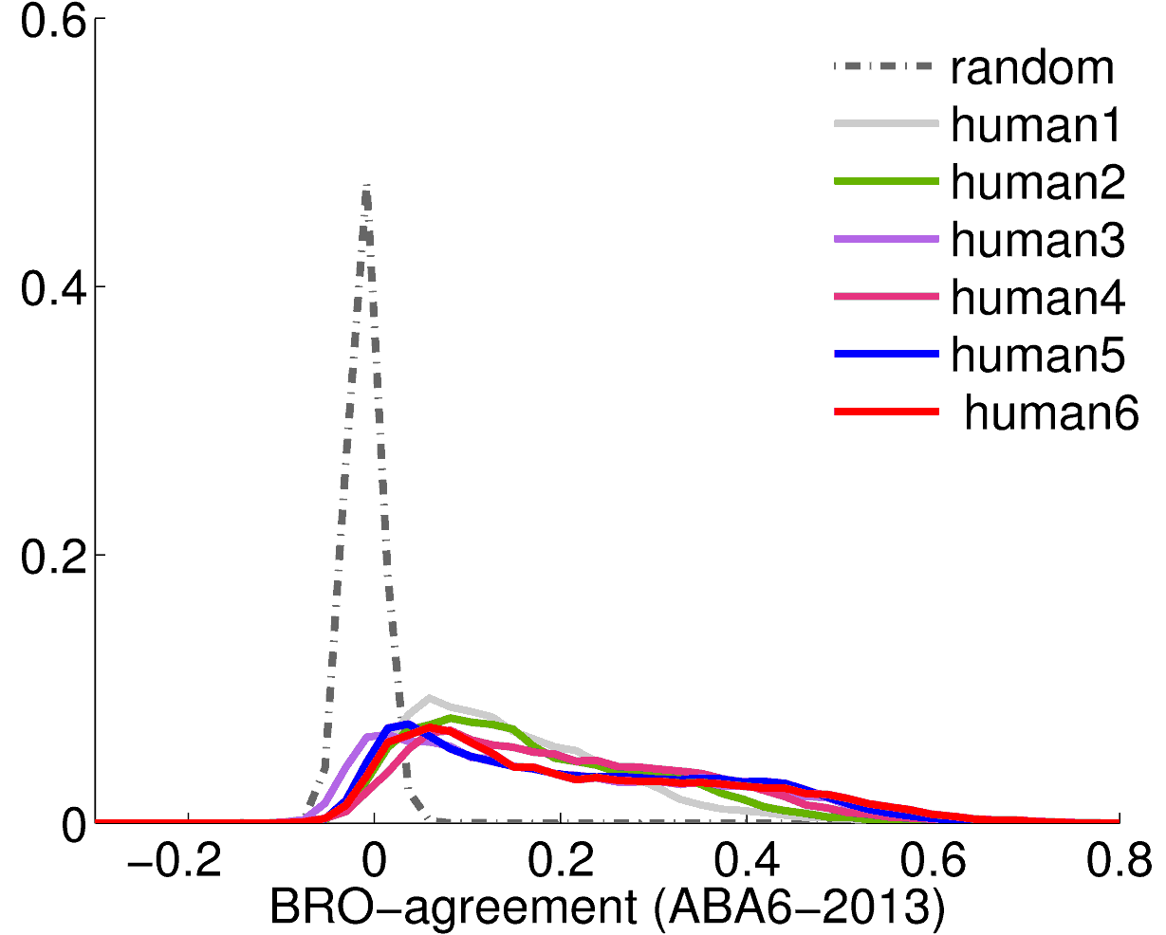
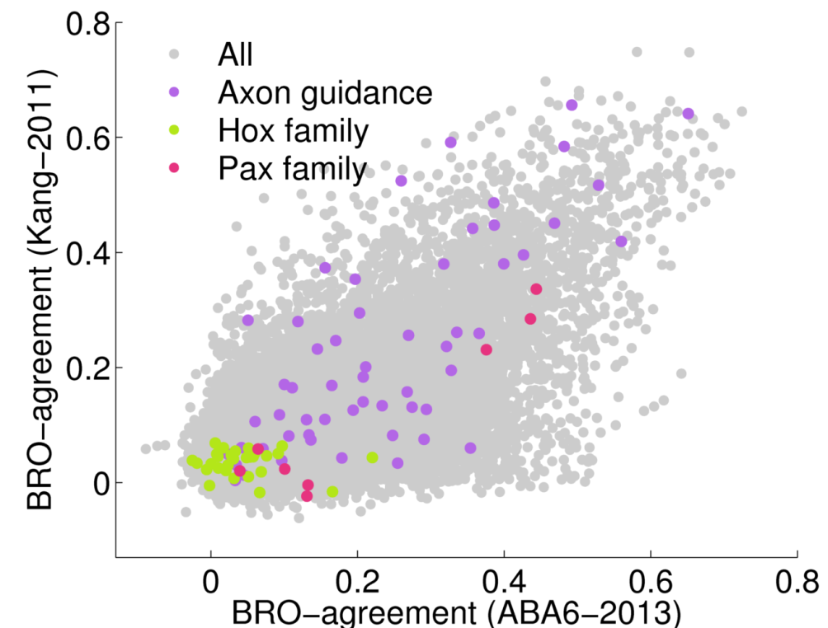
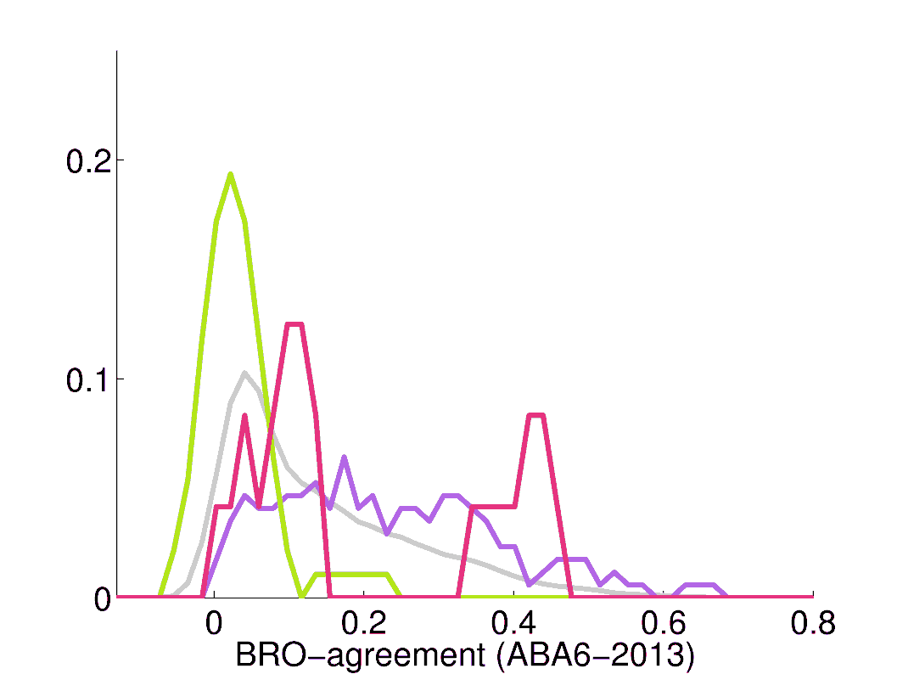
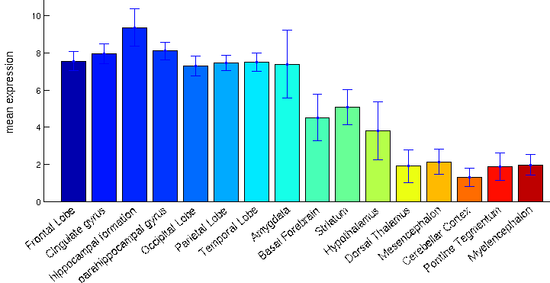
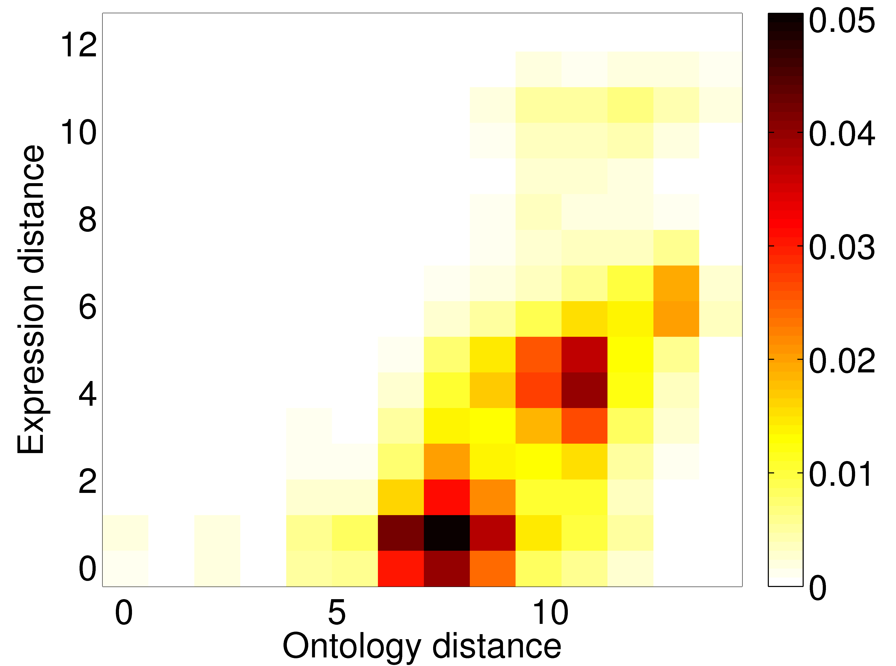
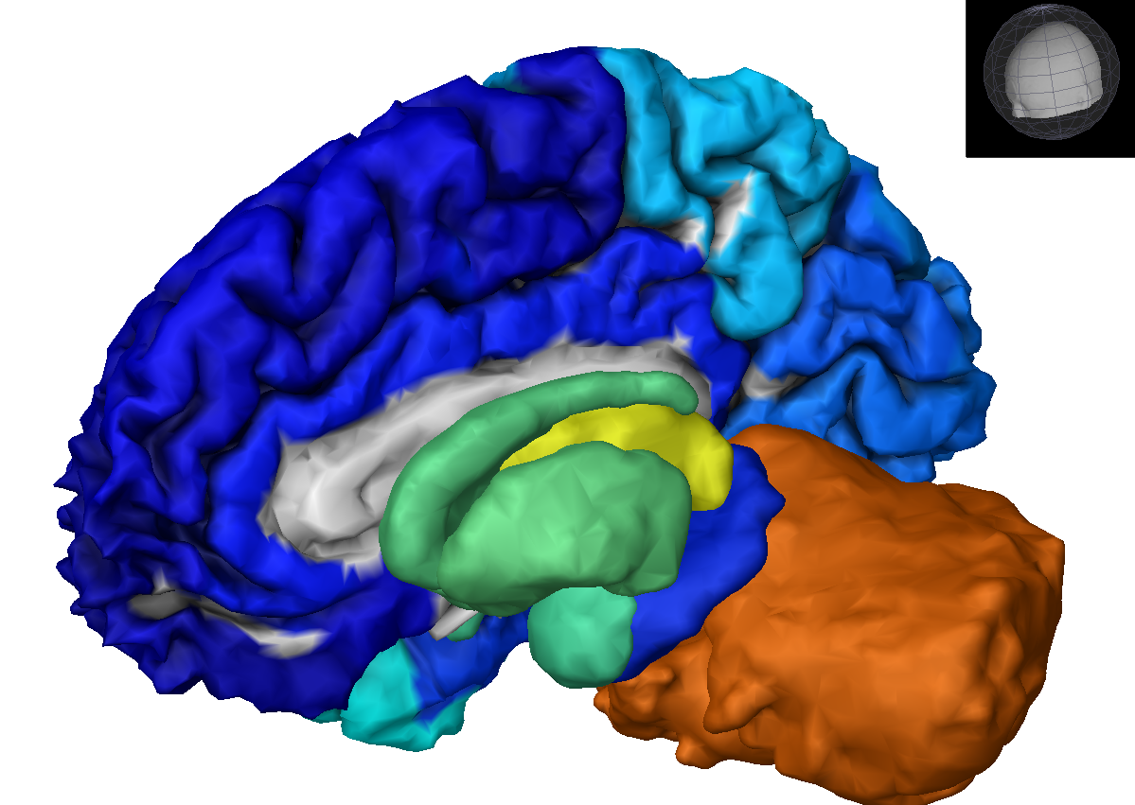
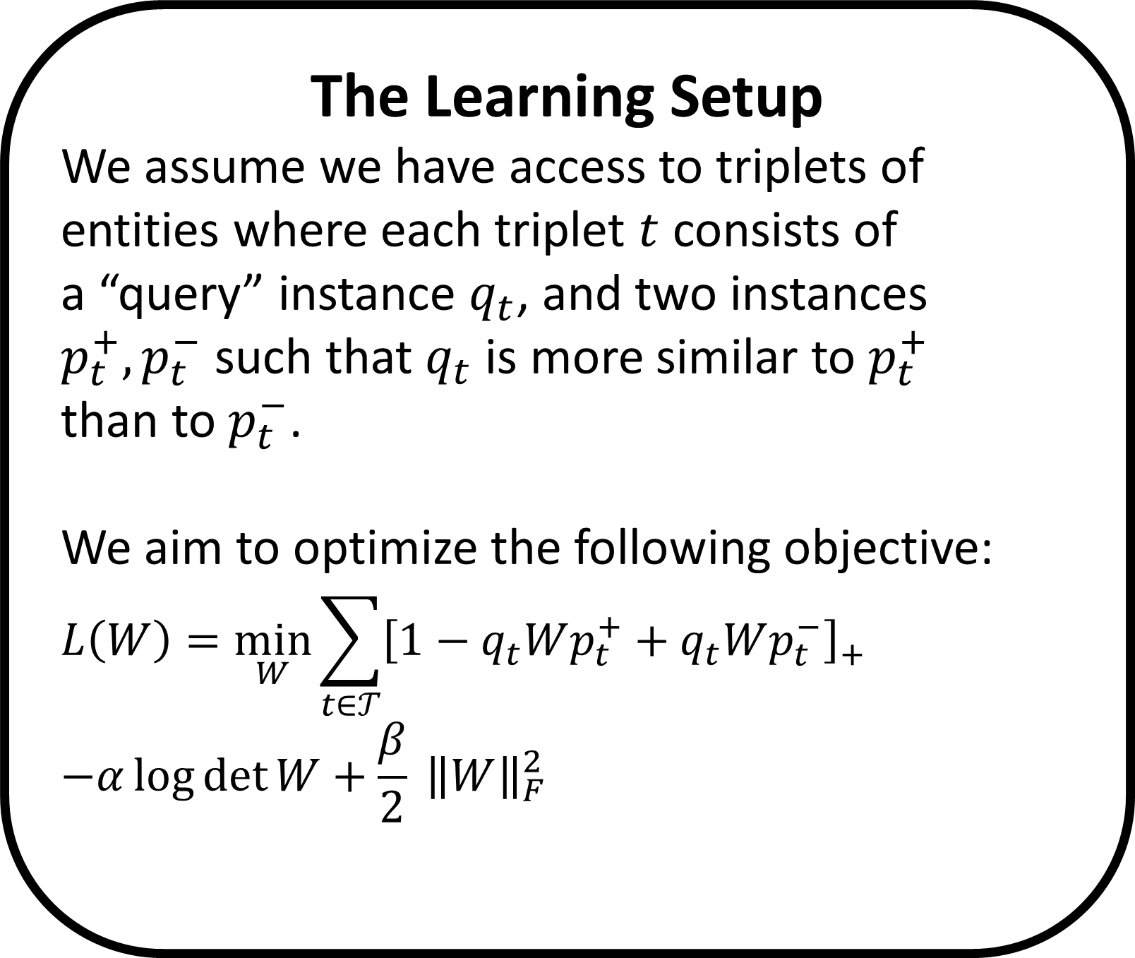
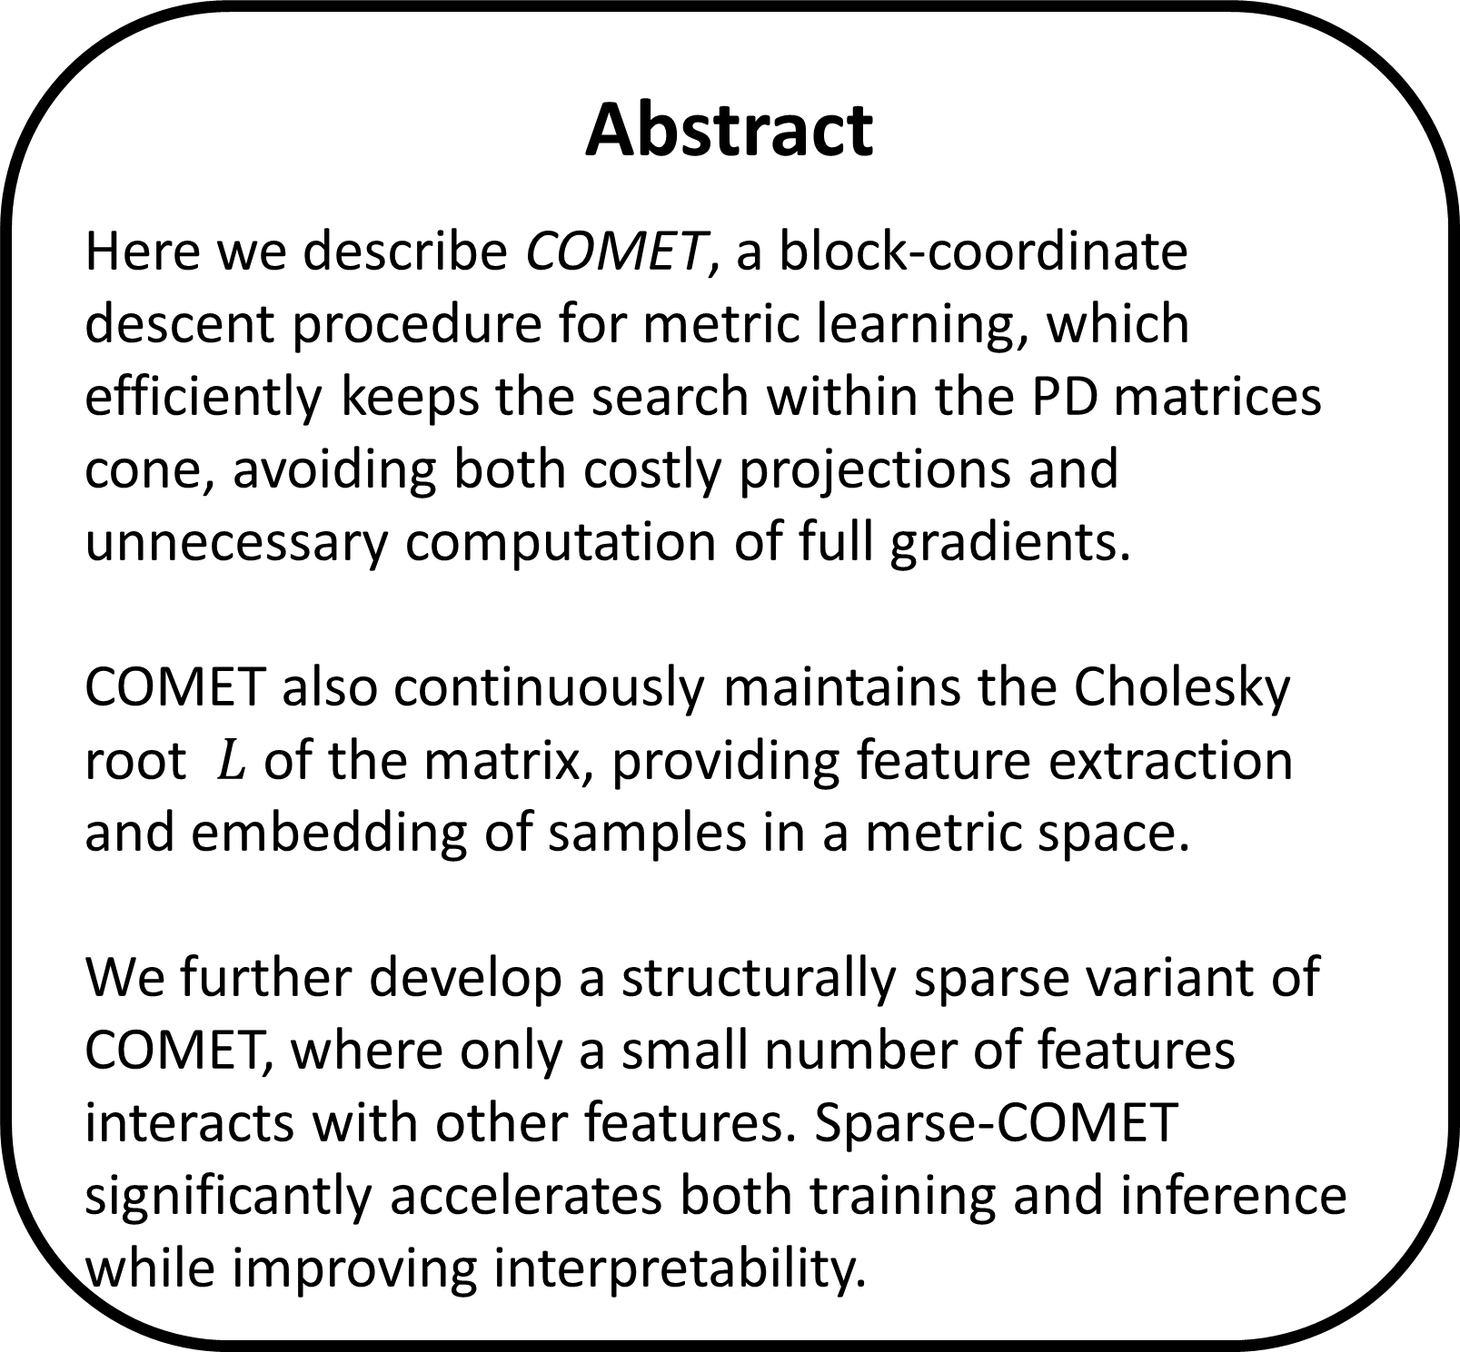
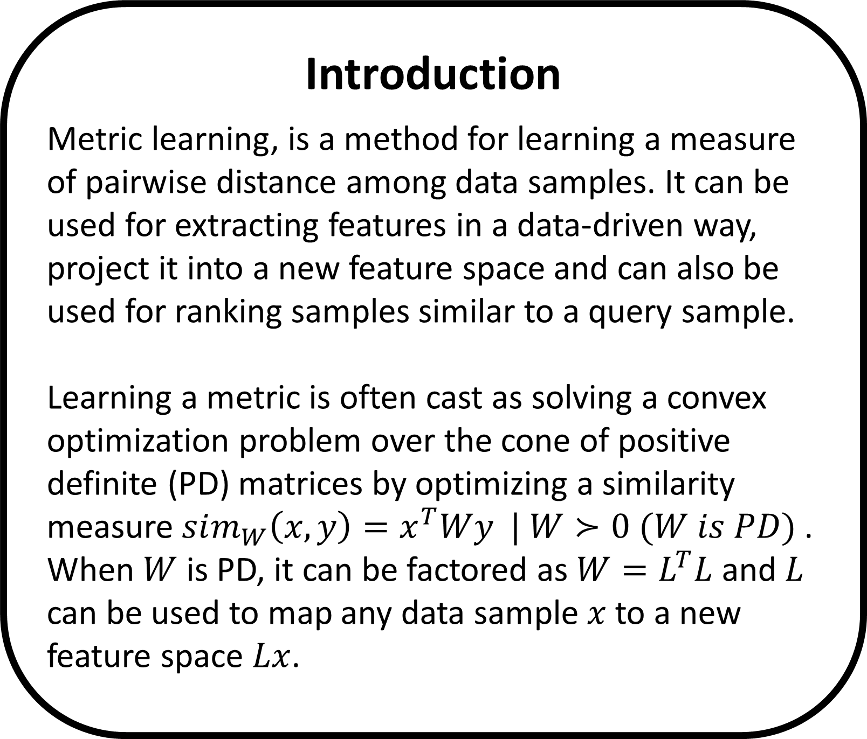
COMET – Learning Sparse Metrics
One Feature at a Time
The Leslie and Susan Gonda Multidisciplinary Brain Research Center
Yuval Atzmon ¹, Uri Shalit ², Gal Chechik ^{1,3}
¹ Gonda Multidisciplinary Brain Research Center, Bar-Ilan University, ² NYU, ³ Google CA
Introduction
Metric learning, is a method for learning a measure of pairwise distance among data samples. It can be used for extracting features in a data-driven way, project it into a new feature space and can also be used for ranking samples similar to a query sample.
Learning a metric is often cast as solving a convex optimization problem over the cone of positive definite (PD) matrices by optimizing a similarity measure $sim_{W}\left(x,y\right)=x^{T}Wy | W≻0 (W is PD)$ .
When $W$ is PD, it can be factored as $W=L^{T}L$ and $L$ can be used to map any data sample $x$ to a new feature space $Lx$.
Gene expression patterns follow the embryonic origin regions
92% of the human genome agrees with the brain-region ontology
Expression across the human cortex is not homogeneous
11% of the human genes show distinct expression patterns that agree with the cortex region ontology
Neighboring regions in the human ontology show similar pattern of expression.
Significance was assets using permutation test.
Astrocytes and neuronal markers are in stronger agreement with BRO than the average gene.
Abstract
Here we describe COMET, a block-coordinate descent procedure for metric learning, which efficiently keeps the search within the PD matrices cone, avoiding both costly projections and unnecessary computation of full gradients.
COMET also continuously maintains the Cholesky root $L$ of the matrix, providing feature extraction and embedding of samples in a metric space.
We further develop a structurally sparse variant of COMET, where only a small number of features interacts with other features. Sparse-COMET significantly accelerates both training and inference while improving interpretability.
Which gene functions agrees
with BRO?
Cell-type specific genes are in stronger agreement with the tree structure than genes on average.
Markers from Cahoy et al. [3].
Robustness across subjects
When projecting the gene expression values on the 1st and 2nd PCs, the tissue samples are ordered from the anterior to the posterior of the neural tube.
The percent of BRO-significant genes is stable when we compute the BRO score for each subject separately
(89%, 90%, 76%, 91%, 83%, 86%).
Brain Region Ontology score
We define a measure of agreement between the expression of a single gene across regions and the brain region ontology (similar results with other scores)
BRO_{score} = Correlation (d_{expression} , d_{tree} )
correlation is across pairs of tissue samples
d_{expression} is the vector of absolute differences of expression levels in two regions.
d_{tree} is the vector of number of edges in the ontology tree that connect two regions.
Development genes are in strong agreement with the tree structure suggesting that they may have important functions in the adult brain.
Axon guidance markers from KEGG.
Example: FEZF2 (ZNF312)
The Learning Setup
We assume we have access to triplets of entities where each triplet $t$ consists of
a “query” instance $q_{t}$, and two instances $p_{t}^{+}, p_{t}^{−}$ such that $q_{t}$ is more similar to $p_{t}^{+}$
than to $p_{t}^{−}$.
We aim to optimize the following objective:
$$L\left(W\right)=\min_{W}{\sum_{t∈𝒯}{{\left[1−q_{t}Wp_{t}^{+}+q_{t}Wp_{t}^{−}\right]}_{+}}}$$
$$−α\log{\det{W}}+\frac{β}{2} {\left\|W\right\|}_{F}^{2}$$
FEZF2 is known to regulate the axon targeting of layer 5 subcortical projection neurons.
House keeping genes are expressed in all cell types. In the adult brain, their scores are significantly higher than random, and match the BRO scores of all genes.
Markers from Eisenberg et al. [4]
Example: Neurod1 receives a high BRO score
Hawrylycz et al., An anatomically comprehensive atlas of the adult human brain transcriptome, Nature 2012
Kang et al., Spatio-temporal transcriptome of the human brain, Nature 2011
Cahoy et al., A transcriptome database for astrocytes, neurons, and oligodendrocytes, J. neuroscience 2008.
Eisenberg et al., Human housekeeping genes are compact, Trends in genetics. 2003
Contact: lior.kirsch@gmail.com, http://chechiklab.biu.ac.il/~lior

Slide 2
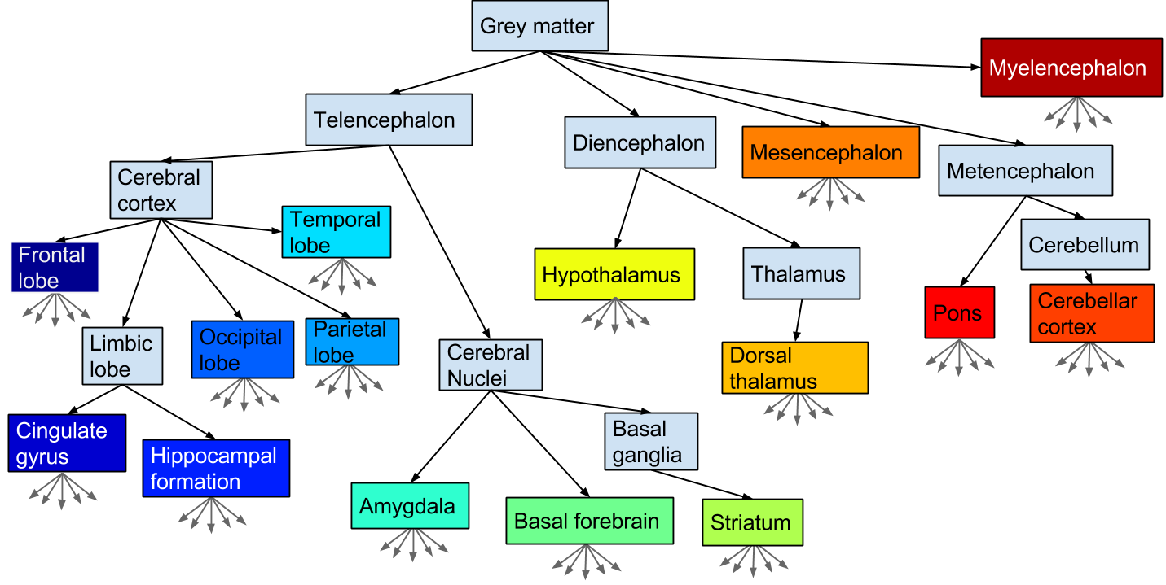
Human areal expression of most genes is
governed by regionalization
The Leslie and Susan Gonda Multidisciplinary Brain Research Center
Lior Kirsch, Gal Chechik
Gonda Multidisciplinary Brain Research Center, Bar-Ilan University, Ramat-Gan, Israel
Background
The human brain is organized in multiple anatomical substructures, each having its own characteristic. The differences between structures are reflected in the area-specific transcriptome signatures. These complex expression patterns raise many questions:
Which genes are expressed in which which brain regions?
Does expression across regions follow certain patterns?
To what extent does development determines expression in the adult brain?
What are the principles which govern spatial patterns of expression?
Gene expression patterns follow the embryonic origin regions
92% of the human genome agrees with the brain-region ontology
Expression across the human cortex is not homogeneous
11% of the human genes show distinct expression patterns that agree with the cortex region ontology
Neighboring regions in the human ontology show similar pattern of expression.
Significance was assets using permutation test.
Astrocytes and neuronal markers are in stronger agreement with BRO than the average gene.
The data
We analyzed two brain transcriptome datasets collected from post mortem human brains.
Microarray from 6 humans and 414 distinct regions; a total of 3702 tissue samples [1]
Microarray from 20 adult donors, and 491 tissue samples [2]
Which gene functions agrees
with BRO?
Cell-type specific genes are in stronger agreement with the tree structure than genes on average.
Markers from Cahoy et al. [3].
Robustness across subjects
When projecting the gene expression values on the 1st and 2nd PCs, the tissue samples are ordered from the anterior to the posterior of the neural tube.
The percent of BRO-significant genes is stable when we compute the BRO score for each subject separately
(89%, 90%, 76%, 91%, 83%, 86%).
Brain Region Ontology score
We define a measure of agreement between the expression of a single gene across regions and the brain region ontology (similar results with other scores)
BRO_{score} = Correlation (d_{expression} , d_{tree} )
correlation is across pairs of tissue samples
d_{expression} is the vector of absolute differences of expression levels in two regions.
d_{tree} is the vector of number of edges in the ontology tree that connect two regions.
Development genes are in strong agreement with the tree structure suggesting that they may have important functions in the adult brain.
Axon guidance markers from KEGG.
Example: FEZF2 (ZNF312)
The Brain Region Ontology tree
We analyzed 414 regions organized in a hierarchical structure.
The ontology was provided from the Allen Institute [1].
FEZF2 is known to regulate the axon targeting of layer 5 subcortical projection neurons.
House keeping genes are expressed in all cell types. In the adult brain, their scores are significantly higher than random, and match the BRO scores of all genes.
Markers from Eisenberg et al. [4]
Example: Neurod1 receives a high BRO score
Hawrylycz et al., An anatomically comprehensive atlas of the adult human brain transcriptome, Nature 2012
Kang et al., Spatio-temporal transcriptome of the human brain, Nature 2011
Cahoy et al., A transcriptome database for astrocytes, neurons, and oligodendrocytes, J. neuroscience 2008.
Eisenberg et al., Human housekeeping genes are compact, Trends in genetics. 2003
Contact: lior.kirsch@gmail.com, http://chechiklab.biu.ac.il/~lior
414 Regions

