Slide 1



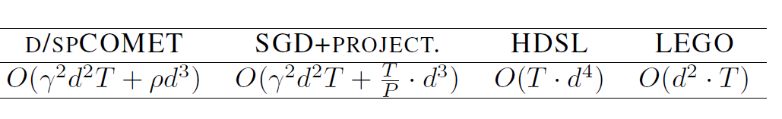
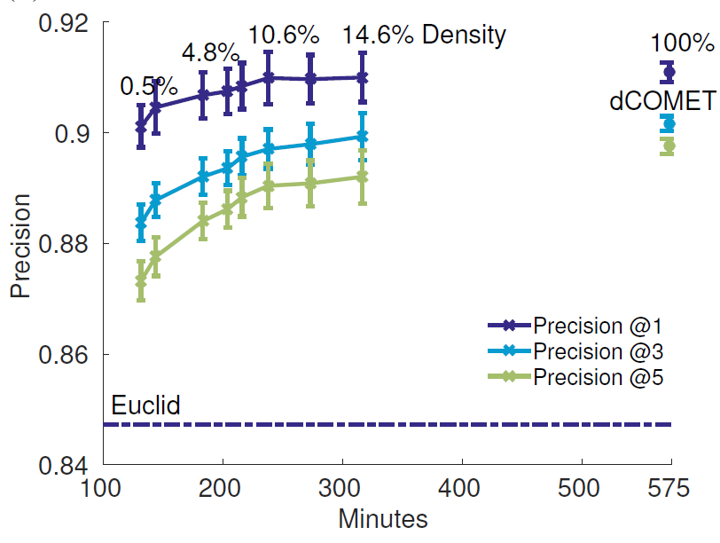
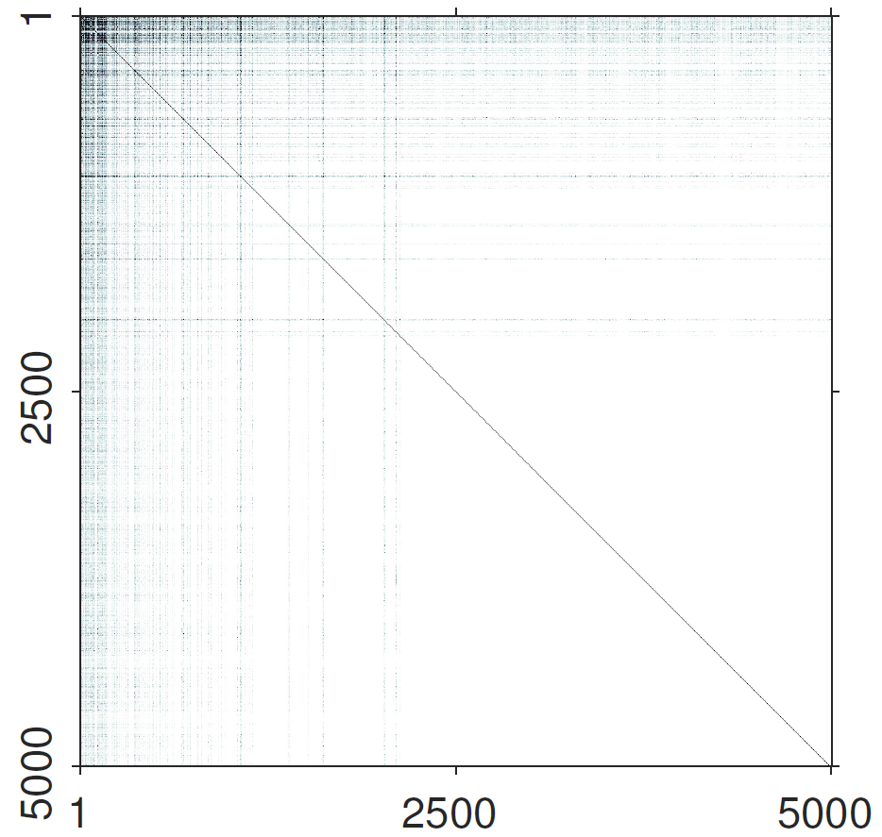

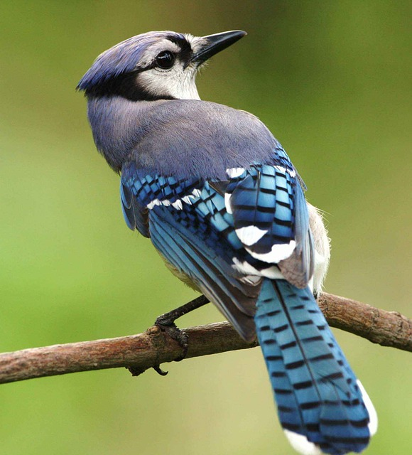

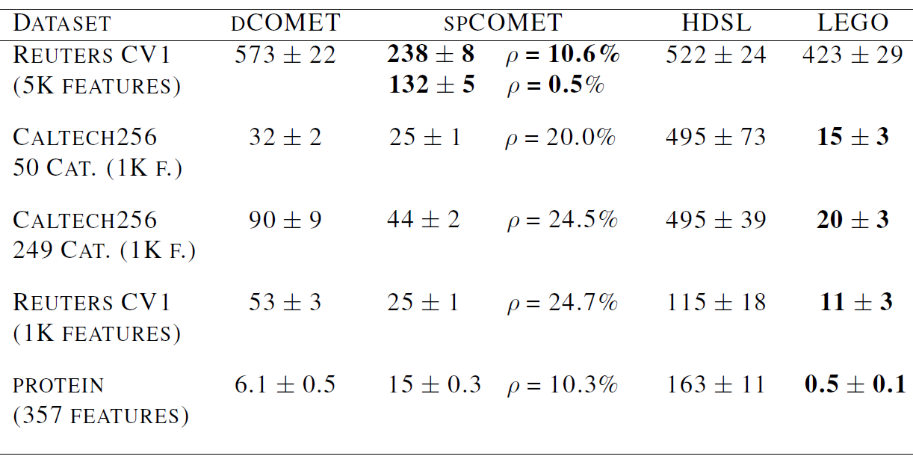
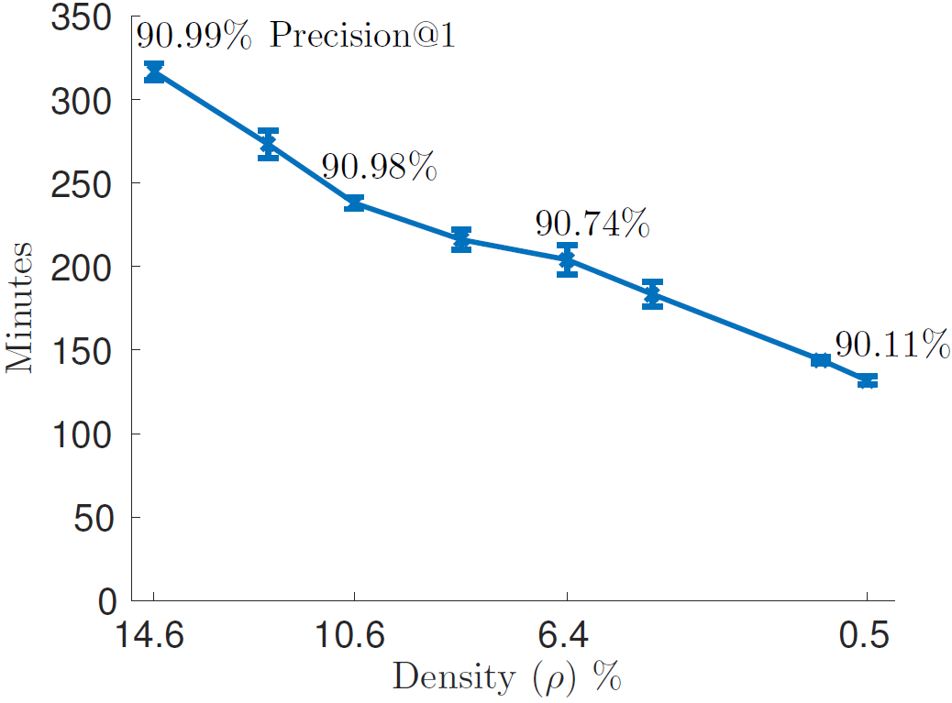
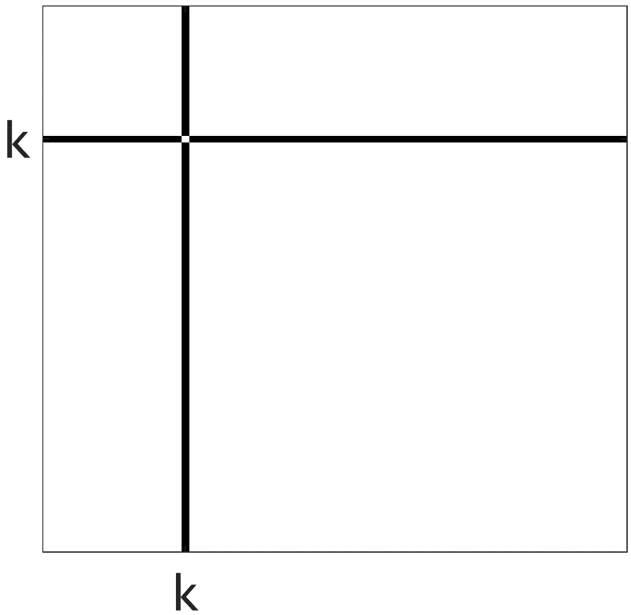
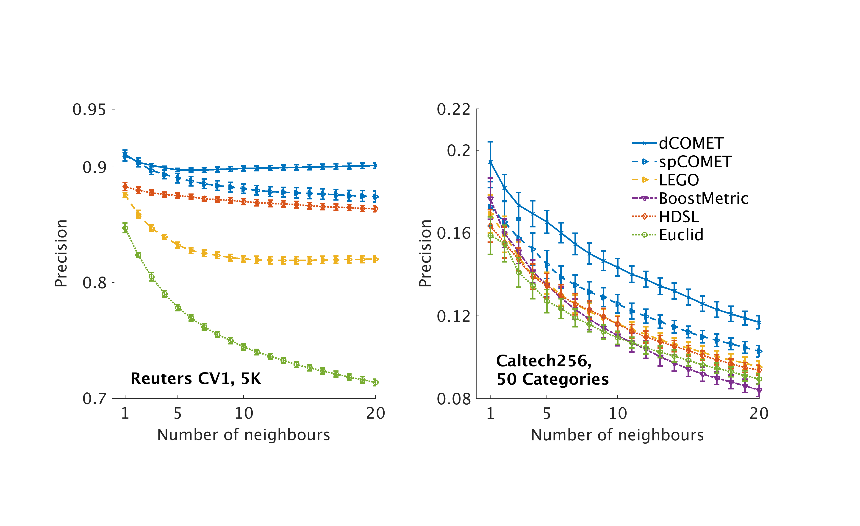
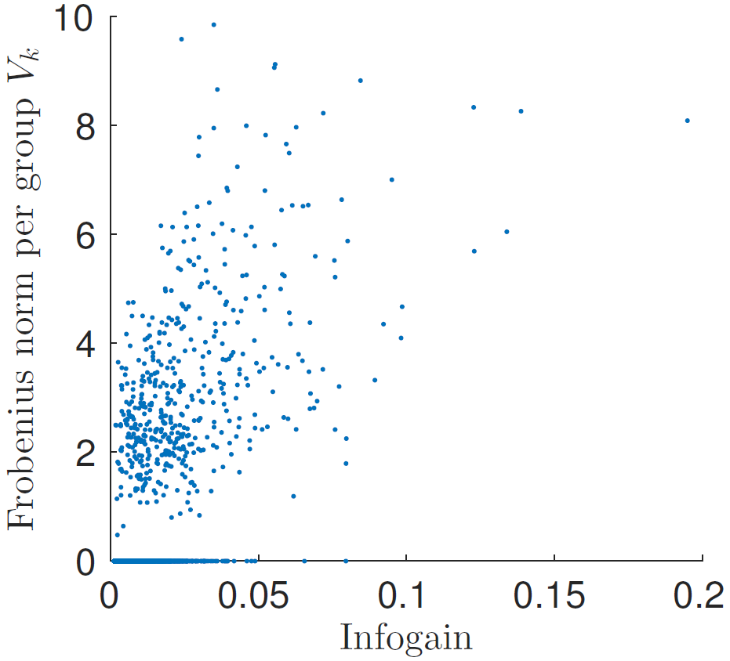
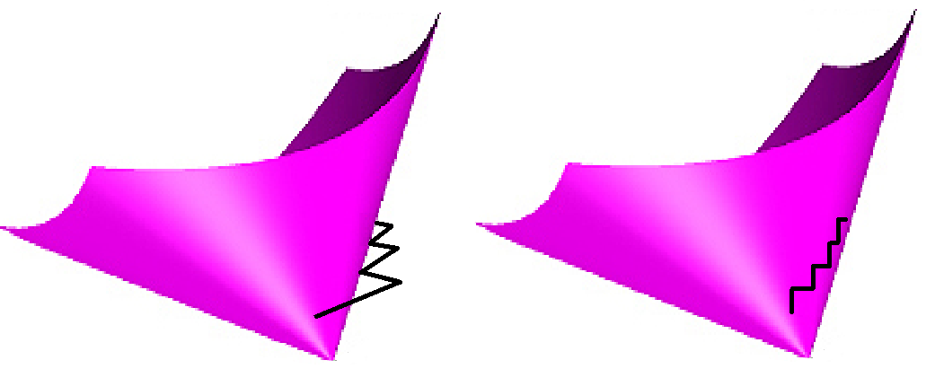



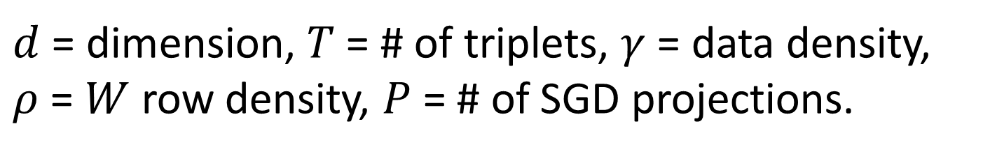
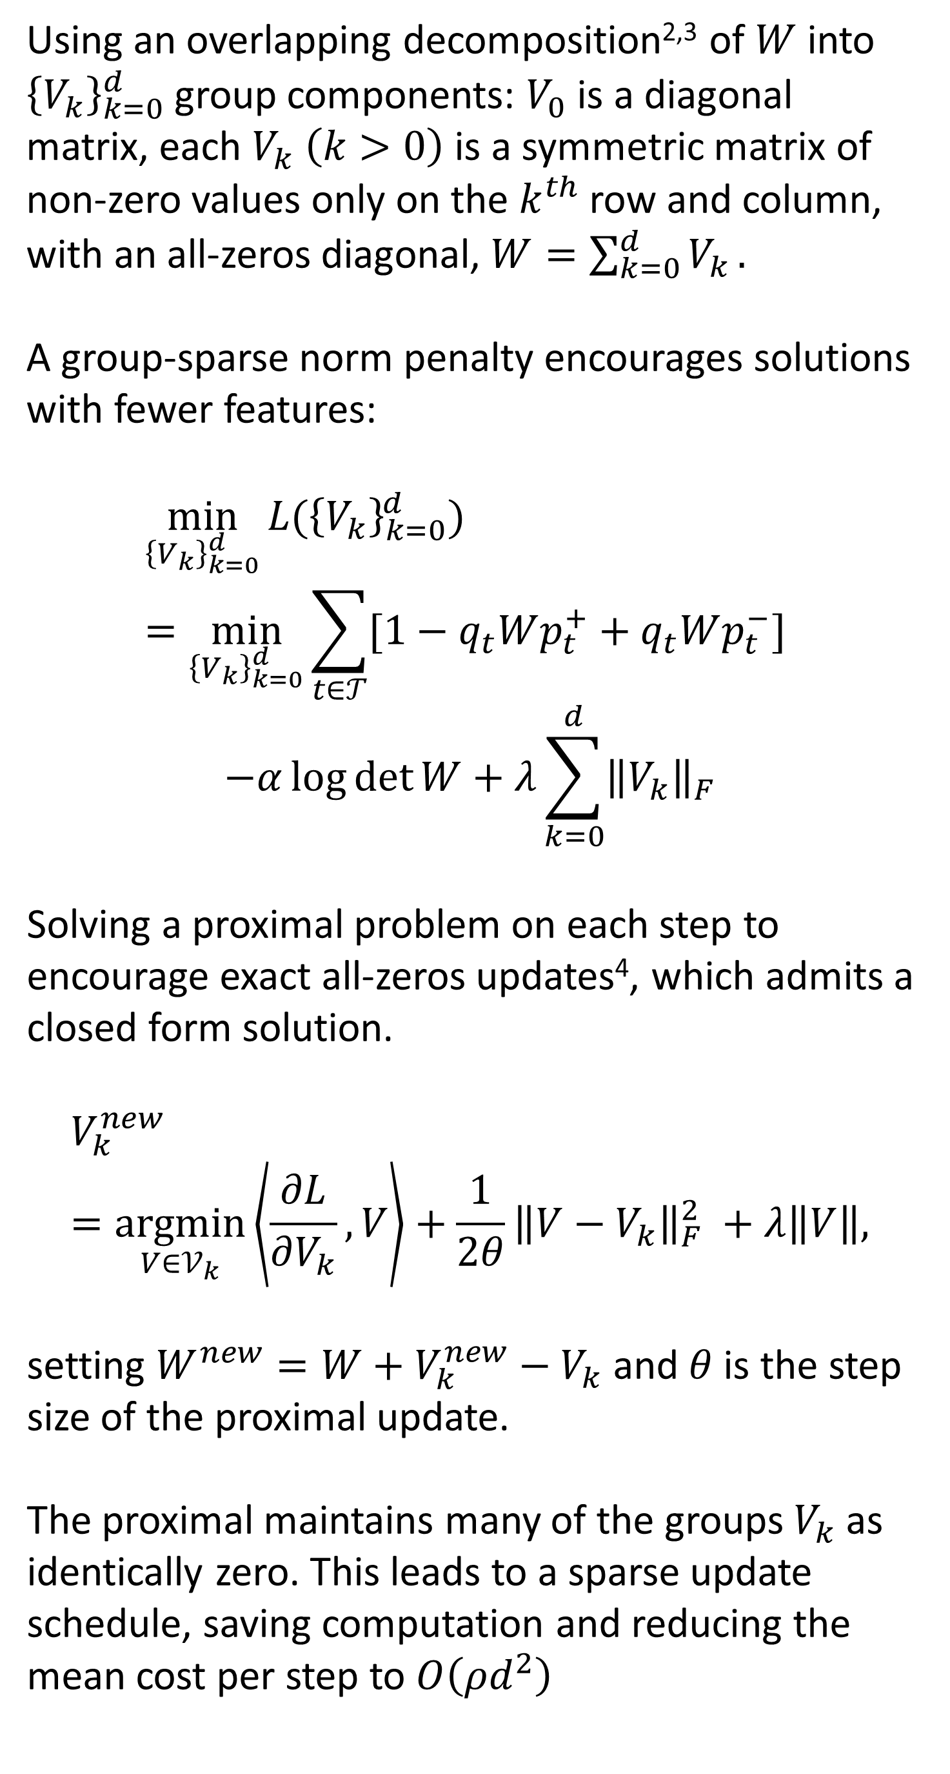

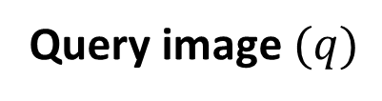
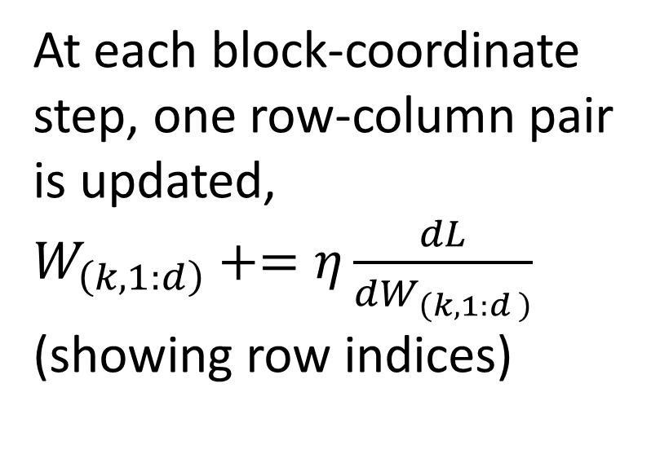
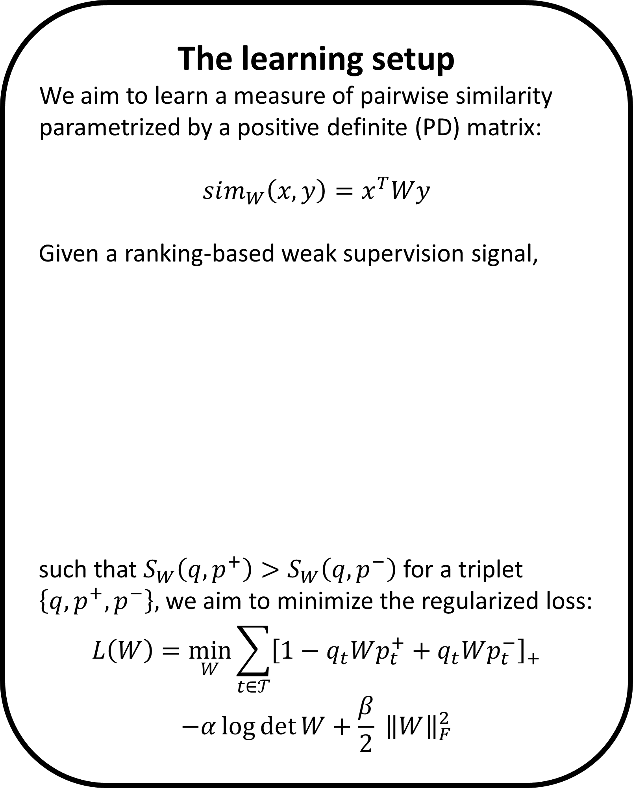
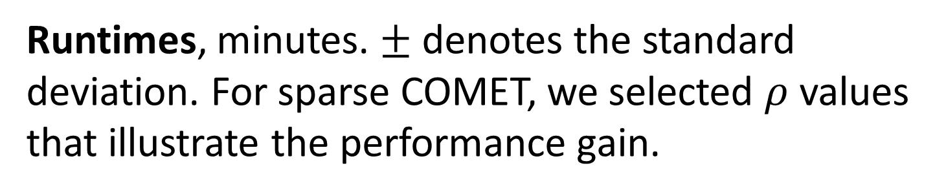

Learning Sparse Metrics, One Feature at a Time
The Leslie and Susan Gonda Multidisciplinary Brain Research Center
Yuval Atzmon ¹, Uri Shalit ², Gal Chechik ^{1,3}
¹ Gonda Multidisciplinary Brain Research Center, Bar-Ilan University, ² NYU, ³ Google CA
The learning setup
We aim to learn a measure of pairwise similarity parametrized by a positive definite (PD) matrix:
$$sim_{W}\left(x,y\right)=x^{T}Wy$$
Given a ranking-based weak supervision signal,
such that $S_{W}\left(q,p^{+}\right)>S_{W}\left(q, p^{−}\right)$ for a triplet $\left\{q, p^{+}, p^{−}\right\},$ we aim to minimize the regularized loss:
$$L\left(W\right)=\min_{W}{\sum_{t∈𝒯}{{\left[1−q_{t}Wp_{t}^{+}+q_{t}Wp_{t}^{−}\right]}_{+}}}$$
$$−α\log{\det{W}}+\frac{β}{2} {\left\|W\right\|}_{F}^{2}$$
Sparse COMET
We propose a new form of structured sparsity. A small set of features interacts with any other features. Other individual features correspond to the diagonal of the learned similarity matrix.
Complexity and runtimes
We compared COMET with approaches that avoid repeated projections to the PD cone.
The effect of sparsity on precision and runtime
Absolute values of the elements of $W$ trained on RCV1. Features are ordered by their information gain.
$d$ = dimension, $T$ = # of triplets, $γ$ = data density, $ρ$ = $W$ row density, $P$ = # of SGD projections.
Query image $(q)$
more similar ${(p}^{+})$
less similar ${(p}^{−})$
Runtimes, minutes. $±$ denotes the standard deviation. For sparse COMET, we selected $ρ$ values that illustrate the performance gain.
Precision at 1, 3 and 5 vs. the mean training run time of COMET. RCV1 dataset with 5K features.
Using an overlapping decomposition^{2,3} of $W$ into ${\left\{V_{k}\right\}}_{k=0}^{d}$ group components: $V_{0}$ is a diagonal matrix, each $V_{k} \left(k>0\right)$ is a symmetric matrix of non-zero values only on the $k^{th}$ row and column, with an all-zeros diagonal, $W=\sum_{k=0}^{d}{V_{k}}.$
A group-sparse norm penalty encourages solutions with fewer features:
$${\min_{{\left\{V_{k}\right\}}_{k=0}^{d}}{L(\left\{V_{k}\right\}}}_{k=0}^{d})=\min_{{\left\{V_{k}\right\}}_{k=0}^{d}}{\sum_{t∈𝒯}{[1−q_{t}Wp_{t}^{+}+q_{t}Wp_{t}^{−}]} }$$
$$−α\log{\det{W}}+λ\sum_{k=0}^{d}{{\left\|V_{k}\right\|}_{F}}$$
Solving a proximal problem on each step to encourage exact all-zeros updates⁴, which admits a closed form solution.
$$V_{k}^{new}=\underset{V∈𝒱_{k}}{argmin}\left\langle \frac{∂L}{∂V_{k}},V\right\rangle +\frac{1}{2θ}{\left\|{V−V}_{k}\right\|}_{F}^{2} +λ\left\|V\right\|,$$
setting $W^{new}=W+V_{k}^{new}−V_{k}$ and $θ$ is the step size of the proximal update.
The proximal maintains many of the groups $V_{k}$ as identically zero. This leads to a sparse update schedule, saving computation and reducing the mean cost per step to $O\left(ρd^{2}\right)$
Mean training time vs. the learned matrix density, RCV1 dataset with 5K features.
Experimental evaluation
We evaluated COMET with three datasets: Object recognition (Caltech256, d=1k, 135k triplets), text classification (RCV1, 4 classes, d=5k, 100k triplets), bio-informatics (Protein, d=357, 20k triplets).
COMET row-column coordinate step
COordinate descent METric learning
At each block-coordinate step, one row-column pair is updated, $W_{\left(k,1:d\right)}+=η\frac{dL}{dW_{\left(k,1:d \right)}}$ (showing row indices)
Precision@top-k, for Caltech256 with 50 cat. and for Reuters CV1.
Comparing with: Euclidean metric (baseline)‏, HDSL⁵, LEGO⁶, BoostMetric⁷,
80%/20% train/test split, 5-fold cross-validation
COMET selects informative features
Frobenius norm of the groups $V_{k}$ vs. the info. gain of feature $k$.
Sparse COMET assigns zero weights to less-informative features.
Projected Gradient
COMET
To avoid costly projections, we use the PD condition of the Schur complement¹ to bound $η$. $η^{max}$ is computed in closed form, costing $O\left(d^{2}\right)$.
We also efficiently maintain the Cholesky root $L$of $W=L^{T}L$. It provides an explicit learned embedding $x→Lx$continuously
during learning.
¹Boyd et al. Convex optimization, 2014
²Jacob et al. Group lasso with overlap and graph lasso, 2009
³Obozinski et al. Group lasso with overlaps: the latent group lasso approach, 2011
⁴Bach et al. Optimization with sparsity-inducing penalties, 2012
⁵Liu et al, Similarity learning for high-dimensional sparse data, 2015
⁶Jain et al. Online metric learning and fast similarity search, 2009
⁷Shen et al. Positive semidefinite metric learning with boosting, 2009
Contact and code: yuval.atzmon@biu.ac.il, http://chechiklab.biu.ac.il/yuvval

Slide 2






COMET row-column coordinate step
COordinate descent METric learning
At each coordinate step update one column and row of the matrix $W$ with the gradient of $L\left(W\right)$ .
$$W+=ηG$$
Using the PD condition of the Schur complement to limit the step to the PD cone:
COMET row-column coordinate step
COordinate descent METric learning
COMET row-column coordinate step
COordinate descent METric learning
Taking a gradient step $W+=ηG$ usually requires projecting the result back to the PD cone.
At each block-coordinate step, one row-column pair is updated, $W_{\left(1:d,k\right)}+=η\frac{dL}{dW_{\left(1:d,k\right)}}$ (row indices)
$$W^{new}≻0 ⟺ c^{∗}−{b^{∗}}^{T}A^{−1}b^{∗}>0,$$
where $c^{∗}=W_{\left(1,1\right)}^{new}$(a scalar), $b^{∗}=W_{\left(2:d,1\right)}^{new}$ and $A^{∗}=A=W_{(2:d,2:d)}$. Resulting with an upper limit to the allowable step size, $η^{max}$.
Efficiently maintaining the Cholesky root $L$of $W=L^{T}L$ resulting in an explicit embedding function $x→Lx$into the learned metric space throughout training.
Projected Gradient
COMET
Projected Gradient
COMET
COMET gradient steps vs. projected gradient steps
Projected Gradient
COMET
COMET takes coordinate steps and updates one feature of the matrix$W$ at a time, with the gradient of $L\left(W\right)$. The PD condition of the Schur Complement provides a closed form bound on $η^{max},$the maximal step size and limits the step to the PD cone.
Efficiently maintaining the Cholesky root $L$of $W=L^{T}L$ resulting in an explicit embedding function $x→Lx$into the learned metric space throughout training.
To avoid costly projections, we use the PD condition of the Schur complement¹ to bound $η$. $η^{max}$ is computed in closed form, costing $O\left(d^{2}\right)$.
We also efficiently maintain the Cholesky root $L$of $W=L^{T}L$. It provides an explicit learned embedding $x→Lx$continuously
during learning.
Projected Gradient
COMET

