Slide 1



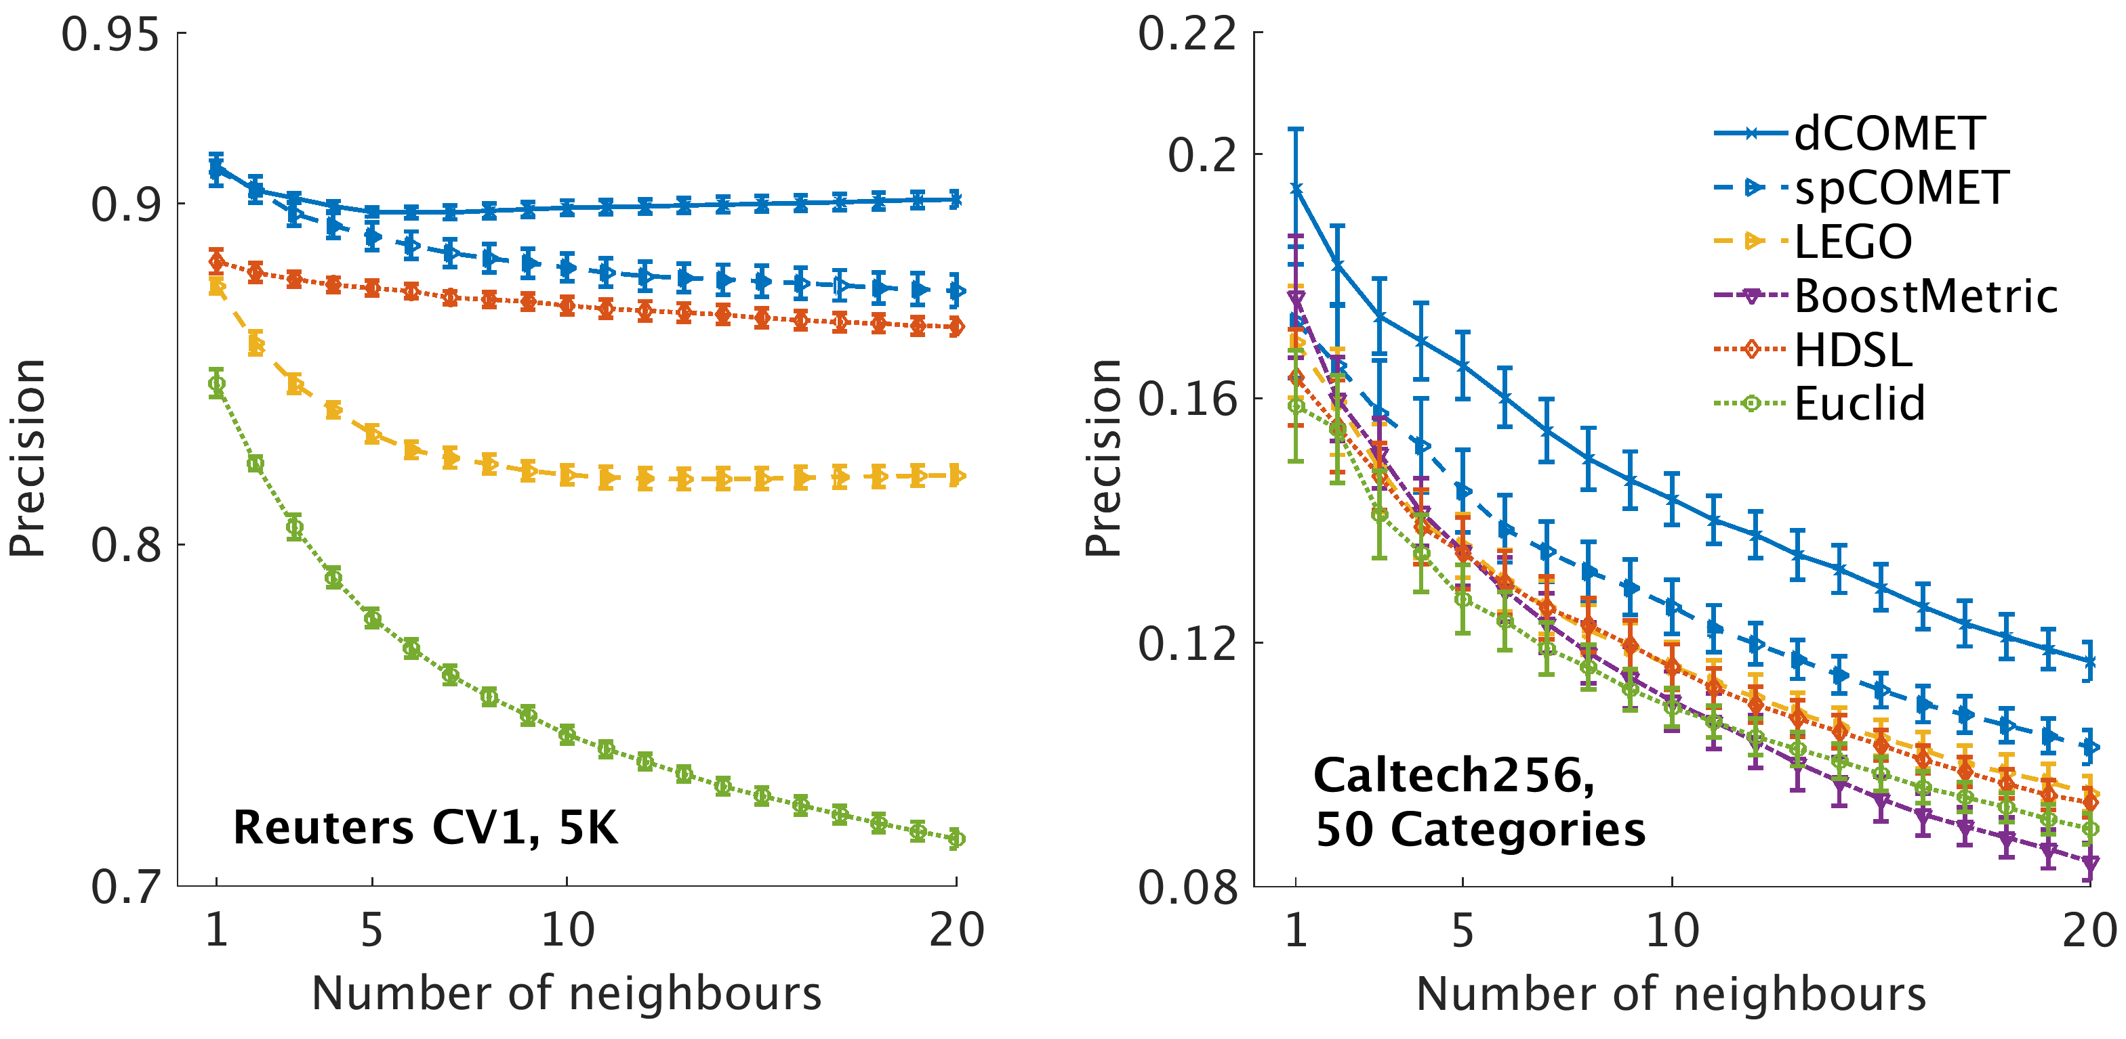
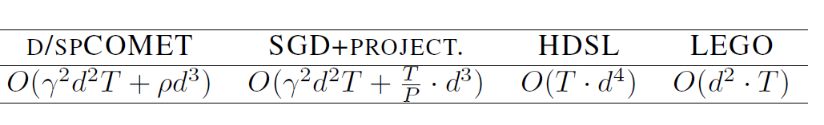

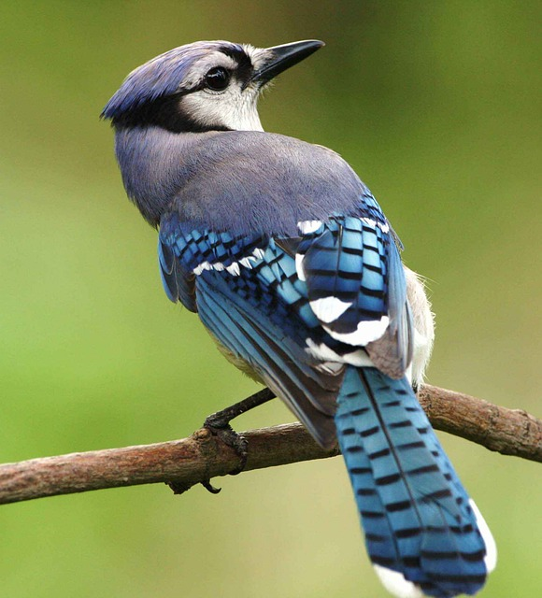

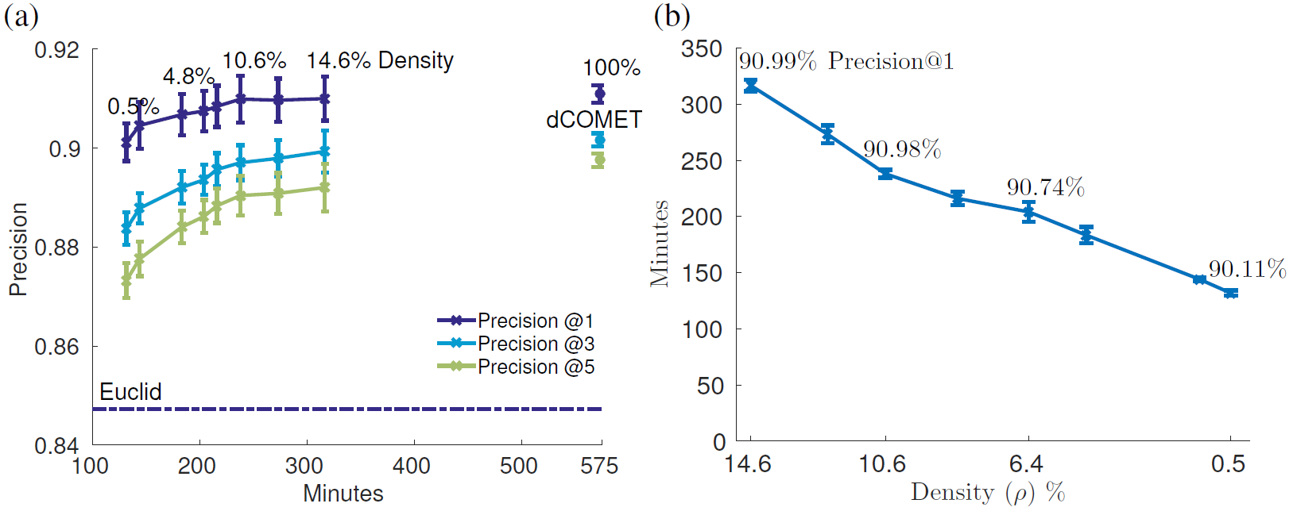
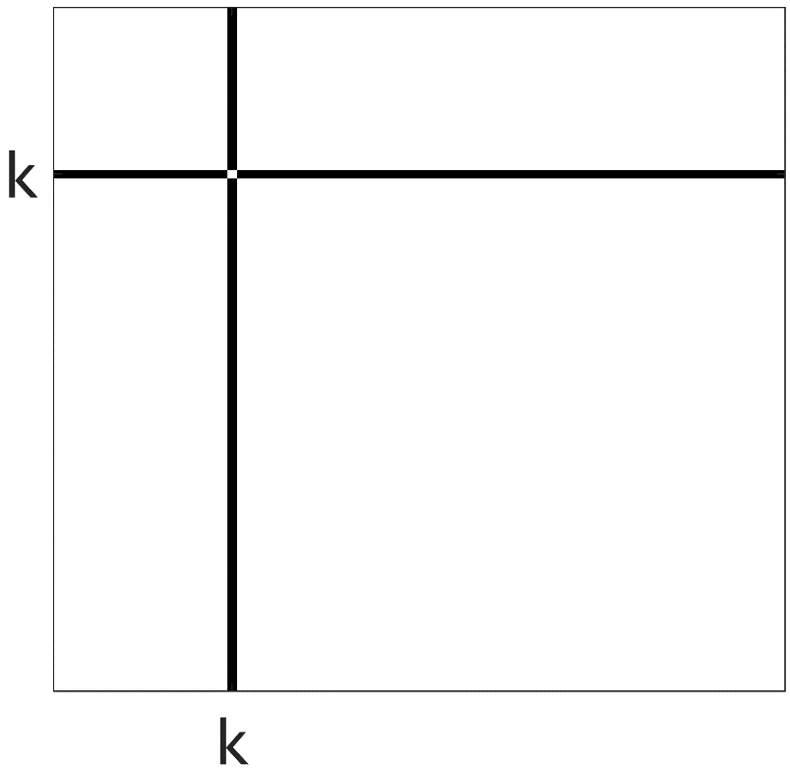

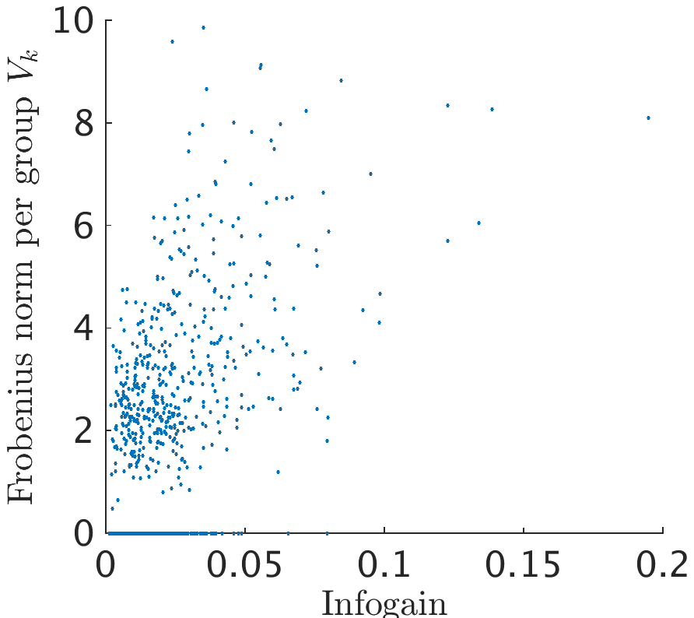
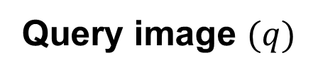

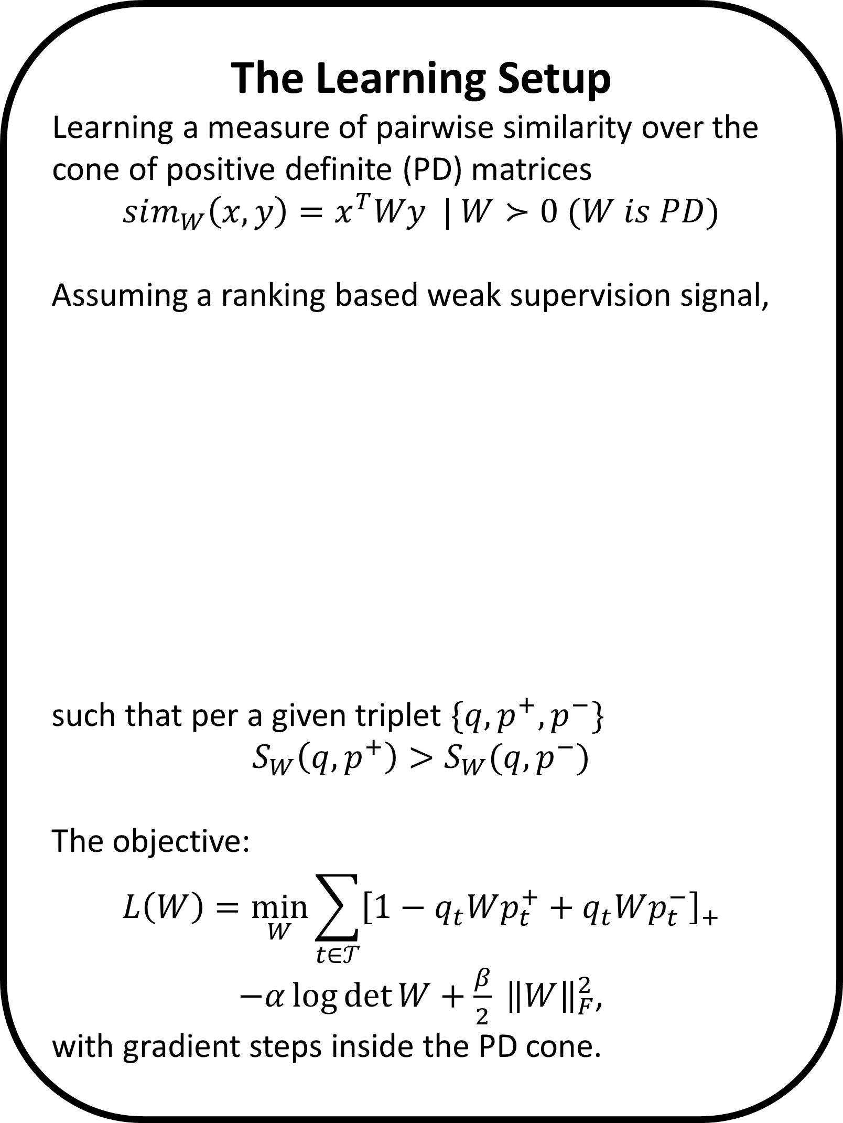
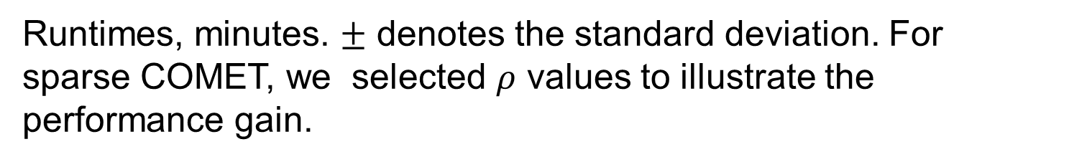


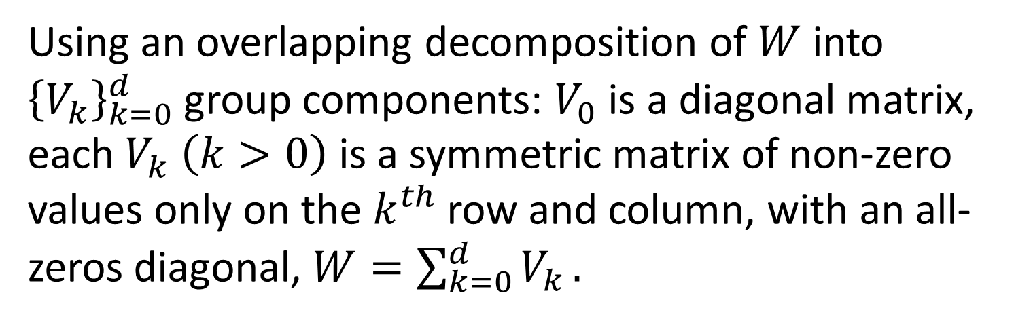



Learning Sparse Metrics, One Feature at a Time
The Leslie and Susan Gonda Multidisciplinary Brain Research Center
Yuval Atzmon ¹, Uri Shalit ², Gal Chechik ^{1,3}
¹ Gonda Multidisciplinary Brain Research Center, Bar-Ilan University, ² NYU, ³ Google CA
The Learning Setup
Learning a measure of pairwise similarity over the cone of positive definite (PD) matrices
$$sim_{W}\left(x,y\right)=x^{T}Wy | W≻0 (W is PD)$$
Assuming a ranking based weak supervision signal,
such that per a given triplet $\{q, p^{+}, p^{−}\}$
$$S_{W}\left(q,p^{+}\right)>S_{W}(q, p^{−})$$
The objective:
$$L\left(W\right)=\min_{W}{\sum_{t∈𝒯}{{\left[1−q_{t}Wp_{t}^{+}+q_{t}Wp_{t}^{−}\right]}_{+}}}$$
$−α\log{\det{W}}+\frac{β}{2} {\left\|W\right\|}_{F}^{2}$,
with gradient steps inside the PD cone.
Sparse COMET
COMET’s structured sparsity allows only a small set of features to interact with any of the other features. Other individual features correspond to the diagonal of the learned similarity matrix.
Complexity and Runtimes
We compared COMET with approaches that avoid repeated projections to the PD cone and to the Euclidean metric baseline.
COMET achieves better precision in every dataset tested.
Query image $(q)$
more similar ${(p}^{+})$
less similar ${(p}^{−})$
Runtimes, minutes. $±$ denotes the standard deviation. For sparse COMET, we selected $ρ$ values to illustrate the performance gain.
80%/20% train/test split, 5-fold cross-validation, comparing: Euclidean metric (baseline)‏. HDSL: Similarity Learning for High Dimensional Sparse Data [Liu et al, 2015], LEGO (ITML): Log-Det Exact Gradient Online [Jain et al. 2008], BoostMetric positive-semidefinite metric learning with boosting [Shen et al. 2009]
The effect of sparsity on precision and runtime
Structured sparsity: Absolute values of the elements of $W$ trained on RCV1, features are ordered by their information gain.
COMET row-column coordinate step
Using an overlapping decomposition of $W$ into ${\left\{V_{k}\right\}}_{k=0}^{d}$ group components: $V_{0}$ is a diagonal matrix, each $V_{k} \left(k>0\right)$ is a symmetric matrix of non-zero values only on the $k^{th}$ row and column, with an all-zeros diagonal, $W=\sum_{k=0}^{d}{V_{k}}.$
Updating the learned matrix one column and row at a time. The PD condition of the Schur complement guarantees that the steps reside inside the PD cone:
A group-sparse norm penalty encourages solutions with fewer features:
$${\min_{{\left\{V_{k}\right\}}_{k=0}^{d}}{L(\left\{V_{k}\right\}}}_{k=0}^{d})=\min_{{\left\{V_{k}\right\}}_{k=0}^{d}}{\sum_{t∈𝒯}{[1−q_{t}Wp_{t}^{+}+q_{t}Wp_{t}^{−}]} }$$
$$−α\log{\det{W}}+λ\sum_{k=0}^{d}{{\left\|V_{k}\right\|}_{F}}$$
Solving a proximal problem on each step to encourage exact all-zeros updates, which admits a closed form solution.
$$V_{k}^{new}=\underset{V∈𝒱_{k}}{argmin}\left\langle \frac{∂L}{∂V_{k}},V\right\rangle +\frac{1}{2θ}{\left\|{V−V}_{k}\right\|}_{F}^{2} +λ\left\|V\right\|,$$
setting $W^{new}=W+V_{k}^{new}−V_{k}$ and $θ$ is the step size of the proximal update.
RCV1 dataset with 5K features.(a) Precision at 1, 3 and 5 nearest neighbor evaluated on the test set vs. the mean training run time of COMET. Dashed line denotes the precision-at-1 of the Euclidean baseline. (b) Mean training time as a function of the learned matrix density.
$$W^{new}≻0 ⟺ c^{∗}−{b^{∗}}^{T}A^{−1}b^{∗}>0,$$
where $c^{∗}=W_{\left(1,1\right)}^{new}$(a scalar), $b^{∗}=W_{\left(2:d,1\right)}^{new}$ and $A^{∗}=A=W_{(2:d,2:d)}$. Resulting with $η^{max}$an upper limit to the allowable step size.
Keeping an updated Cholesky root $L$of $W=L^{T}L$to solve the condition, also result with a continues embedding $Lx$of the features into the metric space.
Informative features are non-zeros
Projected Gradient
COMET
COMET gradient steps versus projected gradient steps
Frobenius norm of the groups $V_{k}$ against the information gain of feature $k$. Sparse COMET assigns zero weights to less-informative features.
Contact and code: yuval.atzmon@biu.ac.il, http://chechiklab.biu.ac.il/yuvval

