Slide 1



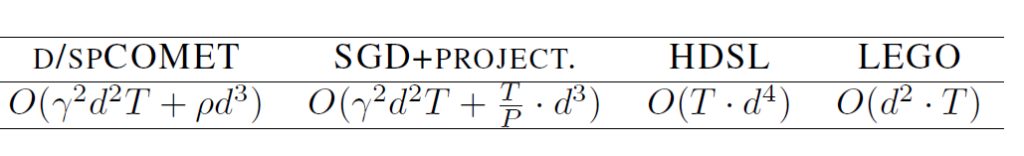
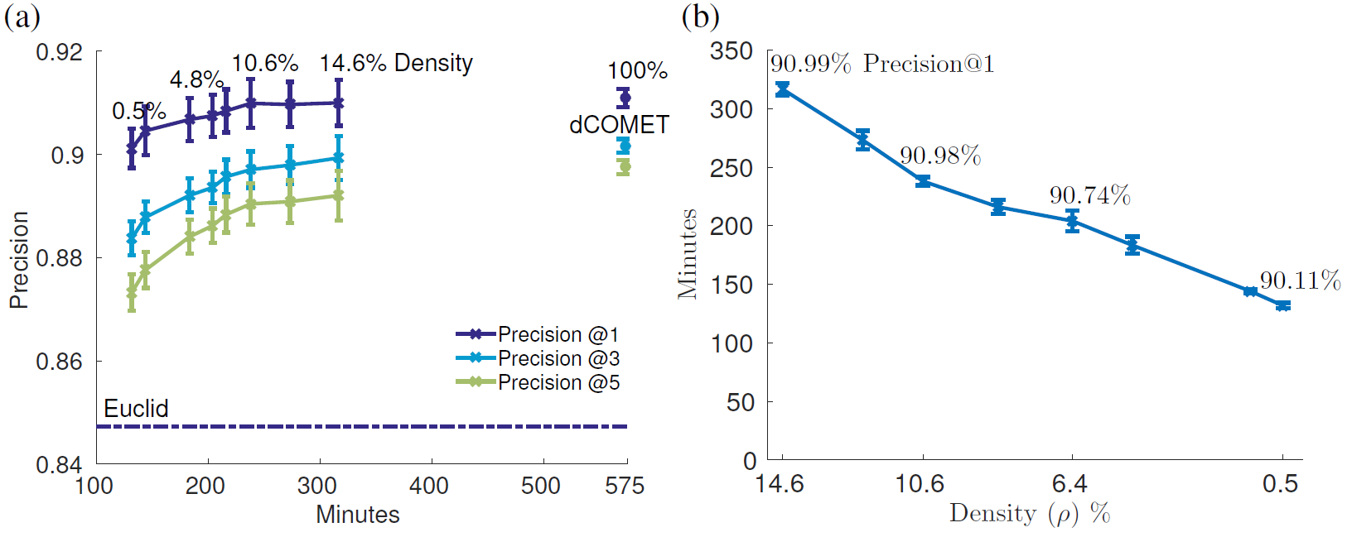

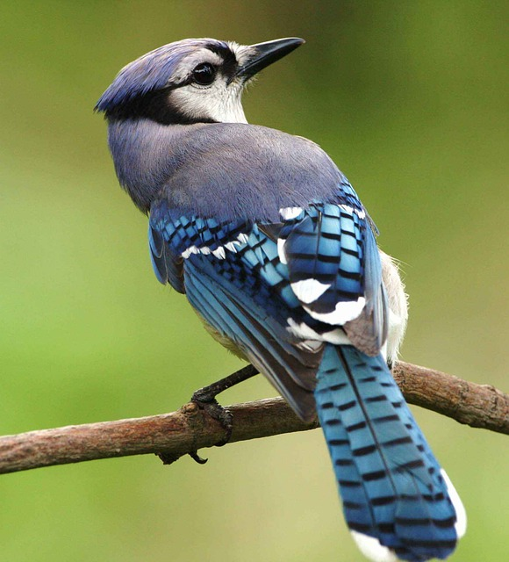

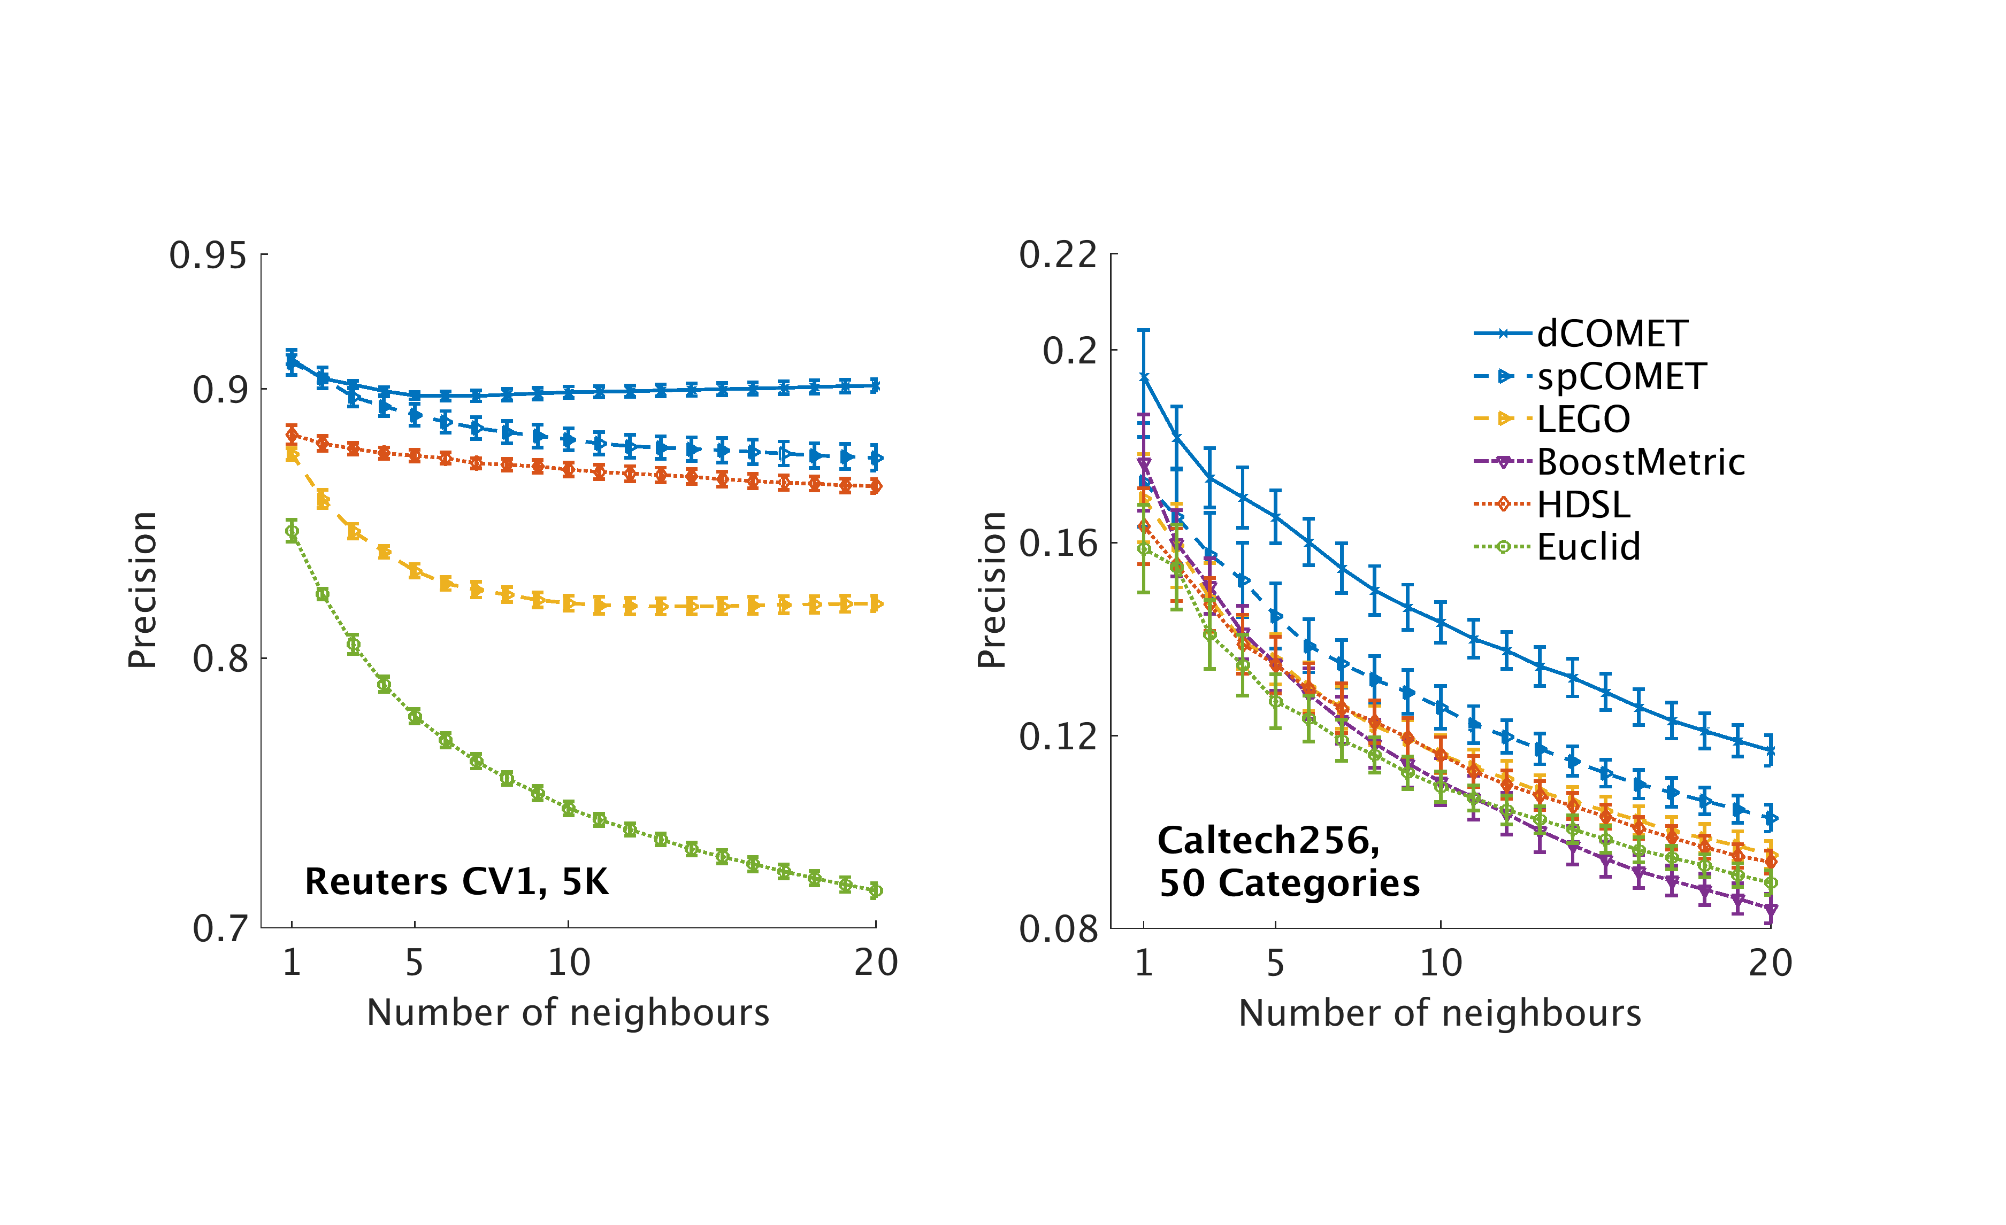
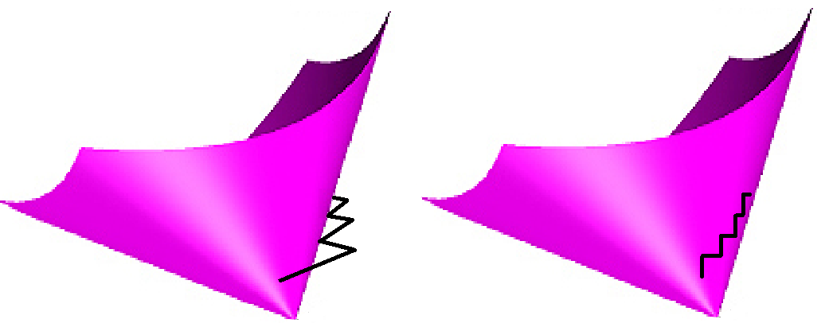
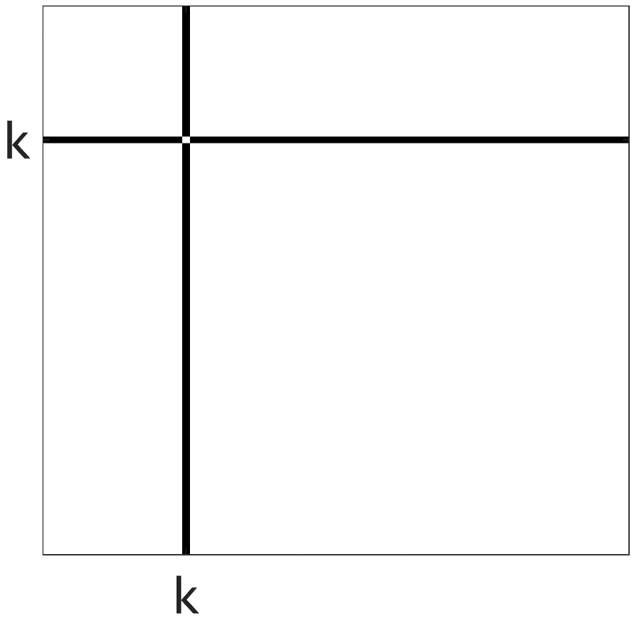
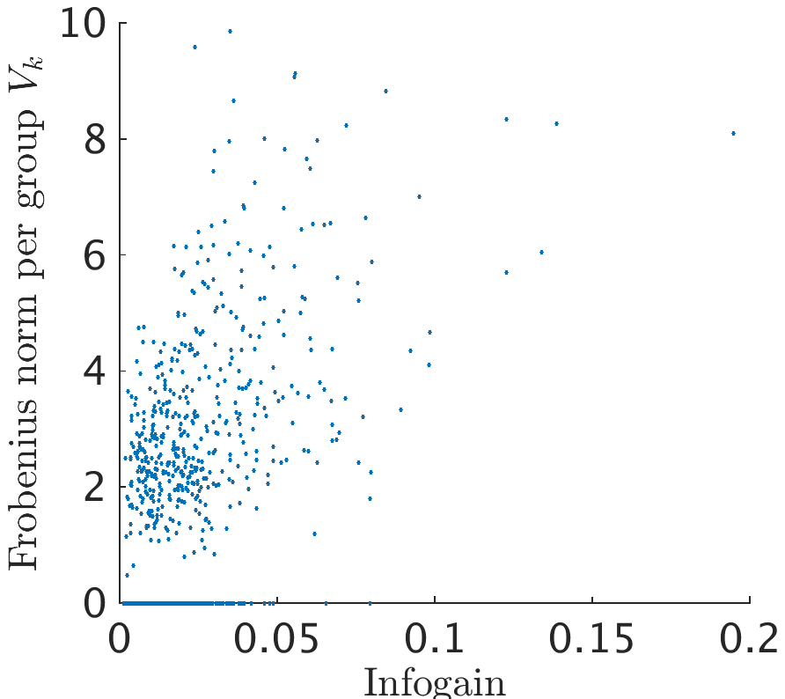

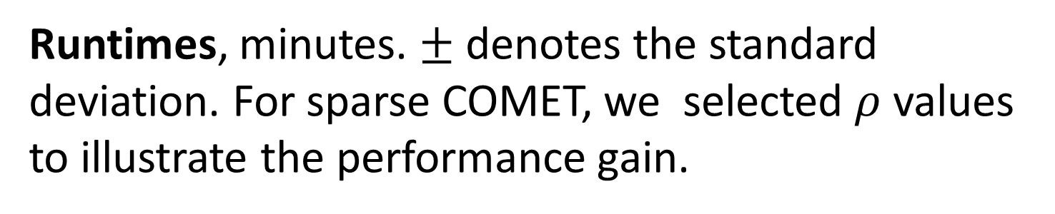
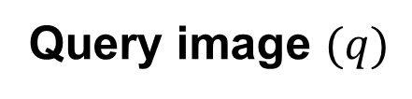
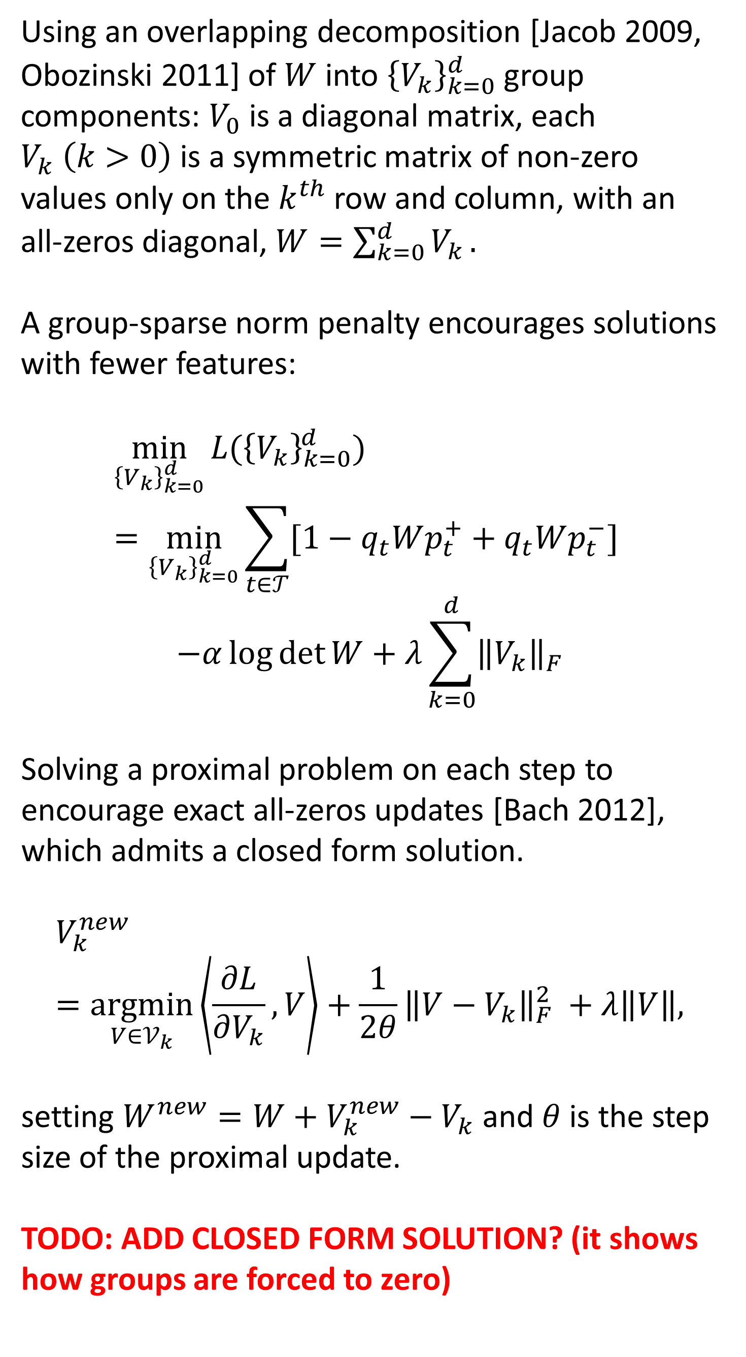
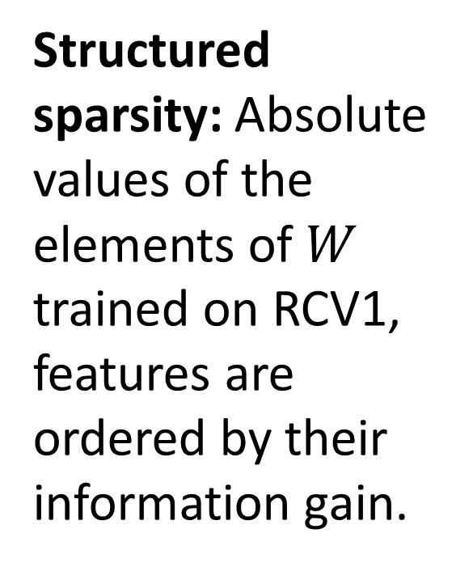
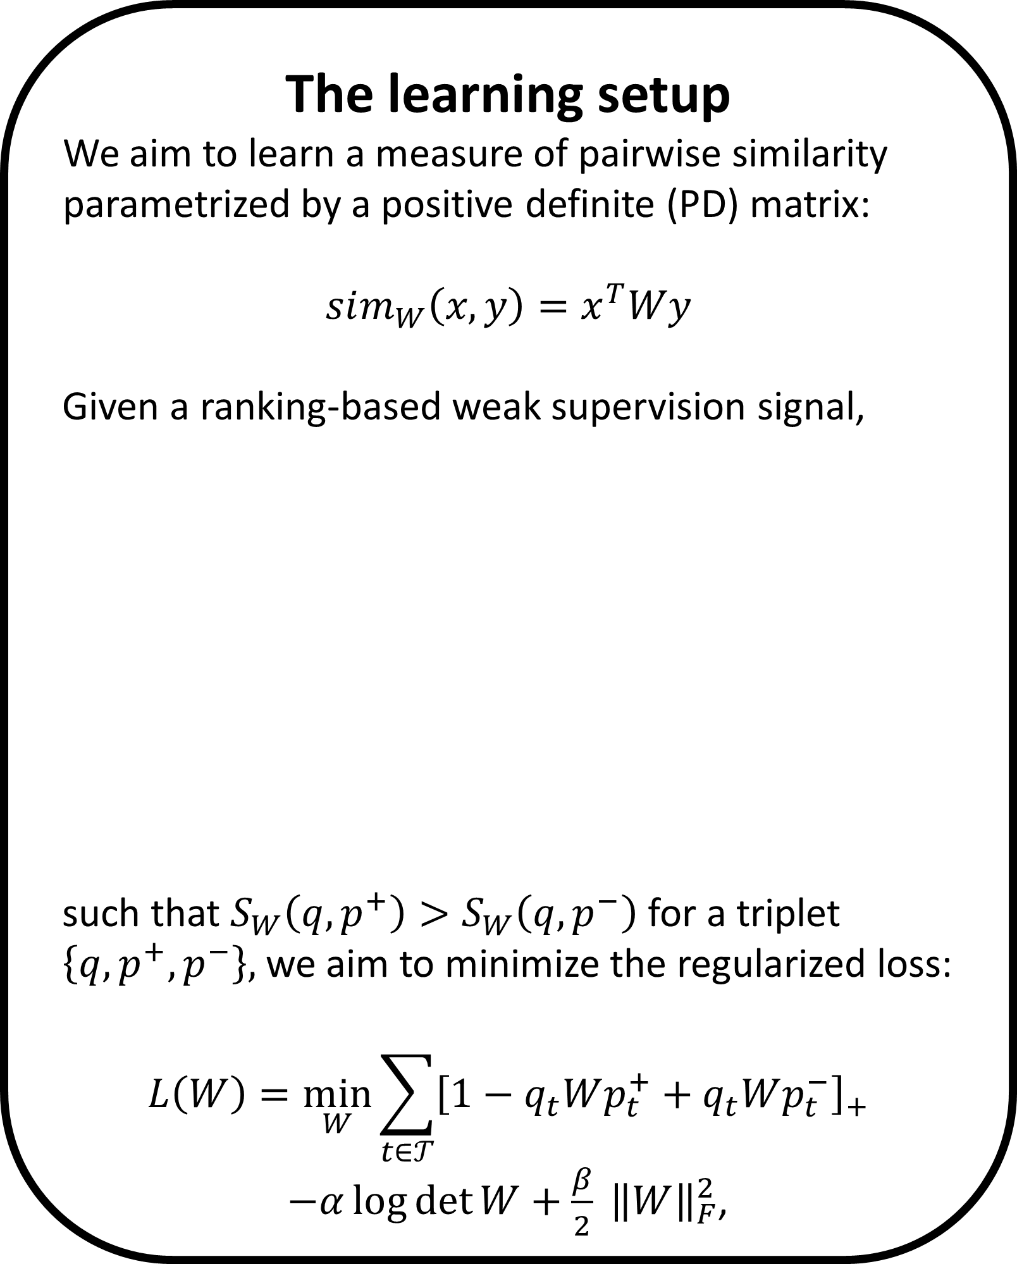




Learning Sparse Metrics, One Feature at a Time
The Leslie and Susan Gonda Multidisciplinary Brain Research Center
Yuval Atzmon ¹, Uri Shalit ², Gal Chechik ^{1,3}
¹ Gonda Multidisciplinary Brain Research Center, Bar-Ilan University, ² NYU, ³ Google CA
The learning setup
We aim to learn a measure of pairwise similarity parametrized by a positive definite (PD) matrix:
$$sim_{W}\left(x,y\right)=x^{T}Wy$$
Given a ranking-based weak supervision signal,
such that $S_{W}\left(q,p^{+}\right)>S_{W}\left(q, p^{−}\right)$ for a triplet $\left\{q, p^{+}, p^{−}\right\},$ we aim to minimize the regularized loss:
$$L\left(W\right)=\min_{W}{\sum_{t∈𝒯}{{\left[1−q_{t}Wp_{t}^{+}+q_{t}Wp_{t}^{−}\right]}_{+}}}$$
$−α\log{\det{W}}+\frac{β}{2} {\left\|W\right\|}_{F}^{2}$,
Sparse COMET
COMET’s structured sparsity allows only a small set of features to interact with any of the other features. Other individual features correspond to the diagonal of the learned similarity matrix.
Complexity and runtimes
Compared COMET with approaches that avoid repeated projections to the PD cone, and to the Euclidean metric baseline.
The effect of sparsity on precision and runtime
Precision at 1, 3 and 5 vs. the mean training run time of COMET.
Dashed line denotes the precision-at-1 of the Euclidean baseline, RCV1 dataset with 5K features.
Structured sparsity: Absolute values of the elements of $W$ trained on RCV1, features are ordered by their information gain.
Query image $(q)$
more similar ${(p}^{+})$
less similar ${(p}^{−})$
Using an overlapping decomposition [Jacob 2009, Obozinski 2011] of $W$ into ${\left\{V_{k}\right\}}_{k=0}^{d}$ group components: $V_{0}$ is a diagonal matrix, each $V_{k} \left(k>0\right)$ is a symmetric matrix of non-zero values only on the $k^{th}$ row and column, with an all-zeros diagonal, $W=\sum_{k=0}^{d}{V_{k}}.$
A group-sparse norm penalty encourages solutions with fewer features:
$${\min_{{\left\{V_{k}\right\}}_{k=0}^{d}}{L(\left\{V_{k}\right\}}}_{k=0}^{d})=\min_{{\left\{V_{k}\right\}}_{k=0}^{d}}{\sum_{t∈𝒯}{[1−q_{t}Wp_{t}^{+}+q_{t}Wp_{t}^{−}]} }$$
$$−α\log{\det{W}}+λ\sum_{k=0}^{d}{{\left\|V_{k}\right\|}_{F}}$$
Solving a proximal problem on each step to encourage exact all-zeros updates [Bach 2012], which admits a closed form solution.
$$V_{k}^{new}=\underset{V∈𝒱_{k}}{argmin}\left\langle \frac{∂L}{∂V_{k}},V\right\rangle +\frac{1}{2θ}{\left\|{V−V}_{k}\right\|}_{F}^{2} +λ\left\|V\right\|,$$
setting $W^{new}=W+V_{k}^{new}−V_{k}$ and $θ$ is the step size of the proximal update.
TODO: ADD CLOSED FORM SOLUTION? (it shows how groups are forced to zero)
Runtimes, minutes. $±$ denotes the standard deviation. For sparse COMET, we selected $ρ$ values to illustrate the performance gain.
Mean training time vs. the learned matrix density, RCV1 dataset with 5K features.
Experimental evaluation
Evaluated COMET with three datasets: Object recognition (Caltech256, 135k triplets), text classification (RCV1, 4 classes, 100k triplets), bio-informatics (Protein-LIBSVM, 20k triplets).
COMET row-column coordinate step
COordinate descent METric learning
Taking a gradient step $W+=ηG$ usually requires projecting the result back to the PD cone. COMET enables taking gradient steps within the PD cone.
Precision@top-k, comparing with:
Euclidean metric (baseline)‏,
HDSL: Similarity Learning for High Dimensional Sparse Data [Liu et al, 2015],
LEGO (ITML): Log-Det Exact Gradient Online [Jain et al. 2008],
BoostMetric positive-semidefinite metric learning with boosting [Shen et al. 2009],
80%/20% train/test split, 5-fold cross-validation
Projected Gradient
COMET
COMET gradient steps vs. projected gradient steps
At each coordinate step, update one column and row of the matrix $W$ with the row-column gradient of $L\left(W\right)$. Using the PD condition of the Schur complement, results with a closed form expression for the upper limit to the allowable step size, $η^{max}$
Which limits the step to the PD cone.
Efficiently maintaining the Cholesky root $L$of $W=L^{T}L$ resulting in an explicit embedding function $x→Lx$into the learned metric space throughout training.
Informative features are non-zeros
Frobenius norm of the groups $V_{k}$ vs. the info. gain of feature $k$.
Sparse COMET assigns zero weights to less-informative features.
Contact and code: yuval.atzmon@biu.ac.il, http://chechiklab.biu.ac.il/yuvval

Slide 2




COMET row-column coordinate step
COordinate descent METric learning
Taking a gradient step $W+=ηG$ usually requires projecting the result back to the PD cone. COMET enables taking gradient steps within the PD cone.
COMET row-column coordinate step
COordinate descent METric learning
Projected Gradient
COMET
COMET gradient steps vs. projected gradient steps
At each coordinate step update one column and row of the matrix $W$ with the gradient of $L\left(W\right)$ .
$$W+=ηG$$
Using the PD condition of the Schur complement to limit the step to the PD cone:
At each coordinate step update one column and row of the matrix $W$ with the row-column gradient of $L\left(W\right)$. Using the PD condition of the Schur complement results with a closed form expression for the upper limit to the allowable step size, $η^{max}$
Which limits the step to the PD cone.
Efficiently maintaining the Cholesky root $L$of $W=L^{T}L$ resulting in an explicit embedding function $x→Lx$into the learned metric space throughout training.
$$W^{new}≻0 ⟺ c^{∗}−{b^{∗}}^{T}A^{−1}b^{∗}>0,$$
where $c^{∗}=W_{\left(1,1\right)}^{new}$(a scalar), $b^{∗}=W_{\left(2:d,1\right)}^{new}$ and $A^{∗}=A=W_{(2:d,2:d)}$. Resulting with an upper limit to the allowable step size, $η^{max}$.
Efficiently maintaining the Cholesky root $L$of $W=L^{T}L$ resulting in an explicit embedding function $x→Lx$into the learned metric space throughout training.
Projected Gradient
COMET
COMET gradient steps vs. projected gradient steps

