Slide 1




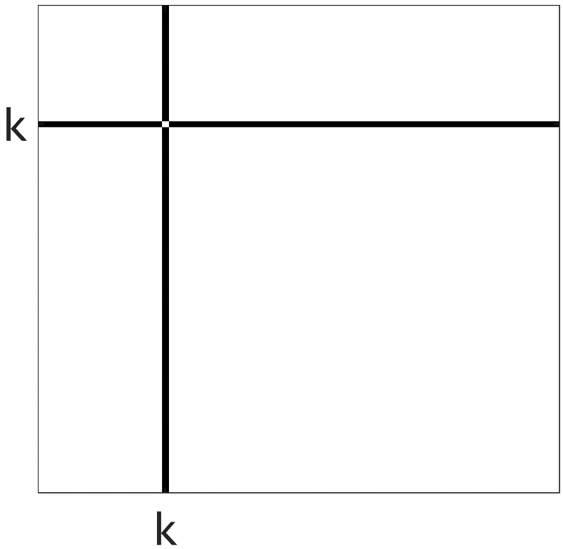
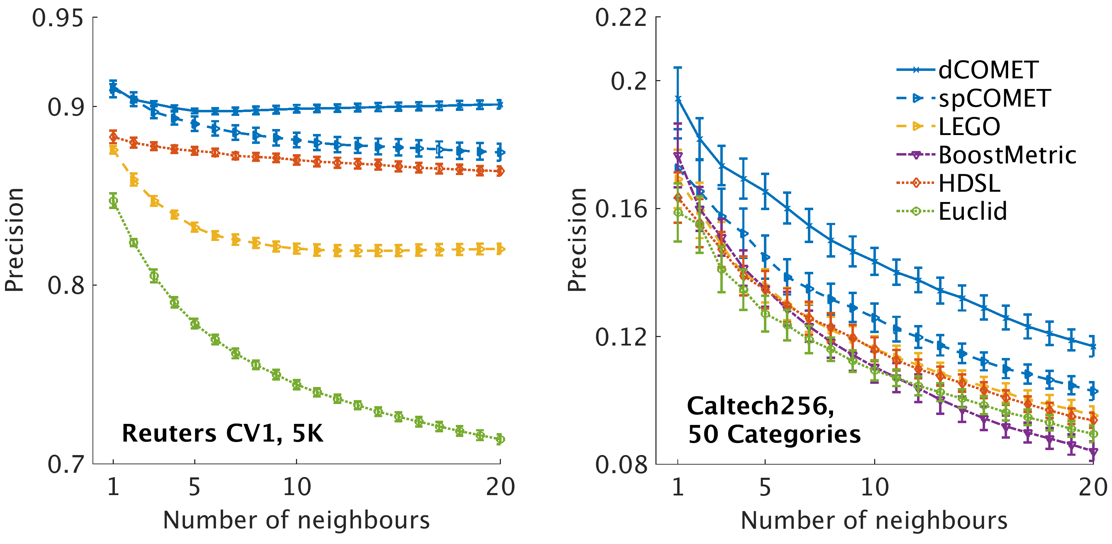
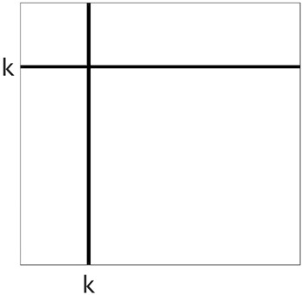
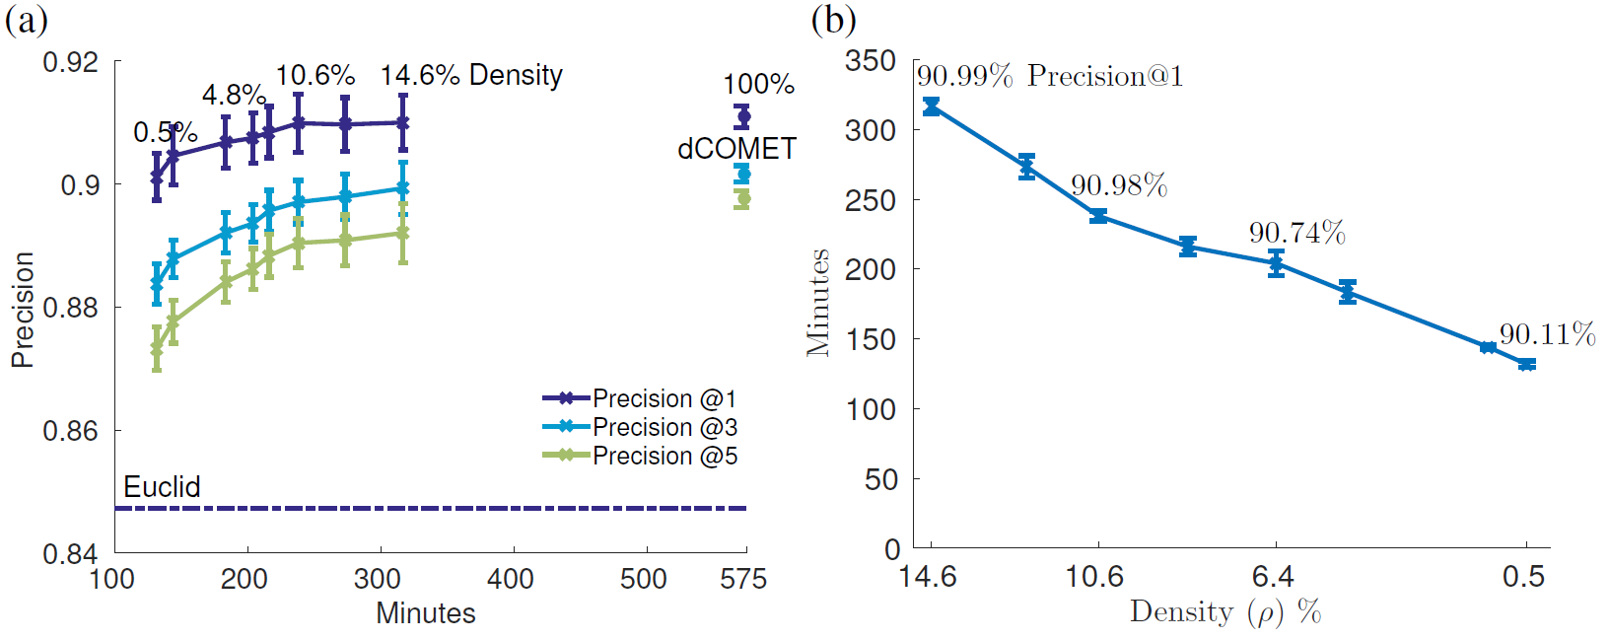
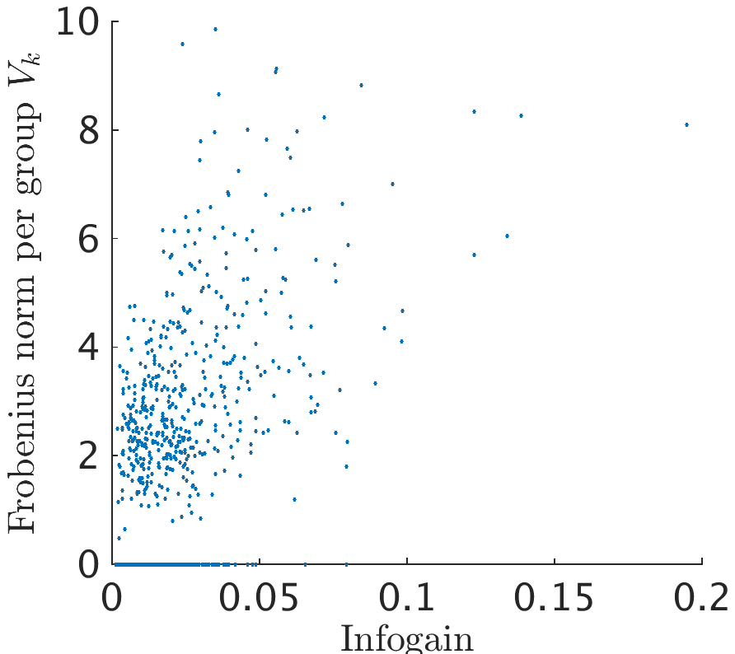
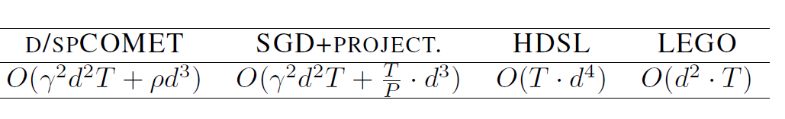
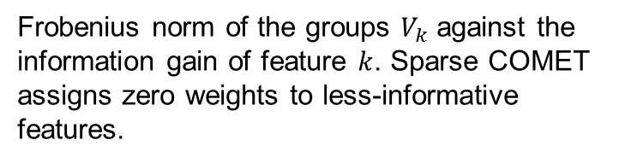
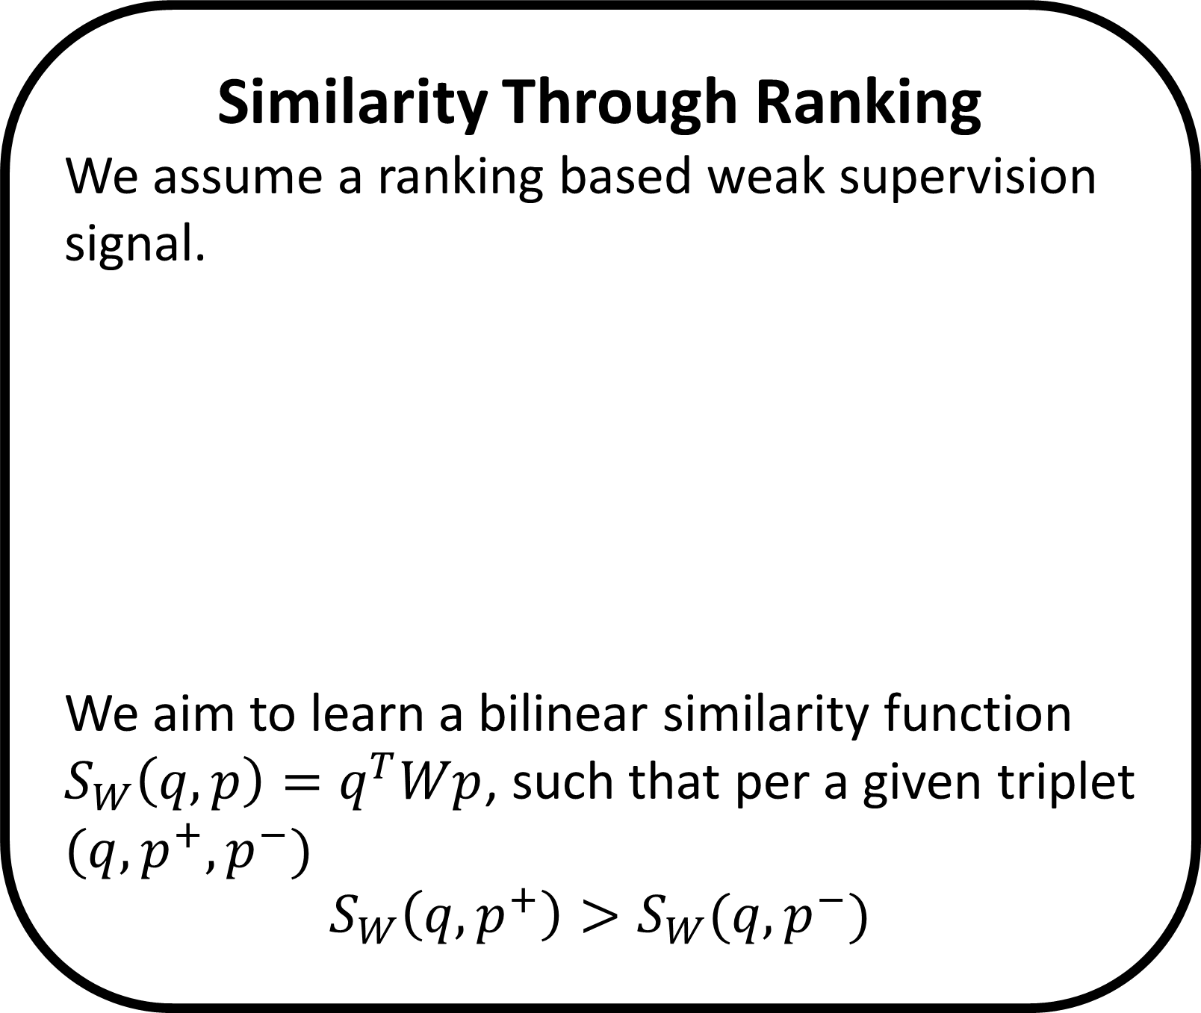



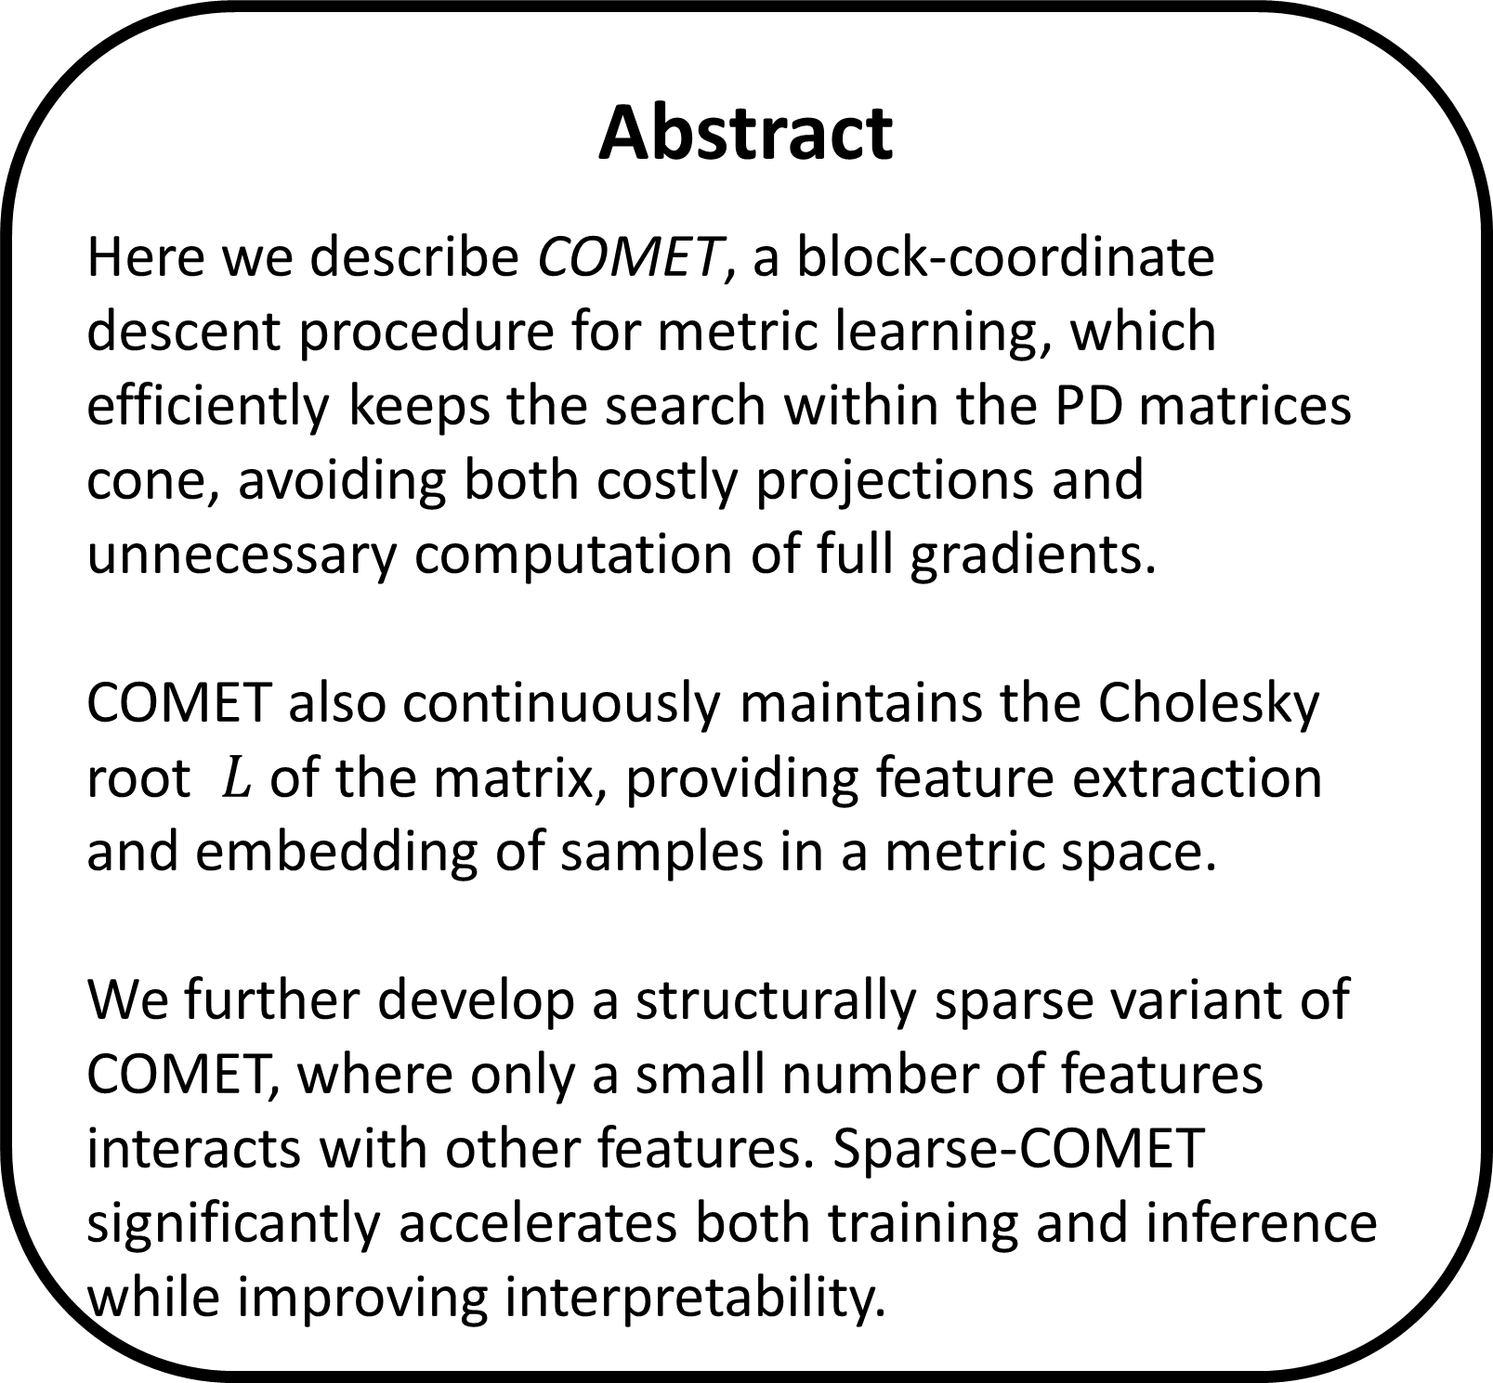


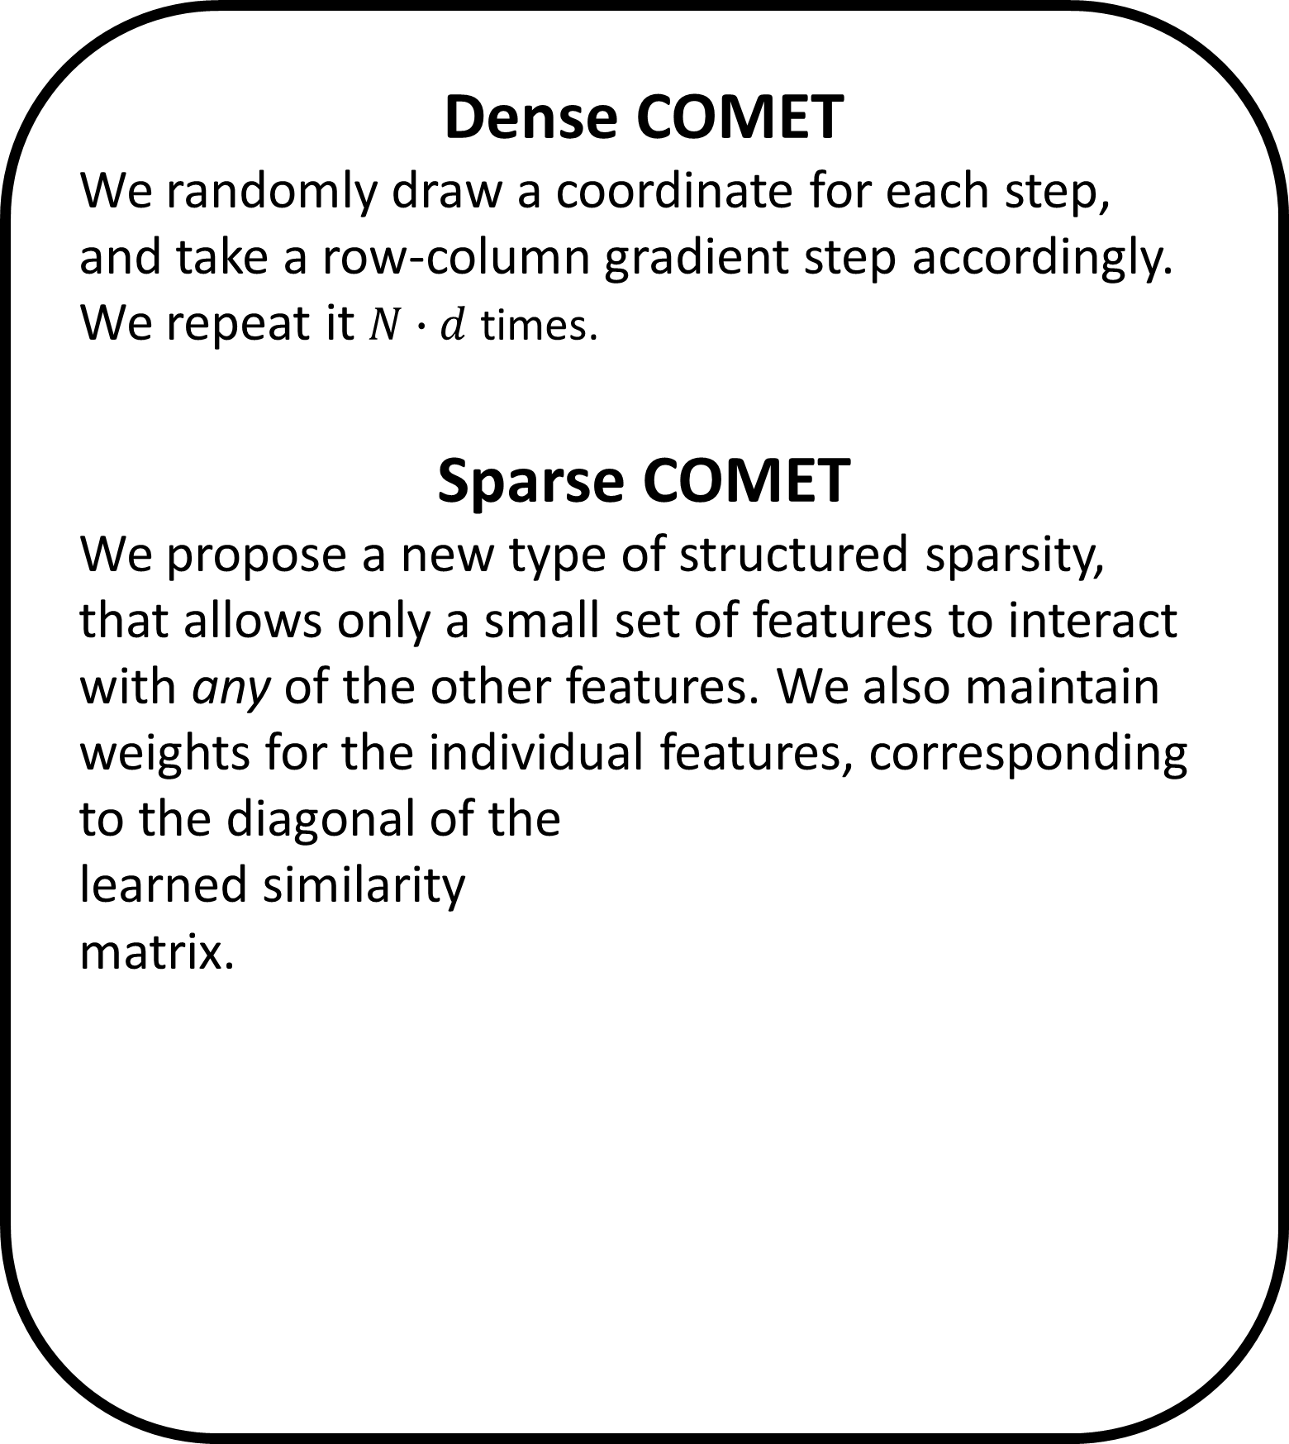
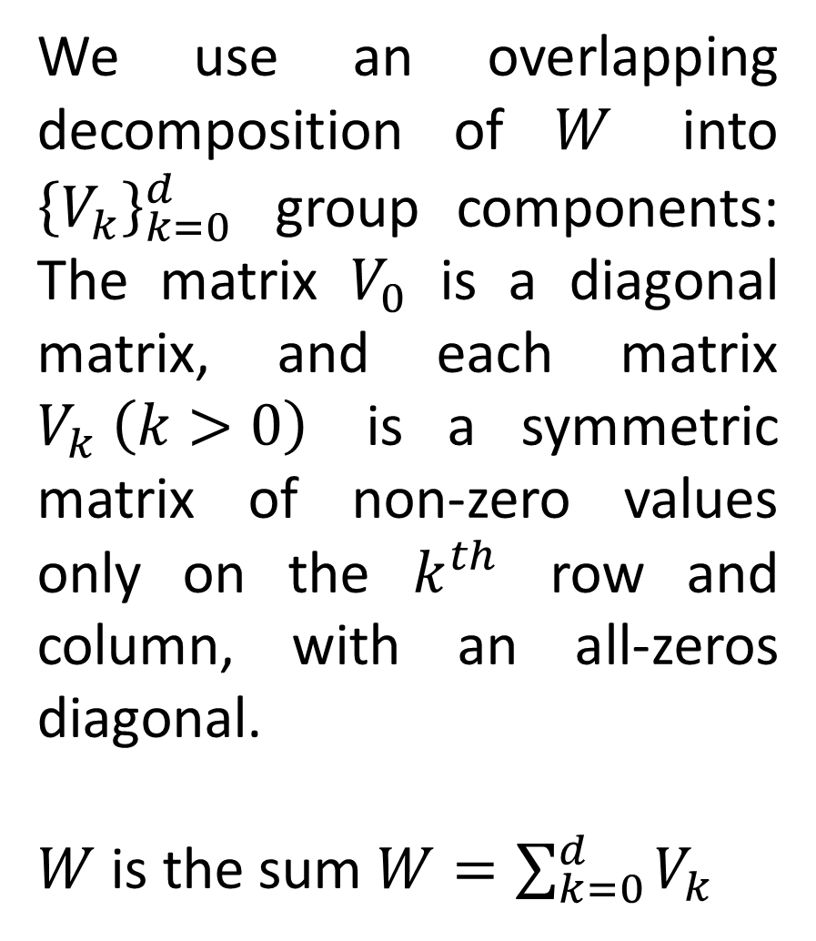
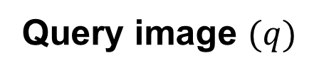
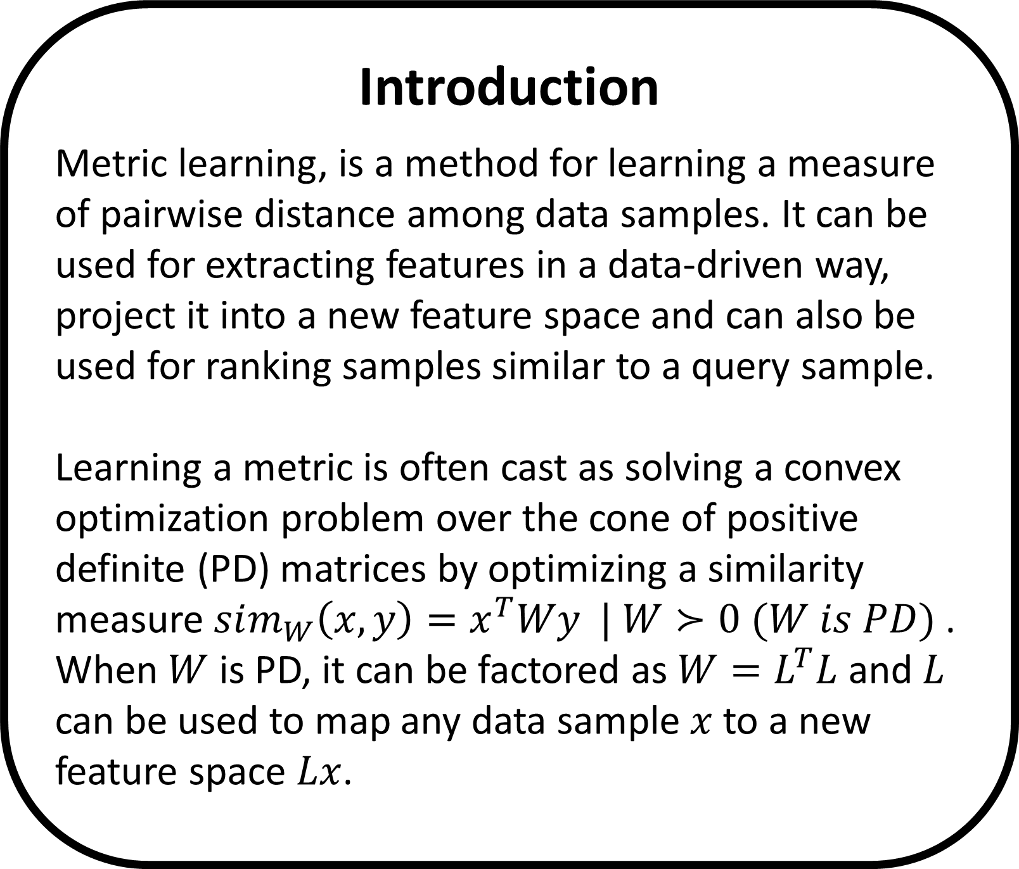

Learning Sparse Metrics
One Feature at a Time - COMET
The Leslie and Susan Gonda Multidisciplinary Brain Research Center
Yuval Atzmon ¹, Uri Shalit ², Gal Chechik ^{1,3}
¹ Gonda Multidisciplinary Brain Research Center, Bar-Ilan University, ² NYU, ³ Google CA
Introduction
Metric learning, is a method for learning a measure of pairwise distance among data samples. It can be used for extracting features in a data-driven way, project it into a new feature space and can also be used for ranking samples similar to a query sample.
Learning a metric is often cast as solving a convex optimization problem over the cone of positive definite (PD) matrices by optimizing a similarity measure $sim_{W}\left(x,y\right)=x^{T}Wy | W≻0 (W is PD)$ .
When $W$ is PD, it can be factored as $W=L^{T}L$ and $L$ can be used to map any data sample $x$ to a new feature space $Lx$.
The Learning Setup
We aim to optimize the following objective:
$$L\left(W\right)=\min_{W}{\sum_{t∈𝒯}{{\left[1−q_{t}Wp_{t}^{+}+q_{t}Wp_{t}^{−}\right]}_{+}}}$$
$−α\log{\det{W}}+\frac{β}{2} {\left\|W\right\|}_{F}^{2}$, with gradient steps inside the PD cone.
A row-column coordinate step
Sparse COMET
d/spCOMET achieves better precision in every dataset tested.
We use an overlapping decomposition of $W$ into ${\left\{V_{k}\right\}}_{k=0}^{d}$ group components: The matrix $V_{0}$ is a diagonal matrix, and each matrix $V_{k} \left(k>0\right)$ is a symmetric matrix of non-zero values only on the $k^{th}$ row and column, with an all-zeros diagonal.
$W$ is the sum $W=\sum_{k=0}^{d}{V_{k}}$
COMET operates by updating the learned matrix one column and row at a time, thus updating the terms relating to one feature at each iteration.
We add a group-sparse norm penalty to the loss to encourage solutions with fewer features and obtain the following objective and optimization :
$${\min_{{\left\{V_{k}\right\}}_{k=0}^{d}}{L(\left\{V_{k}\right\}}}_{k=0}^{d})=\min_{{\left\{V_{k}\right\}}_{k=0}^{d}}{\sum_{t∈𝒯}{[1−q_{t}Wp_{t}^{+}+q_{t}Wp_{t}^{−}]} }$$
$$−α\log{\det{W}}+λ\sum_{k=0}^{d}{{\left\|V_{k}\right\|}_{F}}$$
For encouraging exact all-zeros updates, we solve on each coordinate step the following proximal problem, which admits a closed form solution.
$$V_{k}^{new}=\underset{V∈𝒱_{k}}{argmin}\left\langle \frac{∂L}{∂V_{k}},V\right\rangle +\frac{1}{2θ}{\left\|{V−V}_{k}\right\|}_{F}^{2} +λ\left\|V\right\|$$
and set $W^{new}=W+V_{k}^{new}−V_{k}$, where $θ$ corresponds to the step size of the proximal update.
80%/20% train/test split, 5-fold cross-validation for hyper parameters.
Compared methods: Euclidean metric (baseline)‏. HDSL: Similarity Learning for High Dimensional Sparse Data [Liu et al, 2015], LEGO (ITML): Log-Det Exact Gradient Online [Jain et al. 2008], BoostMetric positive-semidefinite metric learning with boosting [Shen et al. 2009]
Abstract
Here we describe COMET, a block-coordinate descent procedure for metric learning, which efficiently keeps the search within the PD matrices cone, avoiding both costly projections and unnecessary computation of full gradients.
COMET also continuously maintains the Cholesky root $L$ of the matrix, providing feature extraction and embedding of samples in a metric space.
We further develop a structurally sparse variant of COMET, where only a small number of features interacts with other features. Sparse-COMET significantly accelerates both training and inference while improving interpretability.
We employ the PD condition of the Schur complement to efficiently calculate an exact bound over the step size that guarantees that the model takes steps inside the PD cone:
$$W^{new}≻0 ⟺ c^{∗}−{b^{∗}}^{T}A^{−1}b^{∗}>0,$$
where $c^{∗}=W_{\left(1,1\right)}^{new}$(a scalar), $b^{∗}=W_{\left(2:d,1\right)}^{new}$ and $A^{∗}=A=W_{(2:d,2:d)}$. Resulting with $η^{max}$an upper limit to the allowable step size.
We use a Cholesky solver, and following a row-column step we update the Cholesky root of $W$. Hence we also have a continues embedding of the features into the metric space.
The effect of sparsity on precision and runtime
RCV1 dataset with 5K features.(a) Precision at 1, 3 and 5 nearest neighbor evaluated on the test set vs. the mean training run time of COMET. Percentiles denote the density of the learned matrix. Error bars denote the standard error of the mean across 5 random train/test partitions (80\%/20\%). Dashed line denotes the precision-at-1 of the Euclidean baseline. (b) Mean training time as a function of the learned matrix density. Percentiles denote the Precision-at-1
Dense COMET
We randomly draw a coordinate for each step, and take a row-column gradient step accordingly. We repeat it $N∙d$ times.
Sparse COMET
We propose a new type of structured sparsity, that allows only a small set of features to interact with any of the other features. We also maintain weights for the individual features, corresponding to the diagonal of the learned similarity matrix.
Extracted Features
Similarity Through Ranking
We assume a ranking based weak supervision signal.
We aim to learn a bilinear similarity function $S_{W}\left(q,p\right)=q^{T}Wp$, such that per a given triplet
$$(q, p^{+}, p^{−})$$
$$S_{W}\left(q,p^{+}\right)>S_{W}(q, p^{−})$$
Frobenius norm of the groups $V_{k}$ against the information gain of feature $k$. Sparse COMET assigns zero weights to less-informative features.
Computational Complexity and Runtimes
We compared COMET with approaches that avoid repeated projections to the PD cone and to the Euclidean metric baseline.
Query image $(q)$
more similar ${(p}^{+})$
less similar ${(p}^{−})$
Structured sparsity: A heat map of the absolute values of the elements of $W$ trained on RCV1, illustrating the structured sparseness of the learned metric. Features are ordered by their information gain.
Contact and code: yuval.atzmon@biu.ac.il, http://chechiklab.biu.ac.il/yuvval

