Slide 1



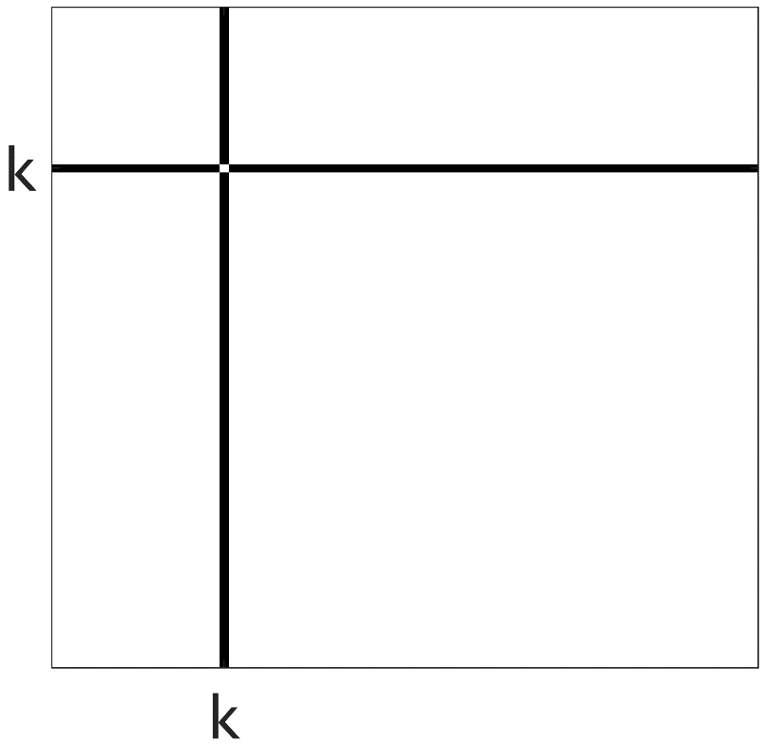
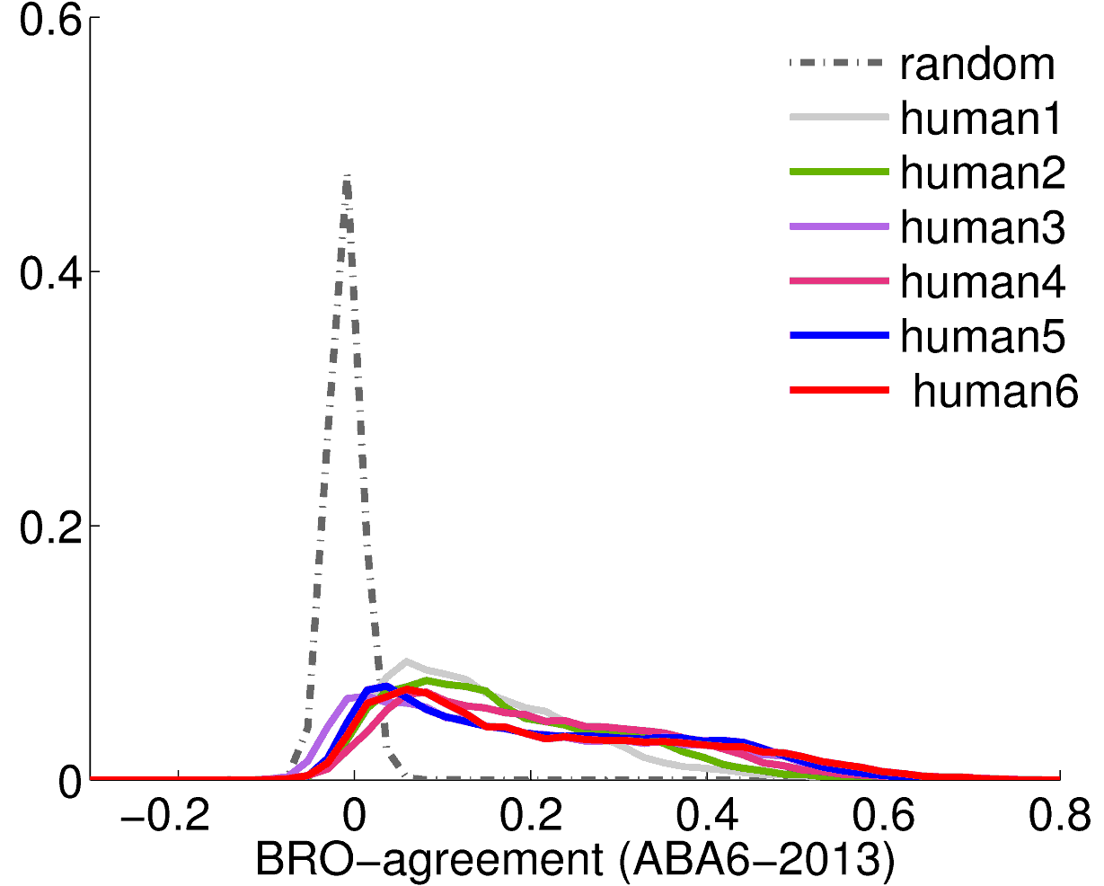
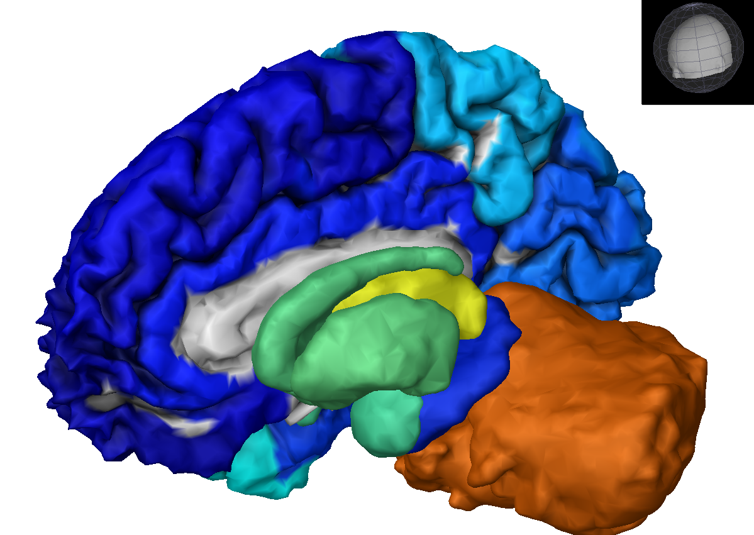
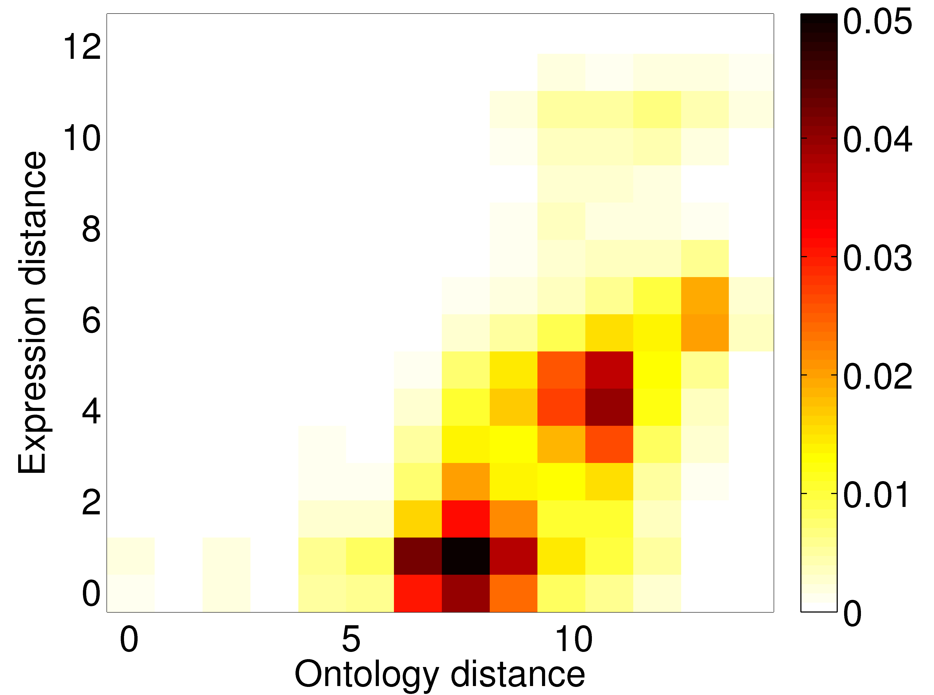
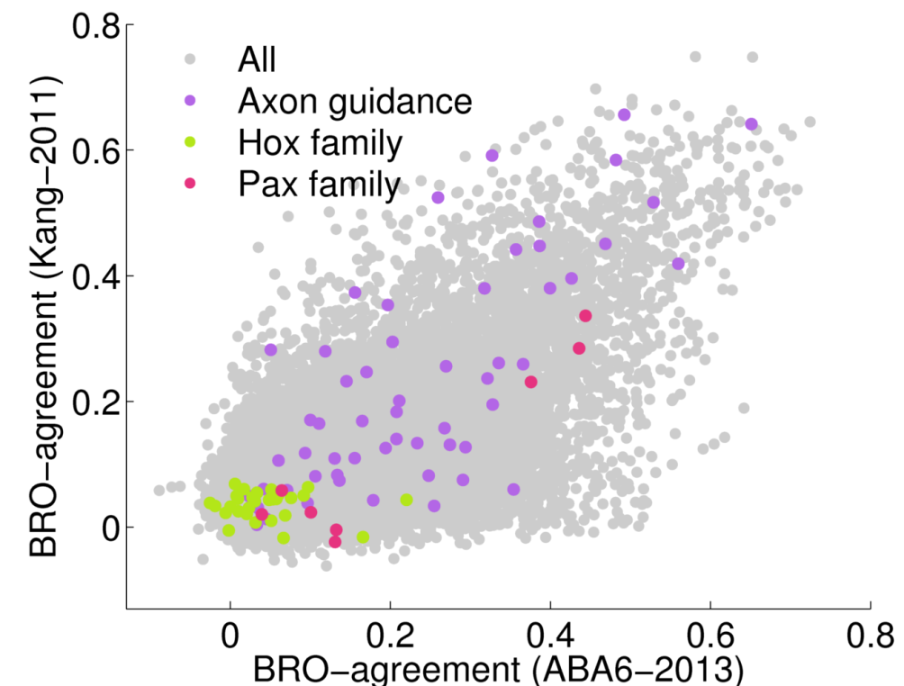
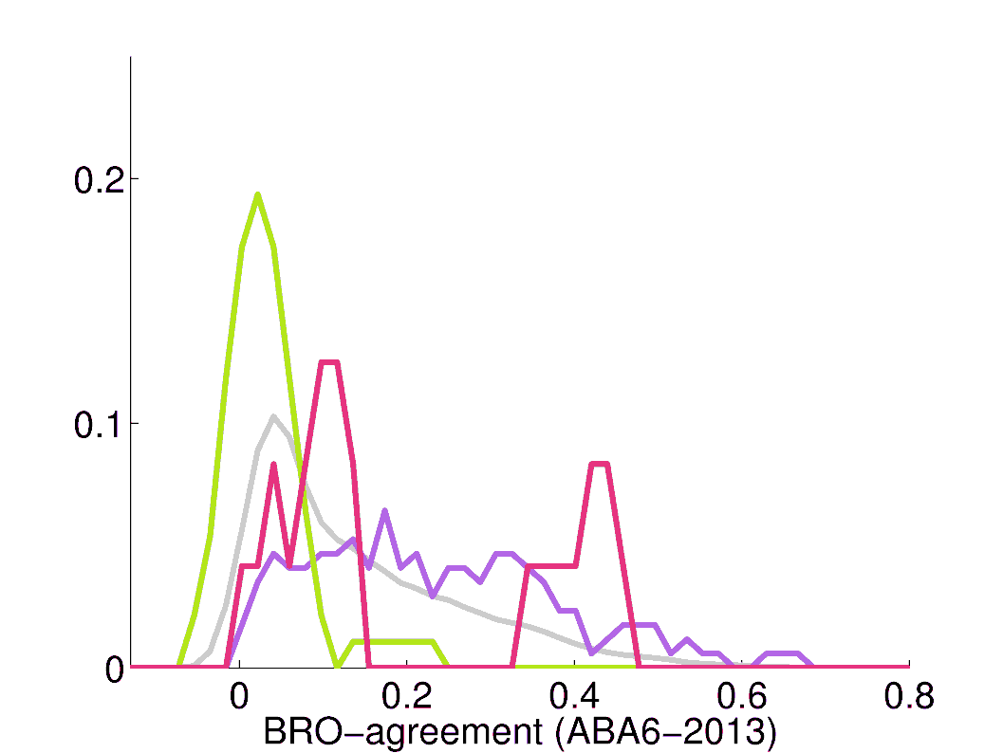
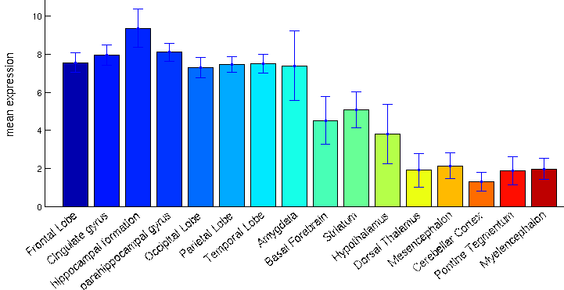
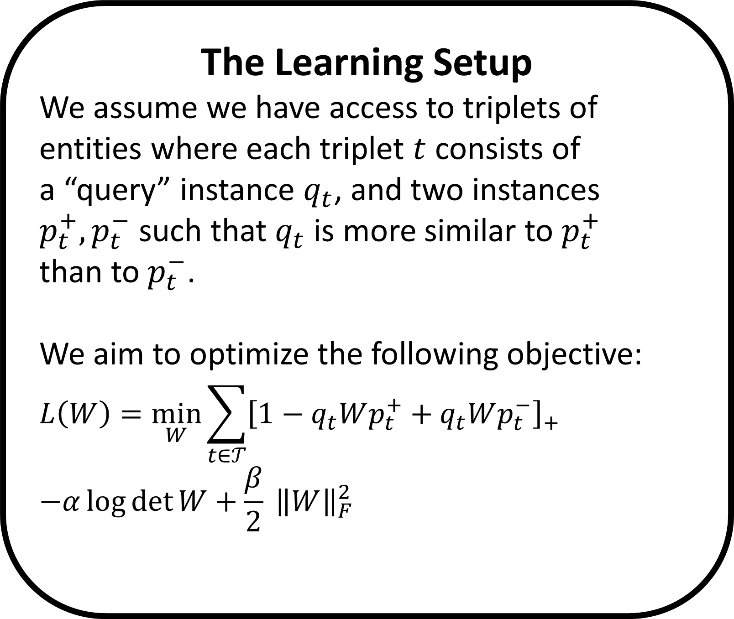
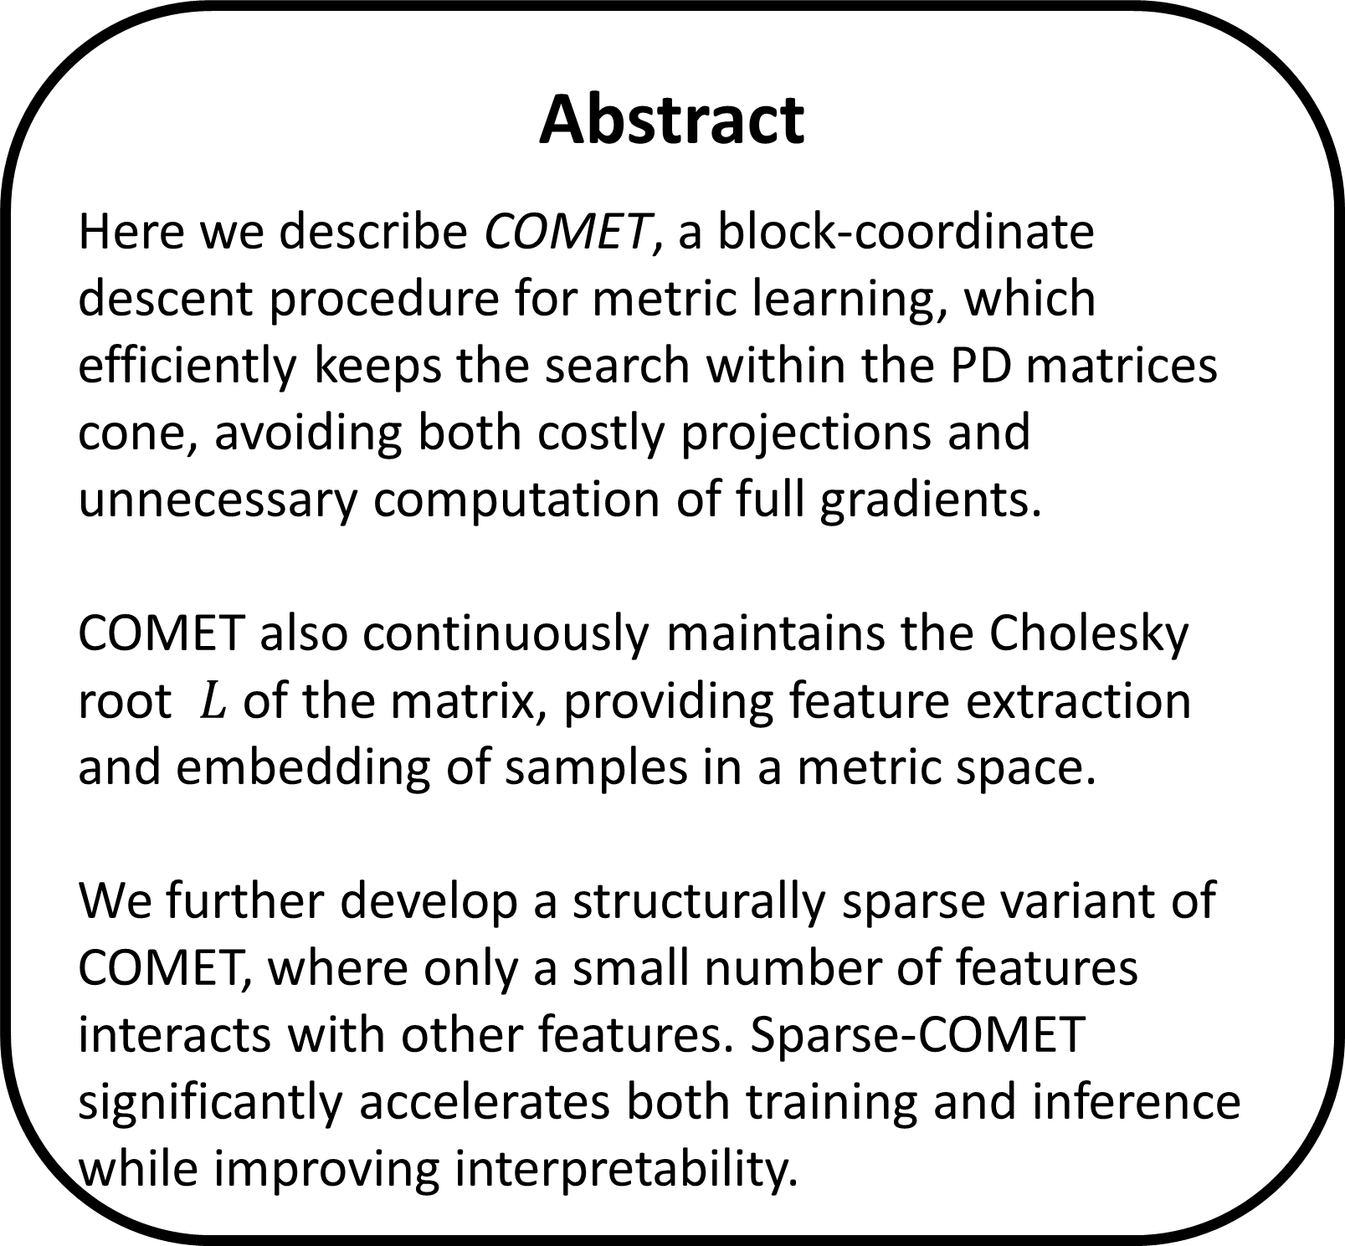

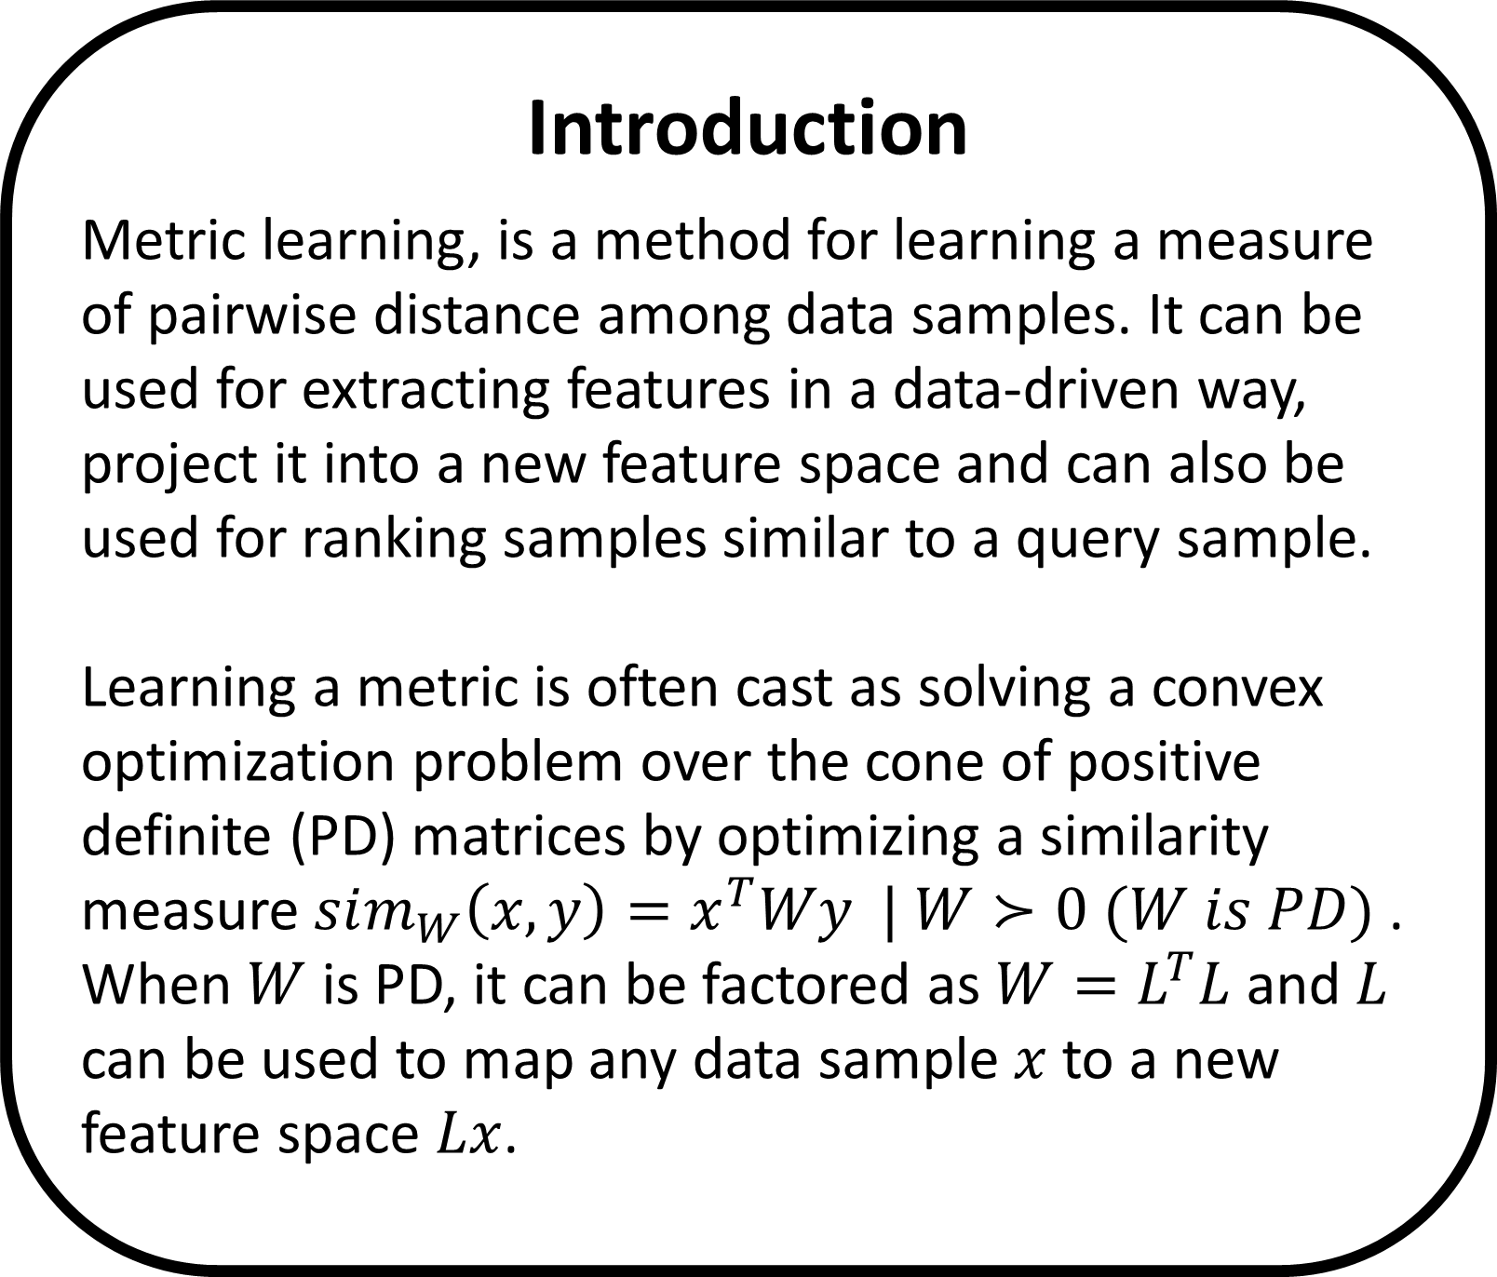
COMET – Learning Sparse Metrics
One Feature at a Time
The Leslie and Susan Gonda Multidisciplinary Brain Research Center
Yuval Atzmon ¹, Uri Shalit ², Gal Chechik ^{1,3}
¹ Gonda Multidisciplinary Brain Research Center, Bar-Ilan University, ² NYU, ³ Google CA
Introduction
Metric learning, is a method for learning a measure of pairwise distance among data samples. It can be used for extracting features in a data-driven way, project it into a new feature space and can also be used for ranking samples similar to a query sample.
Learning a metric is often cast as solving a convex optimization problem over the cone of positive definite (PD) matrices by optimizing a similarity measure $sim_{W}\left(x,y\right)=x^{T}Wy | W≻0 (W is PD)$ .
When $W$ is PD, it can be factored as $W=L^{T}L$ and $L$ can be used to map any data sample $x$ to a new feature space $Lx$.
A row-column coordinate step
Sparse COMET
Expression across the human cortex is not homogeneous
COMET operates by updating the learned matrix one column and row at a time, thus updating the terms relating to one feature at each iteration.
11% of the human genes show distinct expression patterns that agree with the cortex region ontology
We employ the PD condition of the Schur complement to efficiently calculate an exact bound over the step size that guarantees that the model remains within the PD cone:
$$W^{new}≻0 ⟺ c^{∗}−{b^{∗}}^{T}A^{−1}b^{∗}>0,$$
where $c^{∗}=W_{\left(1,1\right)}^{new}$(a scalar), $b^{∗}=W_{\left(2:d,1\right)}^{new}$ and $A^{∗}=A=W_{(2:d,2:d)}$. Resulting with $η^{max}$an upper limit to the allowable step size.
Significance was assets using permutation test.
Astrocytes and neuronal markers are in stronger agreement with BRO than the average gene.
Abstract
Here we describe COMET, a block-coordinate descent procedure for metric learning, which efficiently keeps the search within the PD matrices cone, avoiding both costly projections and unnecessary computation of full gradients.
COMET also continuously maintains the Cholesky root $L$ of the matrix, providing feature extraction and embedding of samples in a metric space.
We further develop a structurally sparse variant of COMET, where only a small number of features interacts with other features. Sparse-COMET significantly accelerates both training and inference while improving interpretability.
Precision at top k
Cell-type specific genes are in stronger agreement with the tree structure than genes on average.
Markers from Cahoy et al. [3].
Robustness across subjects
Dense COMET
We define a measure of agreement between the expression of a single gene across regions and the brain region ontology (similar results with other scores)
BRO_{score} = Correlation (d_{expression} , d_{tree} )
correlation is across pairs of tissue samples
d_{expression} is the vector of absolute differences of expression levels in two regions.
d_{tree} is the vector of number of edges in the ontology tree that connect two regions.
The percent of BRO-significant genes is stable when we compute the BRO score for each subject separately
(89%, 90%, 76%, 91%, 83%, 86%).
Example: Neurod1 receives a high BRO score
Development genes are in strong agreement with the tree structure suggesting that they may have important functions in the adult brain.
Axon guidance markers from KEGG.
Example: FEZF2 (ZNF312)
The Learning Setup
We assume we have access to triplets of entities where each triplet $t$ consists of
a “query” instance $q_{t}$, and two instances $p_{t}^{+}, p_{t}^{−}$ such that $q_{t}$ is more similar to $p_{t}^{+}$
than to $p_{t}^{−}$.
We aim to optimize the following objective:
$$L\left(W\right)=\min_{W}{\sum_{t∈𝒯}{{\left[1−q_{t}Wp_{t}^{+}+q_{t}Wp_{t}^{−}\right]}_{+}}}$$
$$−α\log{\det{W}}+\frac{β}{2} {\left\|W\right\|}_{F}^{2}$$
FEZF2 is known to regulate the axon targeting of layer 5 subcortical projection neurons.
House keeping genes are expressed in all cell types. In the adult brain, their scores are significantly higher than random, and match the BRO scores of all genes.
Markers from Eisenberg et al. [4]
Hawrylycz et al., An anatomically comprehensive atlas of the adult human brain transcriptome, Nature 2012
Kang et al., Spatio-temporal transcriptome of the human brain, Nature 2011
Cahoy et al., A transcriptome database for astrocytes, neurons, and oligodendrocytes, J. neuroscience 2008.
Eisenberg et al., Human housekeeping genes are compact, Trends in genetics. 2003
Contact: lior.kirsch@gmail.com, http://chechiklab.biu.ac.il/~lior

