Slide 1


Slide 2
The Problem
Videos lack clarity
Key details may be hidden
It is difficult to navigate long videos

Slide 3
The Idea
Identify Key Topics in long-format videos
Generate Mind Maps for concept visualization
Enhance Understanding with structured insights

Slide 4
The Algorithm: Transcription & Segmentation
OpenAI Whisper Model – Runs client side on the browser!!
Split the transcript into segments (~30 seconds)

Slide 5
The Algorithm: Vectorization
“There are a lot of ways the people around us can help improve our lives. We don't bump into every neighbour, so a lot of wisdom never gets passed on, though we do share the same public spaces. So over the past few years, I've tried ways to share more with my neighbors in public space.”

Slide 6
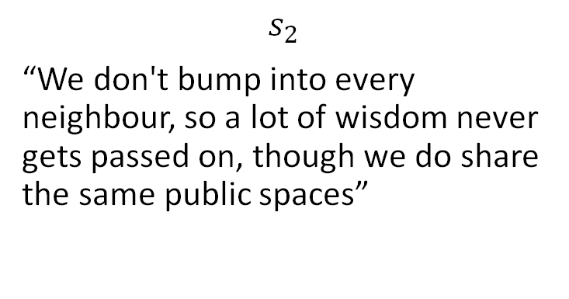
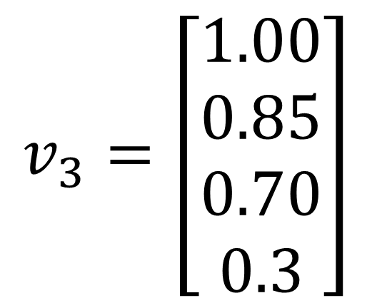
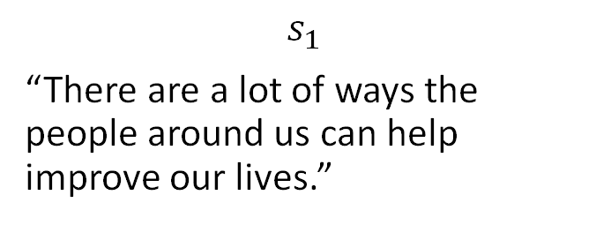
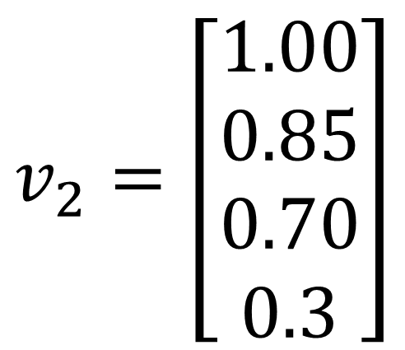
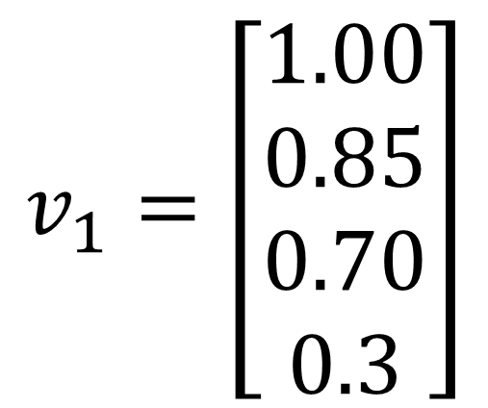
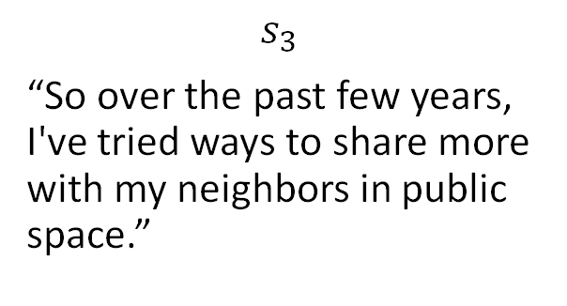
The Algorithm: Vectorization
$$s_{1}$$
“There are a lot of ways the people around us can help improve our lives.”
$$s_{2}$$
“We don't bump into every neighbour, so a lot of wisdom never gets passed on, though we do share the same public spaces”
$$s_{3}$$
“So over the past few years, I've tried ways to share more with my neighbors in public space.”
$$v_{1}=\left[\begin{aligned}1.00 \\ 0.85 \\ 0.70 \\ 0.3\end{aligned}\right]$$
$$v_{2}=\left[\begin{aligned}1.00 \\ 0.85 \\ 0.70 \\ 0.3\end{aligned}\right]$$
$$v_{3}=\left[\begin{aligned}1.00 \\ 0.85 \\ 0.70 \\ 0.3\end{aligned}\right]$$

Slide 7
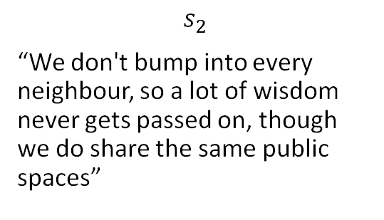
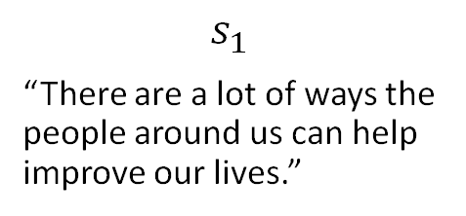
The Algorithm: Similarity
$$s_{1}$$
“There are a lot of ways the people around us can help improve our lives.”
$$s_{2}$$
“We don't bump into every neighbour, so a lot of wisdom never gets passed on, though we do share the same public spaces”

Slide 8
The Algorithm: Similarity

Slide 9



The Algorithm: Similarity
$$v_{i}$$
$$v_{j}$$
$$θ$$

Slide 10

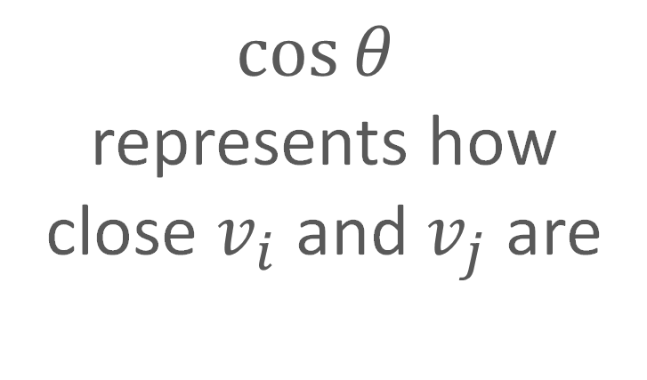
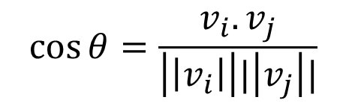


The Algorithm: Similarity
$$v_{i}$$
$$\cos{θ}$$
represents how close $v_{i}$and $v_{j}$ are
$$v_{j}$$
$$θ$$
$$\cos{θ}=\frac{v_{i}. v_{j}}{\left|\left|v_{i}\right|\right||\left|v_{j}\right||}$$

Slide 11
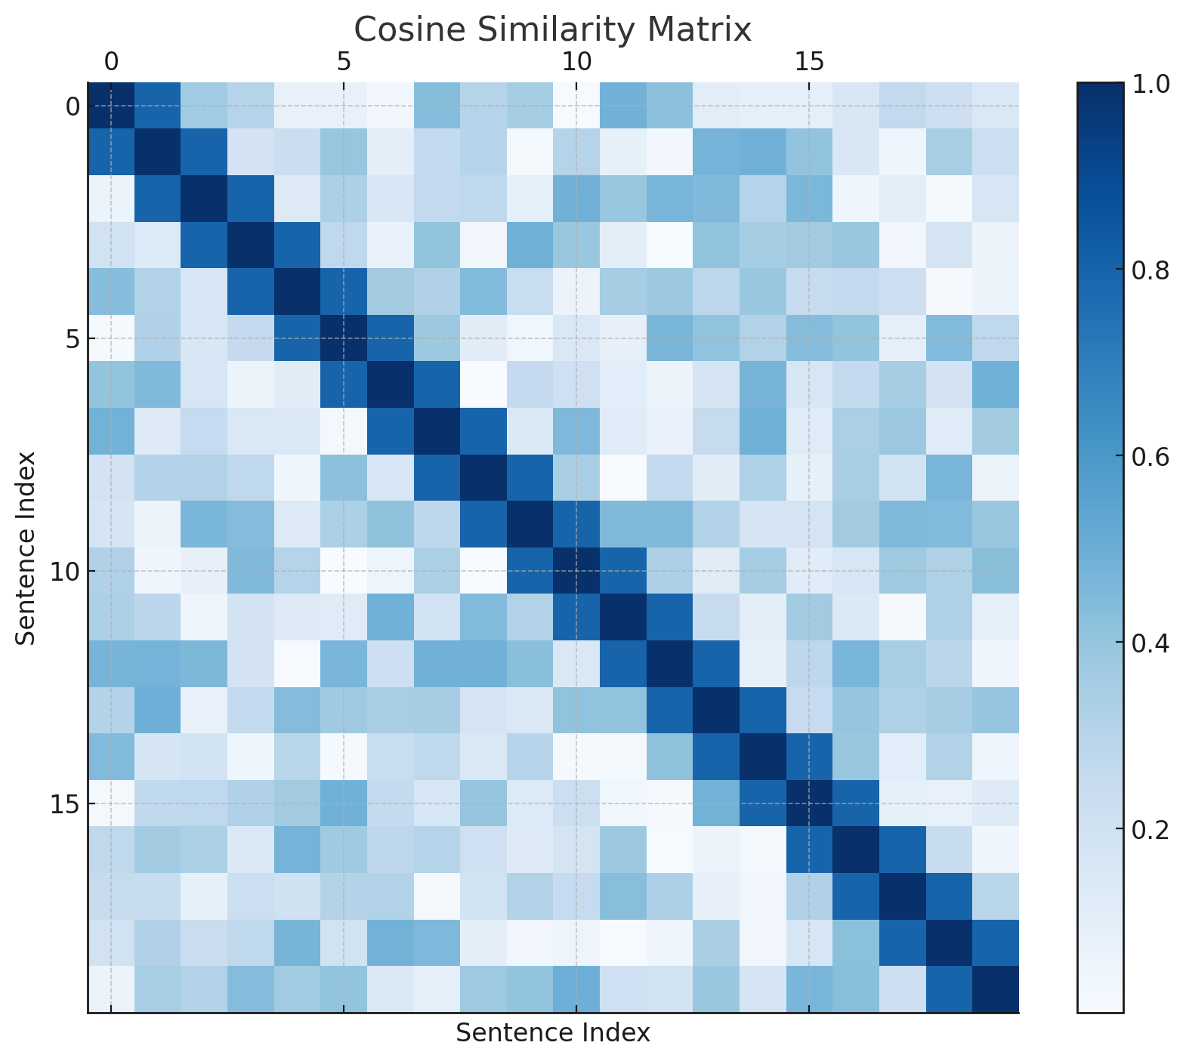
The Algorithm: Cosine Similarity Matrix

Slide 12
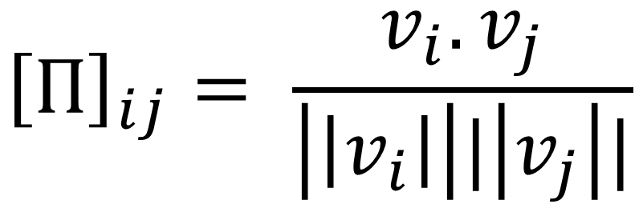
The Algorithm: Cosine Similarity Matrix
$${\left[Π\right]}_{ij}= \frac{v_{i}. v_{j}}{\left|\left|v_{i}\right|\right||\left|v_{j}\right||}$$

Slide 13
Previous Window Similarity
Next Window Similarity
Cross Window Similarity

Slide 18
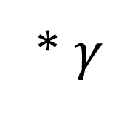
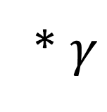
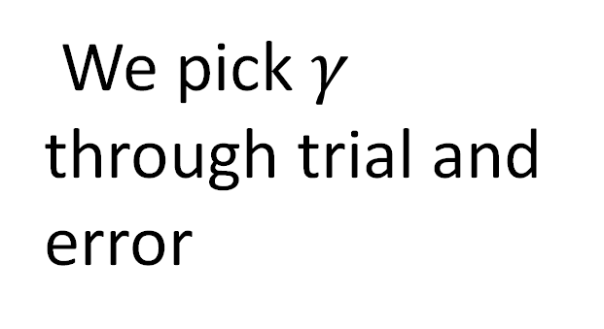
Cross Window Similarity
Previous Window Similarity
<
* $γ$
We pick $γ$ through trial and error
Cross Window Similarity
Next Window Similarity
<
* $γ$

Slide 19
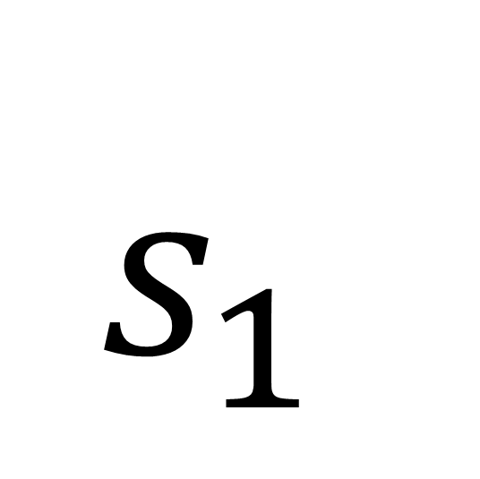
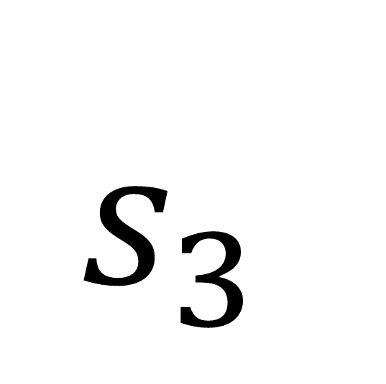
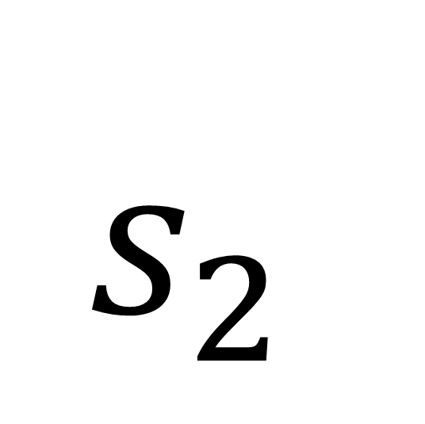
The Algorithm: Group vector embeddings
$s_{1}$
$s_{2}$
$s_{3}$

Slide 20
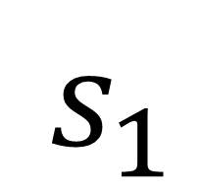
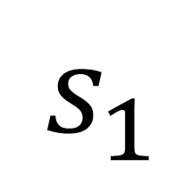
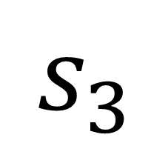
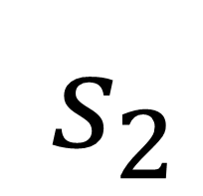
The Algorithm: Group vector embeddings
$s_{1}$
$s_{2}$
$s_{3}$
$s_{1}$

Slide 21
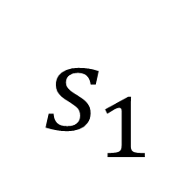
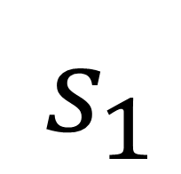
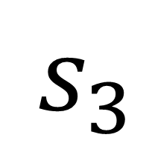
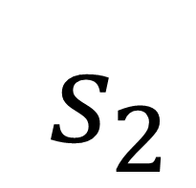
The Algorithm: Group vector embeddings
$s_{1}$
$s_{2}$
$s_{3}$
Extract key words from segments to name the topics
$s_{1}$

Slide 22
Other Applications of the Algorithm
Detecting Functional Domains in DNA, RNA, and Proteins
Detecting Market Regimes (Bullish, Bearish, Sideways)
Detecting Cyberattacks from Network Logs
Detecting Cognitive States from Brain Activity

