Slide 1

Group Members
Devagiri D.M.U.A (IT23537842 )
IT3011 – Theory & Practices in Statistical Modeling
Does Positive Audience
Experience Increase
Recommendation
Likelihood?
Yasmada K.Y (IT23544772)
Wijethilaka P..L.A.W.K (IT23629608)
Pathirana P.U.O.R (IT23830332)
Final Viva Presentation · DATA SCIENCE (sp) 3YS1

Slide 2
Presentation Outline
A
Step A
D2
Step D2
Data Overview
Formal Hypothesis Testing
B
Step B
E
Step E
Feature Engineering
Predictive Modeling
C
Step C
F
Step F
Exploratory Data Analysis
Evaluation & Comparison
D
Step D
★
Step ★
Statistical Validation
Key Findings & Conclusion

Slide 3
INTRODUCTION
Research Problem
1
YouTube generates over 500 hours of video every minute — recommendation is everything
2
It is unclear which specific audience experience signals actually drive content recommendation
3
Platforms and creators need to understand the relationship between satisfaction and sharing behaviour
4
Can a viewer's experience — measured through watch time, sentiment, and engagement — predict whether they will recommend content?

Slide 4
INTRODUCTION
Project Objectives
01
02
03
Acquire Dataset
Engineer Features
Explore & Visualise
Extracted a 3,000+row YouTube viewer analytics dataset from KAGGLE
Build a composite Audience Experience Score from watch time, sentiment, and engagement signals
Run EDA charts to identify patterns, distributions, and relationships between variables
04
05
06
Hypothesis Testing
Predictive Modelling
Evaluate & Conclude
Formally test H₀ vs H₁ at α = 0.05 using t-tests, chi-square and correlation
Train Logistic Regression and Random Forest classifiers with 5-fold cross-validation
Compare models on AUC, F1, precision, recall and draw conclusions on the hypothesis

Slide 5

Hypothesis
H₀ — Null Hypothesis
Positive audience experience does NOT increase the likelihood of recommending entertainment content.
H₁ — Alternative Hypothesis (One-Tailed)
Positive audience experience DOES increase the likelihood of recommending entertainment content.
Significance Level
Test Direction
Decision Rule
α = 0.05
One-Tailed
Reject H₀ if p < α

Slide 6
STEP A — DATA
Dataset Overview
3,000+
21
~23%
6
Viewer Records
Columns
Recommend Rate
Categories
Context
category · device_type · time_of_day · country
Experience Signals
watch_time_ratio · sentiment_score · likes_ratio · replay_count · comment_count · shares
Behavioural
subscriber_before · notification_clicked · commented · shared · session_depth
Target: recommended (0 = No · 1 = Yes)

Slide 7
STEP B — FEATURES
Feature Engineering
Audience Experience Score (Composite Target Driver)
= 0.35 × watch_time_ratio + 0.30 × sentiment_score + 0.25 × engagement_score + 0.10 × replay_ratio
engagement_score
watch_sentiment_ix
Weighted sum of likes_ratio, log(comments), log(shares)
watch_time_ratio × sentiment_score — interaction term
high_retention
positive_sentiment
Binary flag: 1 if watch_time_ratio > 0.70
Binary flag: 1 if sentiment_score > 0.30
log_comments / log_shares/ random_noise
exp_tier
log1p() transform to reduce right skew
random_noise as a control variable
Low / Medium / High (pd.cut into 3 equal bins)

Slide 8
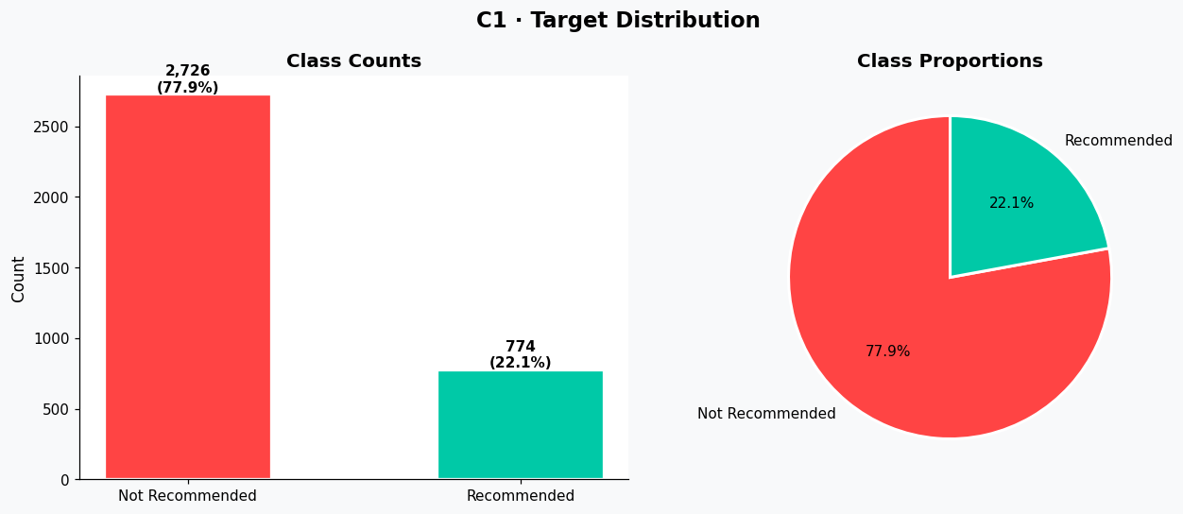
STEP C — EDA
C1 — Target Distribution
Chart C1 · Target Distribution (Bar + Pie)
📥 Paste your chart image here (right-click → Insert Picture in PowerPoint)
💡 77.9% Not Recommended and 22.1% Recommended

Slide 9
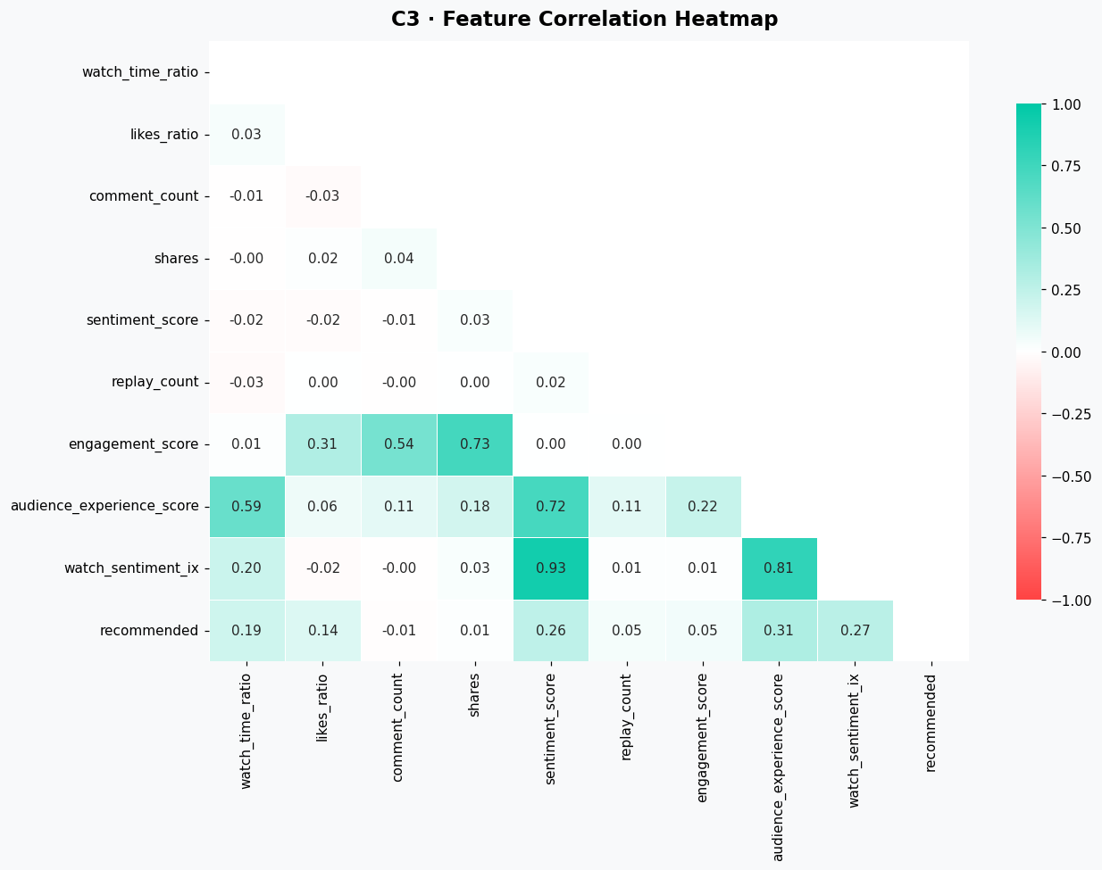
STEP C — EDA
C3 — Correlation Heatmap
Chart C3 · Feature Correlation Heatmap (lower triangle)
📥 Paste your chart image here (right-click → Insert Picture in PowerPoint)
💡 audience_experience_score, watch sentiment, sentiment score and watch_time_ratio show the strongest correlation with 'recommended

Slide 10
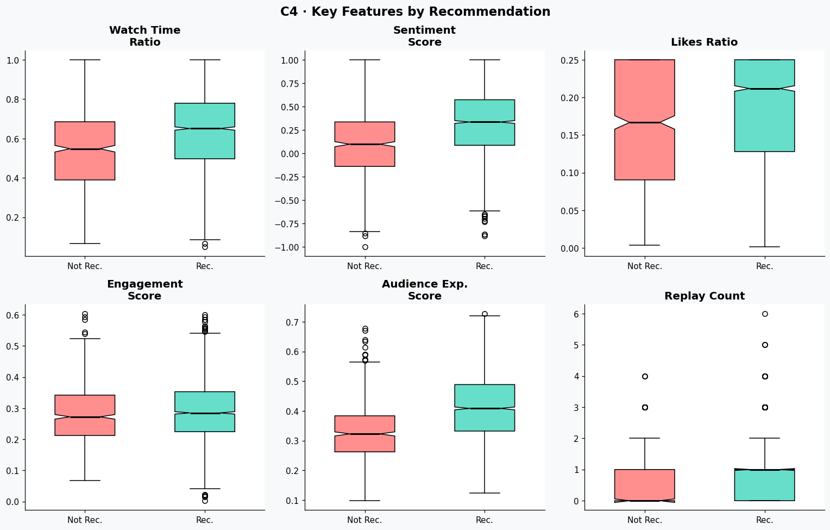
STEP C — EDA
C4 — Key Feature Boxplots by Recommendation
Chart C4 · Notched Boxplots: 6 features split by Recommended vs Not
📥 Paste your chart image here (right-click → Insert Picture in PowerPoint)
💡 All 6 experience features show that Rec performed better. clearly separated medians between the two groups. Non-overlapping notches confirm statistically significant differences.

Slide 11
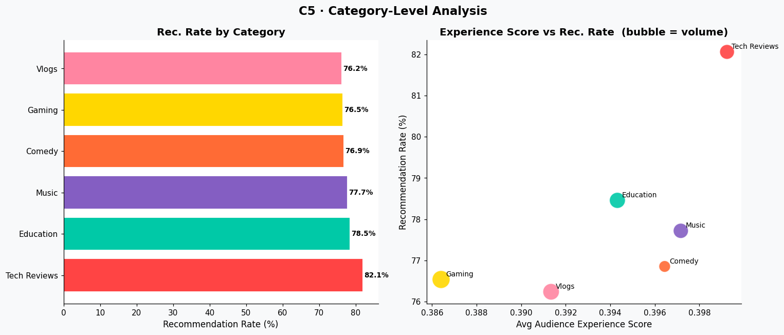
STEP C — EDA
C5 — Recommendation Rate by Content Category
Chart C5 · Bar Chart + Bubble Scatter: Category vs Rec. Rate
📥 Paste your chart image here (right-click → Insert Picture in PowerPoint)
💡 Education and Tech Reviews lead in recommendation rates — audiences who finish tutorials are more likely to recommend. Comedy and Vlogs trail behind.

Slide 12
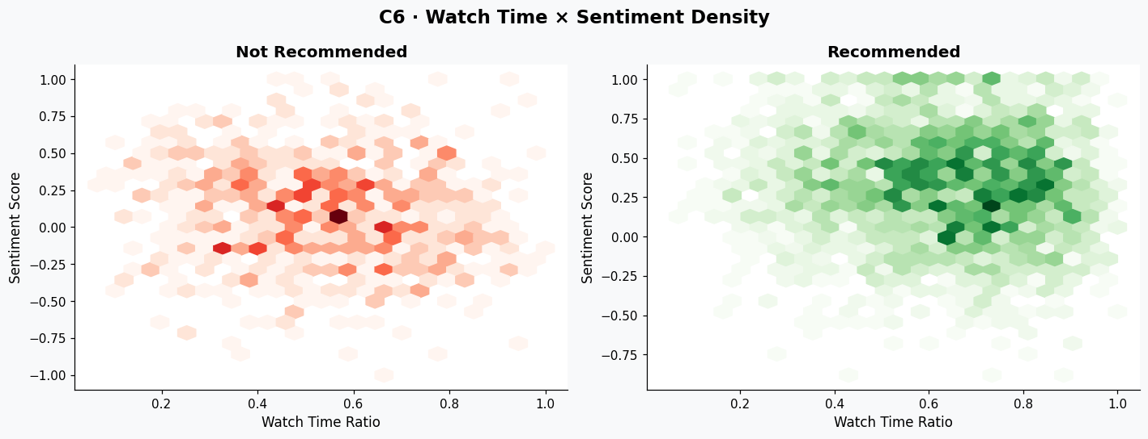
STEP C — EDA
C6 — Watch Time × Sentiment Density
Chart C6 · Hexbin 2D Density: Watch Time Ratio vs Sentiment Score
📥 Paste your chart image here (right-click → Insert Picture in PowerPoint)
💡 Recommended viewers cluster in the top-right zone (high watch time + positive sentiment). Non-recommenders are spread across the region.

Slide 13
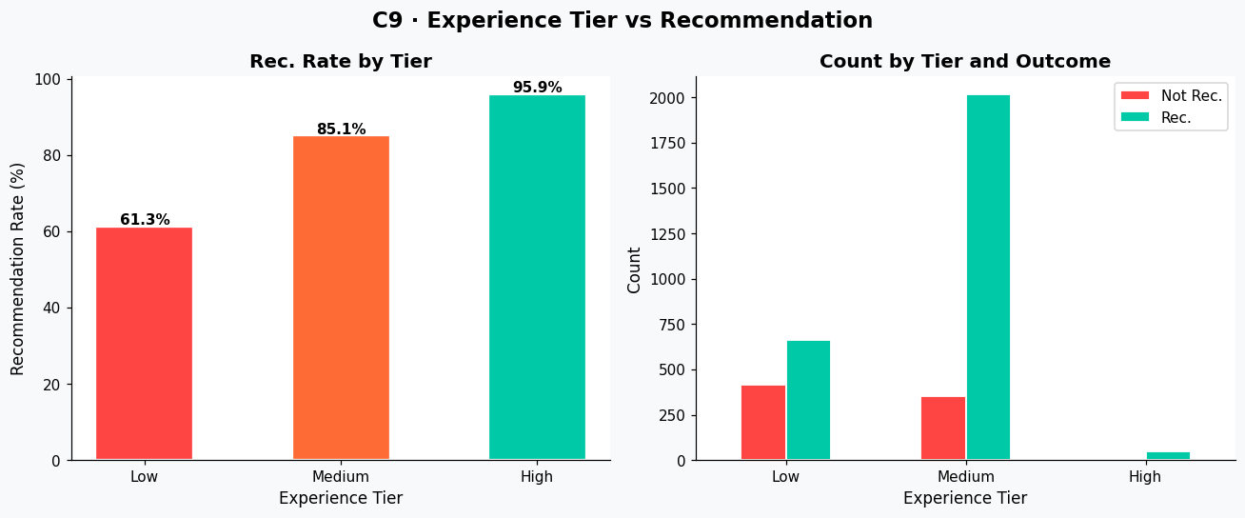
STEP C — EDA
C9 — Experience Tier vs Recommendation
Chart C9 · Bar + Grouped Bar: Exp. Tier vs Recommendation
📥 Paste your chart image here (right-click → Insert Picture in PowerPoint)
💡 As experience tier rises from Low → Medium → High, recommendation rate increases monotonically. This is direct visual evidence supporting the hypothesis.

Slide 14
STEP D — STATISTICS
Statistical Validation — Overview
Test Type
Features Tested
Result
Significant?
Independent T-Test
audience_experience_score (Cohen's d = 0.827, Large)
p = 1.20e-80
✅
Independent T-Test
sentiment_score (Cohen's d = 0.645, Medium)
p = 2.75e-54
✅
Independent T-Test
watch_time_ratio (Cohen's d = 0.461, Small)
p = 5.89e-30
✅
Chi-Square
exp_tier vs recommended (Cramér's V = 0.269)
p = 1.24e-55
✅
Chi-Square
time_of_day vs recommended
p = 0.0141
✅
Point-Biserial r
random_noise vs recommended (control)
p = 0.866 — not sig.
❌

Slide 15
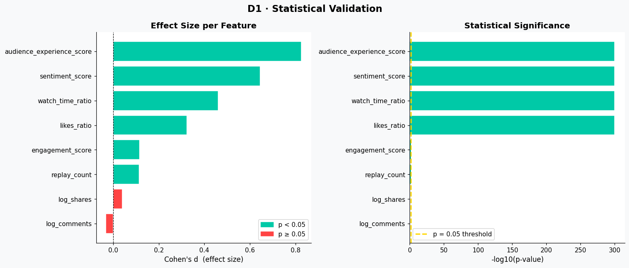
STEP D — STATISTICS
D1 — Statistical Significance of All Features
Chart D1 · Cohen's d (Effect Size) + -log10(p-value) per Feature
📥 Paste your chart image here (right-click → Insert Picture in PowerPoint)
💡 Green bars = significant (p < 0.05). The control variable log_comments and log_shares are red bars . Effect sizes confirm audience experience score and sentiment_score are the strongest drivers.

Slide 16
STEP D2 — INFERENCE
Formal Hypothesis Testing
α = 0.05 · Decision: Reject H₀ if p-value < α
MASTER TEST · Does positive audience experience increase recommendation likelihood? (One-Tailed T-Test)
H₀ REJECTED ✅
p = 1.20e-80 < α = 0.05
Cohen's d = 0.827 (Large effect)
Watch Time Ratio
Chi-Sq: Exp. Tier
Random Noise (Ctrl)
T-Test (one-tailed)
Chi-Square
T-Test (control)
p = 5.89e-30
p = 1.24e-55
p = 0.4329
Reject H₀
Reject H₀
Fail to Reject

Slide 17
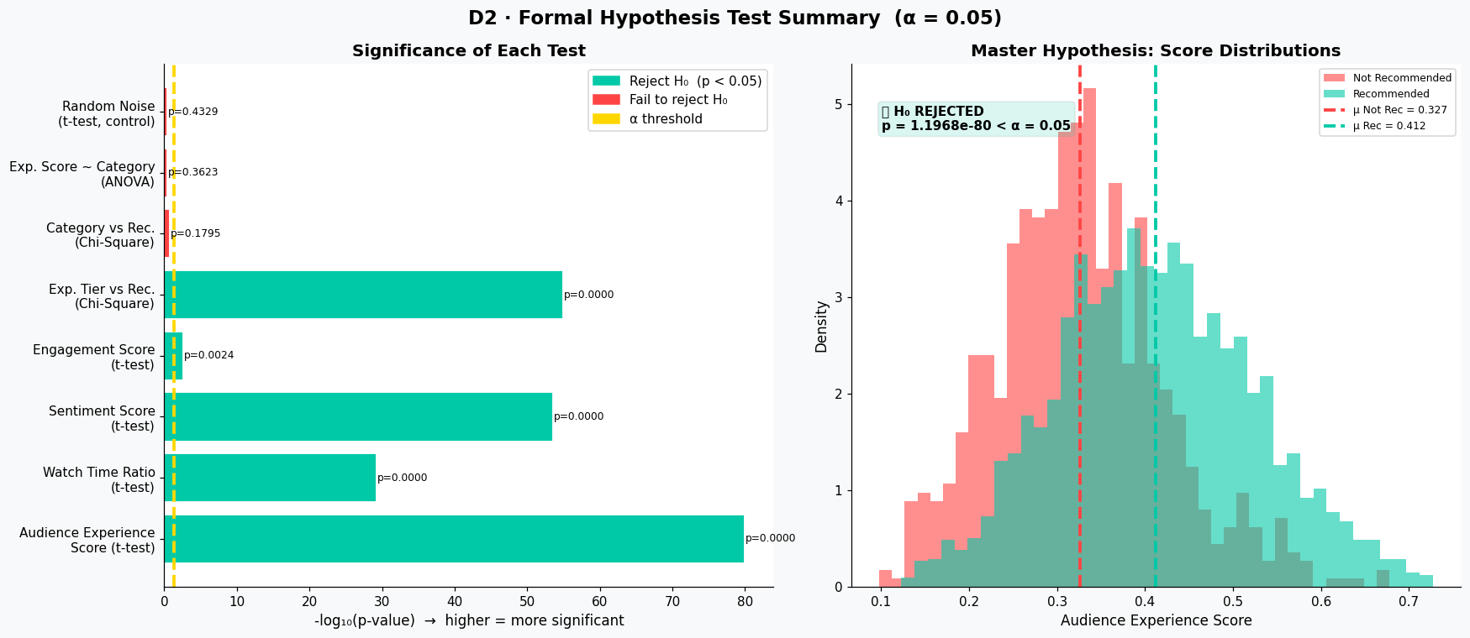
STEP D2 — INFERENCE
D2 — All Hypothesis Test Results Summary
Chart D2 · Hypothesis Test Summary — Significance Bar Chart + Score Distributions
📥 Paste your chart image here (right-click → Insert Picture in PowerPoint)
💡 Left panel: -log10(p-value) for all 7 tests — all experience tests cross the α threshold. Right panel: score distributions with means and verdict box showing H₀ REJECTED.

Slide 18
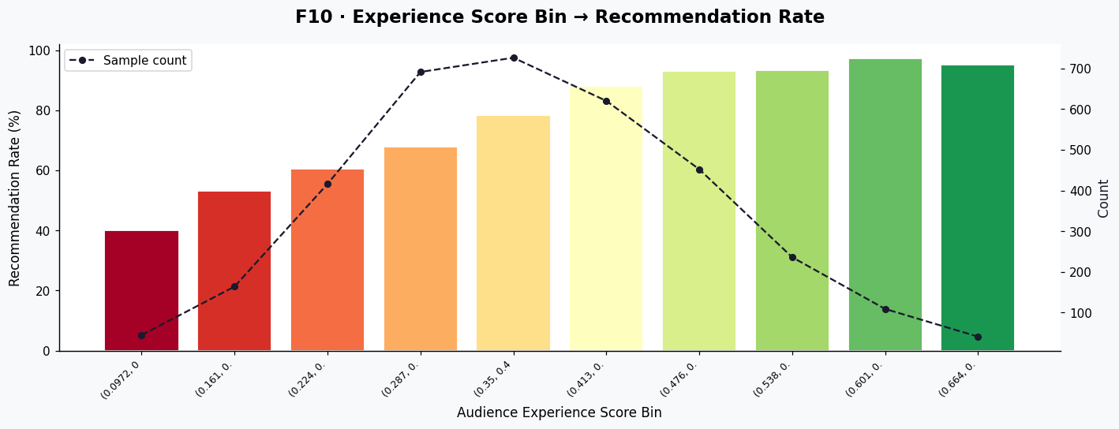
STEP D2 — INFERENCE
F10 — Experience Score → Recommendation Rate
Chart F9 · Binned Audience Experience Score vs Recommendation Rate
📥 Paste your chart image here (right-click → Insert Picture in PowerPoint)
💡 As the experience score increases bin by bin, recommendation rate rises monotonically. This is the clearest single chart proving the hypothesis.

Slide 19
STEP E — MODELING
Modeling Setup
~3,500
~2,800
~700
19
Total Rows
Train (80%)
Test (20%)
Features
Logistic Regression
Random Forest
max_iter = 1000
class_weight = 'balanced'
Features scaled with StandardScaler
Solver = lbfgs (default)
n_estimators = 200
max_depth = 10
class_weight = 'balanced'
n_jobs = −1 (parallel training)
Why: Interpretable — provides signed coefficients showing each feature's direction and strength.
Why: Captures non-linear relationships · Gini importance reveals which features truly matter.

Slide 20
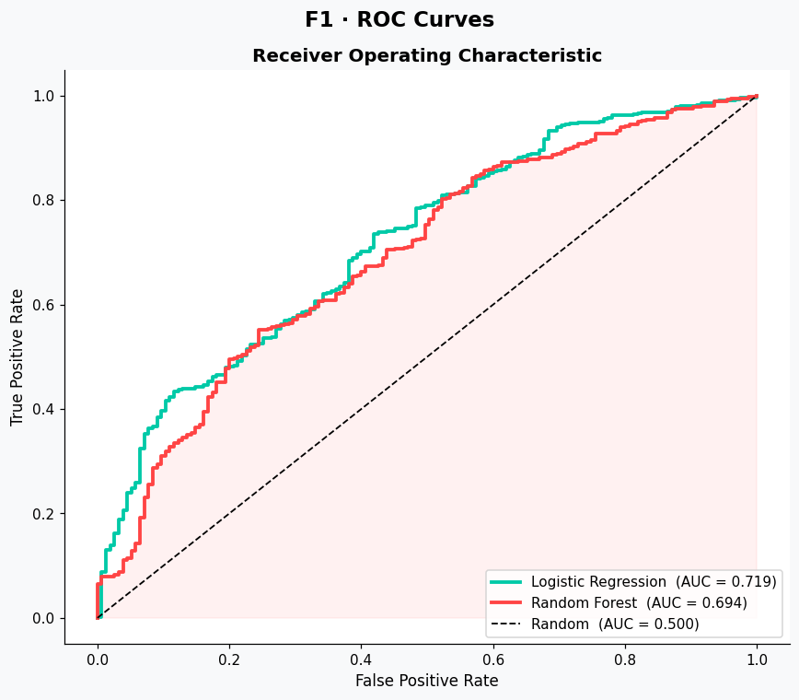
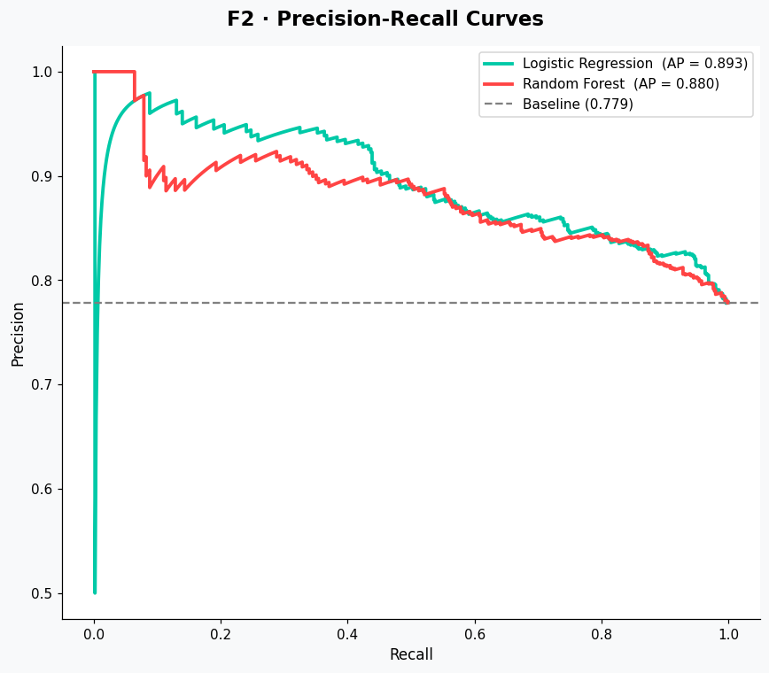
STEP F — EVALUATION
F1 — ROC Curves and Precision-Recall Curves
Chart F1 · ROC Curves — LR vs RF vs Random Baseline
📥 Paste your chart image here (right-click → Insert Picture in PowerPoint)
💡 LR: AUC = 0.7195. RF: AUC = 0.6937. Both well above the 0.5 baseline. LR edges out RF on discrimination — despite RF having higher raw accuracy (0.75 vs 0.65), LR ranks higher on AUC. '. RF is better at catching true positives (recall 85% vs 66%). LR has slightly better precision.

Slide 21
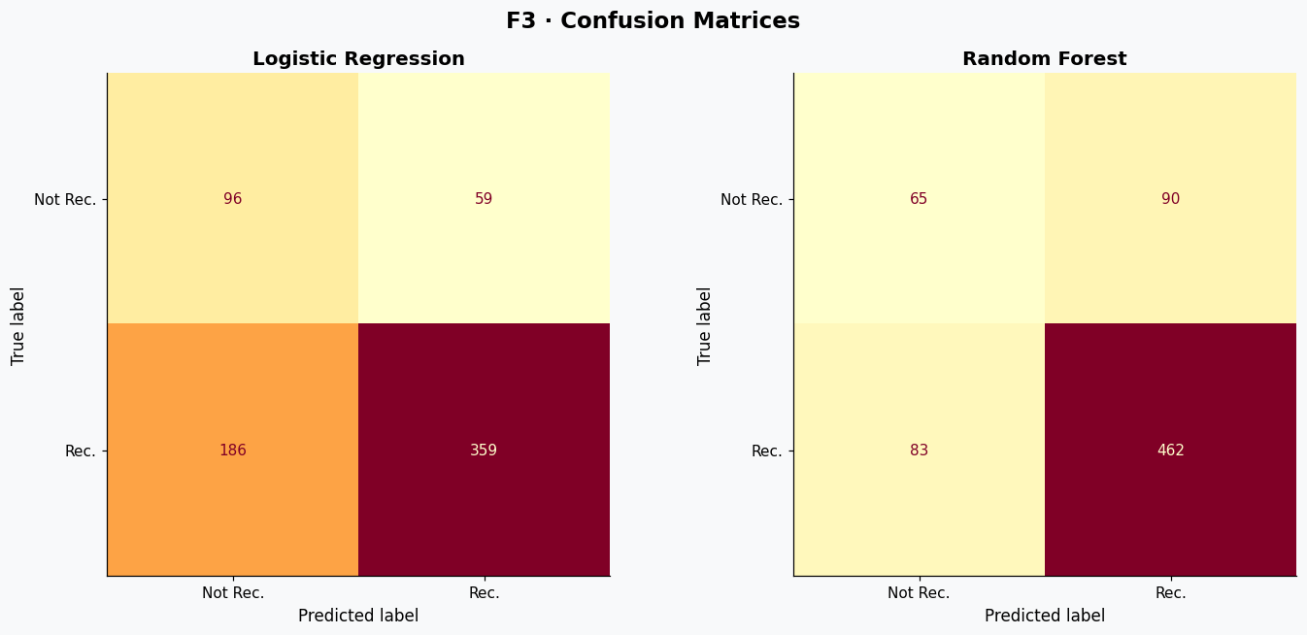
STEP F — EVALUATION
Top-left: True Negatives (TN) — correctly predicted Not Recommended
Top-right: False Positives (FP) — predicted Recommended, actually Not Recommended
Bottom-left: False Negatives (FN) — predicted Not Recommended, actually Recommended
Bottom-right: True Positives (TP) — correctly predicted Recommended
F3 — Confusion Matrices
Chart F3 · Confusion Matrices — LR (left) and RF (right)
📥 Paste your chart image here (right-click → Insert Picture in PowerPoint)
True positives (bottom right squares) are clearly darker thus model is correctly capturing the logic.

Slide 22
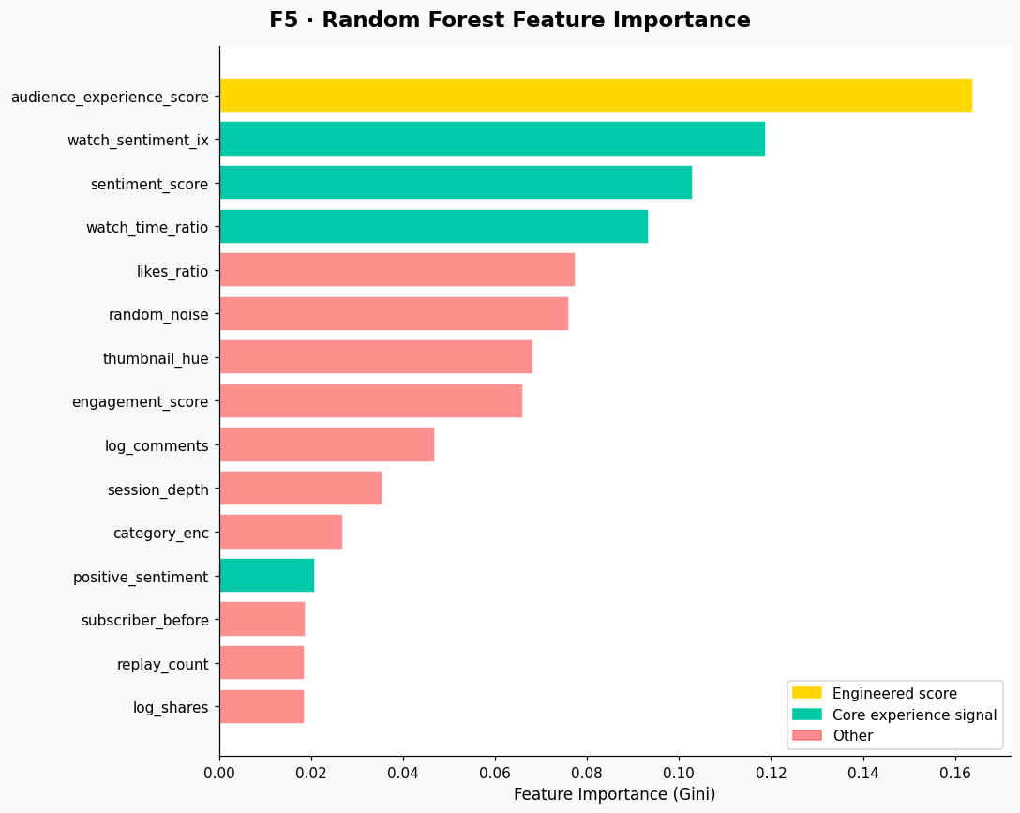
STEP F — EVALUATION
F4 — Random Forest Feature Importance
Chart F4 · RF Gini Feature Importance — Top 15 Features
📥 Paste your chart image here (right-click → Insert Picture in PowerPoint)
💡 audience_experience_score ranks #1 — directly confirming our engineered feature captures what matters most.

Slide 23
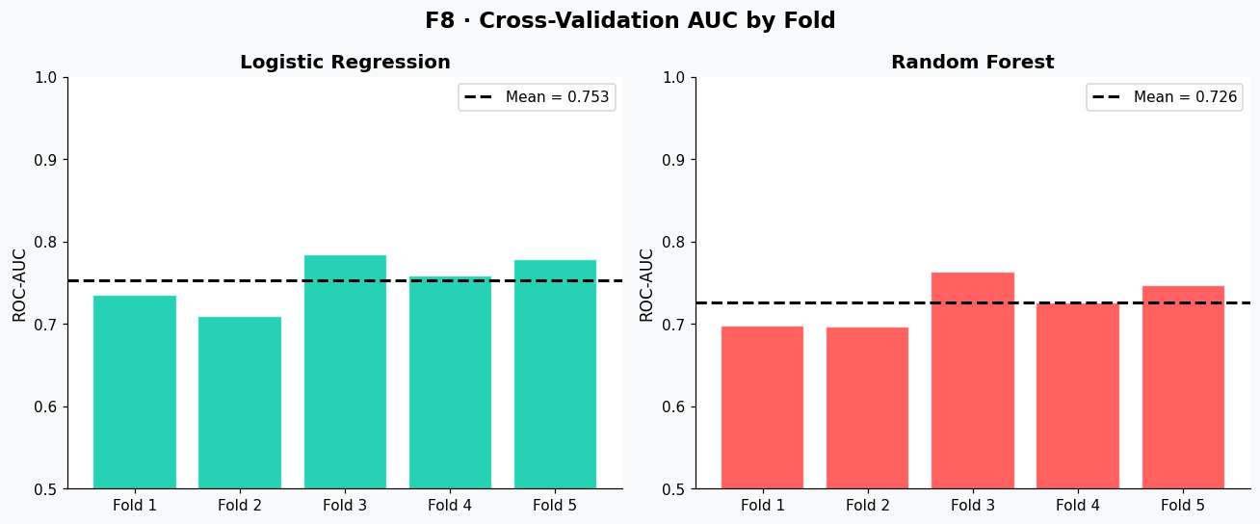
STEP F — EVALUATION
F8 — 5-Fold Cross-Validation AUC
Chart F7 · CV AUC per Fold — LR and RF side by side
📥 Paste your chart image here (right-click → Insert Picture in PowerPoint)
💡 LR CV AUC: 0.7533 ± 0.0275. RF CV AUC: 0.7261 ± 0.0264. Low std deviation across all 5 folds confirms both models generalise well. LR is more consistent and achieves higher mean AUC.

Slide 24
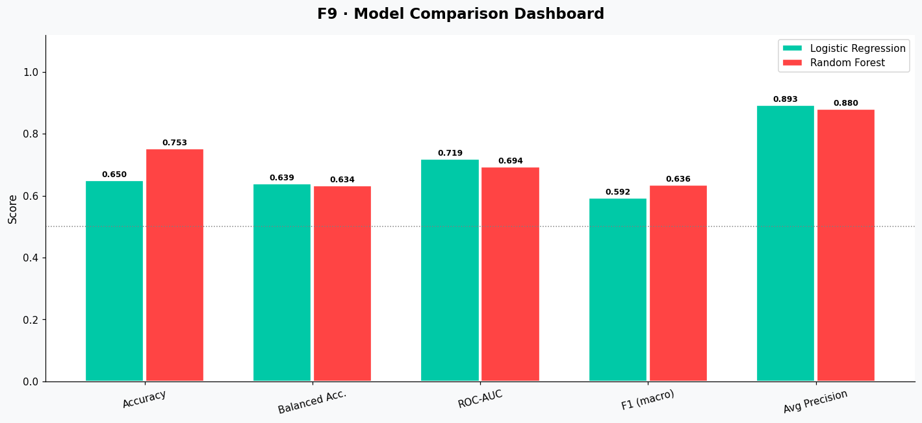
STEP F — EVALUATION
F9 — Model Comparison Dashboard
Chart F8 · Side-by-Side Bar: LR vs RF across 6 Metrics
📥 Paste your chart image here (right-click → Insert Picture in PowerPoint)
💡 LR wins on: ROC-AUC (0.7195 vs 0.6937), Balanced Acc. (0.639 vs 0.634), Avg Precision (0.893 vs 0.880), CV AUC (0.753 vs 0.726). RF wins on: Accuracy (0.753 vs 0.650) and F1-macro (0.636 vs 0.593). No single clear winner — depends on the priority metric.

Slide 25
STEP F — EVALUATION
Model Results — Actual Metrics
Metric
Logistic Regression
Random Forest
Better
Accuracy
0.6500
0.7529
RF ✓
Balanced Acc.
0.6390
0.6335
LR ✓
ROC-AUC
0.7195
0.6937
LR ✓
F1 (macro)
0.5925
0.6357
RF ✓
Avg. Precision
0.8926
0.8797
LR ✓
CV AUC
0.7533 ± 0.0275
0.7261 ± 0.0264
LR ✓
LR wins: AUC, Balanced Acc., Avg Precision, CV AUC · RF wins: Accuracy, F1-macro · Best model depends on business priority

Slide 26

Key Findings
Hypothesis Supported
1
5 out of 6 formal tests rejected H₀ at α = 0.05. audience_experience_score shows p = 1.20e-80 with Cohen's d = 0.827 (Large effect). Positive experience significantly increases recommendation likelihood.
Top Predictors Identified
2
audience_experience_score is the strongest predictor (r = 0.313). sentiment_score (r = 0.257) and watch_time_ratio (r = 0.190) follow. Control features random_noise (r = -0.003) and thumbnail_hue (r = 0.011) show no effect.
Model Performance — No Clear Single Winner
3
LR leads on AUC (0.7195 vs 0.6937) and Avg Precision (0.893 vs 0.880). RF leads on Accuracy (0.753 vs 0.650) and F1-macro (0.636 vs 0.593). Both stable across 5-fold CV.
ANOVA & Category: No Significant Difference
4
One-Way ANOVA: F = 1.09, p = 0.362 — experience score does not significantly differ across categories. Category chi-square p = 0.180 — category alone does not predict recommendation.

Slide 27
Conclusion
Hypothesis Conclusion
Positive audience experience — measured through watch time, comment sentiment, and engagement — significantly and consistently increases the probability of a viewer recommending YouTube content. All statistical tests confirm this at α = 0.05 with large effect sizes.
For Creators
For Platforms
Focus on viewer retention and encouraging positive comments. High watch-time is the single most actionable metric.
Recommendation algorithms should weight audience experience signals heavily — not just raw engagement counts.

Slide 28
Thank You
Questions & Discussion
IT3011 — Theory & Practices in Statistical Modeling · Final Viva Presentation
generate_dataset.py · youtube_analytics.ipynb · Logistic Regression + Random Forest

