Slide 1
CONFUSION MATRIX
Annisa Darmawahyuni

Slide 2
Basic Concept
Classification is a process of categorizing a given set of data into classes. In Machine Learning (ML), you frame the problem, collect and clean the data, add some necessary feature variables(if any), train the model, measure its performance, improve it by using some cost function, and then it is ready to deploy. But how do we measure its performance? Is there any particular feature to look at?
it is a performance measurement for machine learning classification problem where output can be two or more classes. It is a table with 4 different combinations of predicted and actual values.

Slide 3
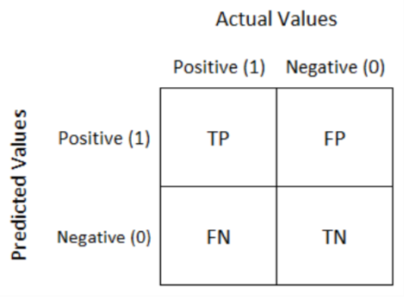
There are four quadrants in the confusion matrix, which are symbolized as below.
True Positive (TP) : The number of instances that were positive (+) and correctly classified as positive (+)
False Negative (FN): The number of instances that were positive (+) and incorrectly classified as negative (-).
False Positive (FP): The number of instances that were negative (-) and incorrectly classified as (+).
True Negative (TN): The number of instances that were negative (-) and correctly classified as (-).

Slide 4
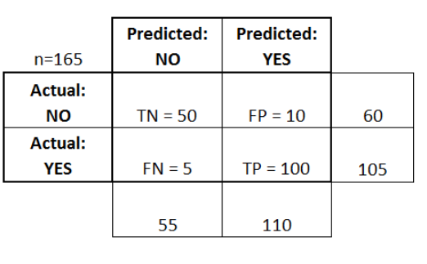
Example (Binary Classification)

Slide 5
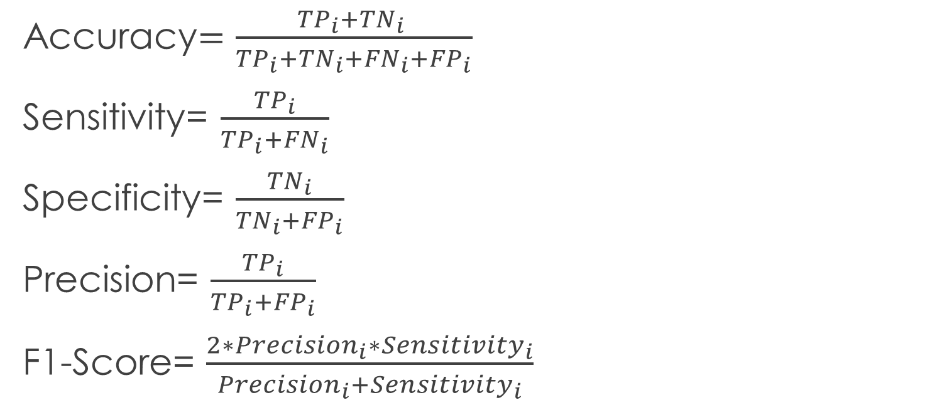
Accuracy, Sensitivity, Specificity, Precision, F1-Score
Accuracy$=\frac{{TP}_{i}+{TN}_{i} }{{TP}_{i}+{{TN}_{i}+FN}_{i}+{FP}_{i}}$
Sensitivity= $\frac{{TP}_{i}}{{TP}_{i}+{FN}_{i}}$
Specificity= $\frac{{TN}_{i}}{{TN}_{i}+{FP}_{i}}$
Precision= $\frac{{TP}_{i}}{{TP}_{i}+{FP}_{i}}$
F1-Score= $\frac{2∗{Precision}_{i}∗{Sensitivity}_{i}}{{Precision}_{i}+{Sensitivity}_{i}}$

Slide 6
Accuracy: Overall, how often is the classifier correct?
(TP+TN)/total = (100+50)/165 = 0.91
Precision: When it predicts yes, how often is it correct?
TP/predicted yes = 100/110 = 0.91
Sensitivity, Specificity, and F1-Score = ?

