Slide 1

NUS HPC ACCESS

Slide 2
0. Bash Scripting Tutorial for Beginners
Bash is a command processor that typically runs in a text window where the user types commands that cause actions.
Shell is a macro processor which allows for an interactive or non-interactive command execution
Scripting allows for an automatic commands execution that would otherwise be executed interactively one-by-one
Notes:
Link: https://linuxconfig.org/bash-scripting-tutorial-for-beginners
I know these concepts are quite abstract. Don’t feel discouraged. Let’s have a hands-on example for it.
Know let open your terminal window.
Shell you interacted with your computer to retrieve a current date and time
Bash is a default interpreter on many GNU/Linux systems
File .sh
$ means variable

Slide 3
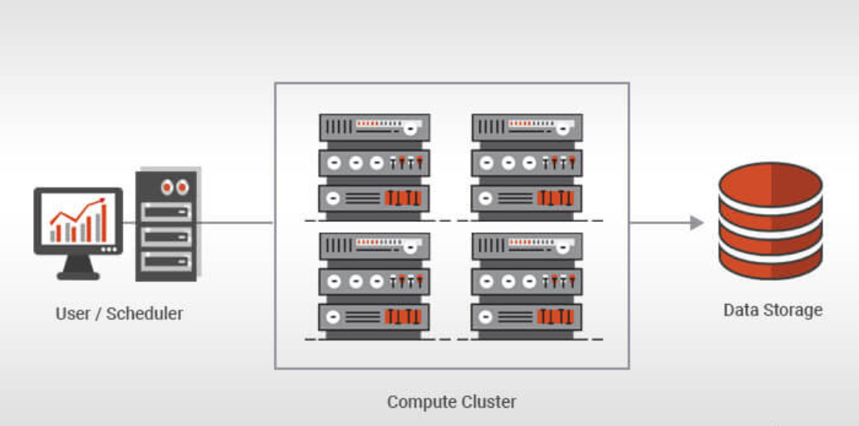
1. What is HPC
HPC is the abbreviation for High Performance Computing
A computer cluster is a set of connected computers (nodes) that work together as if they are a single (much more powerful) machine.
Why we need a scheduler: Without a scheduler, an HPC cluster would just be a bunch of servers with different jobs interfering with each other
PBS: Portable Bash System which gives easy to understand message when you check pending reasons of your batch jobs.
Figure 1: High Performance Computing Architecture
Notes:
Without a scheduler, an HPC cluster would just be a bunch of servers with different jobs interfering with each other. When you have a large cluster and multiple users, each user doesn’t know which compute nodes and CPU cores to use, nor how much resources are available on each node. To solve this, cluster batch control systems are used to manage jobs on the system using HPC Schedulers. They are essential for sequentially queueing jobs, assigning priorities, distributing, parallelizing, suspending, killing or otherwise controlling jobs cluster-wide.
https://www.aspsys.com/solutions/software-solutions/hpc-schedulers/
https://nusit.nus.edu.sg/services/hpc-newsletter/pbs-job-scheduler/

Slide 4
2. Steps to Use NUS HPC
0-Register your HPC
1-Assess the login nodes
2-Find an example file for R job submission [hpc pbs R]
3-Use nano to create your job submission script
4-Submit your file qsub file_name
#!/bin/bash
#PBS –P Project_Title
#PBS –q serial
#PBS –N Job_Name
#PBS –l select=1:ncpus=1:mem=10GB
Notes:
https://nusit.nus.edu.sg/services/hpc-newsletter/pbs-job-scheduler/

Slide 5
3. File Transfer
cd $PBS_O_WORKDIR
np=$(cat ${PBS_NODEFILE} |wc -l) # Get the number of CPUs
module load R-3.6.0
Rscript hello_world.R
exit $? Report completion status
scp /mnt/c/Users/yuwei/Desktop/my_example.txt ephchyu@atlas8:/home/svu/ephchyu/ [a single file]
scp -r /mnt/c/Users/yuwei/Desktop/hpc_test ephchyu@atlas8:/home/svu/ephchyu/ [a folder]

